Slide 1



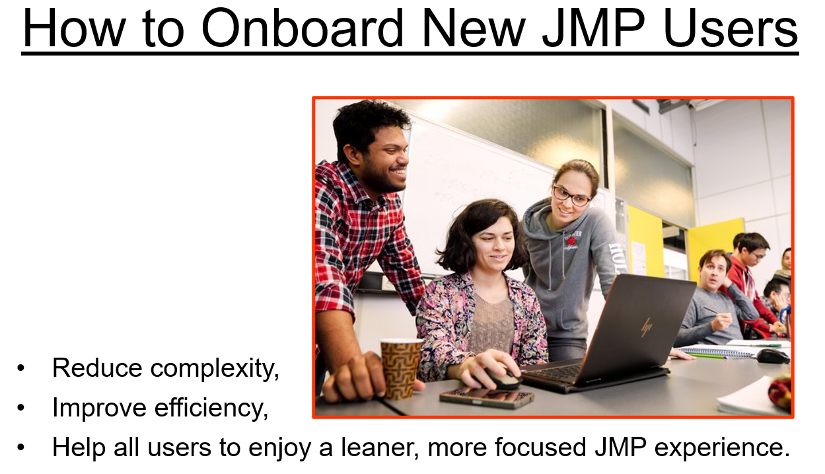
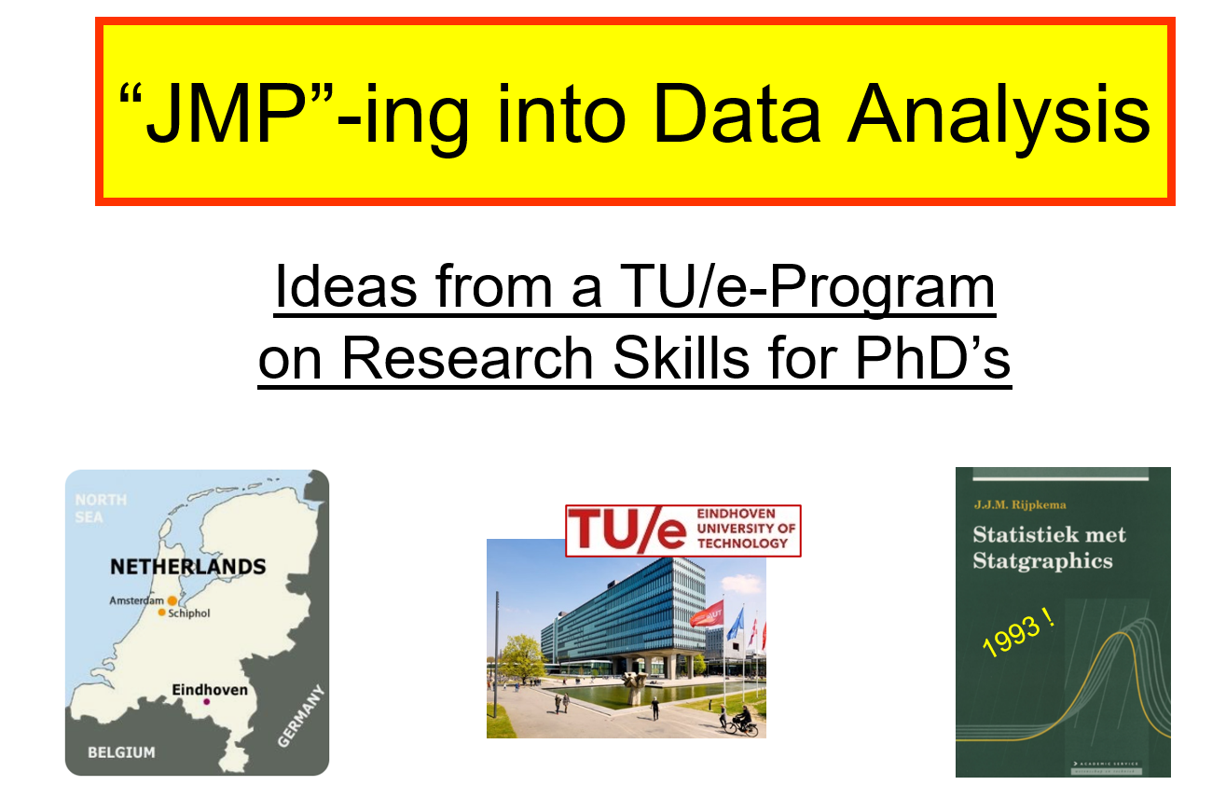
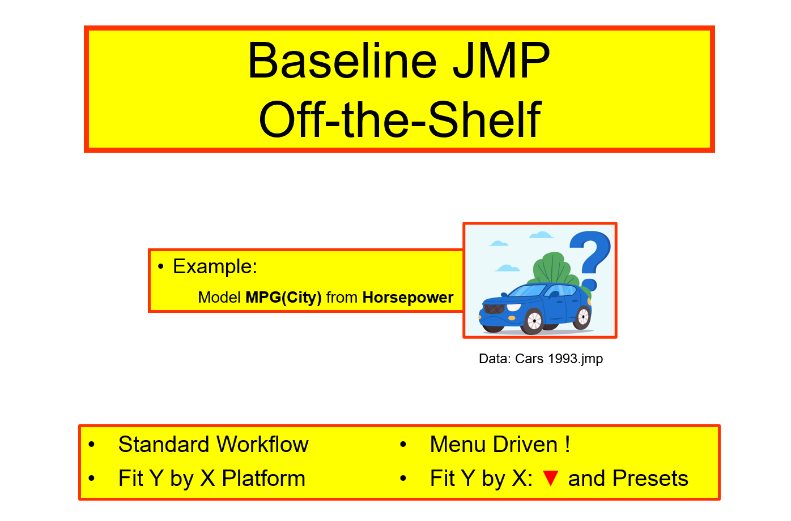
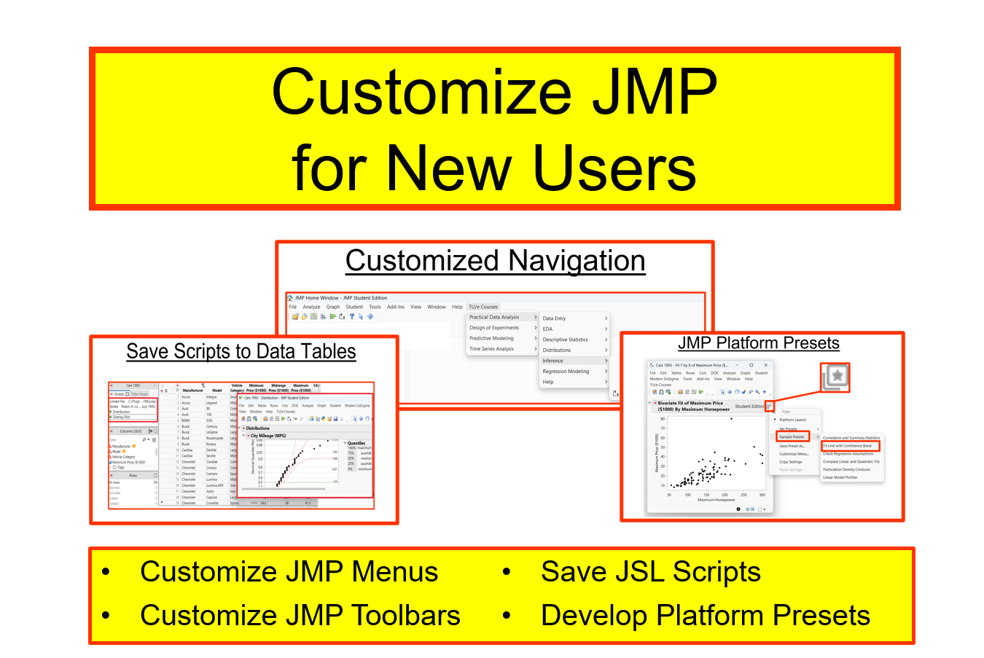
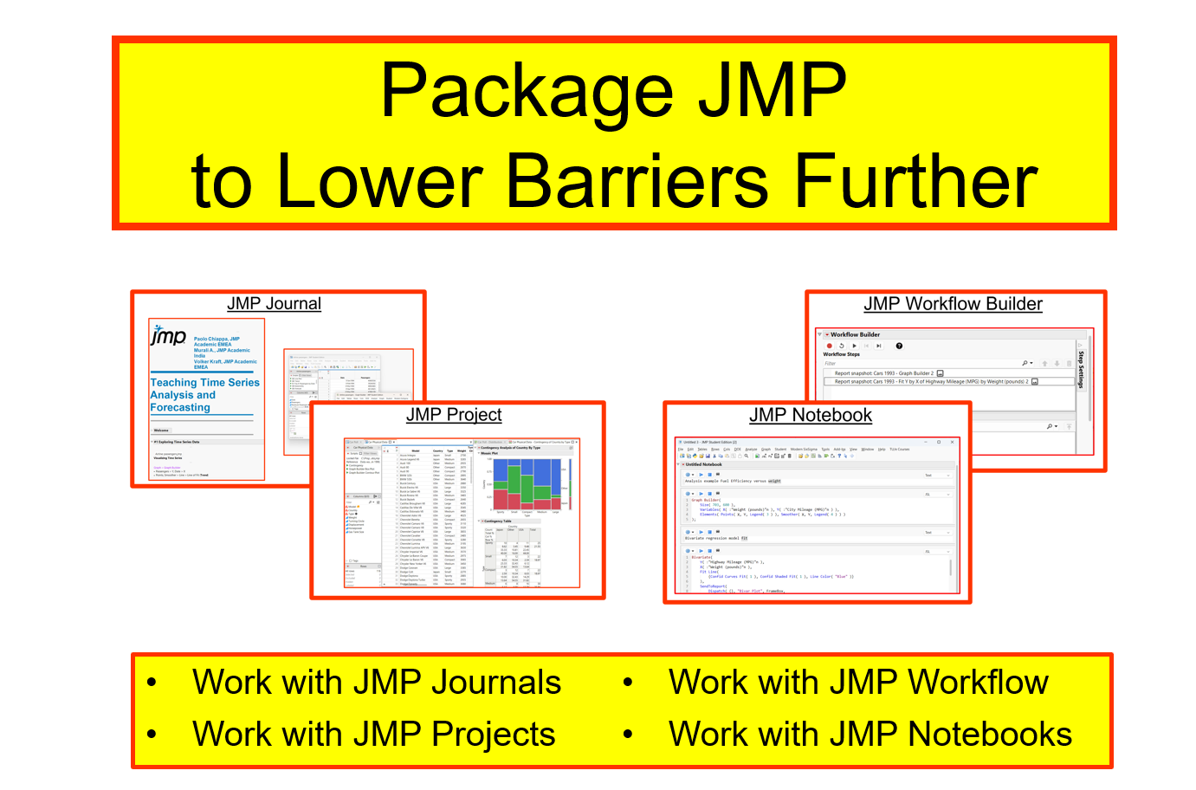
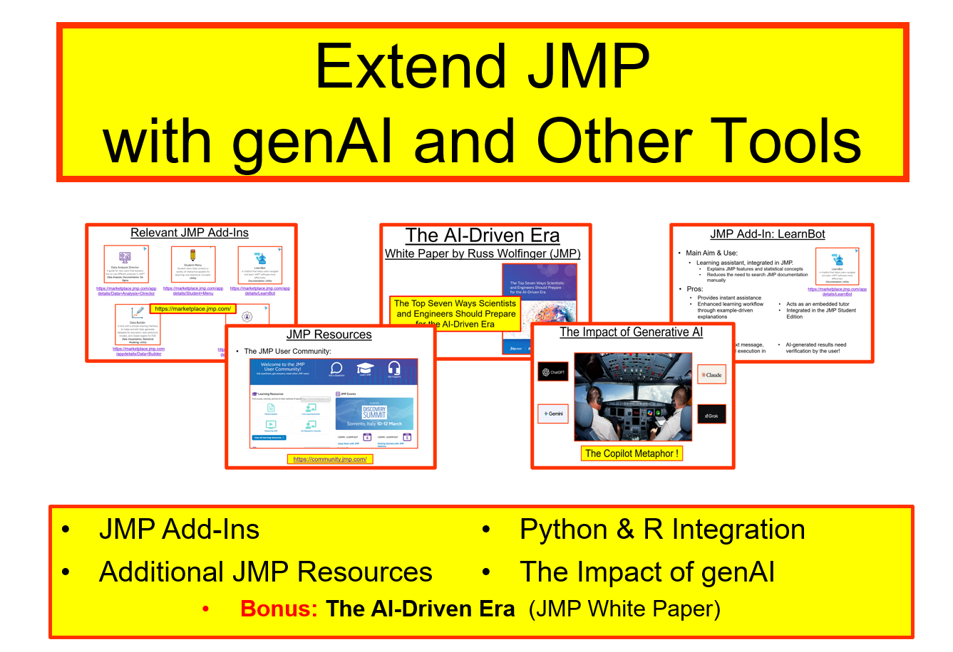
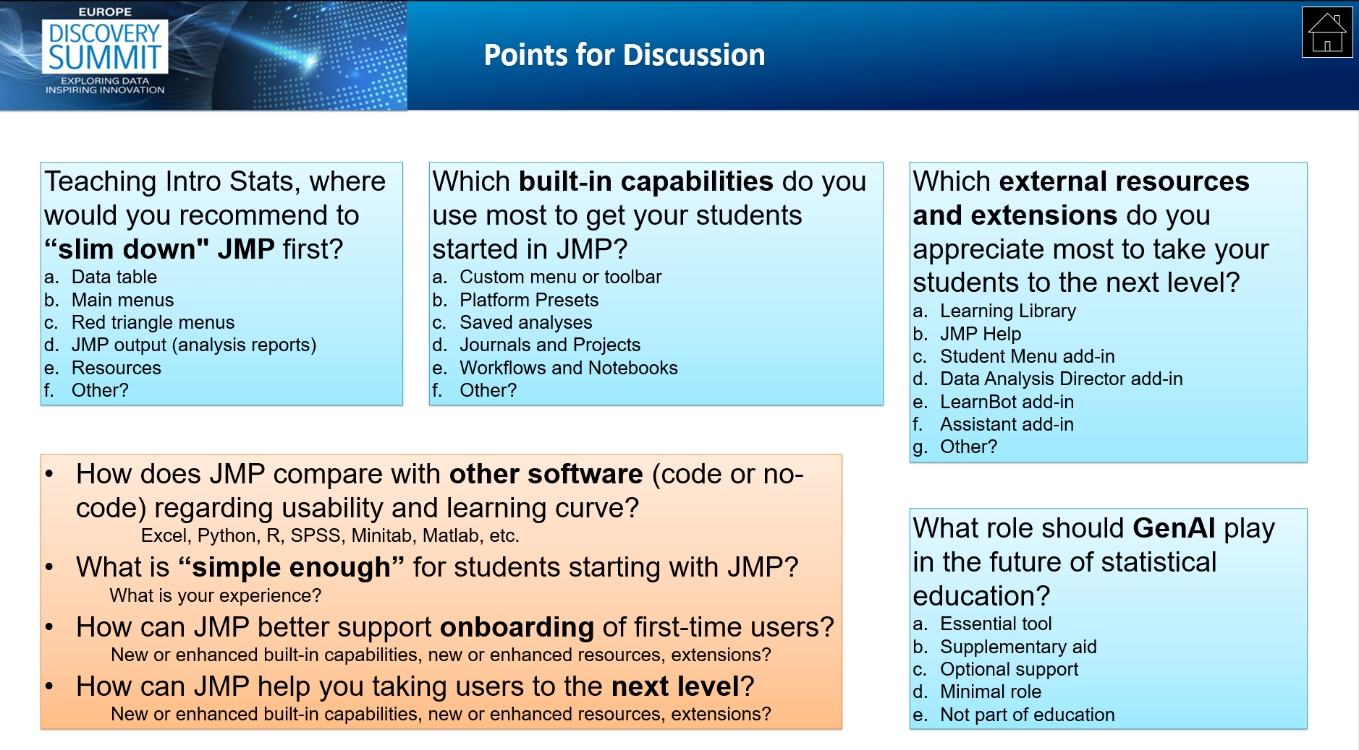
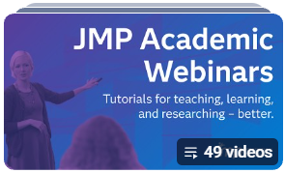


Lost in JMP? Slimming Down for a Better Fit
Abstract Our Challenge Our Scenario
JMP’s long evolution brings great power, a user-friendly, accessible GUI without the need for coding, though first-time users might feel lost with all options provided.
This talk presents a “software diet” approach that streamlines JMP using built‑in tools plus add‑ins like LearnBot and the Data Analysis Director.
The result: clearer guidance, and a leaner, more focused JMP experience for students and new JMP users alike.
Scenario: Teaching Intro Stats courses
JMP “baseline” off-the-shelf
JMP “customized” for new users
JMP “packaged” to lower barriers further
JMP “extended” with genAI and other tools
Details
Background
Baseline
Customized
Packaged
Extended
Discussion
More Examples and References Contact info
For more slides, a JMP journal, and references using the capabilities mentioned here, look up our academic webinar from Feb 11th, 2026 at www.jmp.com/webinar, entitled:
“Focus, Simplify, and GenAI: Making JMP Easier to Use for Your Students”
J.J.M. (Koo) Rijpkema Volker Kraft TU Eindhoven, NL JMP
University Lecturer Academic Ambassador Mathematics & Computer Science JMP Academic Program J.J.M.Rijpkema@tue.nl Volker.Kraft@jmp.com
Notes:
Single sided poster!

Slide 2
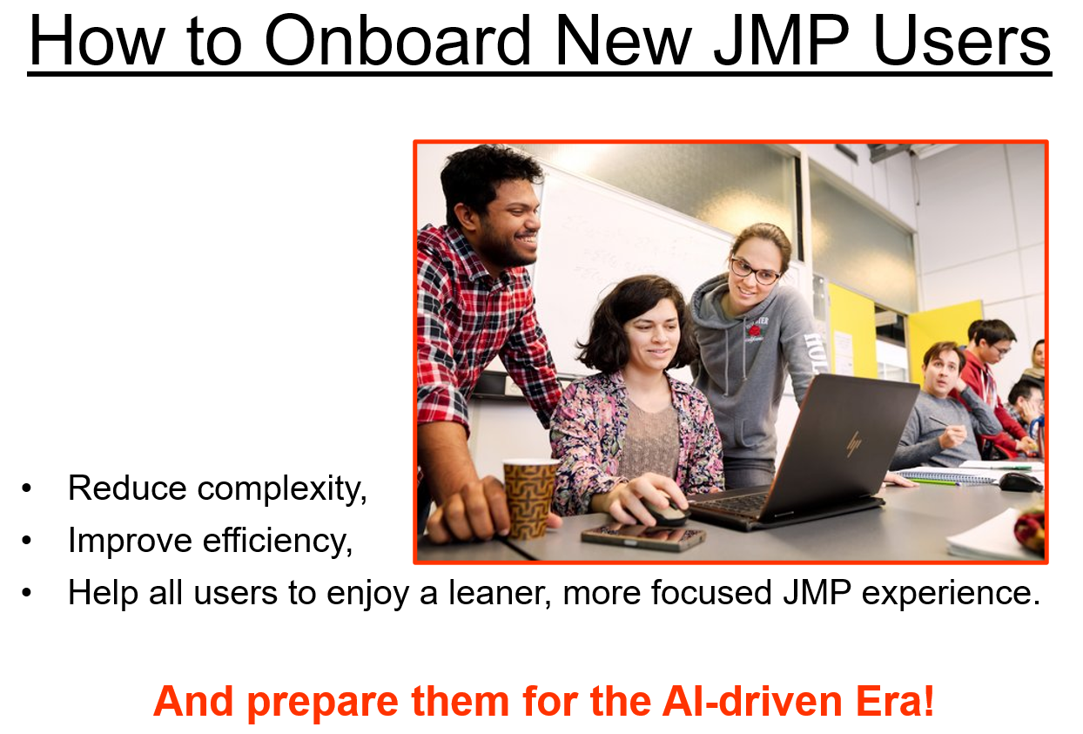
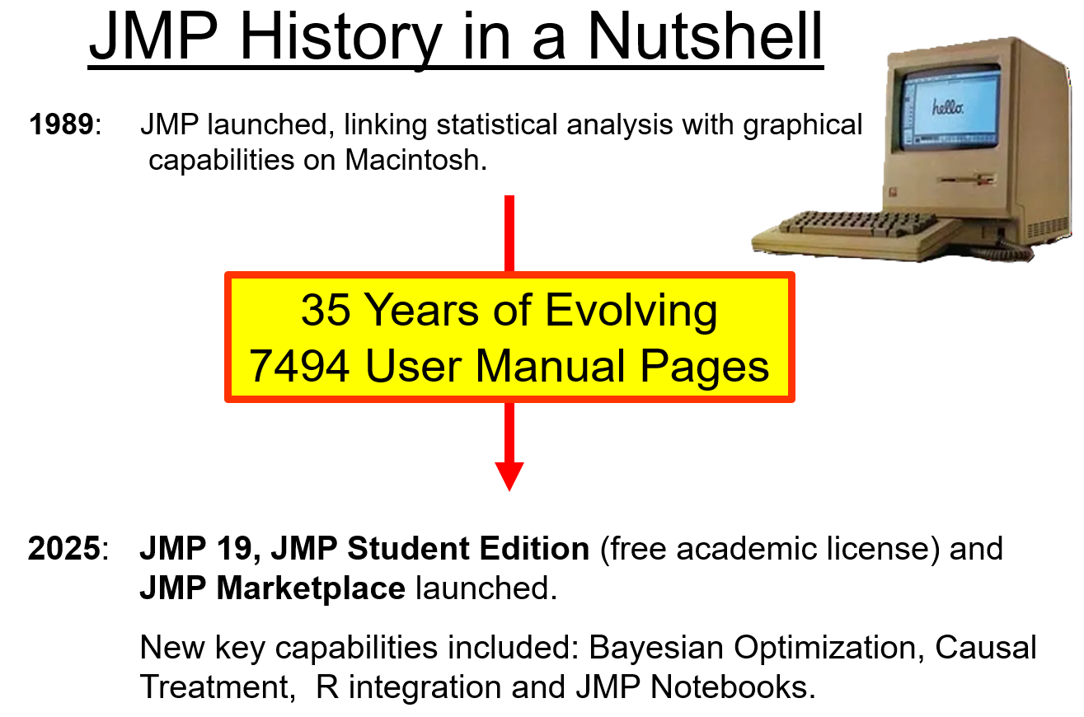
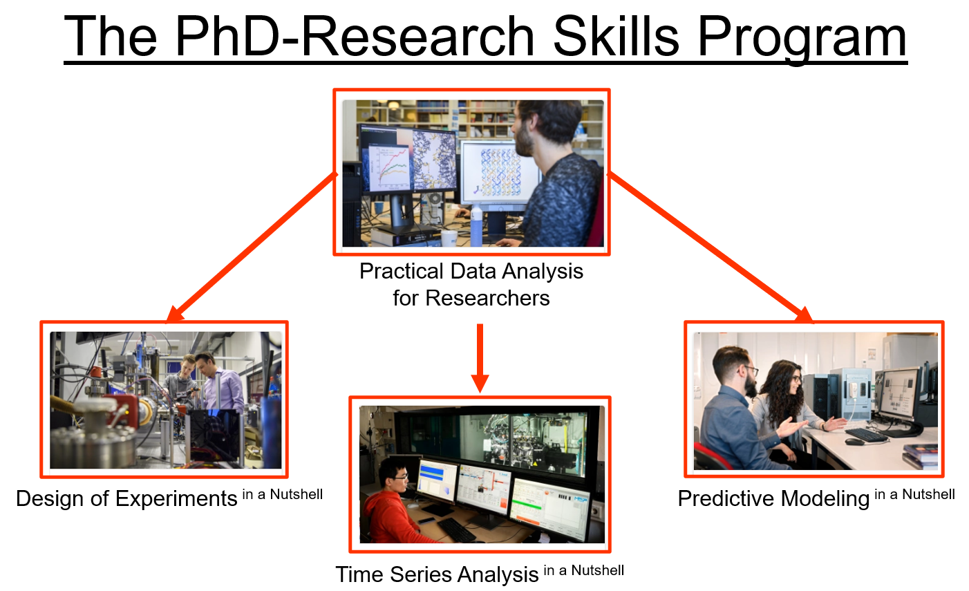
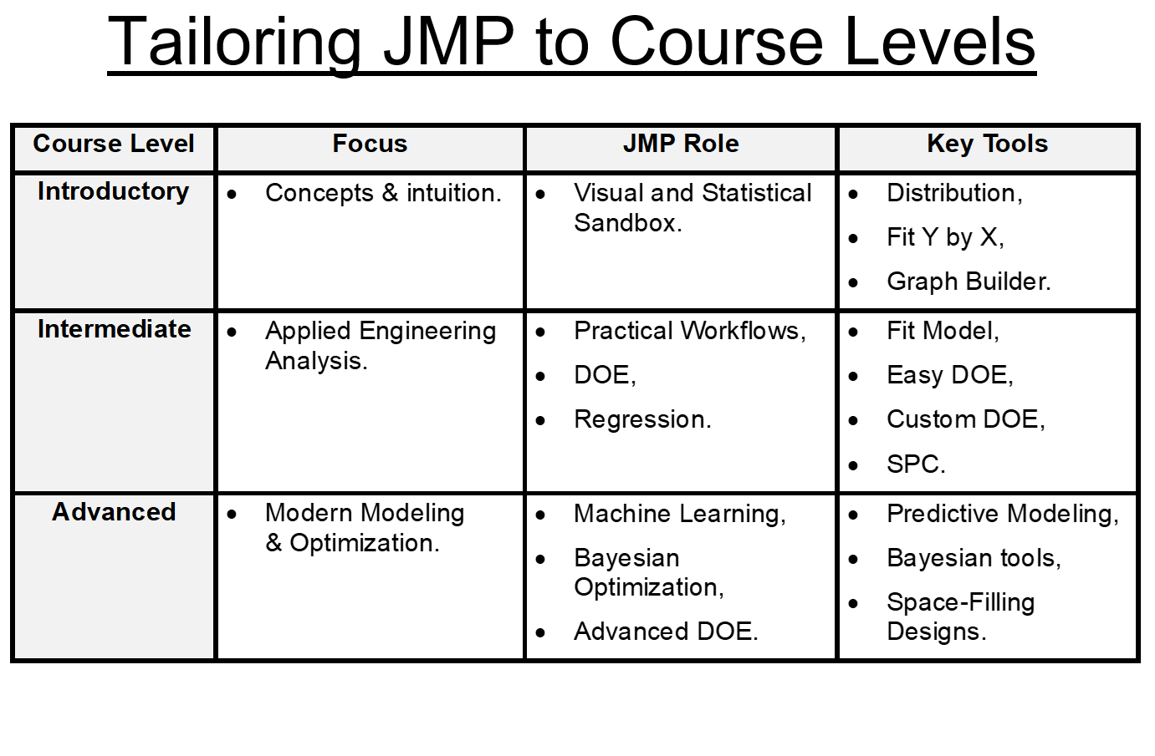
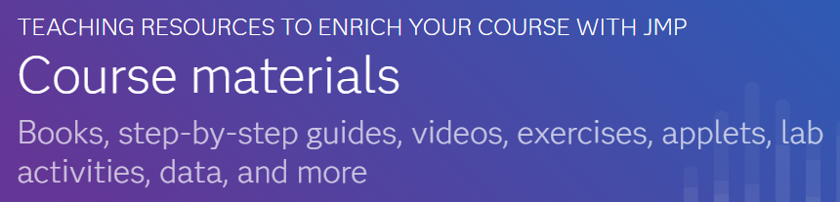
Background: Engineering Statistics Courses using JMP
www.jmp.com/teach

Slide 3
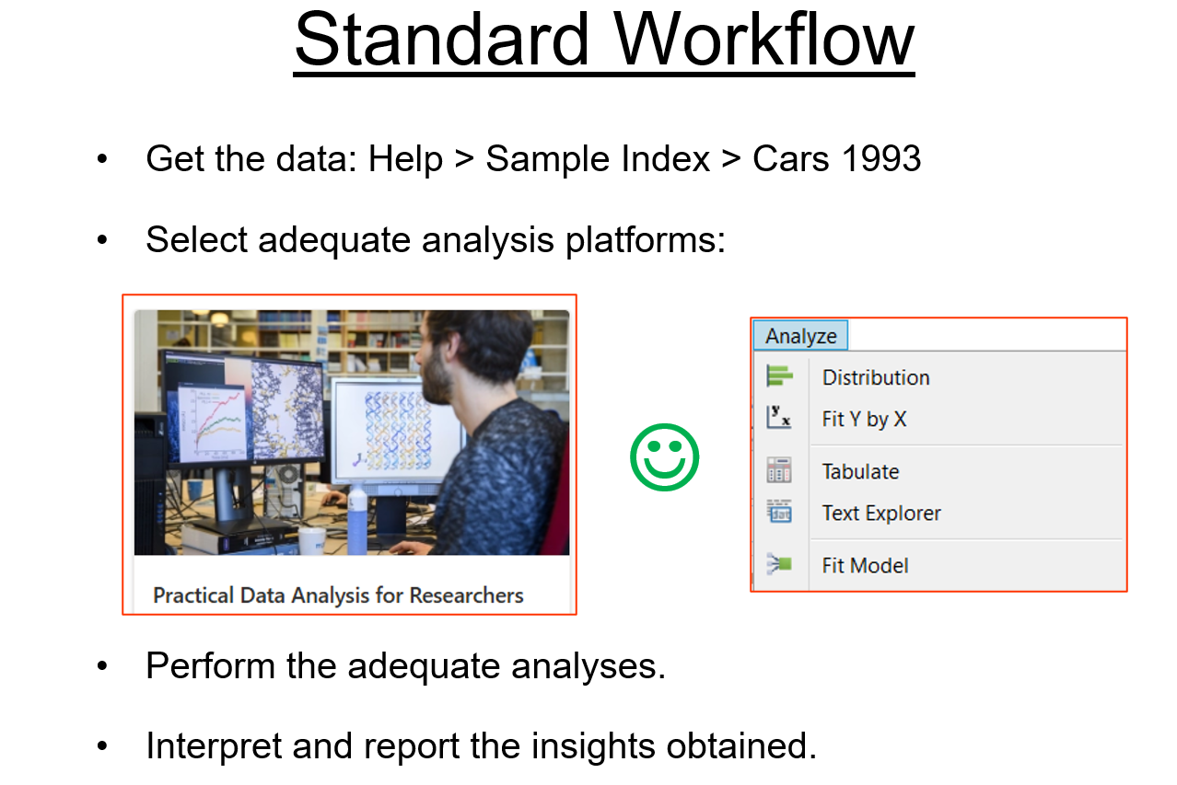
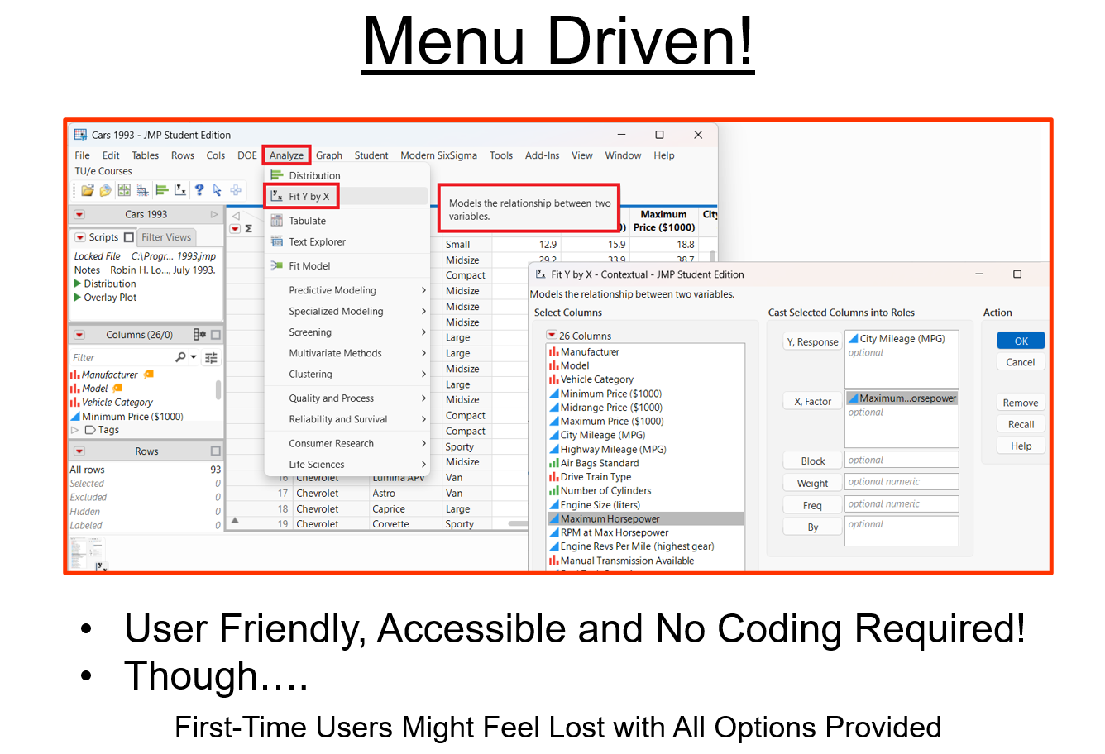
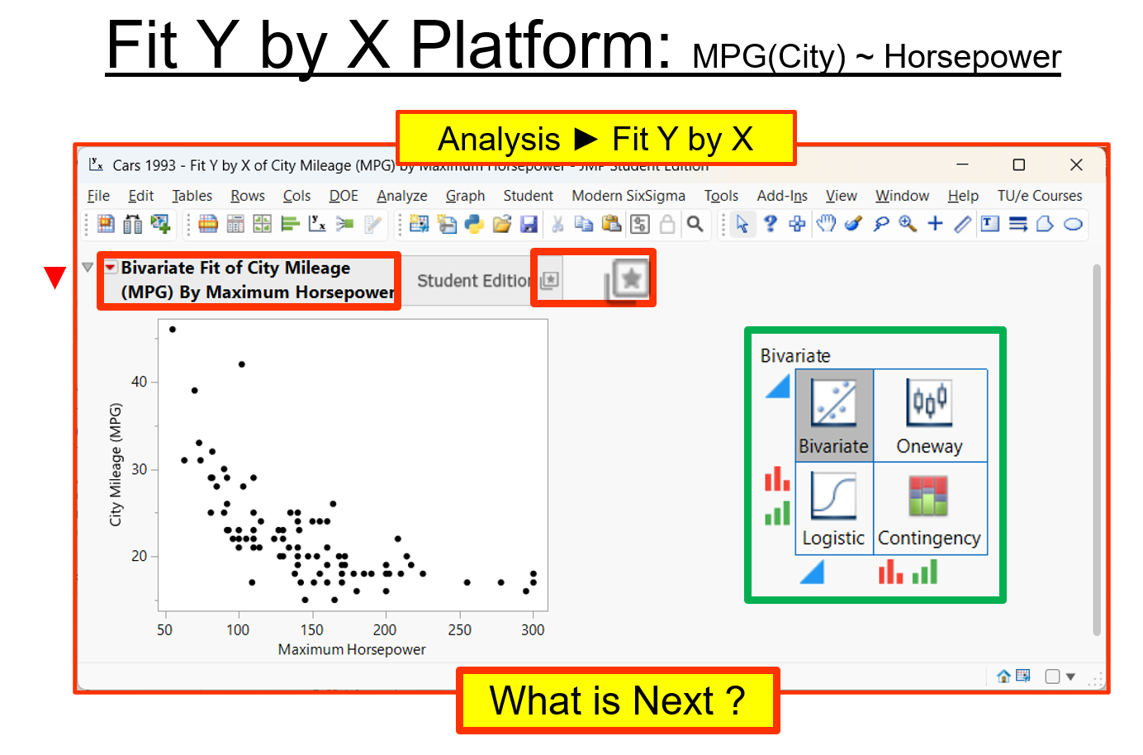
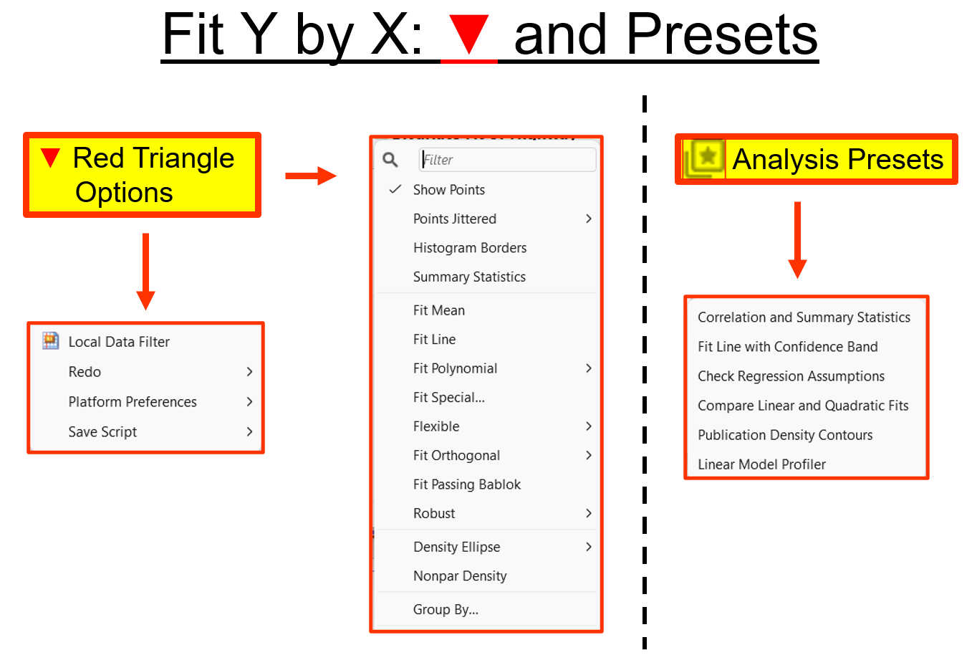
Baseline: JMP Student Edition Off-the-Shelf

Slide 4
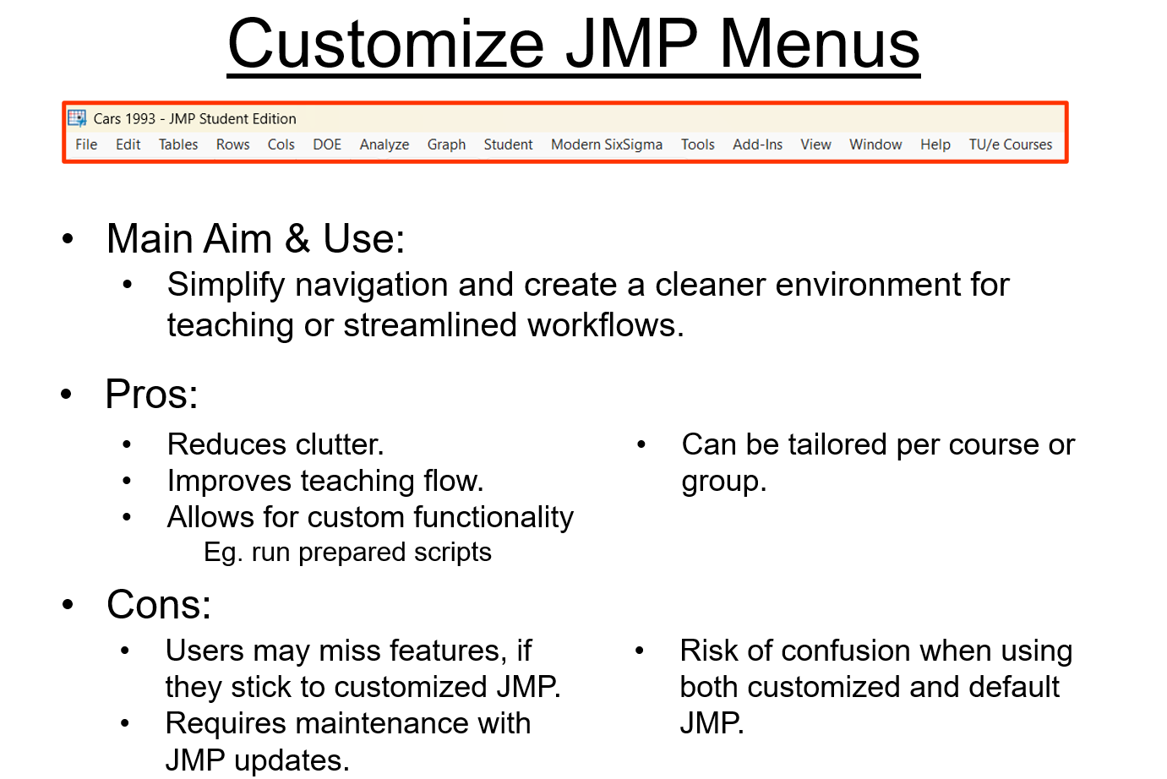
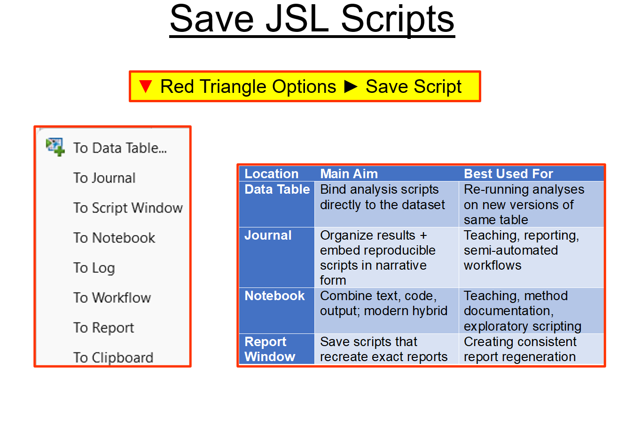
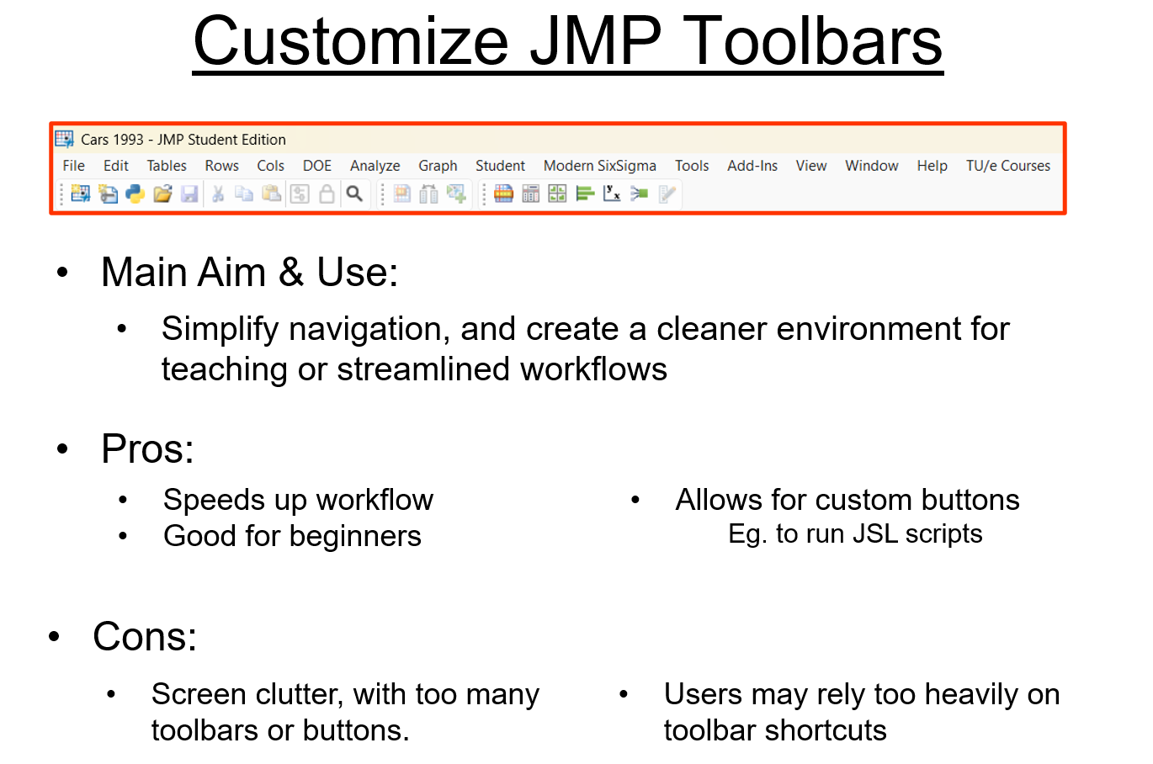
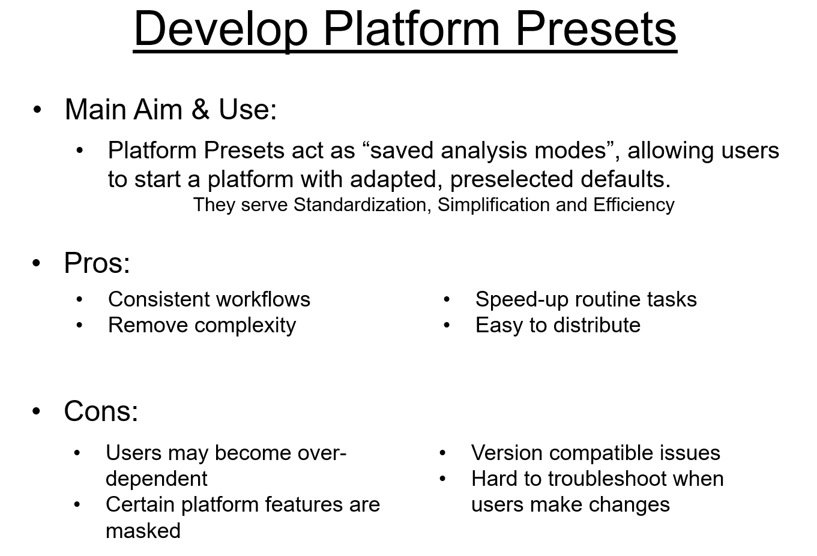
Customize: Built-In Support for Onboarding New Users

Slide 5
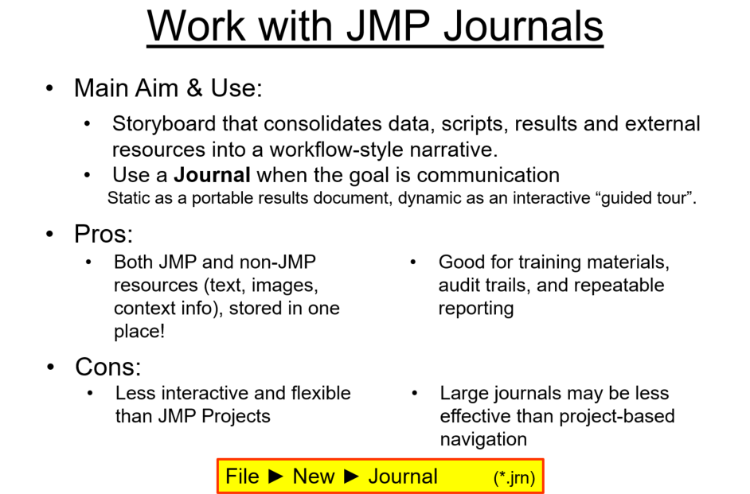
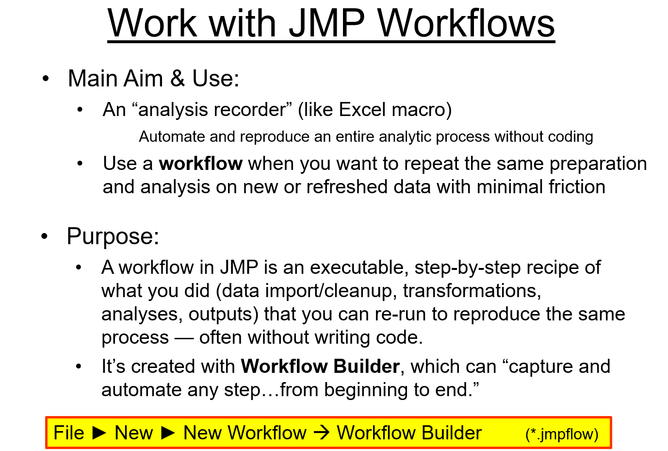
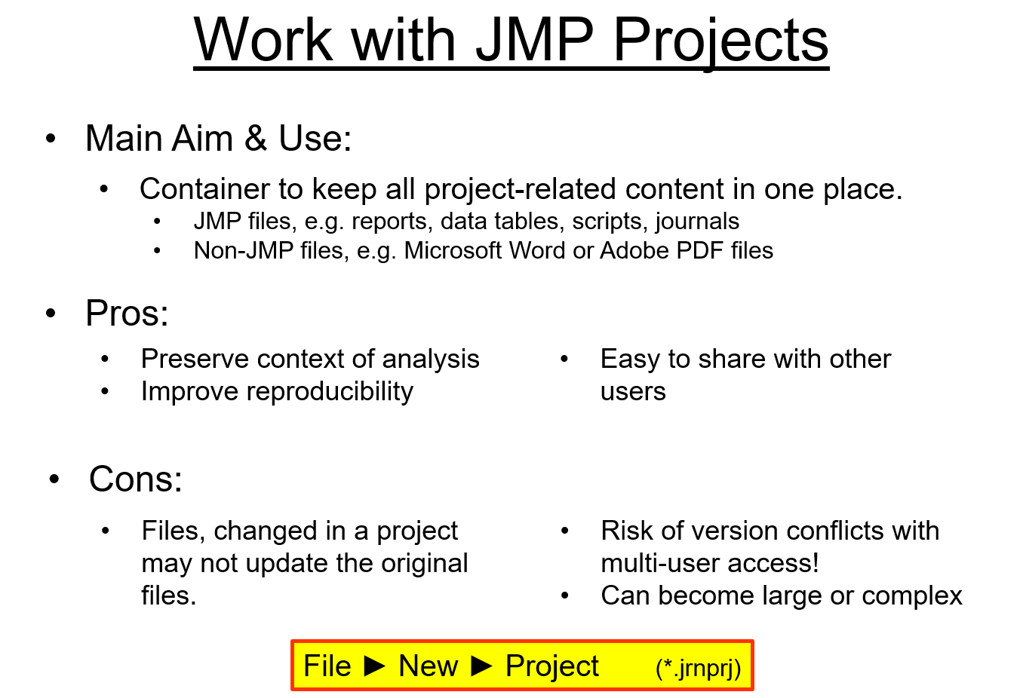
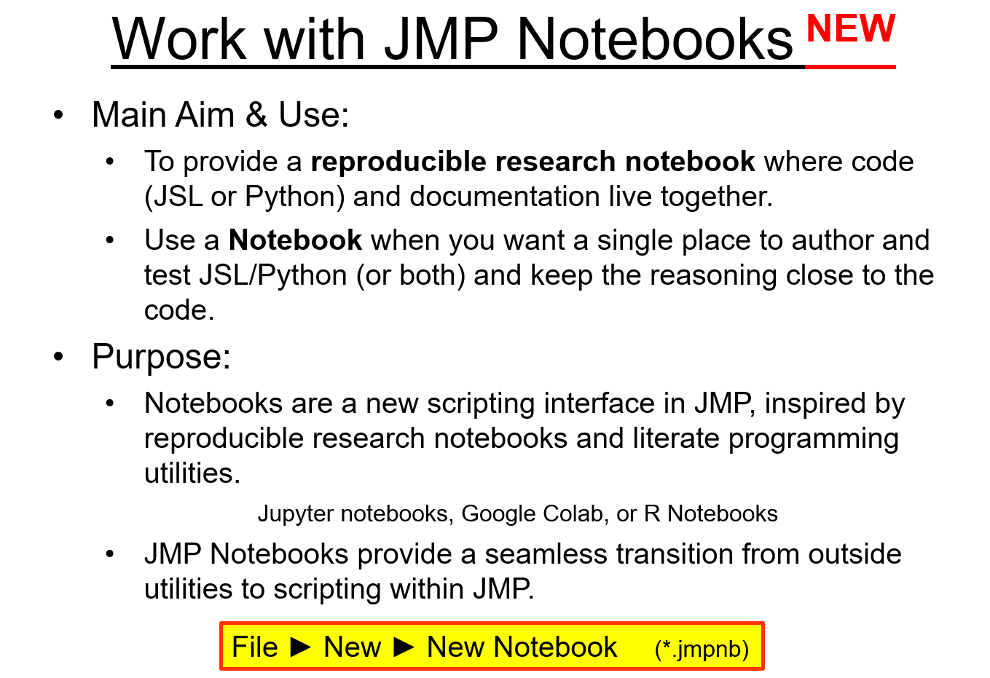
Package: JMP Solutions for Sharing & Reproducibility

Slide 6
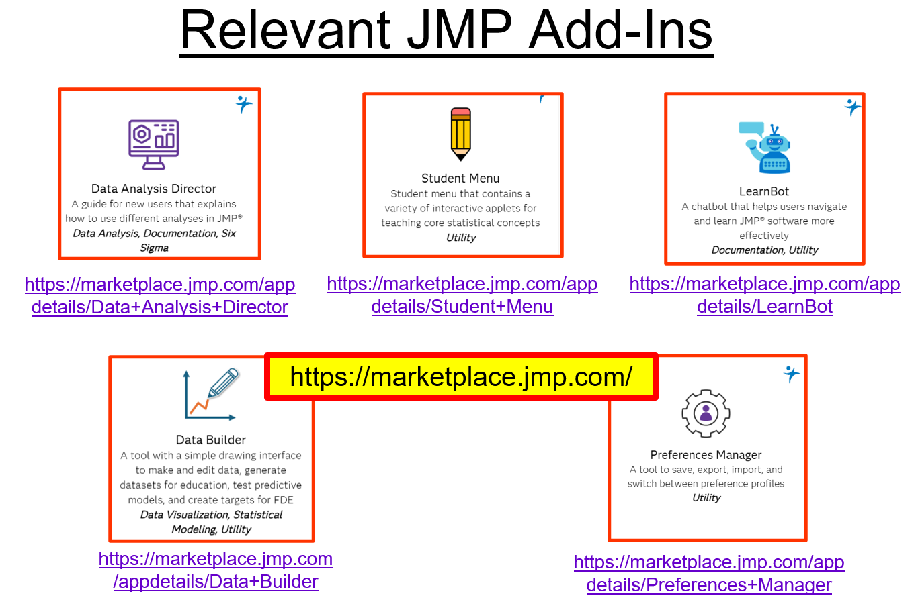
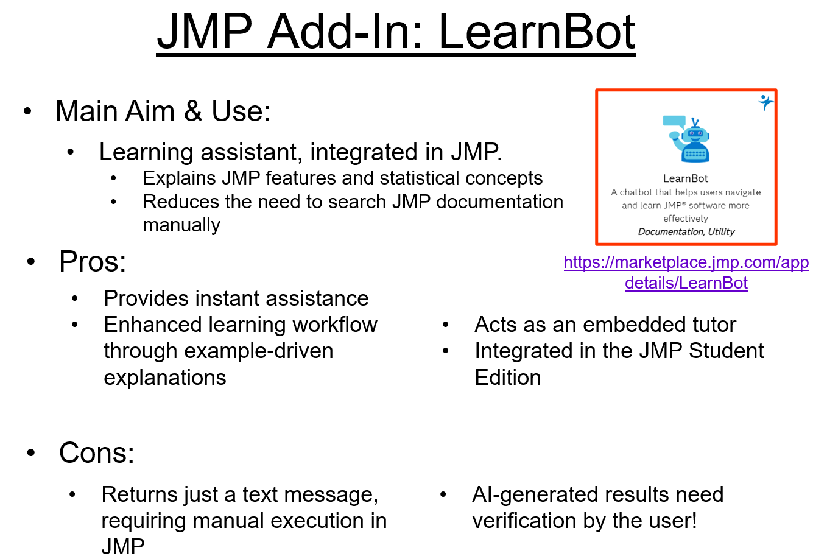
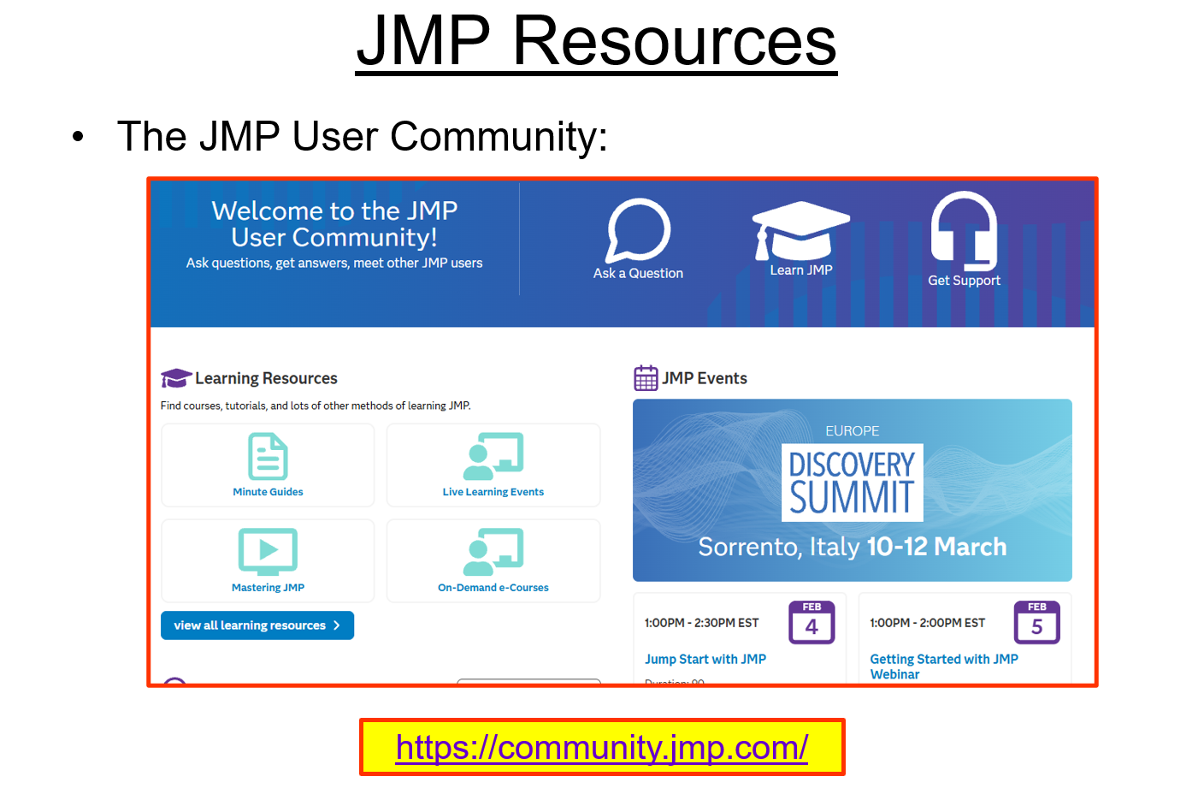
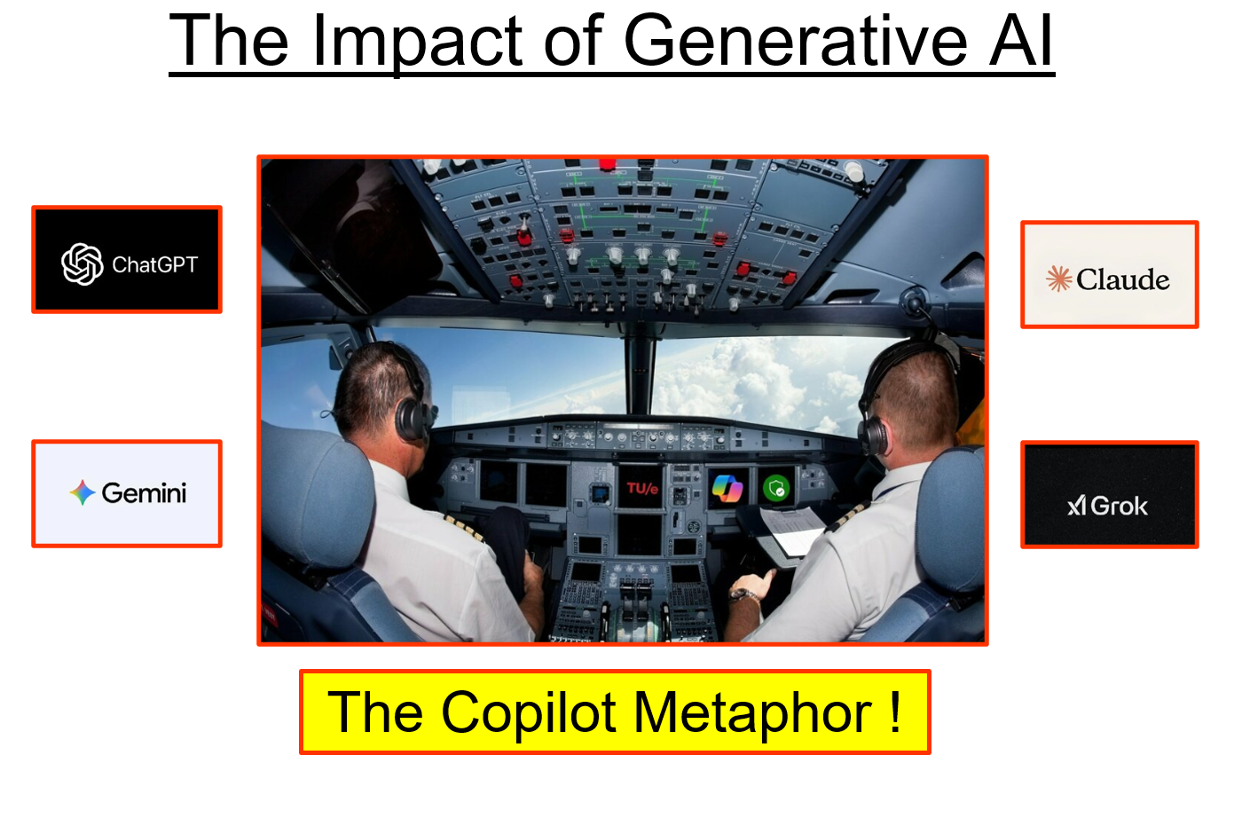
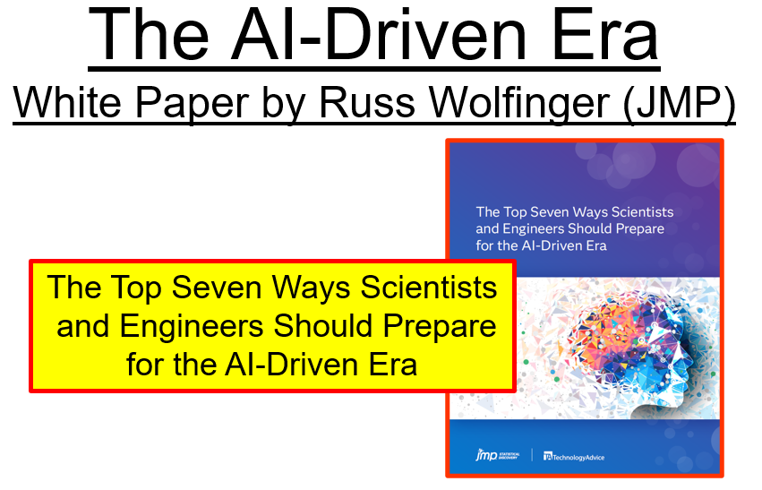
Extend: Functionality for the Next Level

Slide 7
Points for Discussion
Teaching Intro Stats, where would you recommend to “slim down" JMP first?
Data table
Main menus
Red triangle menus
JMP output (analysis reports)
Resources
Other?
Which built-in capabilities do you use most to get your students started in JMP?
Custom menu or toolbar
Platform Presets
Saved analyses
Journals and Projects
Workflows and Notebooks
Other?
Which external resources and extensions do you appreciate most to take your students to the next level?
Learning Library
JMP Help
Student Menu add-in
Data Analysis Director add-in
LearnBot add-in
Assistant add-in
Other?
How does JMP compare with other software (code or no-code) regarding usability and learning curve?
- Excel, Python, R, SPSS, Minitab, Matlab, etc.
What is “simple enough” for students starting with JMP?
- What is your experience?
How can JMP better support onboarding of first-time users?
- New or enhanced built-in capabilities, new or enhanced resources, extensions?
How can JMP help you taking users to the next level?
- New or enhanced built-in capabilities, new or enhanced resources, extensions?
What role should GenAI play in the future of statistical education?
Essential tool
Supplementary aid
Optional support
Minimal role
Not part of education

