Slide 1
Enterprise Add-in Management Strategies
Utilizing Cloud File Sharing for Add-in Deployment
Mike Anderson, Strategic Accounts Program
Hyde Miller, Global Technical Enablement

Slide 2
The problem
Enterprise Add-in Management Strategies
Needs | Git (Github) | Shared Drive
Manage the codebase | 🤩 | ☹️
Easily deploy updates | ☹️ | 😐
Control access/edit permissions | 🤩 | ☹️
Novice-friendly | ☹️ | 😐

Slide 3
The solution
Enterprise Add-in Management Strategies
Needs | Git (Github) | Shared Drive | OneDrive (?!)
Manage the codebase | 🤩 | ☹️ | 😐
Easily deploy updates | ☹️ | 😐 | 🤩
Control access/edit permissions | 🤩 | ☹️ | 🤩
Novice-friendly | ☹️ | 😐 | 🤩

Slide 4
The trick
Enterprise Add-in Management Strategies
JSL files for Add-ins can reside anywhere JMP can access…
So… what’s stopping us from putting the working code in an accessible OneDrive Folder?

Slide 5
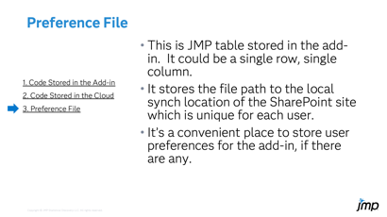
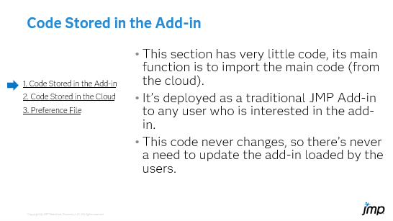
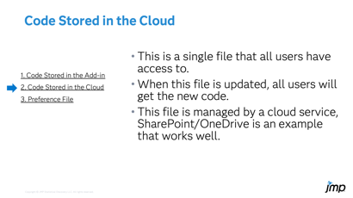
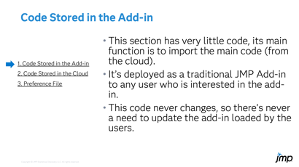
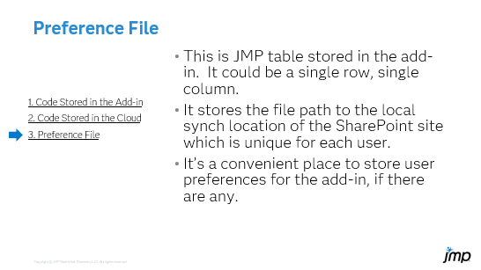
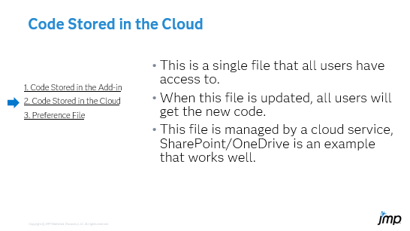
JMP Add-ins Deployed in the Cloud
How it Works: The Add-in is Divided into Three Sections
  Code Stored in the Add-in
  Code Stored in the Cloud
  Preference File

Slide 6
Code Stored in the Add-in
This section has very little code, its main function is to import the main code (from the cloud).
It’s deployed as a traditional JMP Add-in to any user who is interested in the add-in.
This code never changes, so there’s never a need to update the add-in loaded by the users.
  1. Code Stored in the Add-in
  2. Code Stored in the Cloud
  3. Preference File

Slide 7
Code Stored in the Cloud
This is a single file that all users have access to.
When this file is updated, all users will get the new code.
This file is managed by a cloud service, SharePoint/OneDrive is an example that works well.
  1. Code Stored in the Add-in
  2. Code Stored in the Cloud
  3. Preference File

Slide 8
Preference File
This is JMP table stored in the add-in. It could be a single row, single column.
It stores the file path to the local synch location of the SharePoint site which is unique for each user.
It’s a convenient place to store user preferences for the add-in, if there are any.
  1. Code Stored in the Add-in
  2. Code Stored in the Cloud
  3. Preference File

Slide 9
Solution in the wild
(JMP Demo)

Slide 10
JMP Add-ins Deployed in the Cloud
What’s Great About It
Add-ins can be deployed once and updated as needed without forcing users to reload the add-in.
The code stored in the cloud can be managed by each user using the usual cloud storage options to keep a local copy.
  This means the add-in will still work without an internet connection.
  The code will synch to the latest version whenever the user connects.
User access can by controlled by permissions on the code stored in the cloud. There’s no concerns about an add-in being sent to someone who’s not authorized.
Add-ins can have multiple developers, each with write access to the section of code stored in the cloud.

Slide 11
JMP Add-ins Deployed in the Cloud
What’s Great About It
Users only have read access to section of code stored in the cloud. There’s no concerns about users changing the code. This adds a layer of quality control to the add-in.
Code revisioning is easy and convenient.
  Revisions can be “backed out” to the previous version when unexpected results occur.
  Services like GitHub can be used
Code management is “Novice Friendly”.
  For the users, updates occur seamlessly whenever they use the add-in.
  Features like “What’s New” and “Help” can be incorporated and updated with each release.

Slide 13
Supplementary Information

Slide 14
The implementation
Enterprise Add-in Management Strategies
JMP Desktop
Option 1: Real-time Pull
(SharePoint Data Connector)
  OneDrive provides data as requested
  Smaller footprint on machine
OneDrive Folder
Add-in script:
  Dialog to define mirror path
  Checks for a path to mirror
  Opens the add-in package on mirror path
Add-in package
  User Interface
  Add-in code
  Resources
Option 2: Synced Folder
  Changes pushed to mirror on local machine automatically
  Allows offline operation
Mirror of OneDrive location

Slide 15
Setting up the OneDrive Folder
Enterprise Add-in Management Strategies
Set up a Team in Teams
  Creates a SharePoint Site for the users to sync with
  Add developers to the team and site with edit access
  Create a folder in the team channel for the Add-in Package Files
Go to the SharePoint Site (Teams will take you there directly)
  Set the site to sync with your computer
  Add the Add-in package files to the synced folder on your computer
Now you can give users access to the folder (without edit permissions)
They sync the folder to their computers as well

