Slide 1
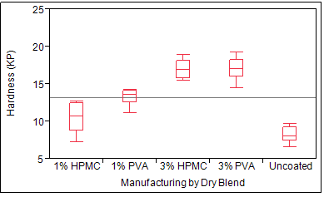
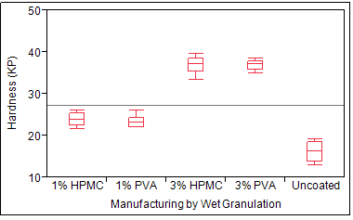


Quality by Design Approach for an Immediate Release Tablet
Venkatesh (‘Venka’) Balasubramanian,
Graduate Student, Rutgers University, New Brunswick, New Jersey, USA.
Abstract
Factors
Fig 2. Tablet Hardness for method of manufacturing types
Immediate release (IR) tablet is a drug product ingested orally and broken down in the Gastro- Intestinal (GI) tract to provide immediate therapeutic relief from common ailments such as fever, pain, migraine headache etc.
Quality by Design (QbD) is about building quality into products and processes during development
Drug product tablet manufacturing is either by Dry blend Vs. Wet Granulation process.
Tablets are film coated using Hypromellose (‘HPMC ‘) or synthetic polymers such as Polyvinyl alcohol (‘PVA’) and other inactive ingredients such as Talc, Titanium dioxide and colorants (dyes).
Polymer coating levels are usually between 1-3% w/w of total tablet weight.
Method of Manufacturing: Wet Granulation vs Dry Blend
Type: Uncoated tablet vs Coated tablets
Coating type: HPMC vs PVA
Coating Weight gain: 1% vs 3%
Conclusions
Uncoated tablets had fastest dissolution and low hardness.
Weak core results in visual defects during coating.
Wet granulation process has robust core than dry blend
HPMC coating has faster dissolution than PVA coating
3% weight gain of HPMC Coated tablets meets acceptance criteria of dissolution (Not more than 15 minutes.)
Increase in coating weight leads to increase in hardness and increase in dissolution time.
Fig 1. SEM image of Uncoated vs Coated Tablet Surface
Results
Fastest dissolution was obtained in following order
Uncoated core manufactured dry blend
Uncoated tablets with wet granulation
HPMC based coating system has optimal dissolution time as compared to PVA based
3% coated tablet weight gain had proper physical properties viz. tablet hardness and free from breakages as compared to uncoated tablets.
Objective
To formulate an immediate release drug product oral solid dosage form (‘tablet’ ) which provides fastest release of drug measured via tablet dissolution (in vitro). Basis: Dissolution in acidic media (pH 2) based on the mean gastric residence time of 30 minutes.
References
FDA Guidance on Immediate Release Solid Oral Dosage Forms. Scale-up and Post Approval Changes (SUPAC): Chemistry, Manufacturing, and Controls. In vitro dissolution and Bioequivalence
Design and Analysis of Experiments, Douglas C. Montgomery, 8th Edition, Wiley

Slide 2
Figure 3. Box Plot of Tablet Hardness across different types of Tablet Coating
Click Here to Return
Tablet Hardness measured in Kiloponds (kP)

Slide 3
Figure 4. Box Plot of Tablet Dissolution across different types of Tablet Coating
Click Here to Return
Dissolution media: Acidic (pH 2)

