Slide 1
Process capability in JMP 12 –A new look
Sue Walsh – JMP Technical Support
Laura Lancaster – JMP Development

Slide 2
Process capability
overview
Definitions
Formulas
Graphics
Capability Indices

Slide 3
Definition
What is process capability?
“Process capability refers to the relationship between the inherent variability in a process compared with the specification for the product.”
Introduction to Statistical Quality Control
Douglas Montgomery

Slide 4
Definition
What is process capability
“Process capability compares the output of an in-control process to the specification limits.”
- NIST Engineering Statistics Handbook

Slide 5
Definition
What is process capability
“Process capability compares the process output with the customer’s specification….The purpose of a process capability study is to compare the process specification to the process output and determine statistically if the process can meet the customer’s specification.”
http://www.qualitytrainingportal.com/resources/spc/spc_process_capability.htm

Slide 6
Definition
What is process capability
Process capability considers both the location and variability in measuring the ability of a process to meet specifications.
Notes:
Traditional process capability analysis assumes normality. Given that the normality assumption is met, capability analysis can detect problems with the location and/or the variability in the measurements.

Slide 7
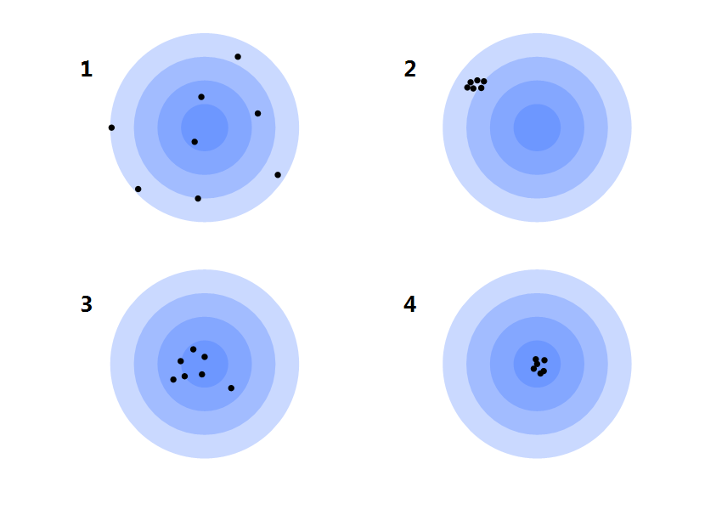
Definition
What is process capability?

Slide 8
Formulas
How is location estimated?
The sample mean is used to estimate the central tendency of the process.

Slide 9
Formulas
How is Variability estimated?
Overall sigma is estimated using the sample standard deviation
Within subgroup sigma can be estimated by:
the average of the ranges
the average of the unbiased standard deviations
the moving range
Notes:
If the process is stable, the overall sigma estimates the process standard deviation. If the process is not stable, the overall estimate of sigma is of questionable value, since the process standard deviation is unknown.
If you do not specify a subgroup ID column, a constant subgroup size, or a historical sigma, JMP estimates the within sigma using the moving range of subgroups of size two.

Slide 10
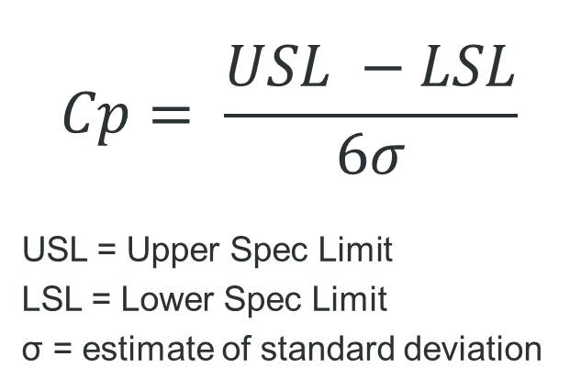
Formulas
$$Cp= \frac{USL −LSL}{6σ}$$
USL = Upper Spec Limit
LSL = Lower Spec Limit
σ = estimate of standard deviation

Slide 11

formulas
$$Cpl= \frac{μ −LSL}{3σ}$$
$$Cpu= \frac{USL − μ}{3σ}$$
$$Cpk=\min{(Cpl, Cpu)}$$

Slide 12

Formulas
$$Cpm= \frac{USL −LSL}{6σ\sqrt{1+ {(\frac{T − μ}{σ} )}^{2}}}$$

Slide 13
DeMonstration

Slide 14
conclusion
Process capability is designed to detect problems with location and variability for an in control, normally distributed process.
The JMP® 12 Process Capability platform is designed to assess process capability visually and statistically.
JMP® 13 is expected to include process capability analysis on non-normal data in this new platform.

