Slide 1
Using Input Variable Transformations to Improve Model Fit and Reduce Experimental Test Size
(on Some Models!)
Jerry Fish
President, Experistats LLC

Slide 2
Agenda
Quickly Review the traditional method of DOE
Propose a different way of looking at problems
  Gives insight into physics of the system
  Maintain curvature (including higher order curvature)
  Maintain interactions (including higher order interactions)
  Reduces Ntrials significantly!!!
Examine when this works, and when it might not
What if you try it and it doesn’t work?
Dimensional Analysis (if time permits)

Slide 3
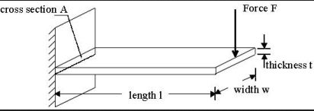
Traditional DOE Applied to Cantilever Beam
There are 5 factors in this experiment:
  All Continuous factors
  F, t, w, L, E (depends on material)
There is one response
  Deflection δ at the end of the beam
Material Elastic Modulus E
δ
L

Slide 4
Example: Cantilever Beam
Choose a Model
  Full Quadratic
Choose a Design
  N unknown coefficients determines minimum number of trials
    N_Independent_trials_{minimum} = N_b_coefficients = 21 independent trials
  JMP DOE Custom Designer recommends a minimum of 27 trials
  I’ll add 5 repeated trials, so a total of 32 tests to run.

Slide 5
Example: Cantilever Beam
Run the Test
  JMP demo – see file “Beam Experiment.jmp”
  Perform Response Surface Analysis

Slide 6
Example: Cantilever Beam
Effects tables & charts show relationships.
Profiler certainly identifies trends.
Rsqd=0.964, RsqdAdj=0.900

Slide 7
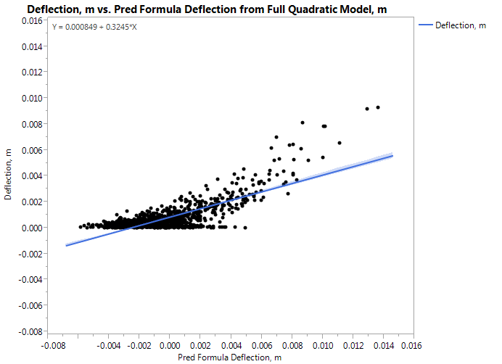
Example: Cantilever Beam
Predicted vs. Observed for 1000 additional tests
Agreement not “the best”.
Could continue using transforms on response
      Not shown here

Slide 8
What about the underlying physics?
0.0000319694961701581+
0.002512757779669* (F - 3) / 2) +
0.00144229447158926* (L - 1.5) / 0.5 +
-0.00407173769780801*(t - 0.02) / 0.01 +
-0.0018597962799624* (w - 0.065) / 0.035 +
-0.00142643334004068* (E - 138500000000) / 68500000000) +
0.000374736293727855* ((F - 3) / 2))^2 +
0.0014381091144981* ((F - 3) / 2) * ((L - 1.5) / 0.5) +
0.00198455291351259* ((L - 1.5) / 0.5)^2 +
-0.00284360562448336* ((F - 3) / 2) * ((t - 0.02) / 0.01) +
-0.00136472901503948*((L - 1.5) / 0.5) * ((t - 0.02) / 0.01)+
0.00488466797916716* (t - 0.02) / 0.01)^2) +
-0.00108356975056316* ((F - 3) / 2) * ((w - 0.065) / 0.035)) +
-0.00105664993062599* ((L- 1.5) / 0.5) * ((w - 0.065) / 0.035) +
0.00178868423368001* ((t - 0.02) / 0.01) * ((w - 0.065) / 0.035)) +
0.000413649650154398 * ((w - 0.065) / 0.035)^2 +
-0.000847480109303951* ((F - 3) / 2) * ((E - 138500000000) / 68500000000) +
-0.00100830655707504* ((L - 1.5) / 0.5) * ((E - 138500000000) / 68500000000) +
0.00164031654389554* ((t - 0.02) / 0.01) * ((E - 138500000000) / 68500000000) +
0.00111394547397489 * ((w - 0.065) / 0.035) * ((E -138500000000) / 68500000000) +
-0.00307859029759946* ((E -138500000000) / 68500000000)^2
Prediction Equation resulting from Full Quadratic Model, 32 trials
Difficult for me to understand much about the physics of this system.
      Often important in lab & design work.

Slide 9
But what if…
What if we could
  Reduce the test size…
  While keeping curvature…
    Even accounting for higher order curvature
  While keeping interactions…
    Even including higher order interactions
  While keeping all factors in the model
AND
Develop a model that gives more understanding into the physics of the system?

Slide 10
Here’s how
Let’s assume that the response can be modeled by the following equation:
where C₀ – C₅ are unknown coefficients.
Recall that we had 21 unknowns in the full quadratic model
  This set the minimum number of independent trials.
Now we have only 6 unknowns.
  Sounds promising!
But JMP DOE generally works with polynomials!
  How do we design a test for a model like this?

Slide 11
Log10 Transform the Input Factors and Response!
Original Equation:
Take Log of both sides
Algebraic manipulation
This looks a lot like a Main Effects model:

Slide 12
Transform the Input Factors!
So our transformed system looks like a Main Effects Model that JMP can easily handle!
  Only 6 unknown b’s, so only requires 6 independent trials
  Remember, the primed variables are all logs of original variables.
Original Variable | Transformed Variable
x₁=F | x’₁=log(F)
x₂=L | x’₂=log(L)
x₃=t | x’₃=log(t)
x₄=w | x’₄=log(w)
x₅=E | x’₅=log(E)
y=δ | y’=log(δ)

Slide 13
JMP (Almost) does this for you!
Use “Transform→Log” from Fit Model dialog.

Slide 14
Proceed from here as normal
Use Custom Designer to set up main effects test.
  6 unknown coefficients = minimum 6 trials
  JMP recommends total of 12
  As before, I’ll add 5 replicate trials
  Total of 17 tests.
    Full Quadratic was 32!
JMP demo
  See file “Beam Experiment with Transforms.jmp” for manual demo.

Slide 15
Output is interesting, but still not meaningful
Profiler is now in terms of transformed (logX) variables.
Rsqd=0.999, RsqdAdj=0.999
  Better than Full Quadratic
Can get predictions of log(Deflection), find sweet spots, etc.

Slide 16
What about the Physics? Undoing the Transform
Prediction equation is still not very meaningful
If we work through the algebra, the prediction equation simplifies to:
logDeflection = (-3.25029 )
+0.244671 * ((LogF - 0.23856 )/-0.23856 )
+ 0.457526 * ((LogL- 0.15051 ) / 0.15051 )
+ -0.72308 * ((LogT - 1.761439 ) / 0.238561 )
+ -0.26573 * ((LogW - (1.261439 )) / 0.261439 )
+ -0.24299 * ((LogE - 11.0805 ) / 0.235436 )
logDeflection = 7.288509866
+ 1.025615560 * LogF
+ 3.039734441 * LogL
- 3.031011854 * LogT
– 1.016415176 * LogW
- -1.032099898 * LogE
Looks like:

Slide 17
Further simplification leads to final equation
logDeflection = log[7.288509866
* F ^{1.025615560}
* L ^{3.039734441}
* t ^{-3.031011854}
* w ^{-1.016415176}
* E ^{-1.032099898} ]
Deflection = 7.288509866* F ^{1.025615560} * L ^{3.039734441}
t ^{3.031011854} * w ^{1.016415176} * E ^{1.032099898}

Slide 18
Use some Logarithm Identities to Simplify
Deflection = 7.29* F ^{1.03} * L ^{3.04}
t ^{3.03} * w ^{1.02} * E ^{1.03}
Now we can see that:
  Deflection is directly proportional to Force
  Deflection is inversely proportional to Width and to Modulus
  Deflection is directly proportional to the Cube of Length
  Deflection is inversely proportional to the Cube of Thickness
This form can be very valuable to engineers and scientists!

Slide 19
Comparison to Known Solution
Beam Bending Equation for Cantilever Beams, Small Deflections
Exponents look good! But constant seems off a bit.
  How well does it predict?
Deflection = 7.29* F ^{1.03} * L ^{3.04}
t ^{3.03} * w ^{1.02} * E ^{1.03}
Deflection = 4 * F * L³
t³ * w * E

Slide 20
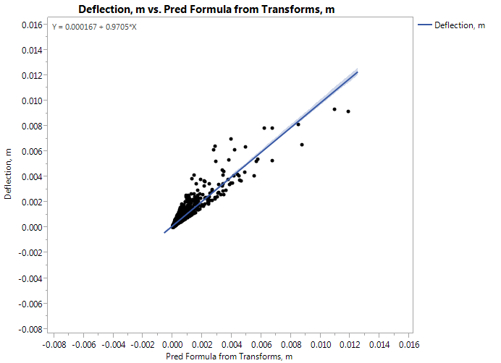
Example: Cantilever Beam
Predicted vs. Observed for 1000 additional tests
Agreement better than Full Quadratic

Slide 21
Additional Accuracy Exploration
Less measurement error certainly improves accuracy of coefficients
More trials does not necessarily improve accuracy of coefficients.
Additional information in supplemental slides at end of presentation.

Slide 22






When will this technique work?
Certain systems of the proper form...
Ideal Gas Law
Darcy’s Law
Dynamic Pressure
Hydrostatic Pressure
Helmholtz Resonance
Hagen-Poiseuille Eqn

Slide 23
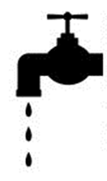
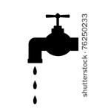

When will this technique NOT work?
Systems with additions in their fundamentals
$h(t)=H_{0}+\left(\frac{{\dot{m}}_{1}}{ρA}+\frac{{\dot{m}}_{2}}{ρA}\text{−}\frac{{\dot{m}}_{3}}{ρA}\right)t$
h

Slide 24
How can I tell if this technique worked?
It all boils down to how well the results model the system or process.
Test some points that haven’t yet been run
  Does it predict sweet spots well?
  Does it model the system well in the region of interest?
If it doesn’t fit the behavior well, then it didn’t work.

Slide 25
I tried it, and it didn’t work. What now?
Collected data is still valid!
  Just use un-transformed variables as usual.
Of course, you’ll be starting with a main-effects model
If you want curvature and interaction effects, go back to the original design and Augment.

Slide 26
About the Author
Jerry Fish is owner and President of Experistats LLC. He is a trained Lean Six Sigma Black Belt, and has many years of experience in statistics and DOE while working for Caterpillar Tractor, Cummins Engine, GE Aircraft Engines, and Lexmark International. He and his wife live in Lexington, KY.
Contact Info:
Jerry Fish
Experistats LLC
experistats@gmail.com
859-433-6231

Slide 27
How does Dimensional Analysis fit in with this?
Dimensional Analysis can mean different things to different people.
In the case of problems like the cantilever beam, we can use dimensional analysis to estimate the final form of the model.
It takes a little practice and engineering judgement to get started with the analysis.

Slide 28
Example: Cantilever Beam Problem
List all variables and their base units
  [L]=length, [M]=mass, [T]=time
* Engineering Experience says deflection depends on I, which depends on t and w.
Variable of Interest | Description | Base Units
δ | Deflection (response) | [L]
F | Force (factor) | [M][L]/[T²]
E | Elastic Modulus (factor) | [M]/{ [L][T²] }
L | Beam Length (factor) | [L]
I* | Beam Area Moment of Inertia (factor) | [L⁴]

Slide 29
Example: Cantilever Beam Problem
Write equation as before:
Replace variables with base units
Now solve for exponents. For example, for [L] terms:

Slide 30
Example: Cantilever Beam Problem
Similarly, for [M] terms:
And for [T] terms:
From the last 2 equations, we know that C1=-C4.
  So either F or E is in numerator, and other is in denominator of final eqn.
Substituting into first equation, this leaves:

Slide 31
Example: Cantilever Beam Problem
We have 1 equation and 3 unknowns, so there are several possible solutions to this particular problem:
The original equation was:
Engineering experience tells us that d generally:
  increases as force increases, so C1 is positive
  Increases as L increases, so C2 is positive
  Decreases as stiffness increases, so C3 is negative

Slide 32
Example: Cantilever Beam Problem
Possible combinations:
All of these solutions are dimensionally possible
True behavior is
C1 | C2 | C3
1 | 1 | -0.5
1 | 2 | -0.75
1 | 3 | -1
2 | 1 | -1
2 | 2 | -1.25
2 | 3 | -1.5
3 | 1 | -1.5
3 | 2 | -1.75
3 | 3 | -2
δ = F * L³
3 * E * I

Slide 33
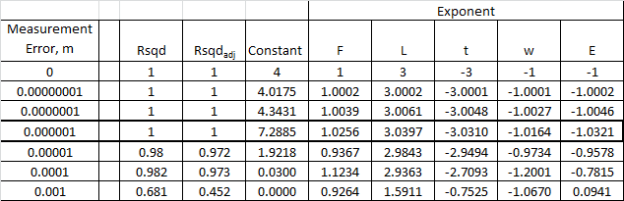
Results for Varying Measurement Error
Smaller measurement error improves fit.
Data for 17 trials, varying standard deviation of measurement error.

Slide 34
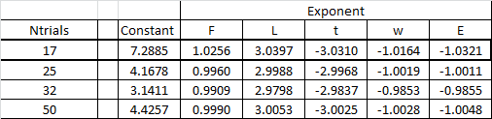
Results for Varying Measurement Error
More trials may help improve fit somewhat.
Data for Measurement Error = 0.000001, varying Ntrials, using 5 replicate trials in each case.

