Slide 1
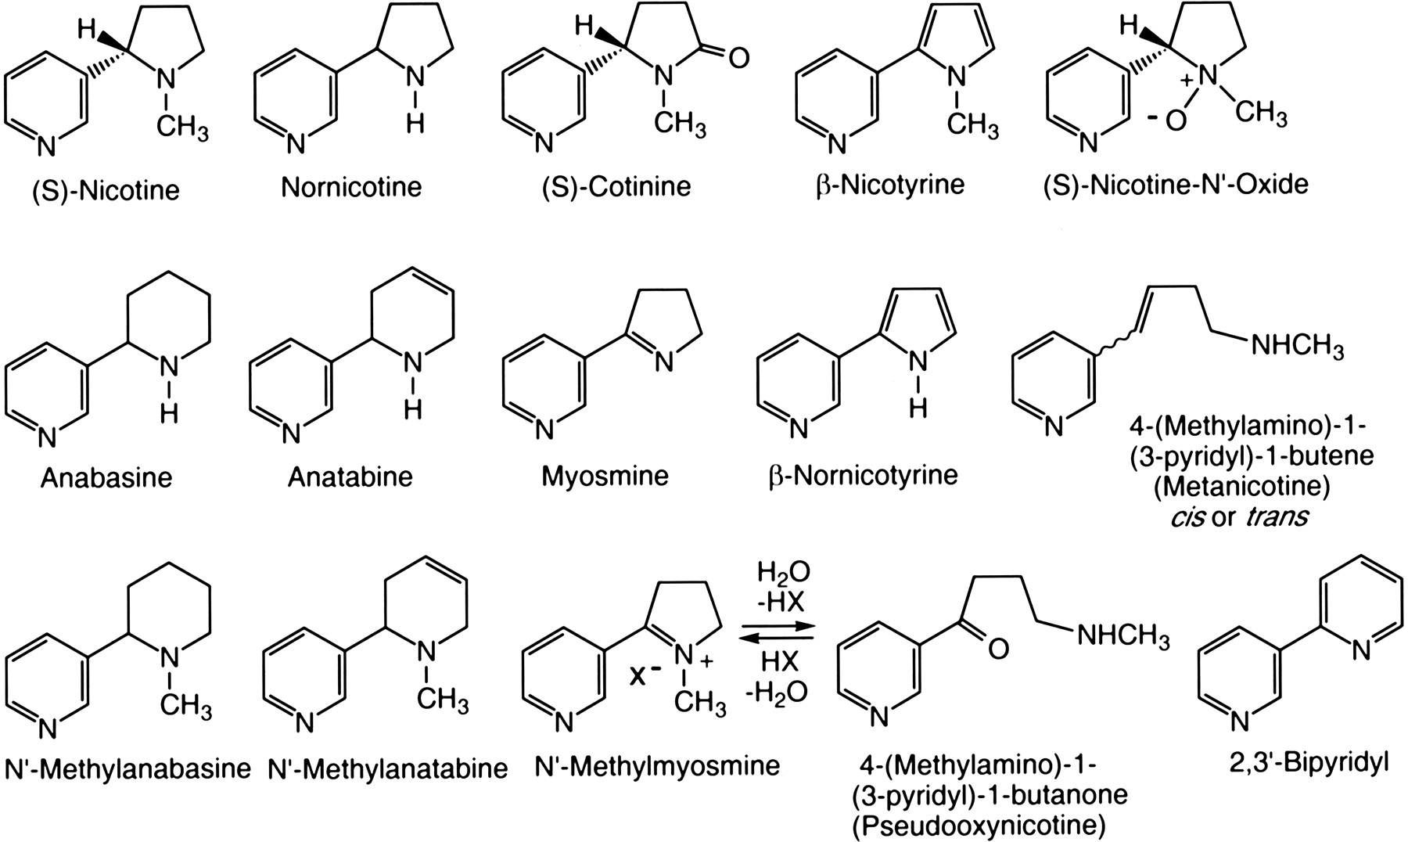
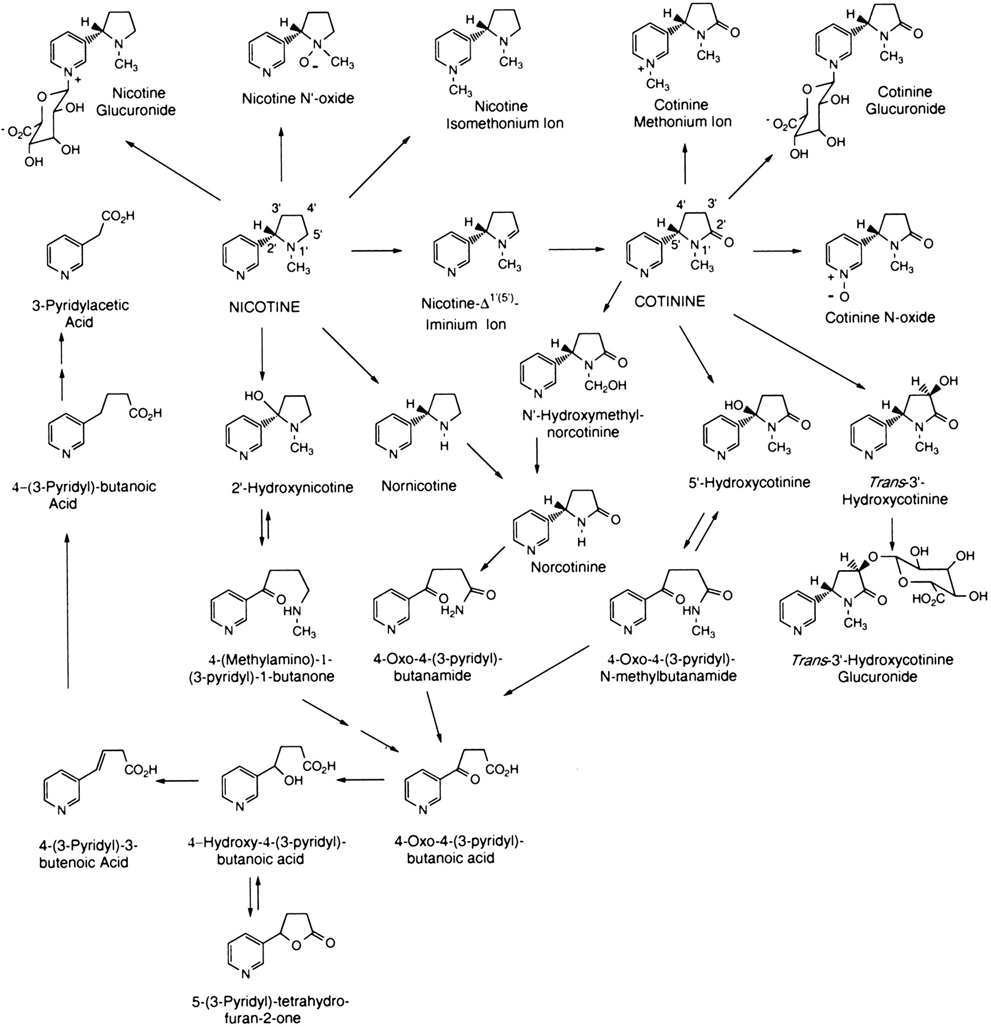
Utilization of JMP® for Nicotine Biomarker Method Validation Stephen Arnstein, MS; June Feng, PhD; Connie Sosnoff, MA; Lanqing Wang, PhD; Division of Laboratory Sciences, Centers for Disease Control and Prevention
Abstract
Monitored Metabolites of Nicotine*
Calibration Curve Assessment of Linearity
Instrument Cross Validation (COTT)
Linear Fit of Response by Nominal Concentration
N = 627
R² = 0.9976
The Division of Laboratory Sciences (DLS) at the Centers for Disease Control and Prevention (CDC) provides guidance to the staff within DLS for acceptance criteria in development and validation analytical chemistry methods. We have utilized basic functionality in JMP® 11 to validate liquid chromatography tandem-mass spectrometry (LC-MS/MS) methods developed by the Tobacco Exposure Biomarkers Lab (TEBL). This presentation will show how “Fit Y by X” and “Matched Pairs” analyses are used to validate a method for measuring nicotine exposure biomarkers. Specifically, the “Fit Y by X” analysis is used to validate the linearity of calibration curves for multiple analytes in the method. Additionally, “Fit Y by X” and “Matched Pairs” analyses are used to compare a new analytical chemistry method with a previous method by generating correlation and difference plots. These techniques are the first steps to creating a JMP® Toolbox for analytical chemistry method validation within TEBL.
0.4 - 0.8%
4 - 7%
NICT
(11 - 15%)
NOXT
~75%
NNCT
2 - 5%
40 - 49%
Correlation Coefficient R²
ANBT | 0.9993 | COXT | 0.9995 | NICT | 0.9999
ANTT | 0.9996 | HCTT | 0.9999 | NNCT | 0.9997
COTT | 0.9991 | NCTT | 0.9998 | NOXT | 0.9999
Conclusions
COTT
The calibration curves for nine nicotine metabolites are linear.
Two methods for measuring cotinine have well correlated results.
The two instruments that are used for the same assay do not show bias over the reportable range.
JMP® is a useful tool for method validation.
(22 - 32%)
1 - 2%
COXT
HCTT
Lack of Quadratic Fit
Results
Method Cross Validation
NCTT
Monitored Analogs of Nicotine
References
Pharmacological Reviews March 2005 vol. 57 no. 1 79-115
JMP®, Version 11. SAS Institute Inc., Cary, NC, 1989-2007.
y = -0.0747 + 1.1111*x
R² = 0.9685
Contact Info: Stephen Arnstein, vfn3@cdc.gov, 770-488-7170
For more information: cdc.gov/biomonitoring/tobacco.html
ANBT
ANTT
* Monitored metabolites account for ~90% of nicotine dose. See the reference in Pharmacological Reviews for more information.
Prob > |t| for Squared Term is > 0.2 for all.
Division of Laboratory Sciences

