Slide 1



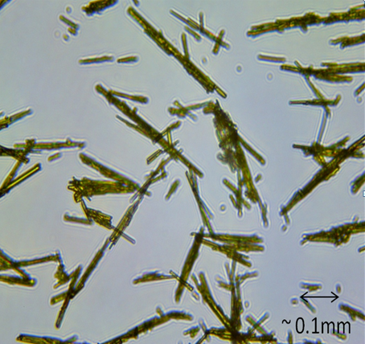
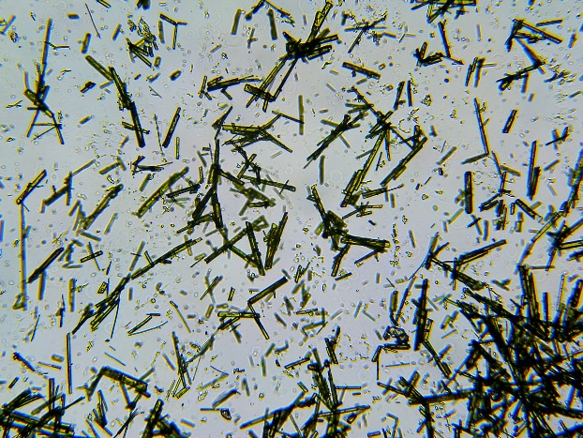
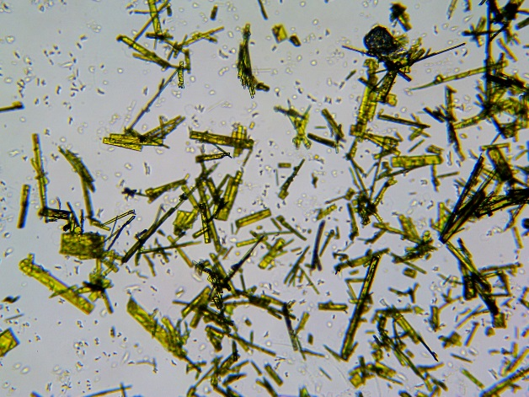
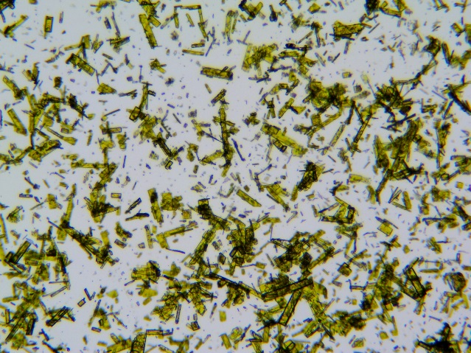
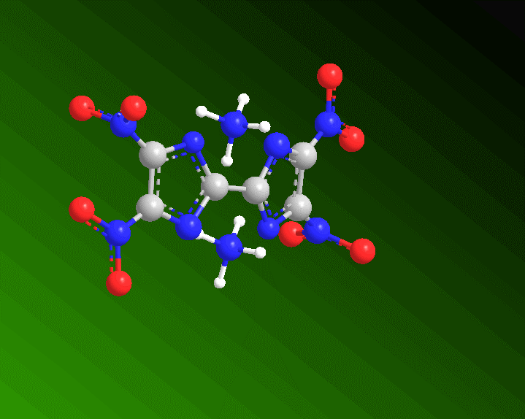
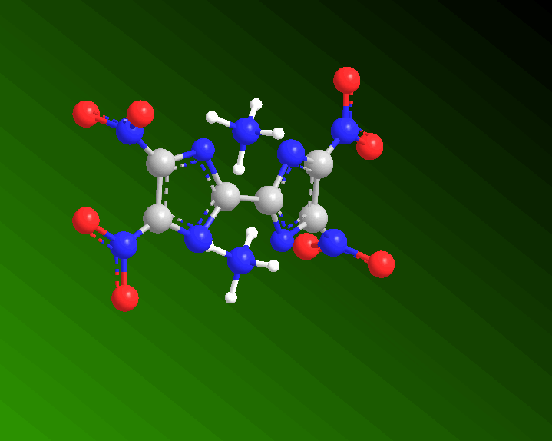
Recrystallization of DATNBI Guided by JMP
Edward Cooke, Dr. Paul Anderson, Dr. Alexander Paraskos,
Melissa Rhode, Douglas Ray, Kevin Singer
US Army – Armament Research Development & Engineering Center (ARDEC)
Unclassified. Distribution A: Approved for Public Release. Distribution is unlimited.
Abstract
Research into novel replacements for legacy explosive materials such as RDX has been ongoing for decades. The underlying goals of that research are to synthesize insensitive and environmentally benign compounds that maintain the baseline explosive performance. Synthesis efforts at Picatinny Arsenal have recently produced a material to meet such requirements: Diammonium 4,4’,5,5’-Tetranitro-2,2’-biimidazolate (DATNBI). Calculations and initial test data indicate this material is a viable candidate to replace RDX in future Army formulations. One hurdle that DATNBI faced in that transition was the crude crystal morphology. The synthesis process produced a needle-like crystal, which has detrimental effects on the processing of the explosive formulation. In order for this material to move forward, modified crystal morphologies were achieved through a recrystallization process.
A ‘textbook’ blocked fraction-factorial experimental design was developed in order to produce these desirable crystals. This poster presents the use of JMP software in modeling and understanding the chemical behaviors at play in the recrystallization process. With categorical and continuous variables producing both qualitative and quantitative responses, various models were necessary to optimize the final recrystallization process. Experimental parameters, microscopy images, and process yields are shared to support justification for final process selection.
Results
Three repetitions were measured for each of the replicates from the 24-run designed experiment. The yield was acquired by filtering the crashed out crystals from the mixture solution. The aspect ratio and surface area were determined by completing a log linear analysis of mean and standard deviations of dimensions measured on microscope images by three different observers totaling 45 different crystals. This analysis accounted for the variance in obtaining those measurements.
Numerical optimization was executed in order to maximize the recovered crystal yield, minimize the aspect ratio and maximize the surface area. The results showed that anti-solvent temperature, DATNBI concentration, and the type of anti-solvent were the strongest factors affecting the responses. Minimal temperature, maximum concentration, and tert butanol as an anti-solvent were determined and evaluated with scale-up efforts confirming the value of the optimizations.
Conclusions
DATNBI is a viable RDX replacement with a crude crystal morphology that required modification in order to be processed in an explosive formulation. Through a fractional factorial DOE and JMP guided optimizations, a more desirable morphology and optimized recrystallization yield was able to be achieved. The process was scaled up to produce one pound of improved DATNBI for continued explosive testing and characterization.
Acknowledgments
The authors would like to acknowledge Ellari L. Hillard and Scott Nies for help with crystal image measurements and Kelley Caflin for solubility data. The research described herein was funded by the Army FREEDM program.
Unclassified. Distribution A: Approved for Public Release. Distribution is unlimited.

Slide 2
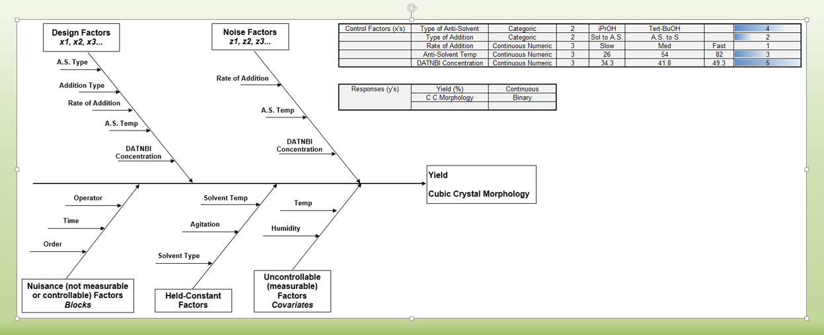

Slide 3
