Slide 1
INTEGRATED PROCESS IMPROVEMENT USING THE SECOND-GENERATION QUALITY TOOLS IN JMP

Slide 2
INTRODUCTION
OUR SECOND GENERATION QUALITY TOOLS
Control Chart Builder (CCB)
Process Capability
Measurement Systems Analysis (MSA)

Slide 3
INTRODUCTION
history
JMP 10 introduced the Control Chart Builder (CCB) and Measurement Systems Analysis (MSA) platforms.
JMP 11 added new features and improvements to CCB and MSA.
JMP 12 introduced the new Process Capability platform.
JMP 13 added nonnormal distributions to the Process Capability platform.

Slide 4
introduction
Motivation and planning
We wanted to modernize our quality platforms and use an integrative philosophy to make quality analysis easier and more effective.
We consulted with Don Wheeler, and these platforms are heavily influenced by his methods and thinking.
We decided on several central ideas to guide our platform development.
Much careful thought was given to the design of each of these platforms.

Slide 5
INTRODUCTION
Central ideas
All quality platforms should be highly visual and make the identification of root causes more intuitive.
There should be no need for data table manipulations to explore different charts or subgrouping.
The charts should be dynamic and produce the most likely chart based on the inputs rather than requiring the use of a list of chart types.
MSA and process capability analyses should relate to the way the SPC is practiced at the user’s organization.
All quality platforms should be easy to use and easy to interpret!

Slide 6
Case studies
Dogwood Cheese Company manufactures ten varieties of cheese.
Appalachian Pharmaceuticals manufactures several drugs in various forms.
Both companies have comprehensive quality plans.
We will look at a few examples that will demonstrate the central ideas used in development and highlight the connections between our new quality tools.

Slide 7
BONUS
PROCESS SCREENING platform
JMP 13 added a new Process Screening platform to the screening menu.
Allows users to quickly screen large numbers of processes for stability and capability.

Slide 8
Control chart builder
Monitoring variation
Graphical way to filter out routine variation to determine if a process is stable and predictable.
Two types of Variability
Common Cause
Special Cause
Need to be able to identify special cause variation.

Slide 9
Control chart builder
Features
Drag-and-drop interface can create many types of charts all in one platform.
It infers type of chart based on data column modeling type and subgroups.
Supports visualization of nested process data.
It is easy to nest subgroups in a chart without having to return to the data table.
Allows test customization that can be saved to preferences.

Slide 10
CONTROL CHART BUILDER
DOGWOOD CHEESE COMPANY – spc plan for MONITORING PERCENT MOISTURE CONTENT
They test the percent moisture content of their cheeses twice a day, in the morning and evening.
We will examine their percent moisture content for their White Vermont Cheddar Cheese line from mid-July to mid-August. They had some issues.
The target for the moisture content of this cheese is 37%.
They use the following control chart warnings/tests for these processes:
Test 1: One point beyond 3 sigma
Test 2 (Altered): 8 points in a row on a single side of the center line
Test 5: 2 out of 3 points in a row beyond 2 sigma
Test 6: 4 out of 5 points in a row beyond 1 sigma
They need an Individual & Moving Range Chart for this data.

Slide 11
Control chart builder
Appalachian pharmaceuticals – spc plan for MONITORING TABLET THICKNESS
They measure the thickness of their tablets at regular intervals, testing 5 tablets in each sample.
We will examine 30 samples of their recent thickness data for their Drug X.
The target thickness for this tablet is 4 mm.
They had been having problems with their tablet press and made adjustments to it after the first 10 samples.
They need an XBar & S Chart for this data.

Slide 12
CONTROL CHART BUILDER
DOGWOOD CHEESE COMPANY – spc plan for monitoring defects in final product
They use a sensory evaluation team to monitor all final products for defects.
The team tests 50 samples from each batch for flavor and texture and records the number of samples that are defective.
We will examine the defect data for their Pepper Jack Cheese in August.
They need an attribute NP Chart for this data.

Slide 13
CONTROL CHART BUILDER
APPALACHIAN PHAMACEUTICALS – spc plan for monitoring vial fill weight
They have a large complex machine that fills their vials in super clean room.
When the machine is filling the vials, it uses a set of 4 needles to fill a block of 4 vials.
After the vials are filled, they are then stopped and sealed and then sent out of the clean room into another room.
In the second room they test the fill weight of the vials at regular intervals during the day.
Because of the fill machine’s complexity, they expect some routine variation in filling over the course of daily production.

Slide 14
Control chart builder
APPALACHIAN PHAMACEUTICALS – spc plan for monitoring vial fill weight
They expect to have both between and within sample variation.
We will examine last week’s production data for their Drug Z 10 dose vials.
They test 12 samples per day with 6 vials per sample.
The target fill weight is 6.1 grams per vial. If vials go below 5.8 grams, they would have to throw away the vials.
They need a Three-Way Chart to account for 2 sources of variation.

Slide 15
Process capability
Process capability analysis assesses how well a process produces product that is within specification.
Capability Indices are metrics that relate process performance to specification limits.
These index calculations assume the process is stable.
Distributional assumptions are also important.
Process capability analysis should always involve more analysis than simply looking at capability indices.
A good process is both capable and stable.

Slide 16
Process capability
Central ideas and resulting features
A capability analysis should reflect the type of control chart used in the SPC program.
A process can be subgrouped by grouping columns or a constant subgroup size, reflecting X-Bar control charts.
The potential performance and past performance should be available alongside each other.
Both within and overall variation are computed for all normal data.
Within variation analyzes potential performance. (also known as short-term variation)
No subgroup – estimated by moving range
With subgroup – estimated by average of ranges or average of unbiased standard deviations.
Overall variation analyzes past performance. (also known as long-term variation)
Most reports and graphs are available for both types of variation.

Slide 17
Process capability
Central ideas and features
Increase ease of use, efficiency, and consistency.
Modernized graphs.
Allow user to select and color the data table values that are outside of the spec limits.
Present the same Individual Detail Report in Process Capability and CCB platforms.
Capability analysis should be available regardless of the distribution.
Allow nonnormal capability for processes with a gamma, Johnson, lognormal, or Weibull distributions or a nonparametric fit.
Nonnormal Capability Indices – Two Methods
Percentile (ISO/Quantile) – Uses standard formulas but replaces the mean with median of the fitted distribution and the 6σ range with corresponding percentile range.
Z-Score (Bothe) – Transforms the spec limits to numbers that have the same probabilities as the fitted distribution on a standard normal scale. The indices correspond to a normal distribution with the same risk levels as the fitted distribution.

Slide 18
Process capability
Old capability platform?
Replaces former Capability platform. The new platform has all the same features plus more.
Former Capability platform still available via scripting.

Slide 19
Process capability
Dogwood cheese company – capability analysis of final product weighing
They test the capability of their final product weighing process for all 10 of their cheese lines.
They test 4 cheeses in each sample. The studies consist of 30 samples.
Each cheese line has a target and lower and upper specification limits that are saved as column properties.
Notes:
Capability Box Plots – I can see that Pepper Jack, Canadian Cheddar, and White American cheese all have products weights out of spec. Monterey Jack and White Vermont Cheddar appear to be pretty off target.
Select and color out of spec values.
Goal Plot – Show the three processes that are not capable and the 2 that are off target. These are using overall sigma. Turn on the within sigma points. Show that Canadian cheddar overall and within points are far apart. Could mean an unstable process.
Show the Individual Detail Reports. Go through a few of them, especially Canadian Cheddar. We need to investigate if this is an unstable process.
Go to CCB and create an Xbar and S chart for Canadian Cheddar. Show how the process has drift and is unstable. Show the same Process Capability report.

Slide 20
PROCESS CAPABILITY
APPALACHIAN PHARMACEUTICALS – capability analysis of drug impurity levels
They test the capability of their drug production processes to keep impurities at low levels.
We will examine the capability of their production of Drug B to keep the impurities remaining after its creation at low percentages.
Drug B has 6 impurities that must stay below 0.5%. These upper spec limits are in a separate spec limits data table.
They believe the data is lognormal.

Slide 21
MEASUREMENT SYSTEMS ANALYSIS (MSA)
MSA studies are designed experiments that help determine how much measurement variation is contributing to the overall process variation.
Assess the precision, consistency, and bias of measurement system.
If your system has too much measurement variation you will miss signals of true variation in your process.

Slide 22
Measurement systems analysis (MSA)
Evaluating the measurement process (EMP)
The Measurement Systems Analysis (MSA) platform was designed to implement Don Wheeler’s Evaluating the Measurement Process (EMP) methodology.
EMP gives visual information and results that are easy to interpret.
EMP emphasizes the effect of measurement ability on SPC: “Given this measurement system, how well can we correctly identify process changes?”
EMP classification system
Shift Detection Profiler

Slide 23
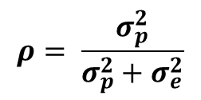
MEASUREMENT SYSTEMS ANALYSIS (MSA)
EMP CLASSIFICATION SYSTEM
Classifies a measurement system by its ability to detect changes in the production process.
Uses the intraclass correlation coefficient to measure the health of a measurement system.
Intraclass correlation coefficient (ρ) - ratio of part variance to total variance.
$$ρ= \frac{σ_{p}^{2}}{σ_{p}^{2}+σ_{e}^{2}}$$
$$σ_{p}^{2}−part variance, σ_{e}^{2} −error variance$$

Slide 24
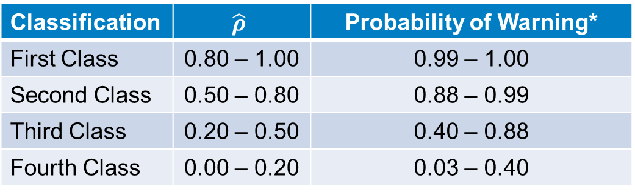
Measurement systems analysis (MSA)
EMP Classification system
Classification | $$\hat{ρ}$$ | Probability of Warning*
First Class | 0.80 – 1.00 | 0.99 – 1.00
Second Class | 0.50 – 0.80 | 0.88 – 0.99
Third Class | 0.20 – 0.50 | 0.40 – 0.88
Fourth Class | 0.00 – 0.20 | 0.03 – 0.40
* Probability of warning for a 3σ shift within 10 subgroups with Test 1.

Slide 25
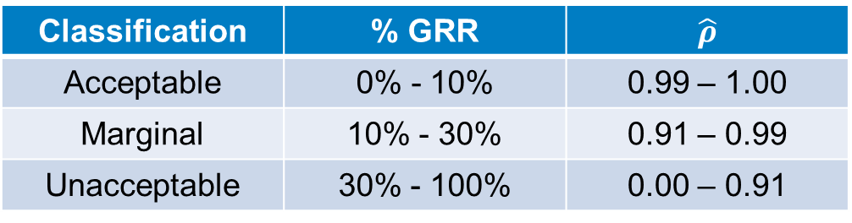
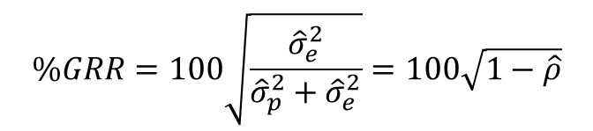
Measurement systems analysis (Msa)
AIAG classification system - gauge R&R
AIAG uses Percent Gauge R&R to classify the health of a measurement system.
$$\%GRR=100\sqrt{\frac{{\hat{σ}}_{e}^{2}}{{\hat{σ}}_{p}^{2}+{\hat{σ}}_{e}^{2}}}=100\sqrt{1−\hat{ρ}}$$
Classification | % GRR | $$\hat{ρ}$$
Acceptable | 0% - 10% | 0.99 – 1.00
Marginal | 10% - 30% | 0.91 – 0.99
Unacceptable | 30% - 100% | 0.00 – 0.91

Slide 26
Measurement systems analysis (msa)
The Shift Detection Profiler
Quantifies the measurement system’s ability to detect process shifts.
Uses the results of the MSA study to help the user make data-based decisions on control chart planning and use.
Allows the user to explore how changes in warning rules and subgroup sizes impact their ability to detect process shifts while keeping the false detection rate reasonably small.
Allows the user to explore “what if” scenarios of how process and measurement system changes impact their ability to detect process shifts.

Slide 27
MEASUREMENT SYSTEMS ANALYSIS (MSA)
DOGWOOD CHEESE COMPANY – MSA study OF cheese PH MEASUREMENTS
They recently ran an MSA study on their ability measure the pH of their cheese during production.
We will examine their MSA study for their Colby Jack Cheese. The study had 5 operators measure the pH of 15 samples of the cheese 3 times.
This MSA is a nested study because each operator measured 15 different samples of cheese.

Slide 28
MEASUREMENT SYSTEMS ANALYSIS (msa)
APPALACHIAN PHARMACEUTICALS – MSA STUDY OF TABLET WEIGHT MEASUREMENTS
They recently ran an MSA study on their ability to measure the weight of their tablets.
We will examine their MSA study for their Drug A. In this study 4 operators weighed 12 tablets 3 times.
This MSA is a crossed study because operator measured the same 12 tablets.

Slide 29
Process screening
A screening platform for quality
Helps to explore a large number of processes at one time to assess where to focus attention.
Calculates and summarizes control-chart, process capability, and process stability metrics.
Creates a process performance graph that summarizes capability and stability in one graph.
Facilitates further exploration of selected processes with easy access to Control Chart Builder and the Process Capability platforms.

Slide 30
Process screening
Appalachian pharmaceuticals – monitoring tablet weights of many drugs
They monitor the weight of the tablets being produced for all of their drugs in tablet dosage form.
We will screen their recent tablet weight data for all of the tablet dosages for Drugs A-G for stability and capability.
We will examine the last 50 samples of their weight data. They weigh 5 tablets in each sample.
Each tablet dosage has a target and lower and upper specification limits.

Slide 31
summary
Understanding how your measurement systems, statistical process control program, and process capability assessments fit together is key to improving and maintaining quality.
A new screening platform helps facilitate assessing the quality of many processes at one time.
These new platforms had many other new features I was unable to demo.
Questions?

