Slide 1
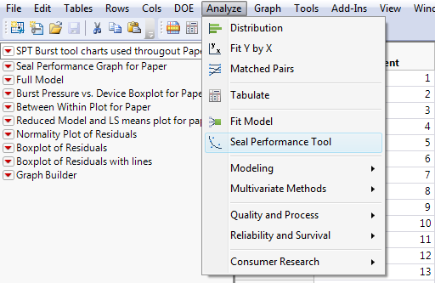
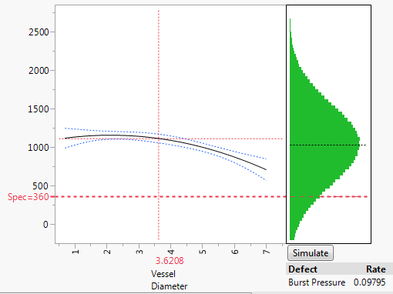
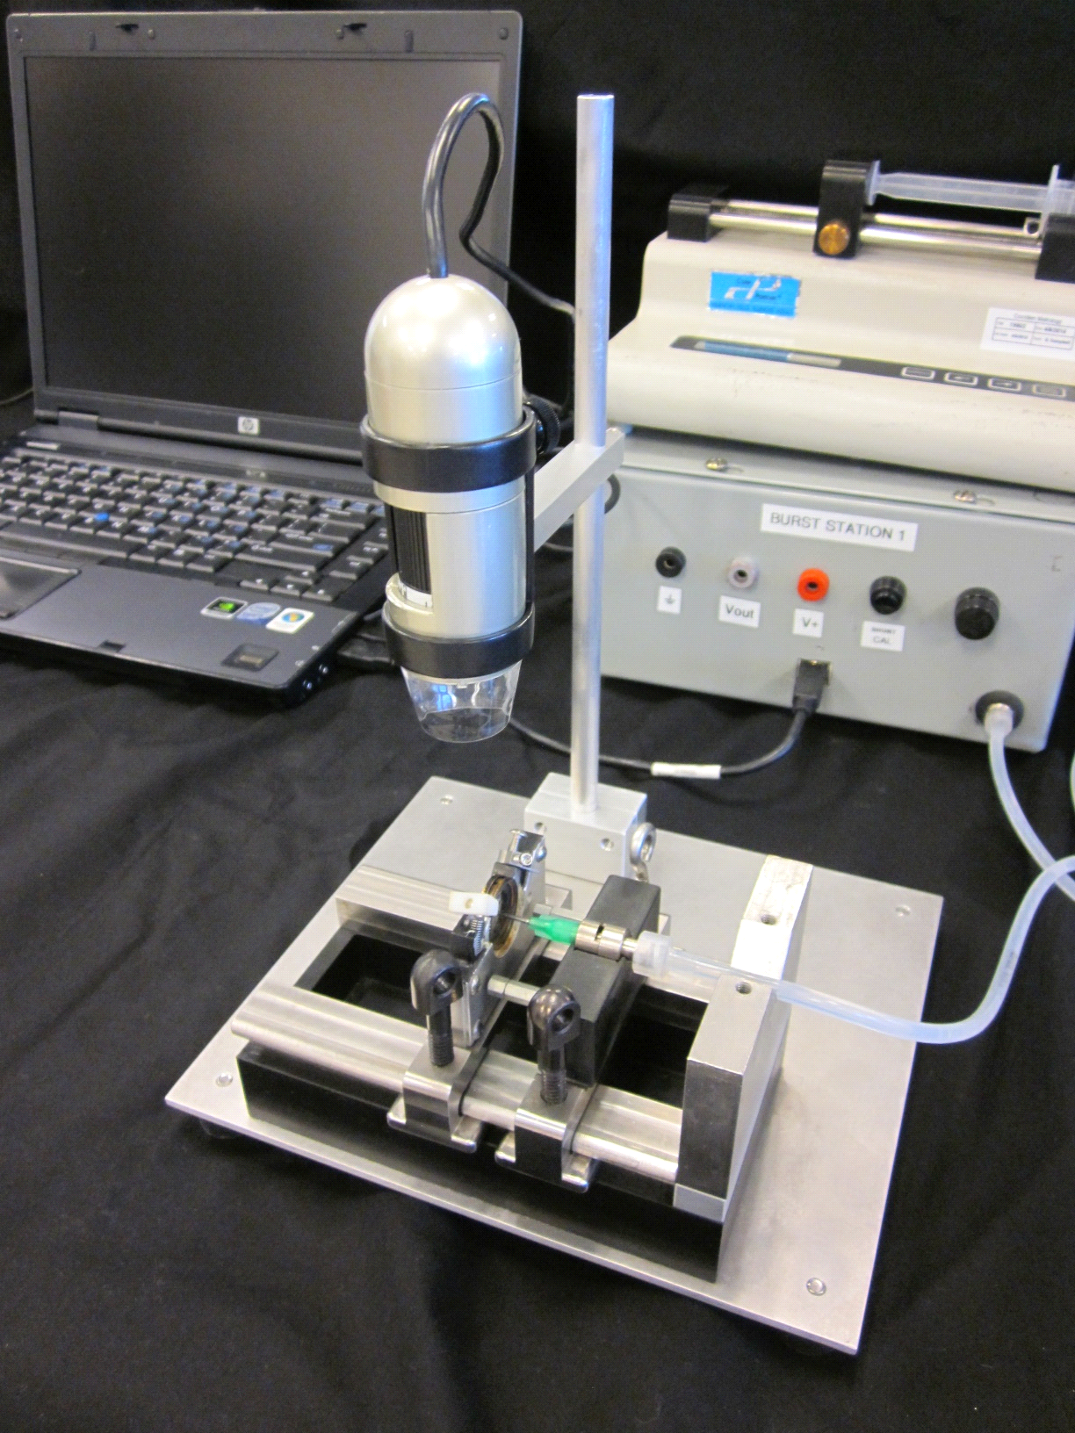
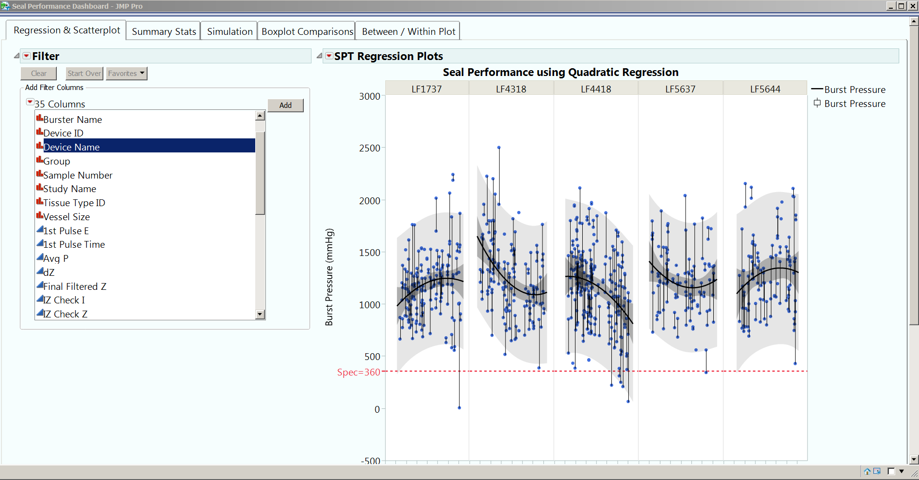

Comprehensive Analysis of Performance Data for Energized Vessel Sealing Devices Using JMP® Pro 12.0
Jim Pappas, Susan Roweton, and J. Bruce Dunne
Tissue Effect Research, Surgical Innovations, Advanced Energy & Stapling, Medtronic, Boulder, Colorado
Abstract
Experimental Methods
Analysis Methods
Burst pressure is a key performance characteristic associated with the development of safe and effective energy-based vessel sealing devices. This performance characteristic is determined by known and unknown variables and include:
Device-to-Device variability
Vessel diameter and associated tissue properties
Electrical parameters (defined by device generator algorithms )
Using JMP® Pro 12.0, a comprehensive analysis approach has been developed that has enhanced the understanding of variables key to optimizing device performance.
Vessel Sealing and Data Capture
Seals created on ex vivo porcine renal arteries.
Seal Performance Dashboard
Created using JSL to facilitate quick analysis of performance data for project teams.
Burst Testing
Benefits
Syringe pump
Computer running BurstLogger software
Encourages the use of ALL the data captured during a vessel sealing study.
Enables an assessment of device reliability over the full range of vessel diameters using graphical analysis combined with simulation models.
Incorporates multiple factor models to develop a more comprehensive understanding of seal performance and the associated sources of variability.
Provides for a more sensitive and accurate comparison of device efficacy between groups as compared to other, more simple methods.
Reduces samples by utilizing models to estimate burst probabilities (< 600mmHg)
Helps find and resolve potential problems early in product development.
DynoLite™ camera
Sample holding fixture
Sealed vessels infused with saline at constant rate until seal failure occurs

Slide 2
Comprehensive Analysis of Performance Data for Energized Vessel Sealing Devices Using JMP® Pro 12.0
Jim Pappas, Susan Roweton, and J. Bruce Dunne
Tissue Effect Research, Surgical Innovations, Advanced Energy & Stapling, Medtronic, Boulder, Colorado
Analysis Methods
Results
Results
Model Building
Created using JSL to facilitate quick analysis of performance data for project teams.
Variance Components
Ability to assess contributions of individual variables to overall variability.
Comparison of Groups
Comparison to predicate and/or competitive devices.
Random Effect | Group 1 | Group 2 | LF1637 | LF1737
Device within Group (s²_{device} ) | * | 23870 (12%) | * | *
Between Seals (s²_{seal event} ) | 113909 (56%) | 79380 (41%) | 48823 (43%) | 105195 (70%)
Within Seals: Residual (s²_{residual}) | 90468 (44%) | 92013 (47%) | 64307 (57%) | 46066 (30%)
Total Variability (s²_{total}) | 204377 (100%) | 195263 (100%) | 113130 (100%) | 151260 (100%)
Source | Degrees of Freedom | F Ratio | Prob > F
Group | 3 | 52.15 | <0.0001
Vessel Diameter Category | 3 | 11.23 | <0.0001
Group * Vessel Diameter Category | 9 | 9.69 | <0.0001
$$Y_{i,j,k,l,n}=μ+G_{i}+D_{j}\left(G_{i}\right)+V_{k}+{(GV)}_{i,k}+S_{l}\left(G_{i}D_{j}V_{k}\right)+ε_{i,j,k,l,n}$$
Y_{i,j,k,l,n} = Burst
µ = Grand Mean
G_{i} = Effect of i^{th} Group (Fixed Effect: G1, G2, G3, etc.)
D_{j} = Effect of j^{th} Device within Group (Random Effect: D1, D2, D3, etc.)
V_{k} = Effect of k^{th} level of Vessel Diameter Category (Fixed Effect: Small, Medium, Large, Extra Large)
(GV)_{i,k} = Effect of Group*Vessel Diameter Category Interaction
S_{l} = Effect of l^{th} Seal Event within treatment combination (Random Effect)
n = 1, 2 as there are 2 replicates per seal event (i.e., 2 sides) for bust
ε = random component for experiment / residual error

Slide 3
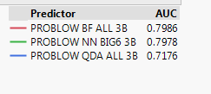
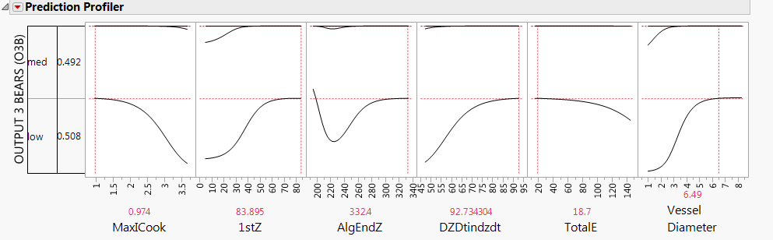
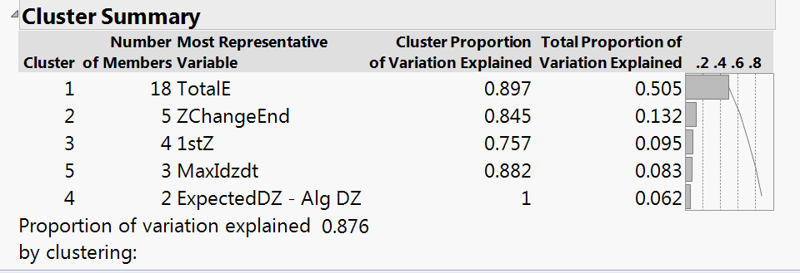
Comprehensive Analysis of Performance Data for Energized Vessel Sealing Devices Using JMP® Pro 12.0
Jim Pappas, Susan Roweton, and J. Bruce Dunne
Tissue Effect Research, Surgical Innovations, Advanced Energy & Stapling, Medtronic, Boulder, Colorado
Next in Line: Predictive Models
Methods
Results
Reduction of Dimensionality
Addressing multicollinearity among electrical parameters using Principal Components Analysis (PCA).
Model Exploration
Numerous approaches used with validation:
Partial Least Squares (PLS)
Neural Nets
Discriminant Analysis
Partitioning: Decision Tree, Bootstrap Forest, Boosted Tree, K Nearest Neighbors
Targeted classification models that used attribute response for burst and estimated probability Burst Pressure < 600mmHg.
Model Comparison
JMP® Pro 12.0 allowed the comparison of various models. Prediction Profiler is a valuable tool for investigating the impact of factor settings on burst performance.
Next Steps
Development of a database that can easily be uploaded into JMP Pro for analysis.
Validate models with additional experimental data.
Identify additional potential factors that further improve model predictions.
JSL Scripts similar to the Seal Performance Tool that illustrate relationships between electrical parameters, tissue parameters, and, ultimately, burst pressure.

Slide 4



Slide 5


Slide 7


