Slide 1

Query Builder to Introduce SQL
JMP Discovery Summit
St. Louis MO | October 18, 2017
1:15 – 1:45 pm

Slide 2

Context: Undergraduate “Intro Stats” Course
What to pack?
Descriptive Statistics
Elementary probability
Probability distributions
Study Design/ DOE
Data Collection
Inference
  Tests
  Estimation
  Model fitting
Technology
Notes:
Buddy movies….

Slide 3


Context: Undergraduate “Intro Stats” Course
“Analytics”
“Big Data”
Internet of things
More Open Data
  Three V’s
  Many sources
  Many formats
Visualization
Notes:
Buddy movies….

Slide 4

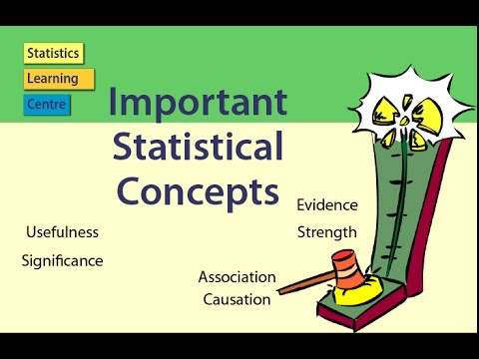
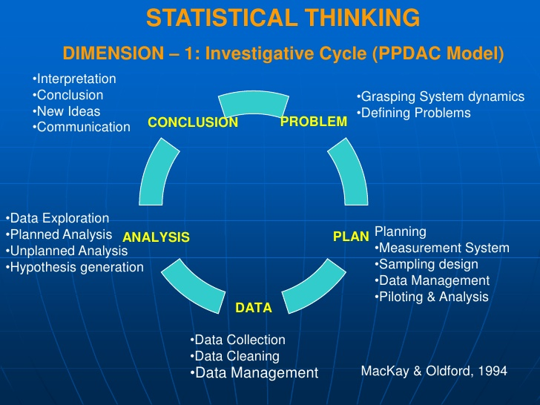

Context: Undergraduate “Intro Stats” Course
Teach Statistical Thinking
  Full investigative process
  Multivariate thinking
Concepts > Procedures
REAL DATA in context
Active Learning
Technology to
  Explore Concepts
  Analyze Data
Assessments to improve & evaluate learning
Notes:
Buddy movies….

Slide 5

Context: Undergraduate “Intro Stats” Course
Teach Statistical Thinking
  Full investigative process
  Multivariate thinking
Concepts > Procedures
REAL DATA in context
Active Learning
Technology to
  Explore Concepts
  Analyze Data
Assessments to improve & evaluate learning
Notes:
Buddy movies….

Slide 6
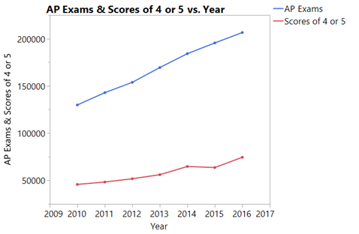
Incoming Students Know something…

Slide 7
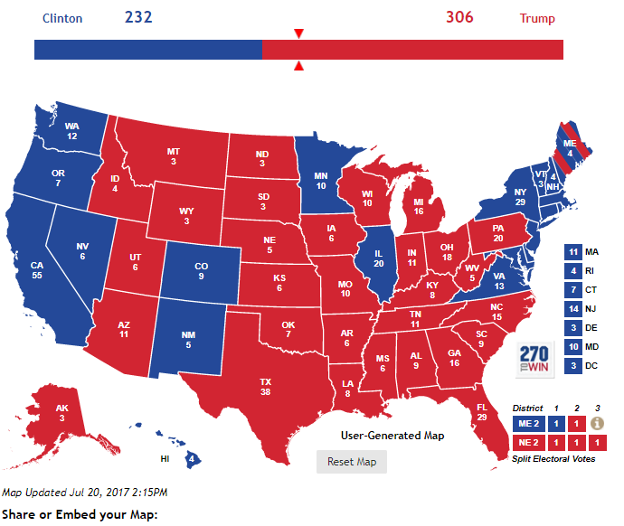

A GAISE-Worthy Task
How hard is it to create an accurate predictive model?

Slide 8
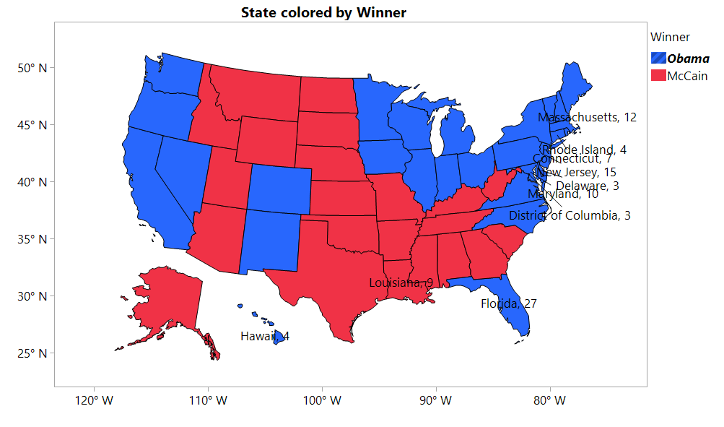
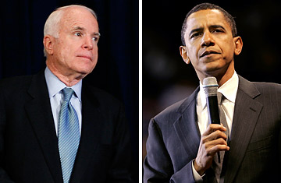
A Related GAISE-Worthy Task
(with Sample Data)
How hard is it to create an accurate predictive model?

Slide 9
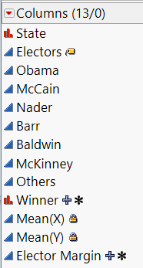
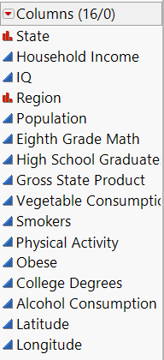
Available Data Easily at Hand
US Election 2008
US Demographics

Slide 10
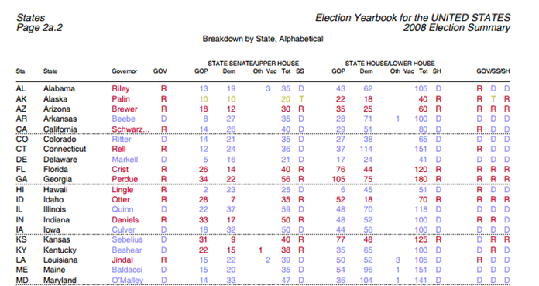
Can supplement with data from other sources
www.polidata.org

Slide 11
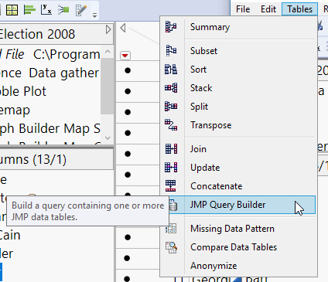
Query Builder is a great platform to introduce database concepts & SQL
The layout of the launch windows prefigures SQL logic
Gently introduces
  Keys
  Joins
  Select
  Filter (where)
  Order by

Slide 12
Now on to the Demo…
DEMO
The following slides are included in case of demo disaster

Slide 13
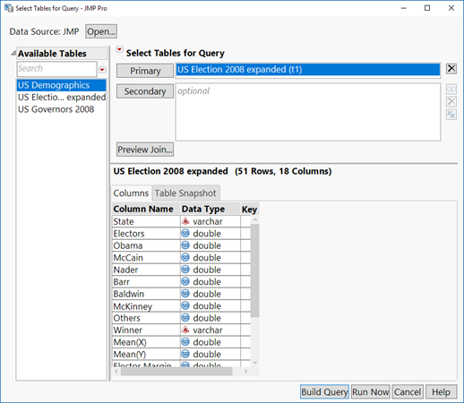
DEMO
Query Builder
  Choose tables
  Preview available columns

Slide 14
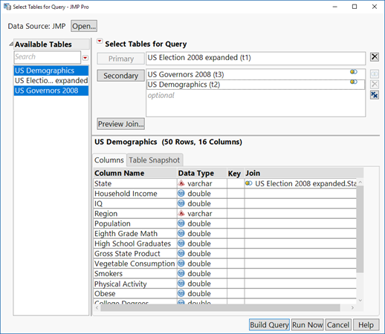
DEMO
Query Builder
  Choose tables
  Preview available columns
  Preview proposed JOIN

Slide 15
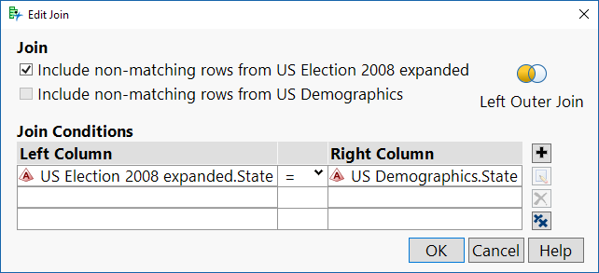
DEMO
Query Builder
  Choose tables
  Preview available columns
  Preview proposed JOIN
  Ability to revise the join conditions

Slide 16
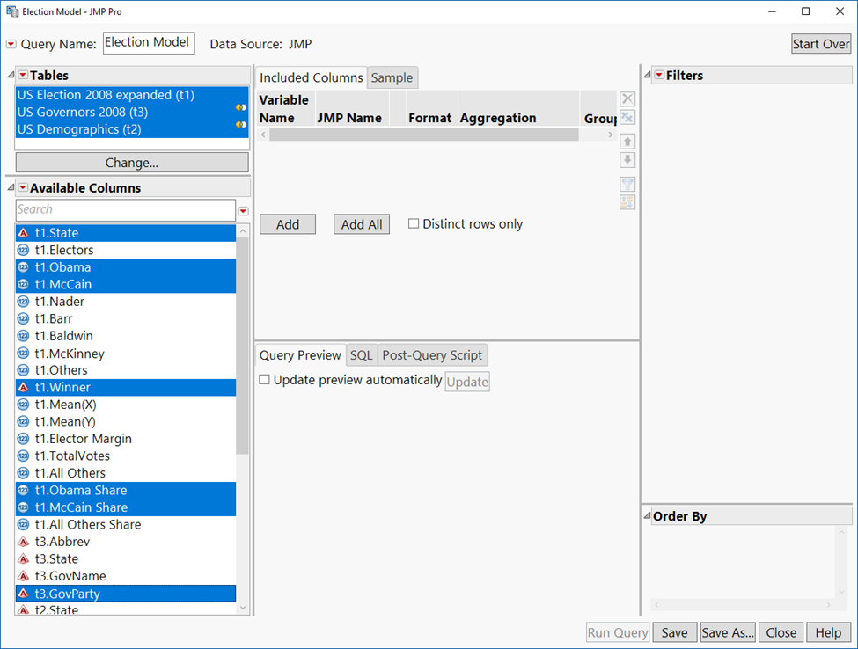
DEMO
Query Builder
  Name the Query
  Choose columns to
  select

Slide 17
DEMO
Query Builder
  Name the Query
  Choose columns to
  select
  Included Columns

Slide 18
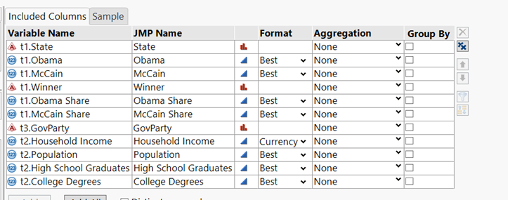
DEMO

Slide 19
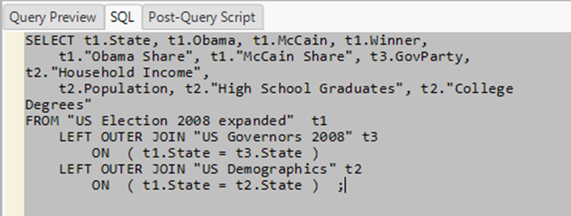
DEMO
Query Builder: Inspect the SQL code

Slide 20
Demo conclusion – final thoughts/ Q&A

Slide 21


Conclusion
We can pack more than we thought…
Query Builder is just one platform that undergrads can handle
JMP can teach concepts

Slide 22
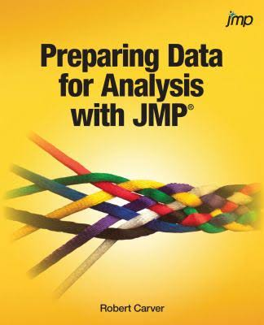
DISCUSSION (and a plug)
Comments
Questions
Suggestions

Slide 23
Contact info:
rcarver@Stonehill.edu
rcarver@brandeis.edu

