Slide 1
Developing Health Care Case Studies with JMP®
Overcoming Hurdles
Mary Ann Shifflet and Jane Oppenlander
University of Southern Indiana, Clarkson University
Demand for analytics
  Government mandate to collect data to find opportunities to contain health care costs
  Health care professionals need to engage in self-service analytics
  Global health care analytics market projected to grow to $42.8B by 2024
  Analytics is highest priority in the industry
  “analytics is a prerequisite for all of the major initiatives currently underway to address value-based care” Dan Burton Health Catalyst CEO
Application areas
Health Care
Clinical
Patient Management
Financial Management
Operations

Slide 2
How Do We Meet the Need?
Provide relevant curriculum that includes real world applications to train:
  Statisticians and data scientists
  Health care analysts and administrators
  Physicians and nurses
  Related service providers (e.g., physical and occupational therapists, pharmacists)
Case studies are valuable for students to learn how to apply statistical methods to solve data-driven health care problems.
JMP working group developing health care quality case studies for classroom and self-study use.

Slide 3
Benefits and Challenges of Using Case Studies in the Classroom
Best Practices in Statistics Education¹ | Benefits/Challenges
Use real data | Open source patient level data difficult to obtain Patient privacy concerns Available data often highly aggregated Teaching data management skills
Foster active learning in the classroom | Case studies foster student discussion Case studies replicate real life problems
Use technology for developing conceptual understanding and analyzing data | JMP offers many visualization and analysis tools JMP contains a collection of quality tools
Teach statistics as an investigative process of problem-solving and decision-making. | JMP facilitates focus on problem solving rather than coding and calculation Need authentic health care quality stories to provide context Provide technical background and terminology
¹Guidelines for Assessment and Instruction in Statistics Education 2016 College Report

Slide 4
Case Study Structure and Usage
Structure:
  Background
  Task
  Data and Data Management
  Analysis and JMP Instructions
  Summary and Table of Concepts and Tools
  Exercises and Discussion Questions
Topics covered:
  Data visualization
  Descriptive statistics
  Control charts
  Comparative analysis
Usage:
  Instructor – in class or online
  Practitioners
  Students
  Highlight specific statistical topics
  Highlight specific JMP tools
  Emphasize statistical thinking

Slide 5
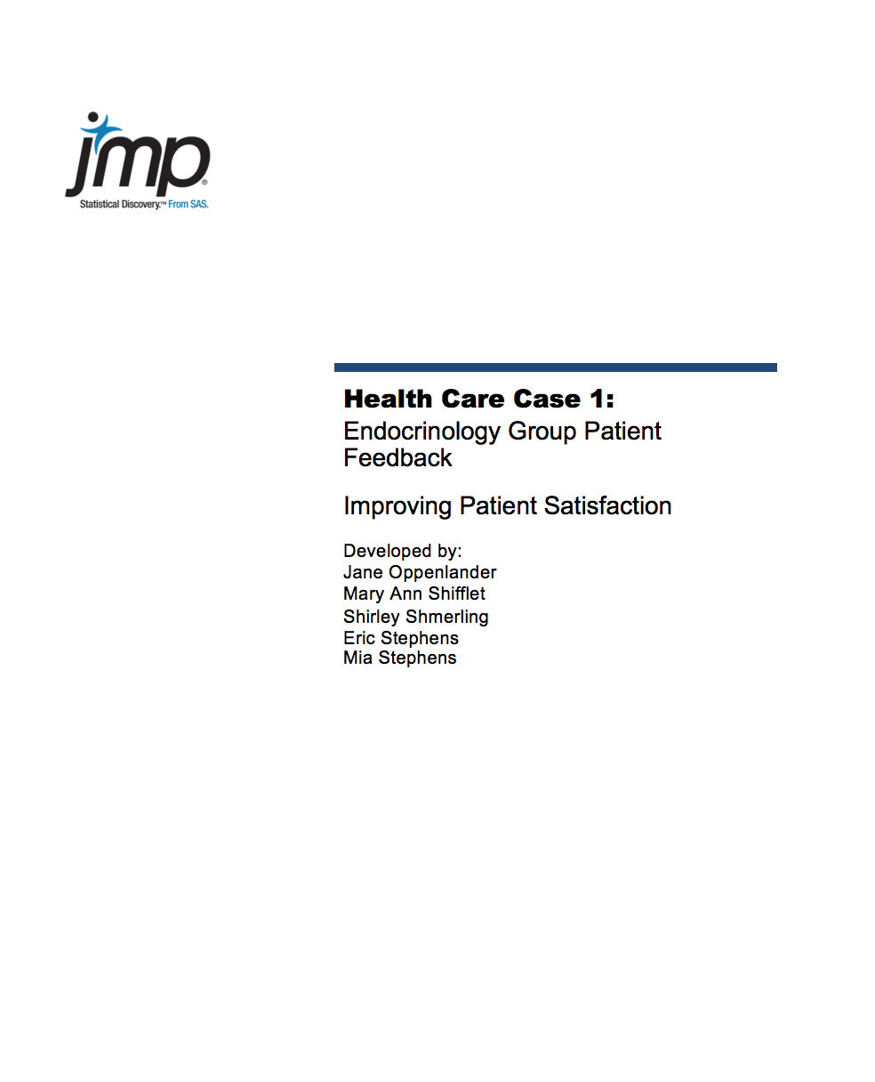
Example Case: Endocrinology Group Patient Feedback
Synopsis:
A practice seeks to improve patient satisfaction by collecting and analyzing survey data and identifying changes in office operations.
Statistical Methods/Tools | Data Management Tasks/Concepts | JMP Platforms/Features | Quality Tools
Bar Charts | Import Excel Spreadsheet | Distribution Platform | Pareto Chart
Run Charts |  | Graph Builder | Voice of the Customer
Histograms |  | Tabulate
Scatterplots |  | Multivariate Methods
Summary Statistics
Correlations

Slide 6
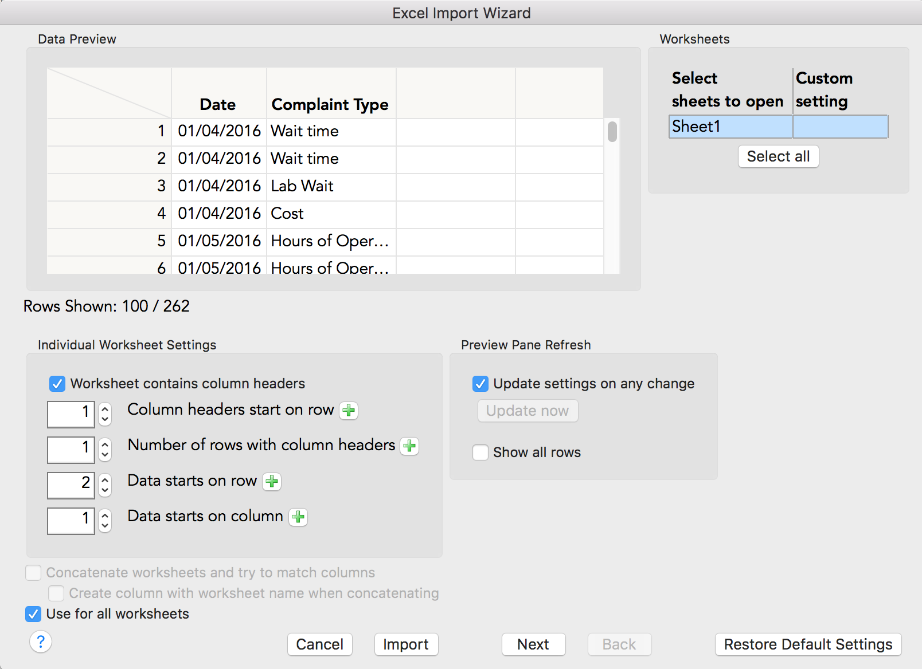
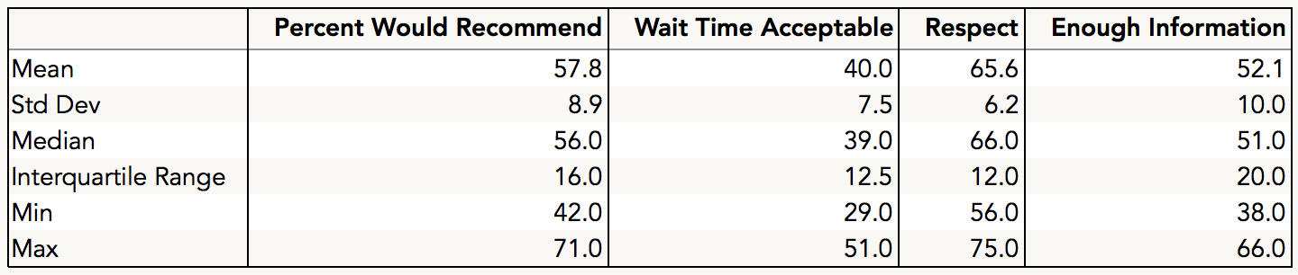
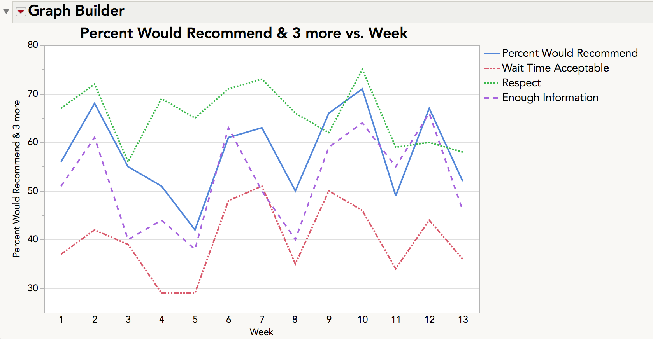
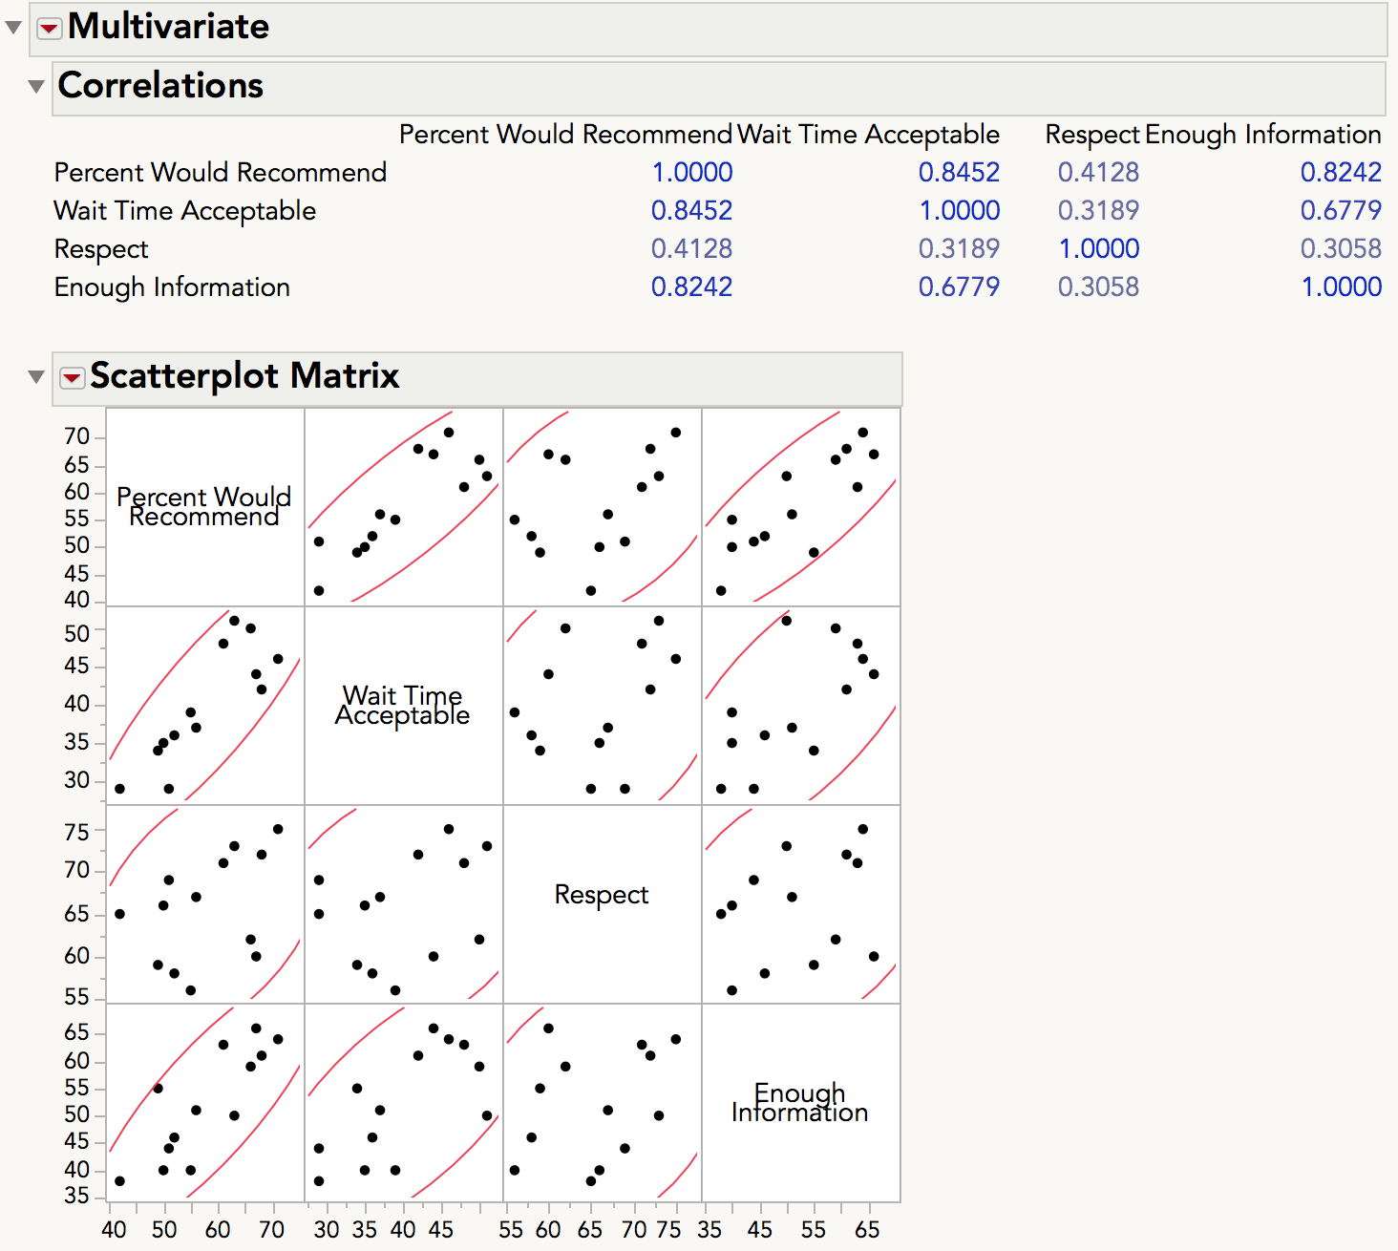
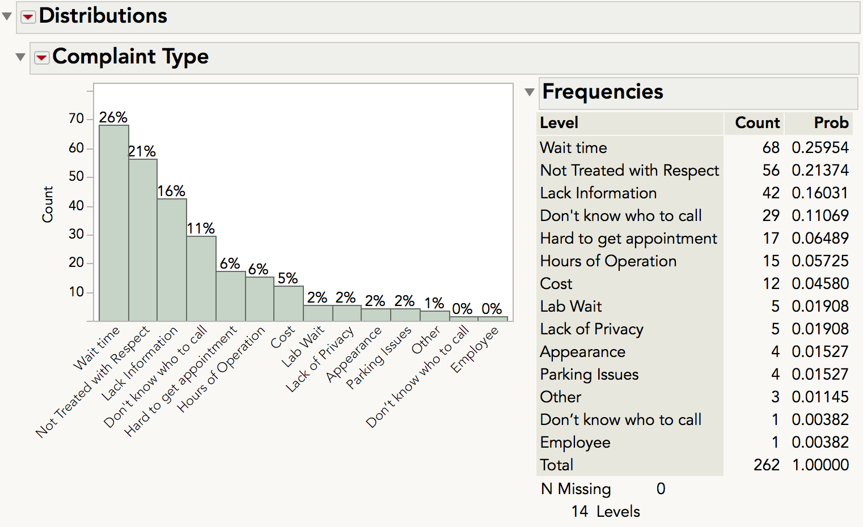
Example Case (Continued)

Slide 7
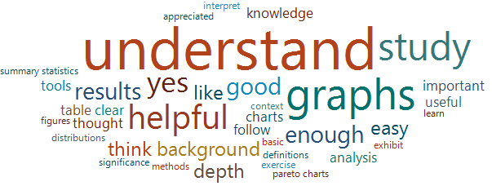
Classroom Pilot Testing Feedback
Pilot tested in an on-line introductory MBA statistics course.
Evaluation Questions:
  Is there sufficient depth/explanation of statistical and quality concepts?
  Are the JMP instructions adequate?
  Is there sufficient background and context for the case?
  How does the case flow?
  Are the problems at the end useful for learning? Are they at an appropriate level of difficulty?

Slide 8
Status, Recommendations and Future Actions
Case studies posted at www.jmp.com/cases
Cases under development
  Variation in the cost of hip replacements in New York State
  Reducing Cesarean sections in Illinois
  Improving in-patient safety through diabetes management
  California hospital emergency department ambulance diversions
For teachers
  Share feedback from classroom use
Collaboration between practitioners and academia
  Make realistic health care scenarios available
  Share HIPAA compliant datasets
  Provide feedback on applicability/usefulness of cases

Slide 9
References and Contact Information
References
  Grandview Research
    http://www.grandviewresearch.com/press-release/global-healthcare-analytics-market
  Health Catalyst
    https://www.healthcatalyst.com/news/analytics-outweighs-accountable-care-population-health-icd-10-as-an-it-priority-say-health-system-execs/
  Oppenlander, J. E. and P.A. Schaffer, Data Management and Analysis Using JMP: Health Care Case Studies, SAS Press, 2017.
Contacts
  Jane Oppenlander – joppenla@clarkson.edu
  Mary Ann Shifflet – mshifflet@usi.edu

