Slide 1



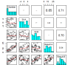
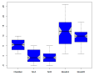
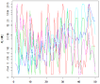


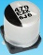
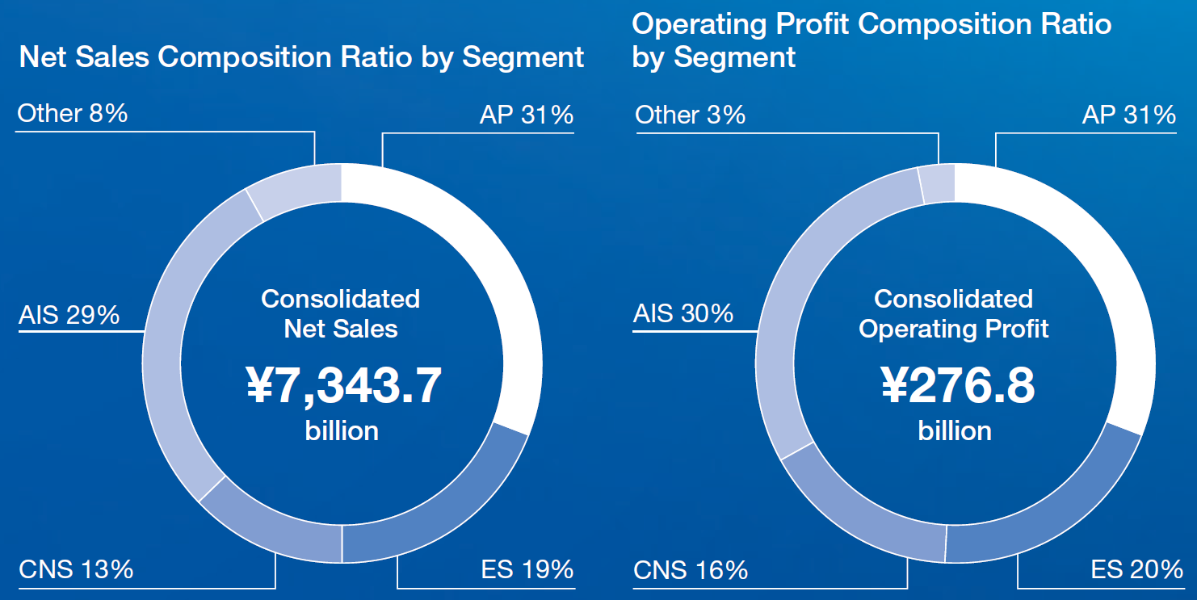
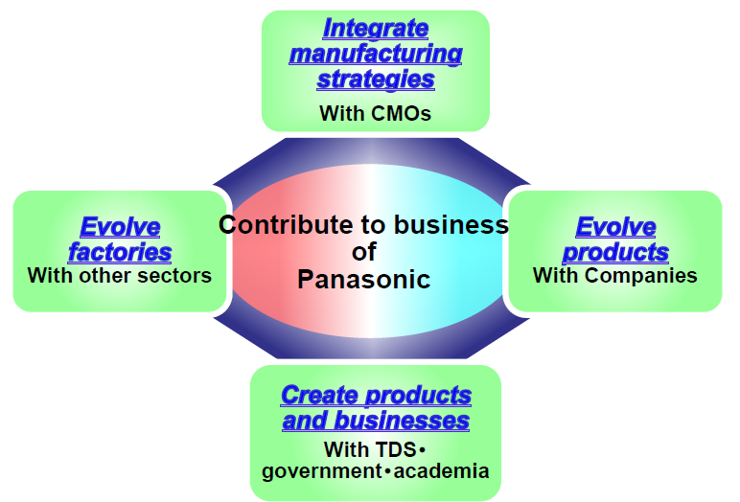
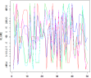

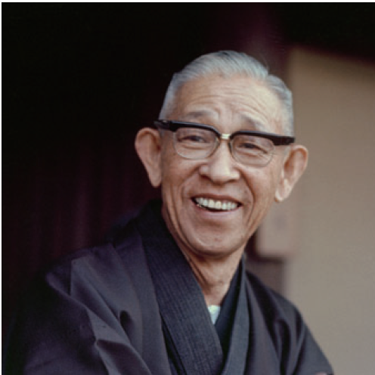
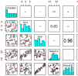
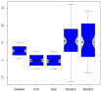


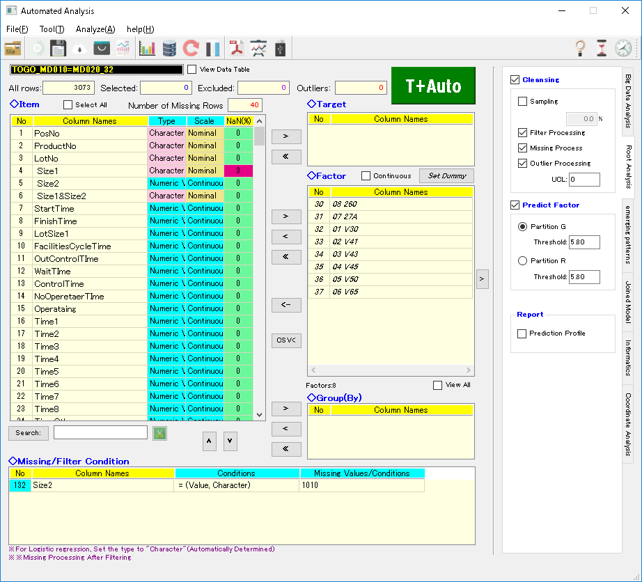
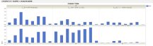
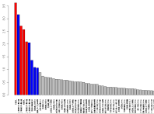
JMP® Applications for Utilizing Big Data on Manufacturing
¹ Nobuo Hara, ² Kouichi Kanematsu
1: Panasonic Corporation, 2: SiM24 Co., Ltd
#Contact e-mail: hara.nobuo@jp.panasonic.com
Technology
Ｂｅｆｏｒｅ
■ Data Management(S.E. or Commercial)
■ Data Analysis(Only Visualize)
Slow
Response
to Changes
Principal Verification | Advanced Development | Mass Production Verification | Industrialization
●System Engineer
Target Area/Product
Japan | America | China
Business Contribution
Big
Data
Analysis
System
High
Cost
Process Process
A ・・・ X
8/7
：
9/8
Management items: Many
Difficult to
continue operation
Difficult to
Understand the entirety
Products for EV
Others
Founder
Konosuke Matsushita
Our Business
Our Department
Target Process
Trend change：Small
Cylindrical Large square type
Li Battery
Capacitor
●Commercial Analysis Tool
Difficult
Method
Big
Data
Difficult
Connection
Analysis：Individualization
Difficult to
Judge
Ａｎｏｔｈｅｒ
ＥＴＬ S/W
Analysis
System
LED panel
Lettuce
Target Process
Benefit
◆Data Management Module(ETL developed in-house)
Ａｆｔｅｒ
Easy connection to several types of DB servers , instantly evaluation by some edit wizards(Non Programming).
■ Data Management(General-purpose I/F)
■ Data analysis(Diagnosis report)
◆Data Analysis Module(Powered by JMP, Python and so on)
1-click solutions to Anomaly detection system & Forecast management (Non data analyst).
Unified management
Seamless
I/F
Analysis
No Column Names Effect
00 27A_FA111 Failure Rate
Use case
Big
Data
This
System
Analysis
System
①Traceability
②Quality analysis
(Visualize, Factor analysis)
③Prediction management
Anomaly detection
Equipment
Failure
Lot Segment
Management
Material
Machine
Man
Measure
Market
Measured
Importance
Target
Process
Big
Data
Extract
Compare
F.B. or F.F.
Easy to understand the entirety
Analysis
ー
Target Process
Easy Settings
Product
Deficiency
Outputs
Search
Prediction formula
Directly Connected
to the Action
ｆ（x1,x2,x3,..）
Process Survey
Analysis
Ｎσ
Modeling
Specification
T
Factor

