Slide 1
Building a Set of Statistical Tools with Scripting in JMP
Sean Hardy – Biostatistician Sr., IDEXX Laboratories, Inc.

Slide 2
Contents
Purpose
Basic JMP Tool Building Blocks
Basic Tool Building Walkthrough

Slide 3
Purpose
Section I:

Slide 4
Why might we want specialized tools?
Ease of use
Controlling the output
Directly answer the question the user is trying to ask

Slide 5
EXAMPLE:
Comparison of Two Diagnostic Tests

Slide 6
Brief Overview of Analysis/Business Need:
You have two diagnostic tests, test A and test B, looking to detect a certain disease.
You have N₁ independent subjects with known true disease status, and N₂ independent subjects with known healthy status.
Use test A and test B on each subject, and compare the results.
Which test has better Sensitivity (% of diseased subjects accurately identified)?
Which test has better Specificity (% of healthy subjects accurately identified)?

Slide 7
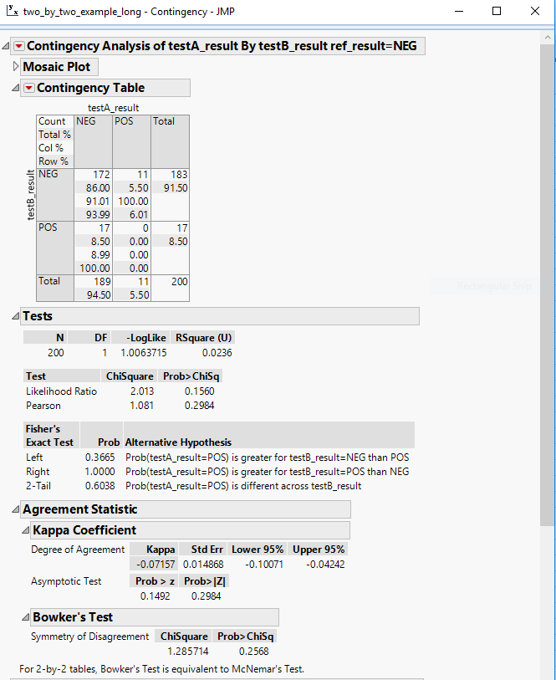
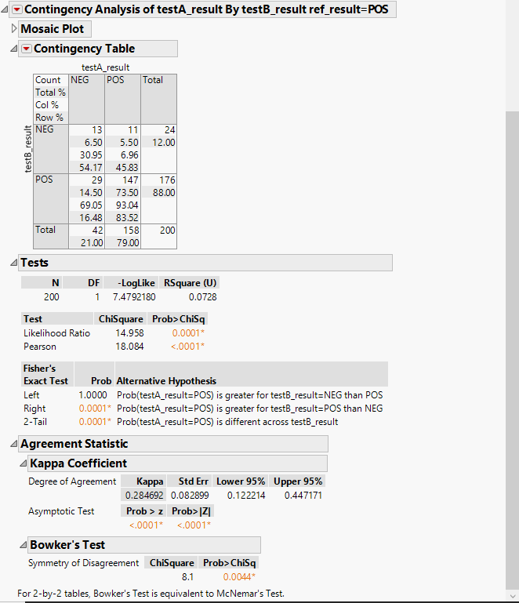
Using JMP, Results for using “Fit Y by X”:

Slide 8
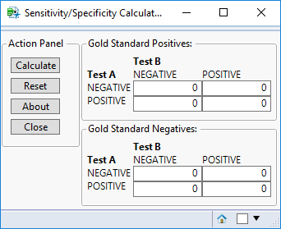
Example Tool – Brief Live Demo

Slide 9
Basic JMP Tool Building Blocks
Section II.

Slide 10
Basic JMP Tool Building Blocks
Expressions
Organizational Boxes
  V List Box
  H List Box
  Panel Box
Visual Interface Boxes
  Text Box
  Button Box
  Number Edit Box
  Column List Box

Slide 11
Basic JMP Tool Building Blocks
Window
H List Box

Slide 12
Basic JMP Tool Building Blocks
Window
H List Box
V List Box

Slide 13
Basic JMP Tool Building Blocks
Window
H List Box
V List Box
Panel Box

Slide 14
Basic JMP Tool Building Blocks
Window
H List Box
V List Box
Panel Box

Slide 15
Basic Tool Building Walkthrough
Section III.

Slide 16
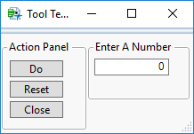
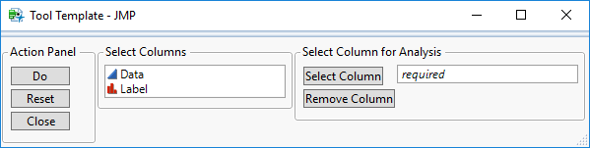
Basic Tool Building Walkthrough – Two Examples
SQRT Tool
Use your own formulas and number entry
DIST Tool
Use columns from a data set and a specific analysis from JMP

