Slide 1
The Fun Part: My Favorite Things
JMP 14 – Mandy Chambers, Principal Test Engineer

Slide 2






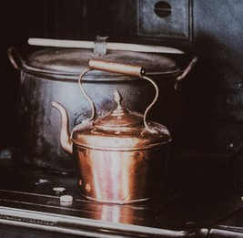


.. My favorite things …

Slide 3










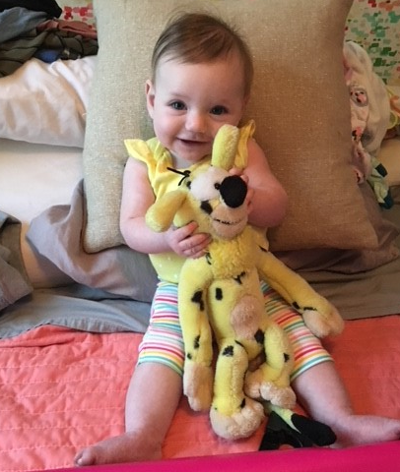



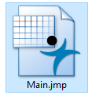
Mandy Loves JMP & other LOVES!
Jeff
Christmas
Family
Grayson
Palmer
UNC
Beach..turtles

Slide 4
JMP 14 Favorites
Multiple file import loads a single data table, or a collection of data tables, with just a few clicks
Virtually joined tables now allow shorter column names from the link referencing columns, and row state synchronization
Projects provide a single document interface to JMP, and allow easy navigation of open windows, data tables, scripts and more
Recode has been improved and its interface has had a tune up
Data filters are more shareable among linked subsets or by groups
Local Data filters have been expanded so they are accessible to all the linked subsets
Data table features in JMP 14 are new and improved
- Grouping table scripts and nesting them
- Column images as markers
- Select duplicate rows added to the rows menu
- Labels to Codes/Codes to Labels added to the columns utilities menu
- Event handler column property added to provide links in data table
Multiple File Import
Virtual Join enhancements
Projects
Recode
Data filter & Local Data filter enhancements
Data Table features

Slide 5
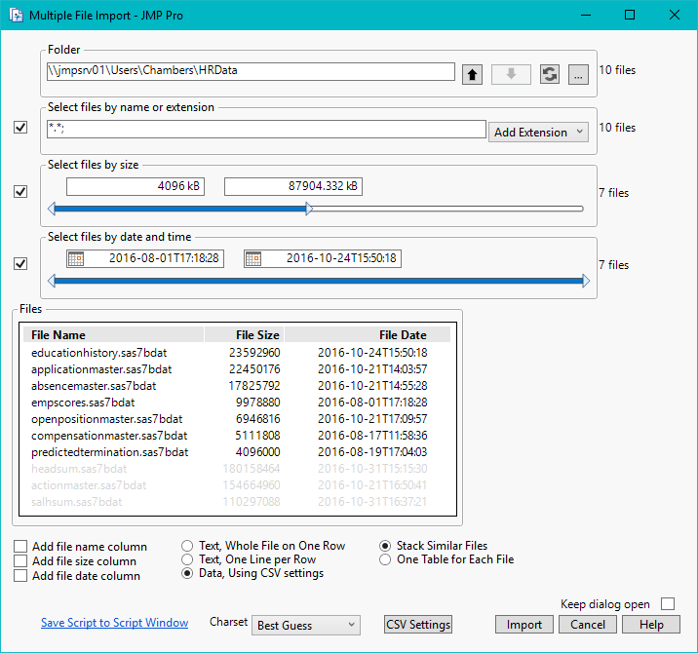

Multiple File Import
Specify import options, filter files by specific criteria, and import to a single column (great to use with Text Explorer)
or into a multi-column table. This new feature also writes table scripts in the tables it creates, for reuse later.

Slide 6
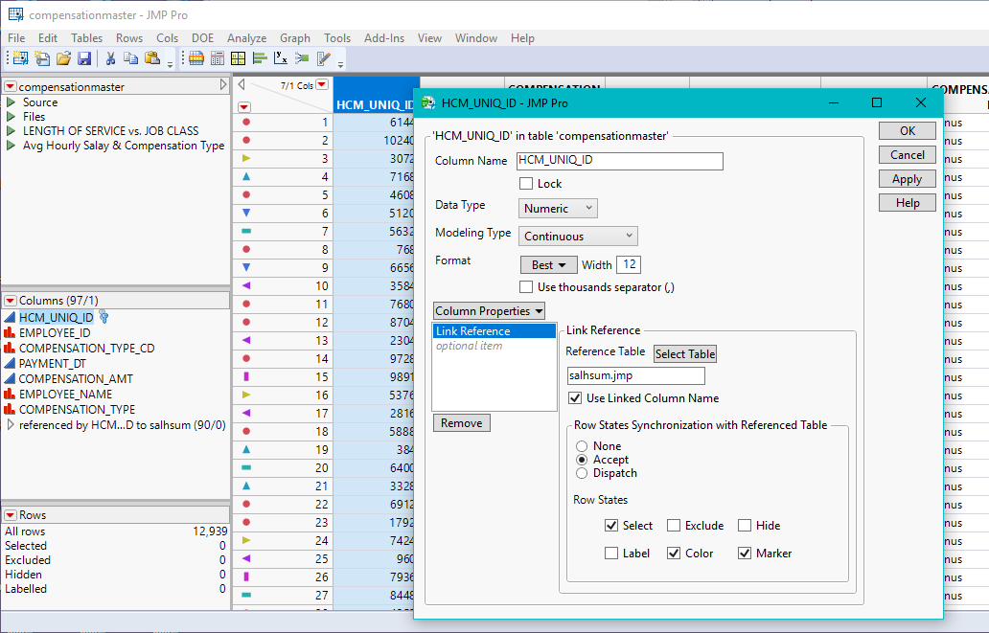

Virtual Join
Set Property(
"Link Reference",
{Reference Table( "salhsum.jmp" ), Options(
"Use Linked Column Name"(1),
Row States Synchronization with Referenced Table(
Accept( 1 ),
Row States( Select, Color, Marker )
) )} );
Data table column names can now be made shorter when linking virtually joined tables together,
making reports and graphs with shorter titles and axis labels. Row state synchronization has been added for setting up the link reference columns so you can accept or dispatch row states between data tables.

Slide 7

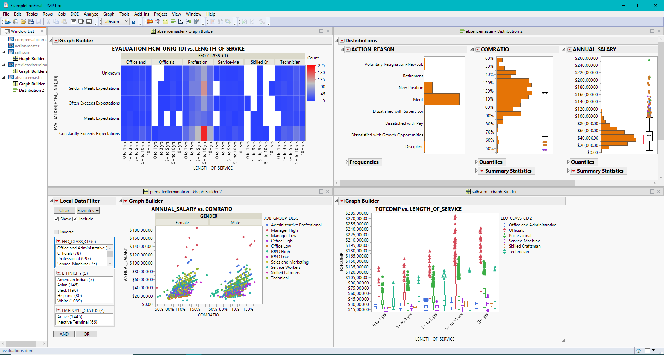
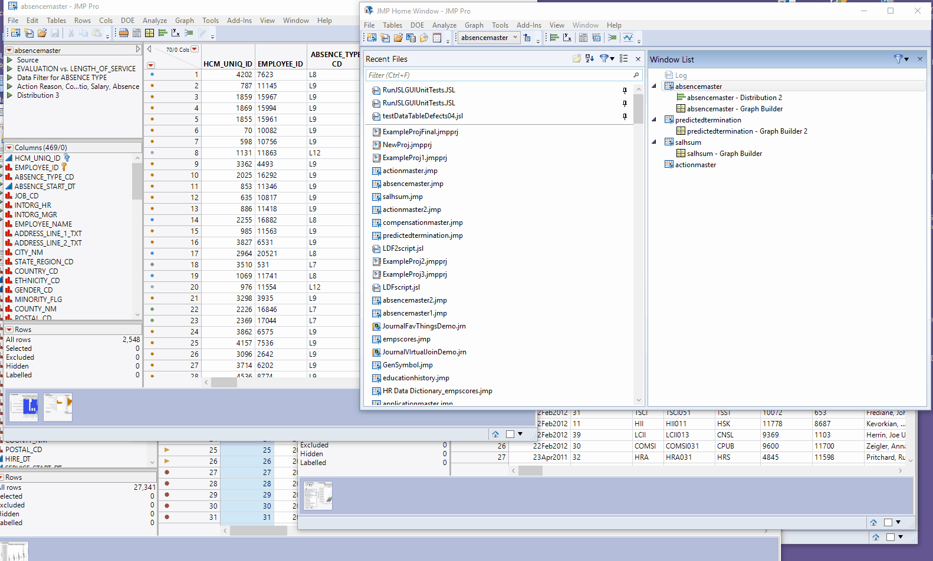
Projects
Projects can be used to quickly open and close many files associated with one or more individual analysis you may be working on at the same time, eliminating the need to run multiple JMP sessions.

Slide 8
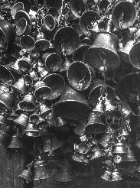
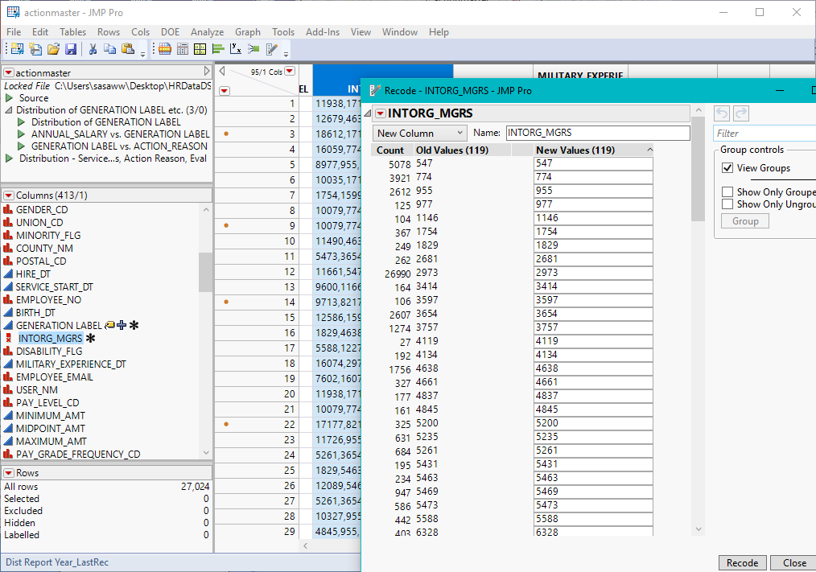
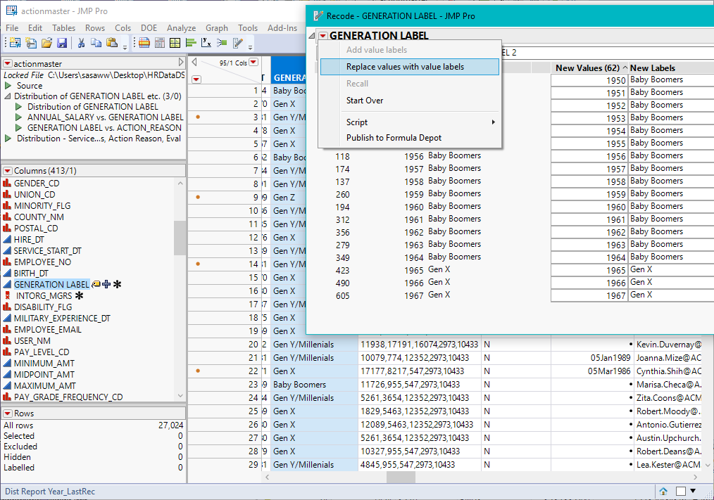
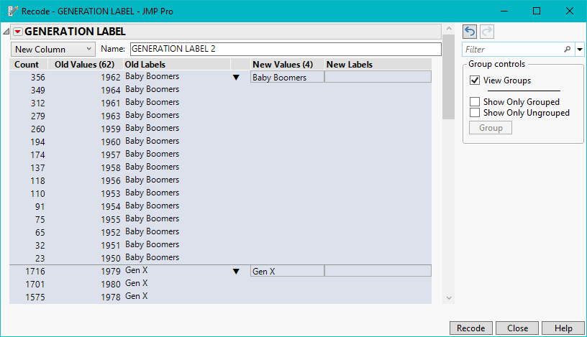
Recode
Recode now supports multiple response data, value labels and regular expressions.
Multiple Response column & Value Labels

Slide 9
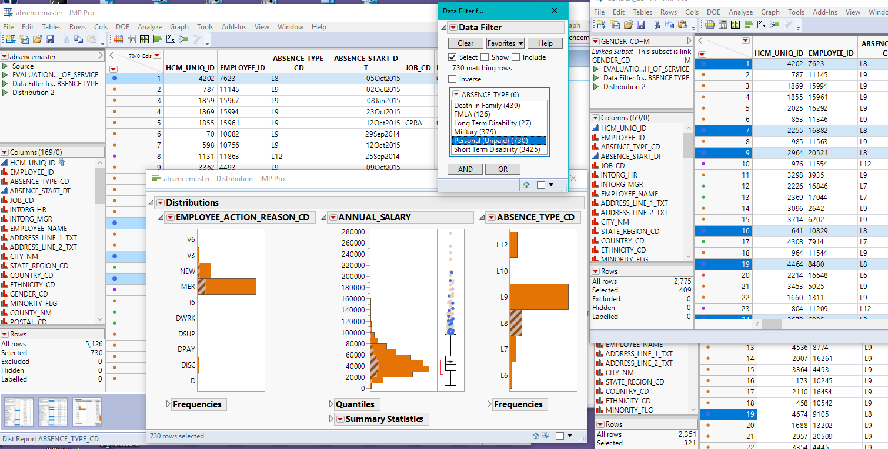

Data Filter
Data filters are more shareable among linked subsets or by groups
dt=Open("absencemaster.jmp");
subsets = dt << Subset(By(:GENDER), link to original data table(1));
..dog bites..

Slide 10
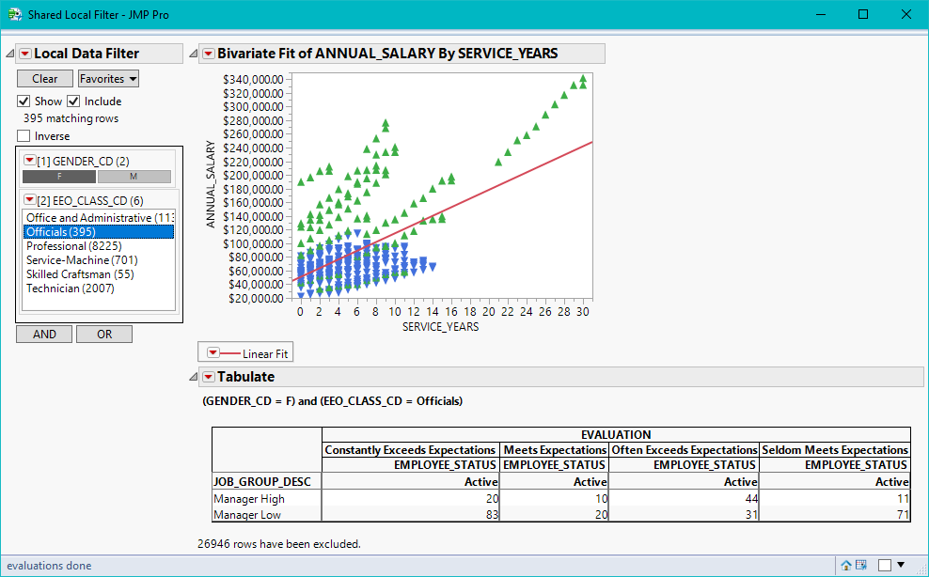

Local Data Filter
Local data filters have been expanded so they are accessible to all the linked subsets.
dt=Open("salhsum.jmp");
New Window( "Shared Local Filter",
Data Filter Context Box(
H List Box( dt <<
Data Filter( conditional, Local,
Add Filter( columns( :GENDER_CD, :EEO_CLASS_CD ) ) , etc…
..ouch!

Slide 11

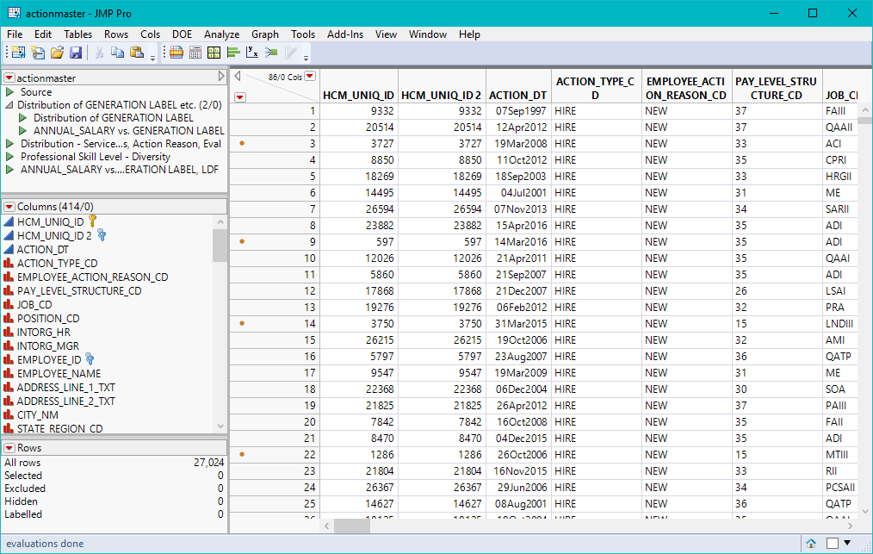
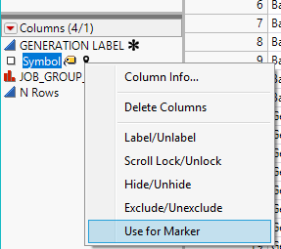
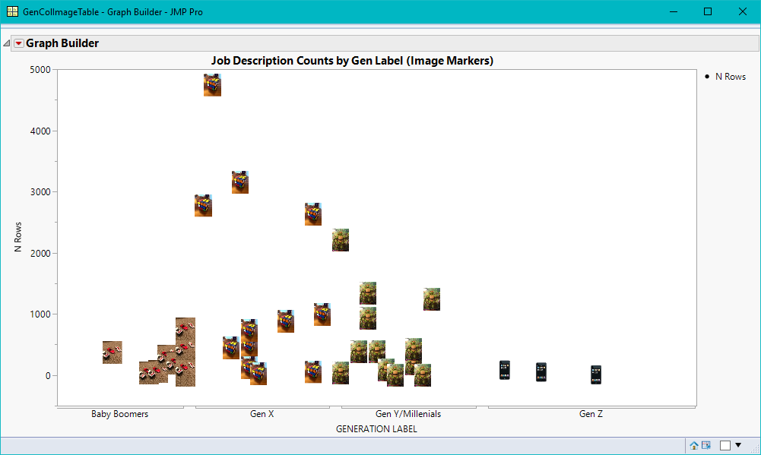
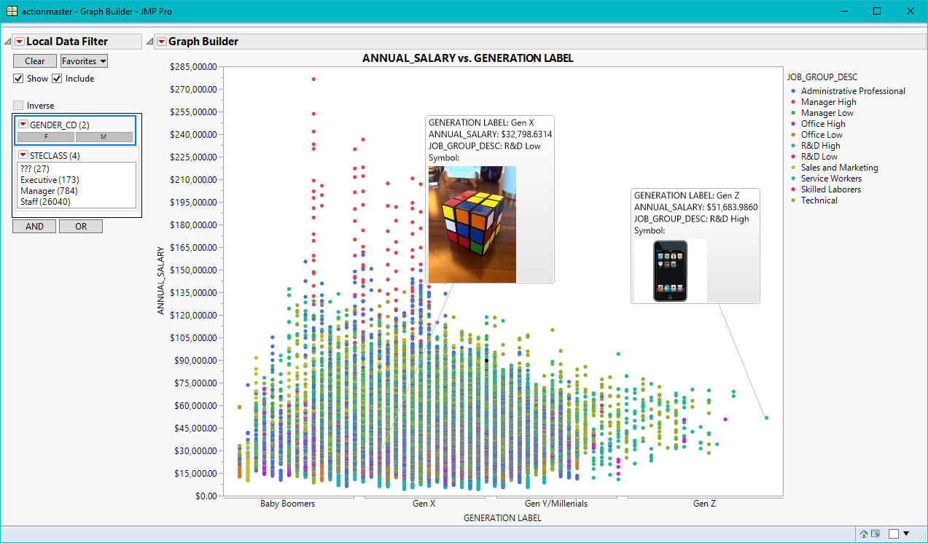
Data table features
Grouping table scripts and nesting them allows for better organization.
Column images as markers provide the ability to associate pictures with data points.

Slide 12
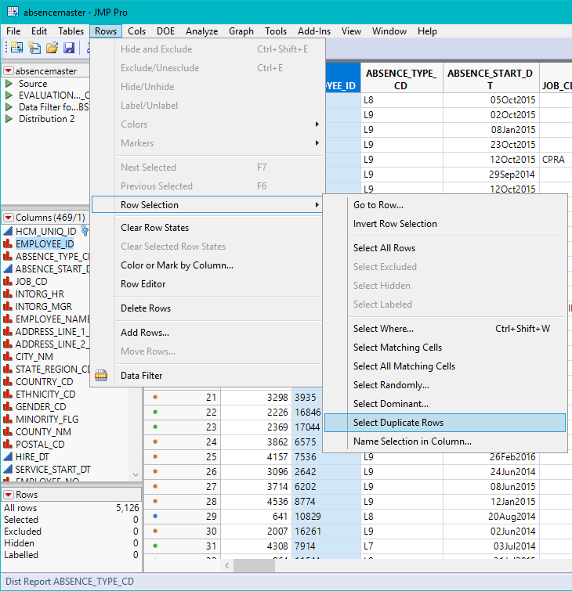
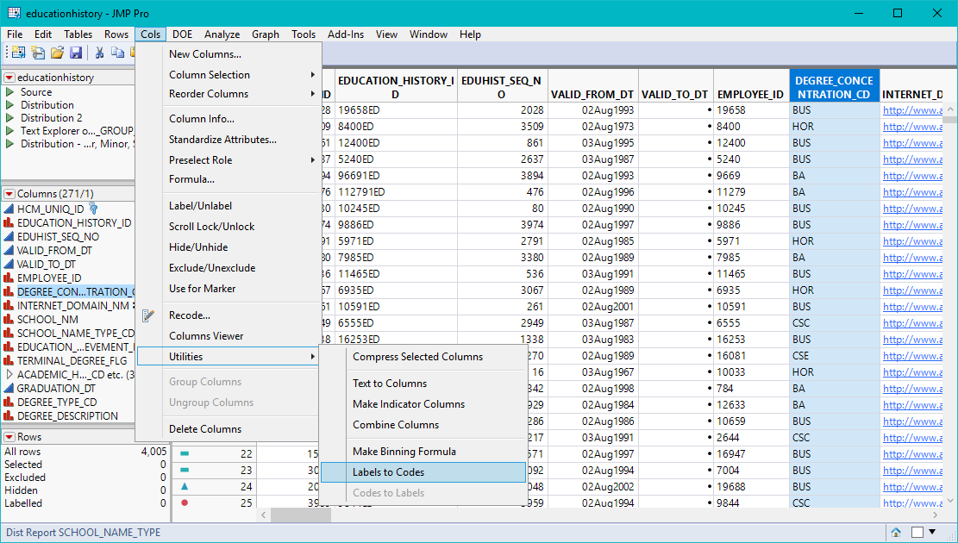
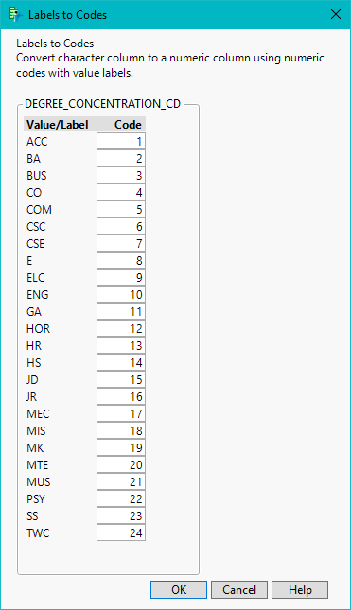
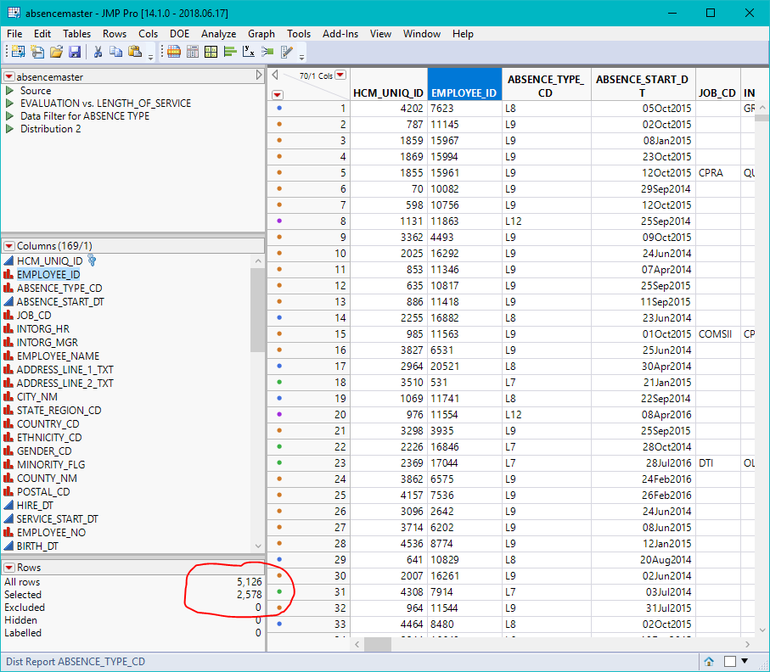
More Data table features
Select duplicate rows-added to the rows menu (delete duplicate rows)
Labels to Codes/Codes to Labels -converting strings to numeric codes saves memory

Slide 13
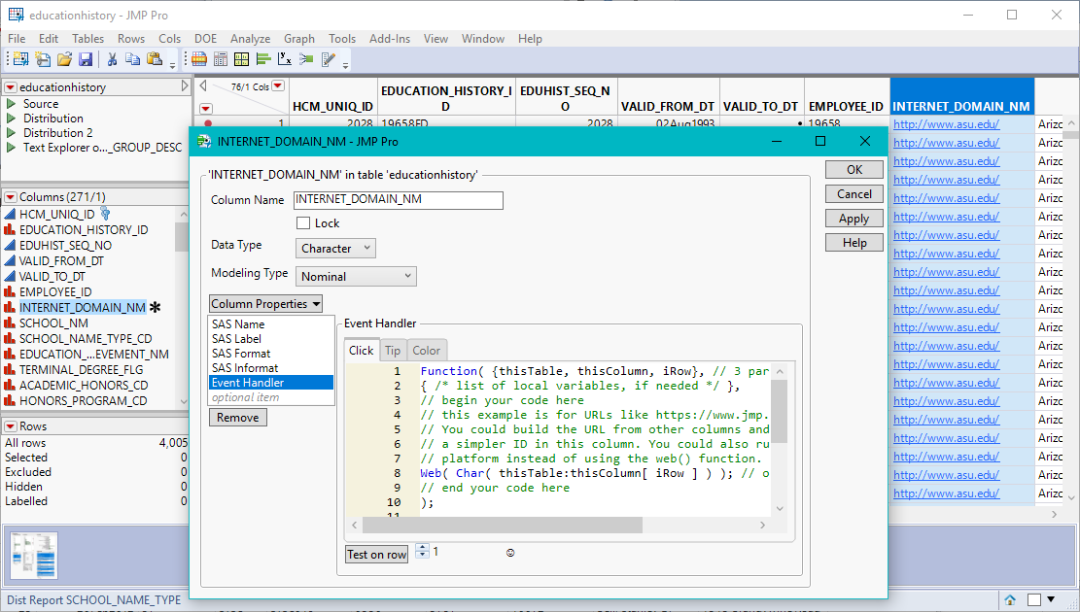
And even more Data table features
New clickable links within the data table are now available through the Event Handler column property.
DEMO

Slide 14
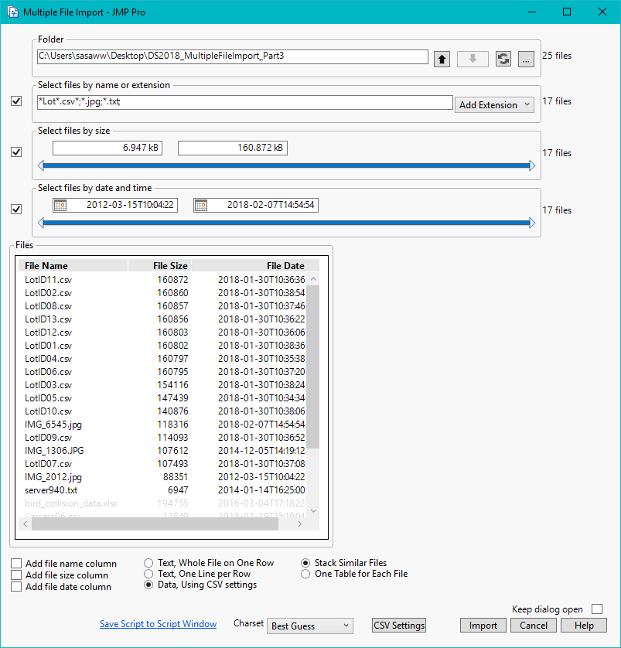
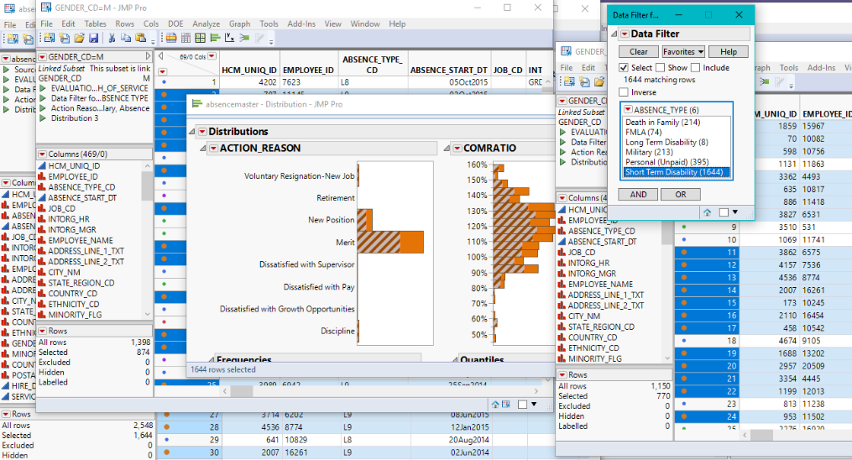
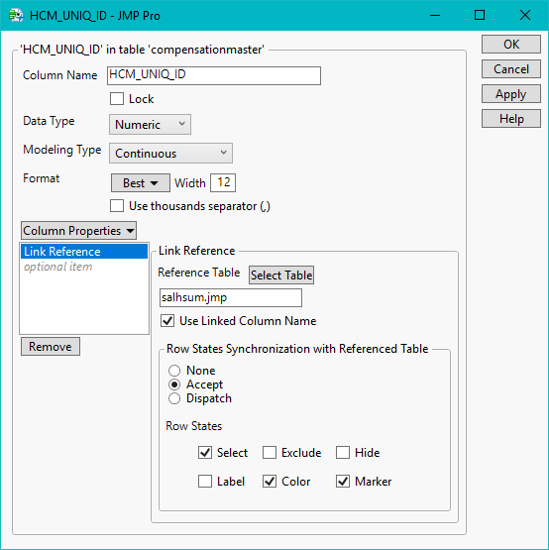
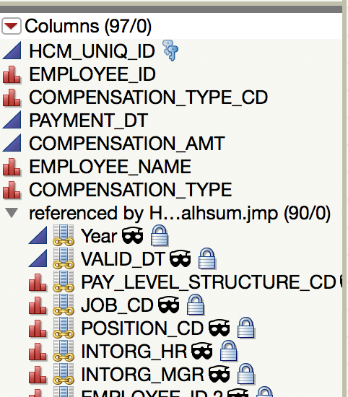

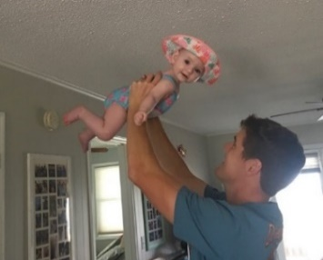
My Top 3 Favorites!
Multiple File Import
Data Filter/Local Data Filter more shareable
Virtual Join link reference column names shorter
.. remember my favorite things??

Slide 15

Questions?
JMP makes me glad!
Jmp.com

