Slide 1
BIG MOLECULES MEET BIG DATA:
Predicting Protein Tertiary Structure from Combinatorial Data
Stan Siranovich, Principal Analyst, Crucial Connection LLC
Abstract
Objective
Conclusions
The experimental determination of protein structure is typically time consuming and relatively expensive. Hence statistical methods for the prediction of some structural parameters of these proteins would be valuable. This poster discusses the prediction of one property, the Root Mean Square Deviation (RMSD) from some measured and calculated protein attributes using JMP 14.
Predict a single point metric (RMSD) for tertiary protein structure
Significant prediction factors were all some measurement of an exposed area
About 25% of the variation in RMSD could be explained by the model
Partial Least Squares is an effective platform when predictor variables are highly correlated
Exploration and visualization are important first steps in an analysis
Platforms
Tables > Subset
Analyze > Distributions
Graph > Scatterplot Matrix
Analyze > Multivariate Methods > Multivariate
Analyze > Fit Y by X
Analyze > Multivariate Methods > Partial Least Squares
Prepared for JMP Discovery Summit 2018 - Cary NC

Slide 2
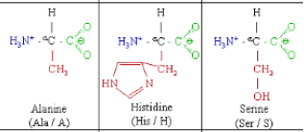
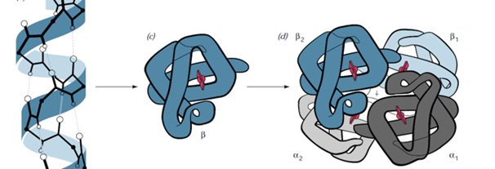
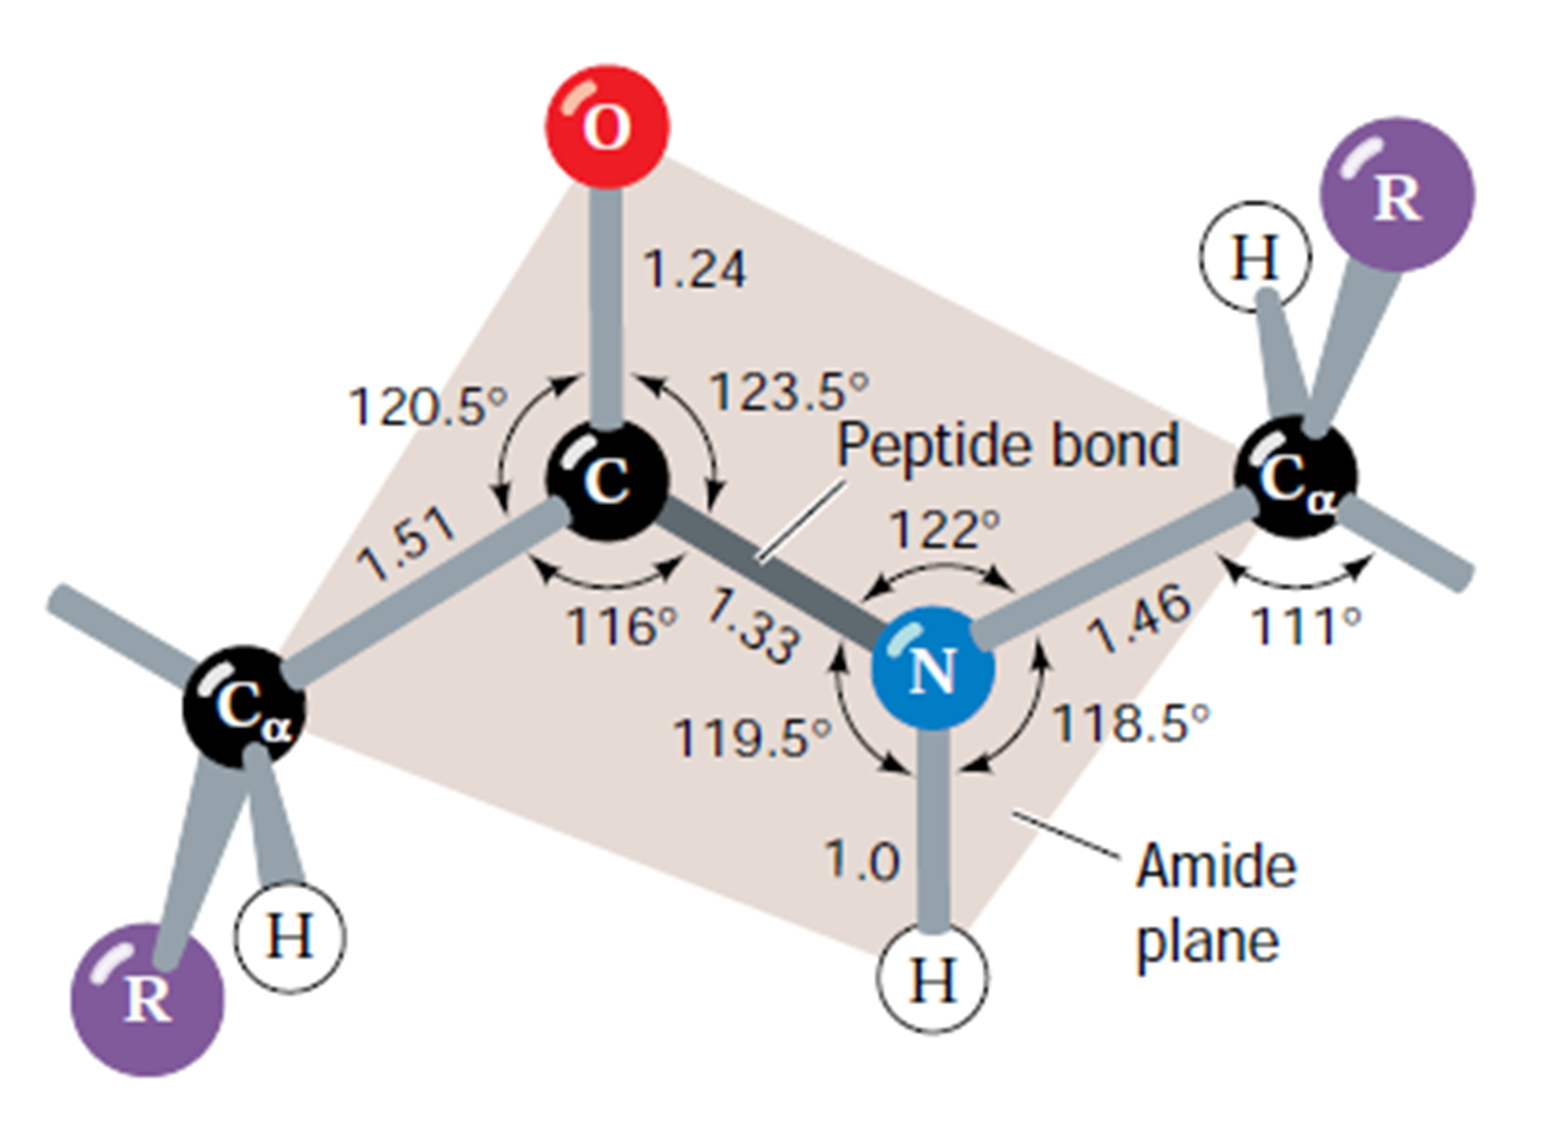
Chemistry and Protein Structure
Primary
Secondary to Tertiary to Quaternary
Trans conformation and coplanar – maximizes π-bonding overlap.
Resonance in the peptide bond gives it ~40% double bond character
Above two factors account for peptide group’s rigidity
Hydrophobicity of side chain is main determinant of conformation
Notes:
molecule forms a spiral which leads to secondary structures
which then folds into tertiary structure – what we’re interested in
which may join with other protein molecules into a final, (in this case) globular protein.

Slide 3

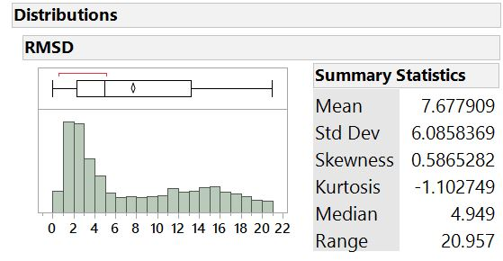
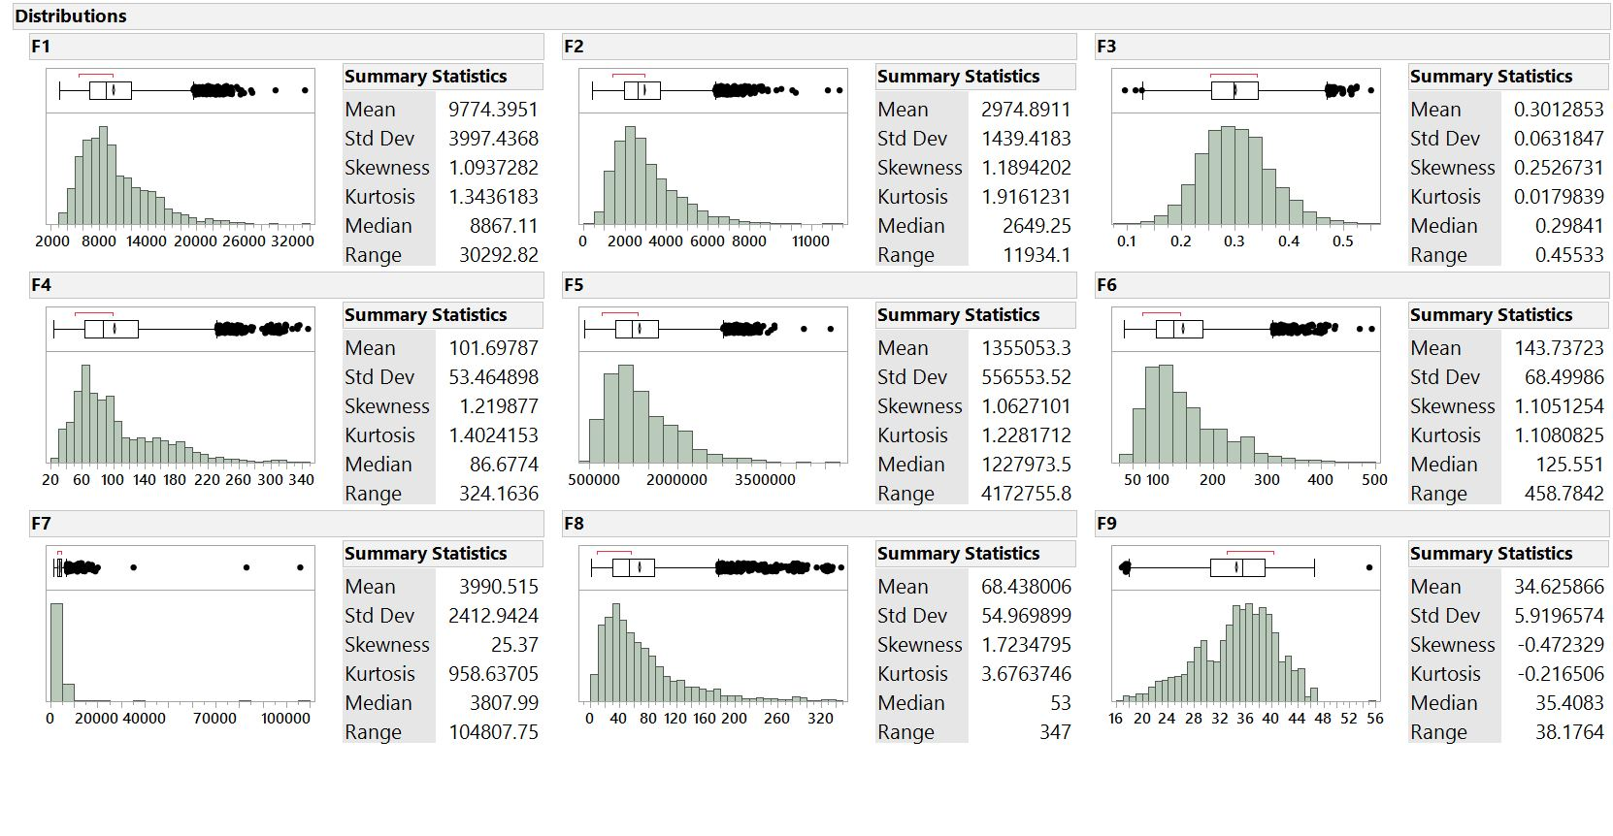
Table of Variables and the Analyze > Distribution Platform
Variable | Description
RMSD | Root Mean Square Deviation – dependent variable
F1 | Total Surface Area
F2 | Non-polar exposed area
F3 | Fractional area of exposed non-polar residue
F4 | Fractional area of exposed non-polar part of residue
F5 | Molecular mass weighted exposed area
F6 | Average deviation from standard exposed area of residue
F7 | Euclidean distance
F8 | Secondary structure penalty
F9 | Spatial distribution constraints (N,K Value)
Predict RMSD
from F1 thru F9

Slide 4
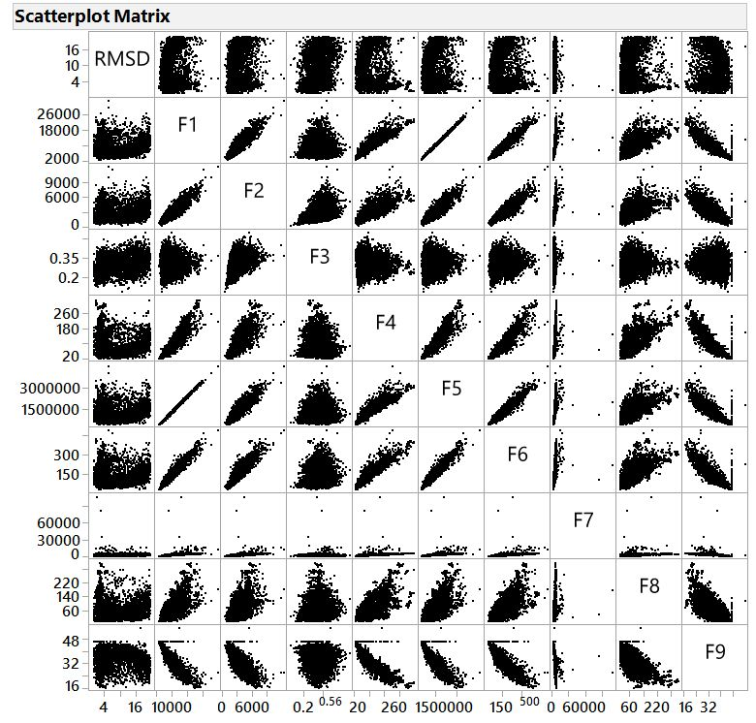
Scatterplot Matrix and Correlations
High correlation among independent variables
Low correlation of dependent variable (RMSD) with independent variables
Dependent variable (RMSD) is oddly bimodal with second peak near 16

Slide 5
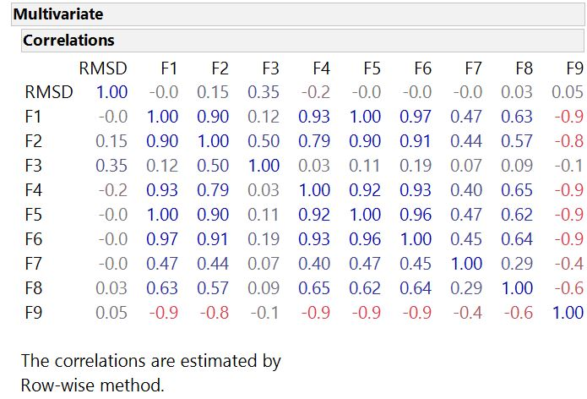
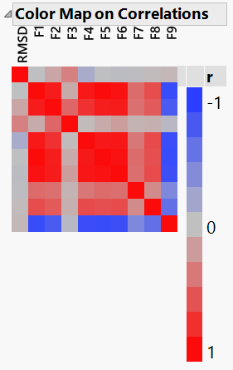
Correlations – another View

Slide 6
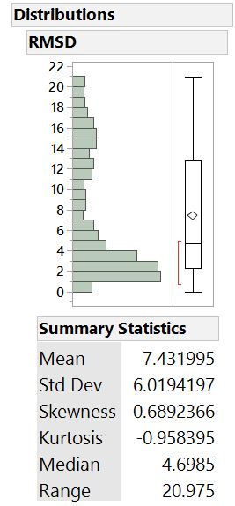
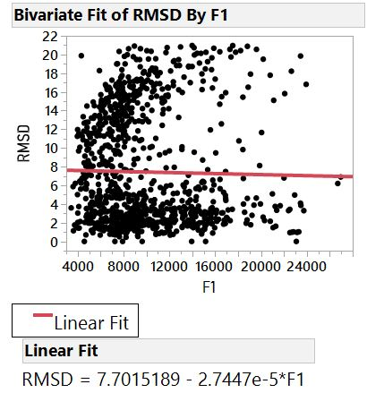
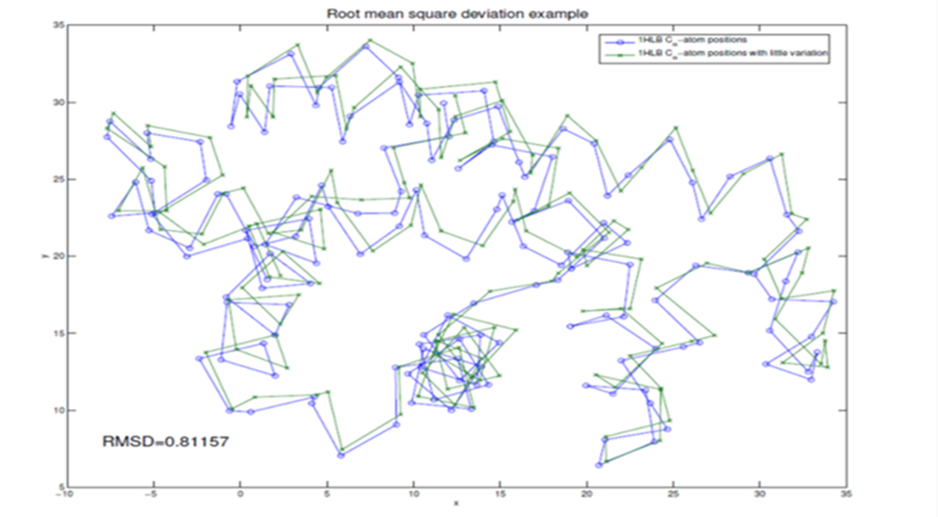
Bivariate Fit Visualizations Show many odd Distributions – this Example is for F1 (Total Surface Area, sample size = 1000)

Slide 7
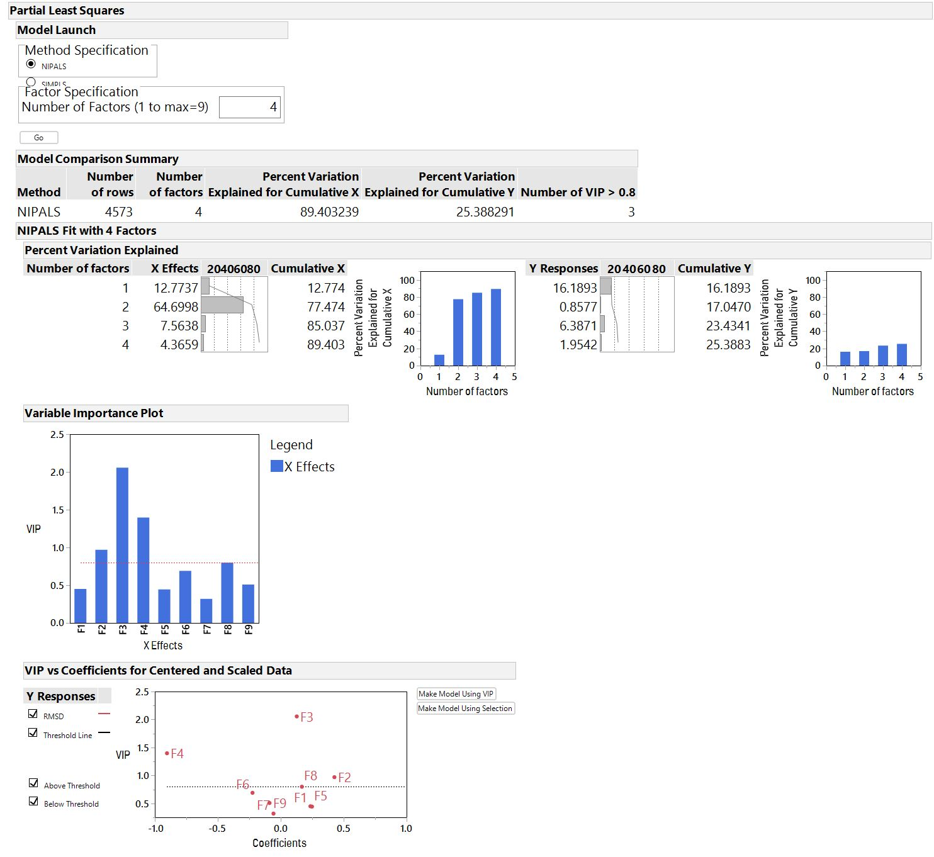
Four Factors Explain 89% of Variance of X and Three Factors Explain 25% of Variance of Y (RMSD)
Variable | Description - predictors
RMSD | Root Mean Square Deviation – dependent variable
F2 | Non-polar exposed area
F3 | Fractional area of exposed non-polar residue
F4 | Fractional area of exposed non-polar part of residue
F8 | Secondary structure penalty
Number of factors used to predict both X and Y
More (cumulative) detail on X and Y
Conclusions
Significant prediction factors were all some measurement of an exposed area
About 25% of the variation in RMSD could be explained by the model
Partial Least Squares is an effective platform when predictor variables are highly correlated
Exploration and visualization are important first steps in an analysis
VIP plot for all X. Note the default cutoff line at 0.8
VIP vs. coefficients used for regression line to predict RMSD.
Note VIP default cutoff at 0.8.
Note that F4 and F2 have the largest magnitude.

Slide 8
Contact Information
Title
Author
Big Molecules Meet Big Data:
Predicting Protein Tertiary Structure from
Combinatorial Data
Stan Siranovich
Principal Analyst
Crucial Connection LLC
Jeffersonville, IN
stan@CrucialConnection.com
www.CrucialConnection.com www.StanSiranovich.com

