Slide 1




Time is precious!
Swetlana Berger and Angela Manginelli
Non-Clinical R&D Statistics
GSK Vaccines, Emil-von-Behring-Straße 76, 35041 Marburg, Germany
Abstract
Conclusion
In clinical trials, the procedures to prepare human biological samples for the testing or testing procedure itself (called assay) are rather complicated: several steps need to be followed, with accuracy and precision.
One important parameter to be evaluated is the time needed to accomplish each step of the process: what happens if one lab technician is slower than another? What time window can be considered acceptable for a specific step?
We will try to answer these questions using JMP tools and platforms, from the design phase of the experiment (DoE) to the analysis of data (contingency analysis)
DoE platform is a powerful tool for creating experimental designs which perfectly fit the assay development specific settings
Especially helpful is the Custom Design function, enabling to construct specific design solutions
For design candidates diagnostic tools enable evaluation of the quality, design can be adjusted (e.g. adding runs) to be able to meet the targeted explanatory power
The whole analysis was performed using the JSL scripting: from the data import and preparation to the graphical representation of the outcome
A combination of basic functions such as Graph Builder, Tabulate, Summary was used to perform the contingency analyses
JSL scripting is a powerful tool, especially if the analysis is performed repeatedly
No significant impact of sample or bacterial loading time on measurements of test samples was detected
The endogenous complement human Serum Bactericidal Assay (enc-hSBA) is a qualitative assay, used to determine the effectiveness of vaccines against Neisseria meningitidis serogroup B strains
Human samples and living bacteria are manually loaded on microtiter plates; up to 69 samples can be analyzed per test. Titer “<4”, “4 “ and “8” are possible outcome of the test
The impact of variations in sample loading time and bacteria loading time on measured titers was investigated.
Case Study I: Planning and Evaluation of DoE
I‘m Swetlana Berger, I studied mathematics and physics and did my PhD in quantitative genetics in Goettingen.
Currently I‘m responsible for the statistical support in the development of serological clinical assays and for the improvement of statistical methods used.
JMP became quickly one of my favorite statistical software and I love the friendly graphical user interface and the DoE platform.
Contact: swetlana.x.berger@gsk.com
Case Study II: Contingency Analysis
My name is Angela Manginelli, I am a mathematician and I have a PHD in bioengineering.
I joined the pharma world 5 years ago (first Novartis Vaccines then GSK Vaccines) in the statistics group.
My main responsibility is the statistical support in the development and the validation of serological clinical assays. JMP is a great statistical software and I enjoy very much both the interactive platform and the power of the scripting
Contact: angela.a.manginelli@gsk.com
During the development of a Group B Streptoccocus Multiplex ELISA assay, the experimental conditions must be optimized
Using DoE several combinations of influential factors (incubation time of samples, incubation time or concentration of 2nd antibody…) are systematically investigated. Compared to full factorial design, the use of Optimal DoE allows to minimize needed resources without reducing the predictive power of the experiment
A targeted power design was implemented by including in the model previous knowledge on responses (e.g. inter-dilutional CV)
Conflict of interests: This work was sponsored by GlaxoSmithKline Biologicals SA. Angela Manginelli and Swetlana Berger are employees of the GSK group of companies.
JMP Discovery Summit Europe 2018

Slide 2
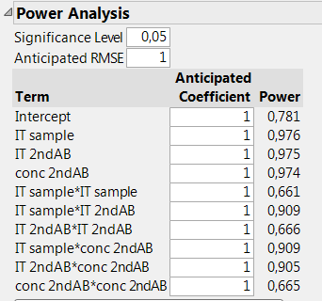
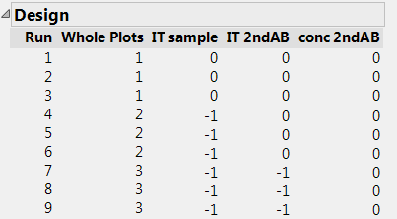
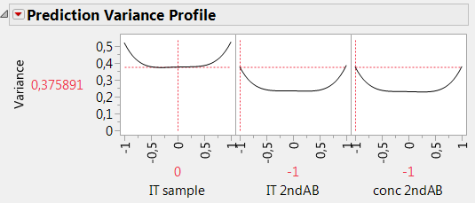
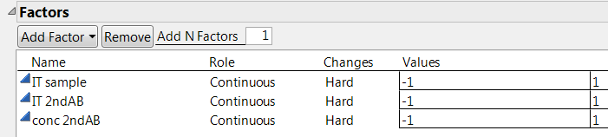
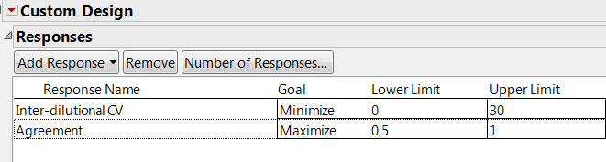
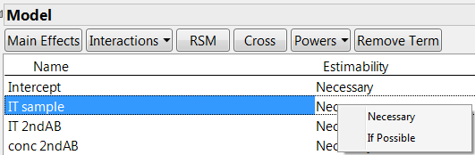
Case Study I: Planning and Evaluation of Optimization DoE
I or D-optimal Design?
Experimental Design
Using Custom Design function of JMP DoE platform an I or D-Optimal design (depending on the intended use of the model) can be developed
D-optimal design focuses on the precision in parameters estimates and thus was used in previous screening experiment
Prediction oriented I-optimal designs is the best choice for an experimental design aimed at optimizing experimental parameters
Number of iterations was increased to 10000 to improve the optimality of the final design. Higher number of iteration helps to avoid discovering a local instead of a global optimum
Constrains to specific factor levels were defined using the Disallowed Combinations option: shortest incubation times are not applicable to the lowest concentration, using inequality those constrains were implemented
A decision on run budget was taken: small effects were expected, still if the expected error in responses was small, the total number of runs was set to 104
Design Evaluation
Power analysis
the probability of discovering true effects is calculated, based on previous knowledge about responses. The number of runs was increased, until the power for all terms reached at least 0.6
We increased the number of center points, which specifies additional runs in combinations of midpoints of each factor under investigation
Prediction Variance Profile displays the predictive variance of each factor implemented in the model
Choice of response
Definition of the Model
Choice of measurement of assay optimality is crucial for success of an optimization experiment. This could be mesaures of goodness of dose-response fit or the performance of assay based on sample measurements (e.g. Inter-dilutional CV or agreement)
Knowledge about the response measuring the optimality of assay helps to improve the design: from the previous screening experiment it is known that interdilutional CV hardly crosses the upper limit of 30% . This limit of response was taken into account and easely implemented in Custom Design.
Experimental factors included in the model : incubation time sample and of 2nd antibody, concentration of 2nd antobody
Using the Change option Hard a split plot design was created
The targeted model consists on main factors, all pairwise interactions and quadratic effects. The interactions were weighted as „If possible“
Fraction of Design Space summarizes the information delivered in the Prediction Variance Profiles across all given factors and is especially helpfull if multiple factors are included in the model.

Slide 3
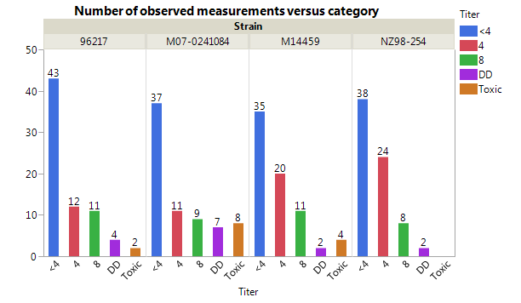
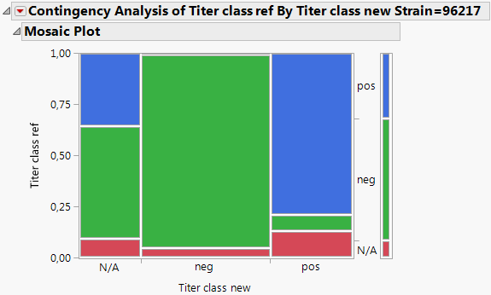
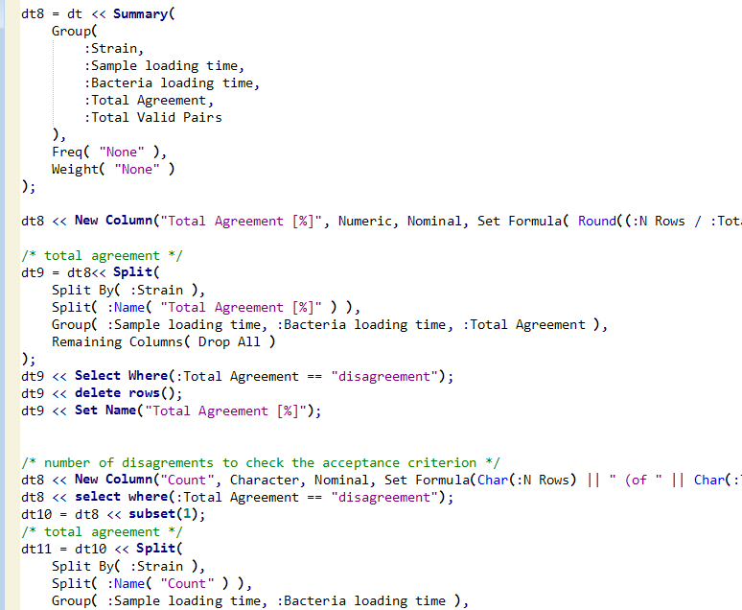
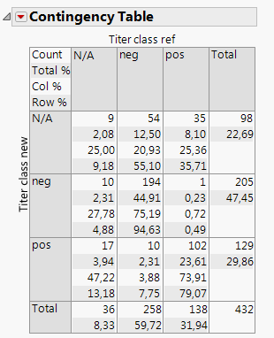
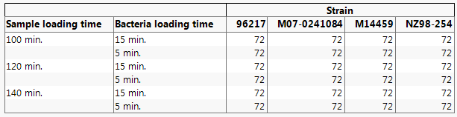
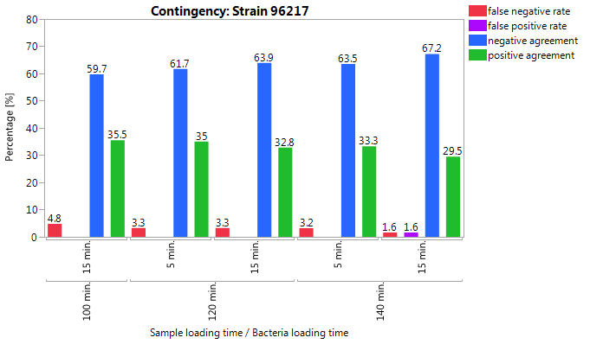
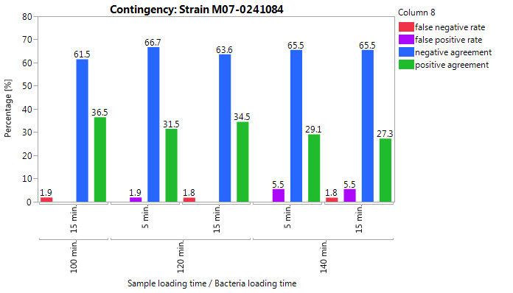
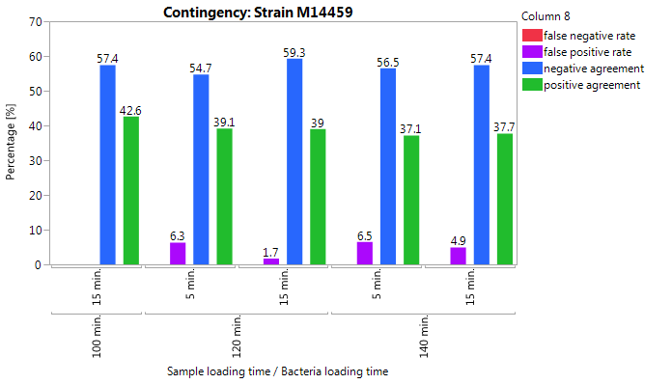
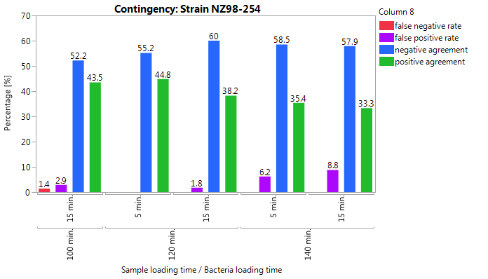
Case Study II: Contingency Analysis
Full Factorial Design
Two key parameters in the enc-hSBA test procedure were investigated: the sample loading time (time between all samples are placed on the plate and the addition of bacteria ) and the bacteria loading time (time needed by the operator for the application of the bacteria)
The question to be answered was: does the variation in sample or bacteria loading times affect the measurement of efficiency of the vaccine?
A total of 60 samples and 2 controls yields up to 72 measurements for each test condition: each sample was tested 1 time under 6 experimental conditions and each control sample was tested 6 times under 6 experimental conditions.
100 min for sample loading time and 5 min for bacterial loading time was the reference condition
This experiment was performed with identical setting for four Men B strains:
Evaluation of Experimental Data
The design was powered for a pre-defined significant response by means of Clopper-Pearson binomial CI
The whole analyses was performed using the JSL scripting, combining basic functions such as Graph Builder, Tabulate, Summary, from data import and preparation to graphical evaluations and contingency analyses
JSL scripting is a powerful tool, especially if the analysis should be re-run
For samples with valid results in the reference condition contingency analysis was performed
Number of valid results in reference condition: Strain 96217 : 66
Strain M14459: 66
Strain M07-0241084 : 57
Strain NZ98-254: 70
Results
No significant impact of sample or bacterial loading time on measurements of test samples was detected for any of the four MenB strains

