Slide 1


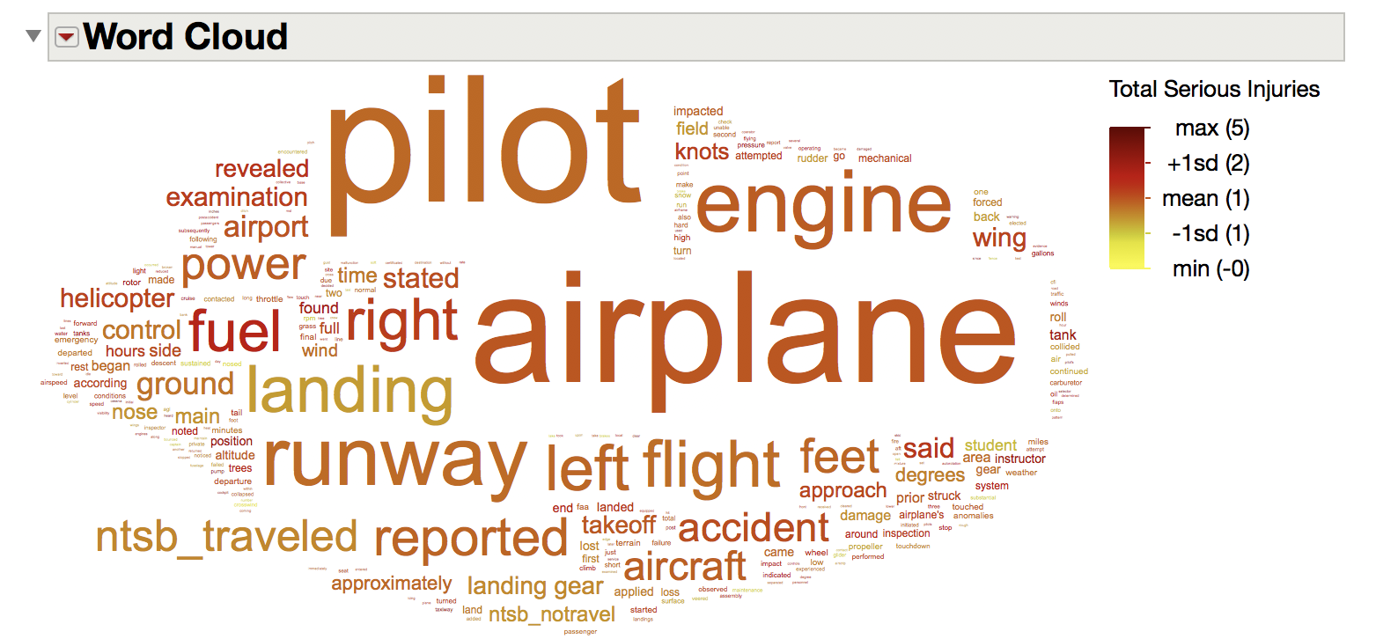
Flying Through the Word Cloud into Modeling with JMP Pro Text Explorer
Laura A. Higgins, Ph.D.
JMP Senior Global Technical Enablement Engineer, SAS
Abstract
What else can you do?
The world is full of unstructured text, and most of it goes unexplored. Further complicating this, extracting meaning and value from text until recently required special tools. JMP Pro’s Text Explorer has many powerful options for bringing insight into text data and using the curated term list. Let’s fly beyond the word cloud and explore the modeling tools of Text Explorer.
Once you have curated text, don’t stop at the word cloud – try one of these other techniques to uncover meaning hidden in text data.
Are there underlying themes in the data? Find which documents (rows) cluster together.
What conceptual topics and themes occur across documents with terms found together?
Create stable variables from text analysis to use in modeling. Understand if topics contribute in a positive or negative way to an outcome variable.
Create output for market basket/association analysis.
Where to learn more

Slide 2
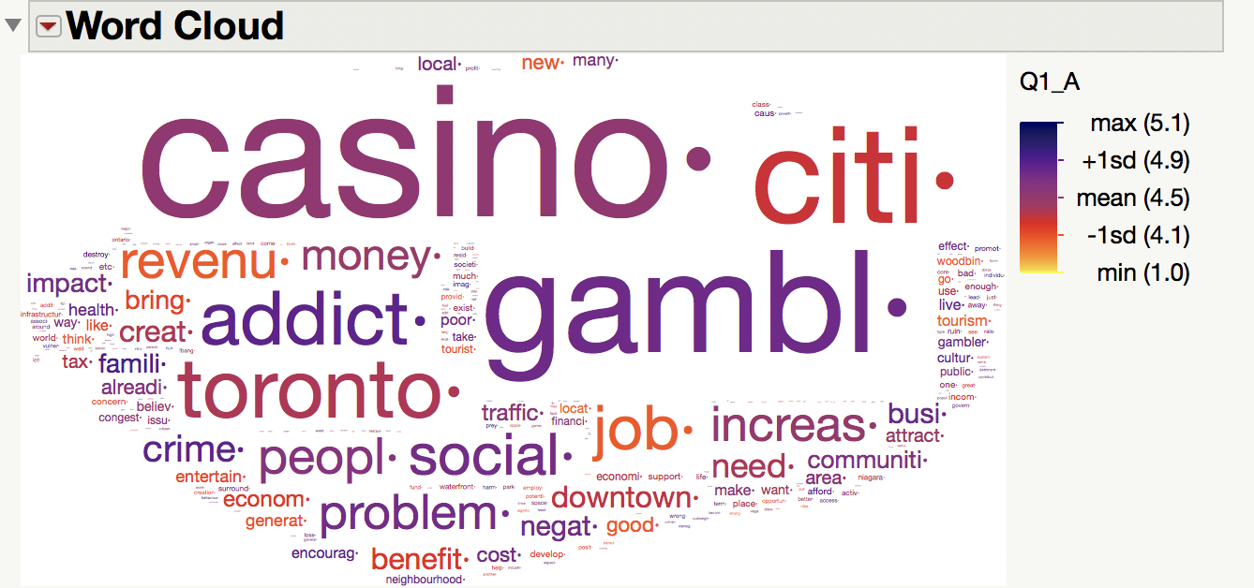
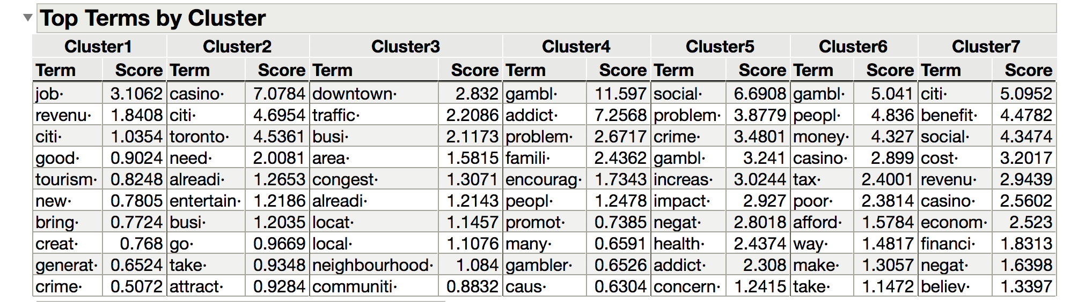
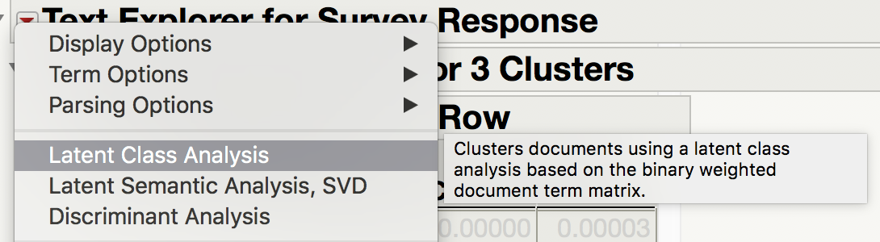
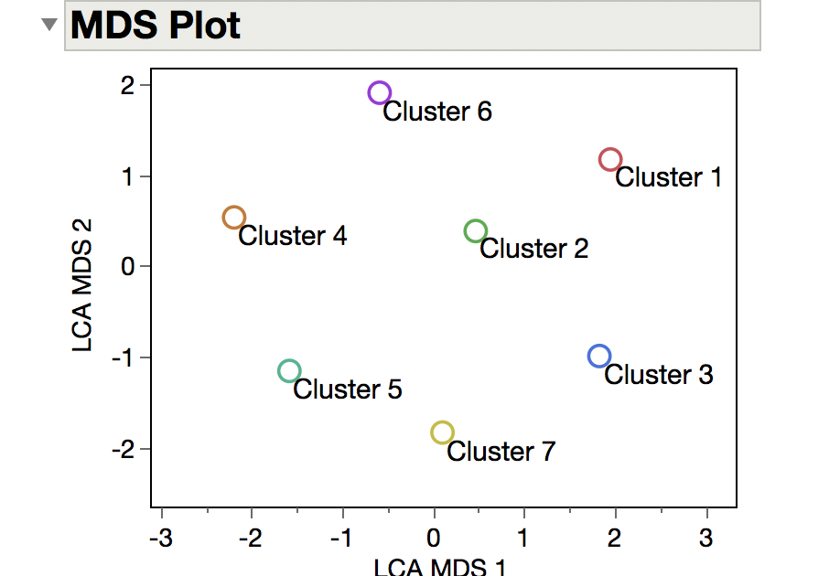
Flying Through the Word Cloud into Modeling with JMP Pro Text Explorer
Laura A. Higgins, Ph.D.
JMP Senior Global Technical Enablement Engineer, SAS
Which documents cluster together: Latent Class Analysis
Are there underlying themes in the data?
Find which documents (rows) cluster together.
Cluster 4 = crime
Cluster 1 = jobs
How to do this
How many clusters? Iterative process
Find meaningful clusters with Top Terms and MDS Plot
Compare BIC – lower is better
Check out Mixture Probability and read the text
Cluster 4 = crime
Cluster 1 = jobs

Slide 3
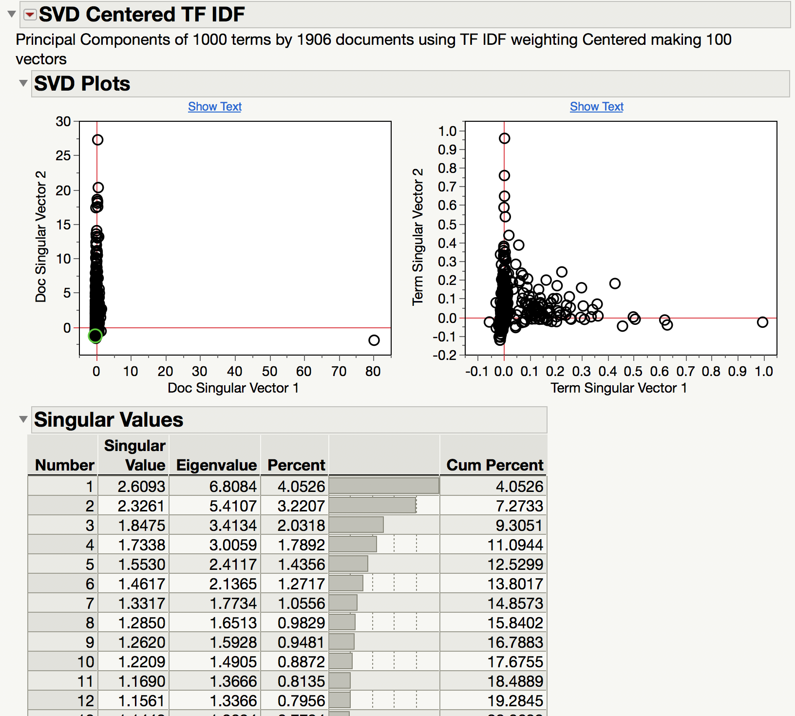
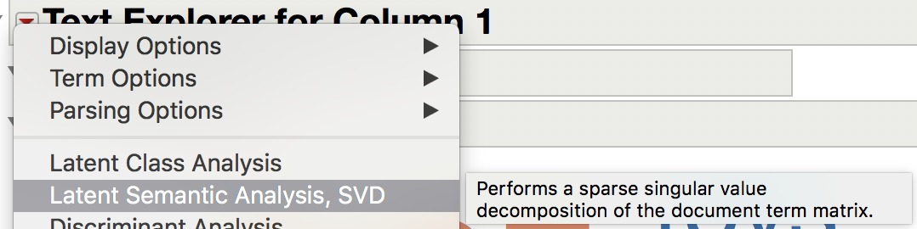
Flying Through the Word Cloud into Modeling with JMP Pro Text Explorer
Laura A. Higgins, Ph.D.
JMP Senior Global Technical Enablement Engineer, SAS
Latent Semantic Analysis:
Step 1 for Further Analysis
Create the document term matrix (SVD).
First step for many other analyses.
How to do this
Latent Semantic Analysis is Principal Components
Use SVD Plots and read text for interpretation
Singular Values show how much signal = Cumulative Percent of Variation
Use one of the following techniques for further analysis
12 Components explain 19.2% of the variation in the text data

Slide 4
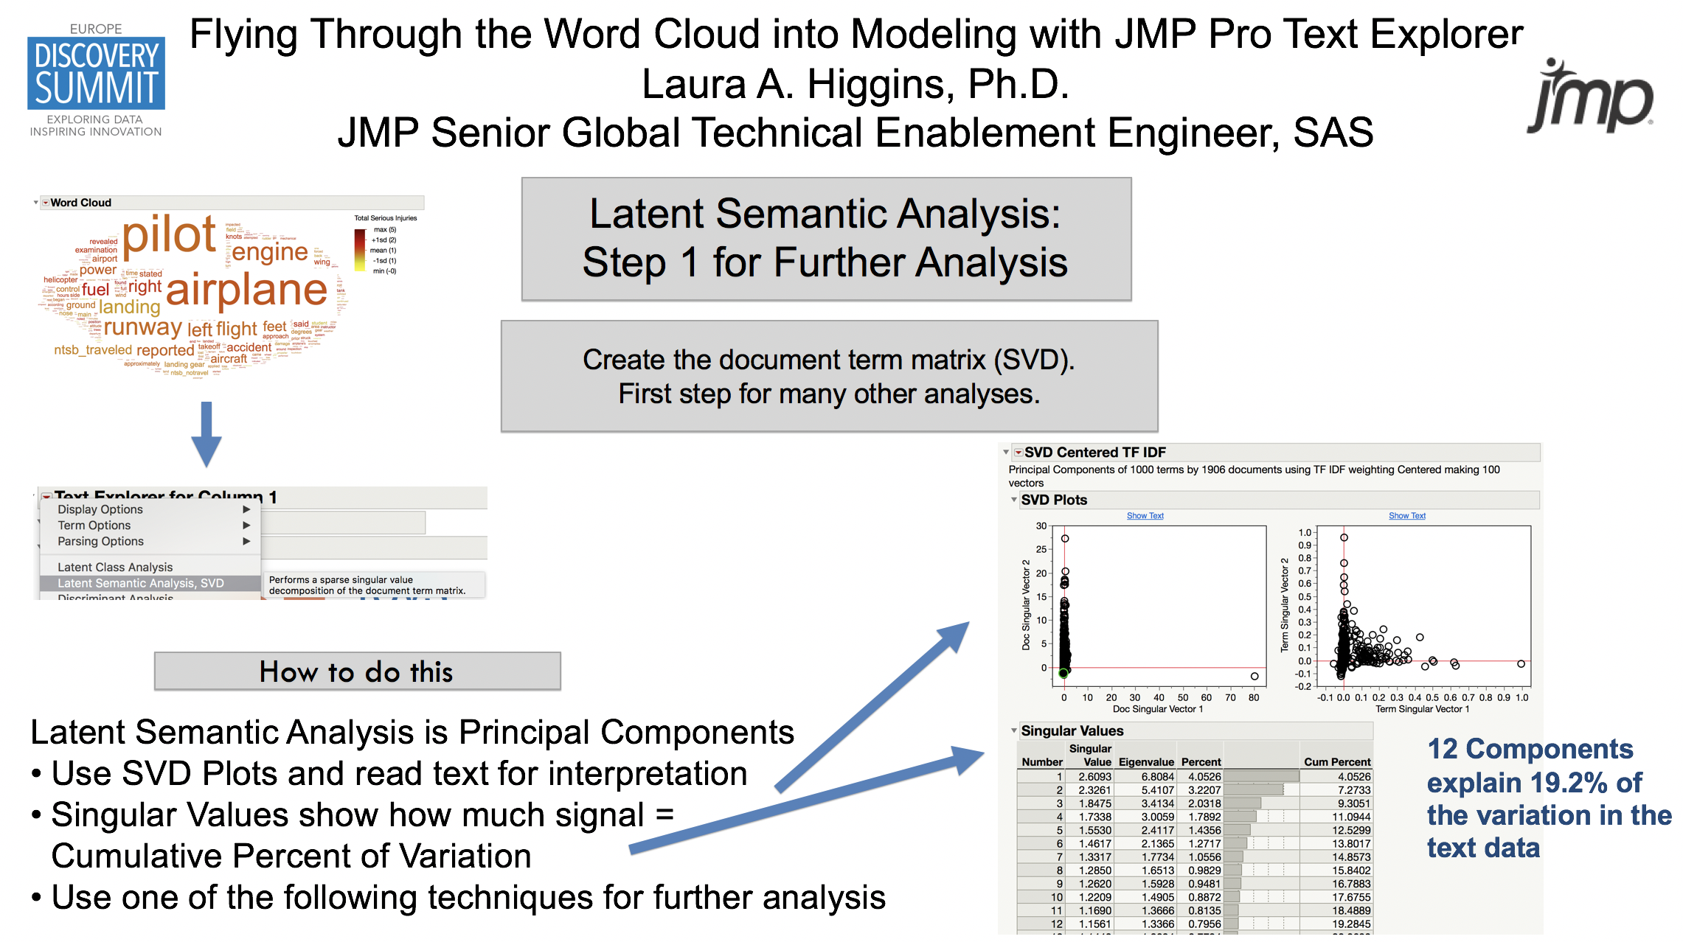
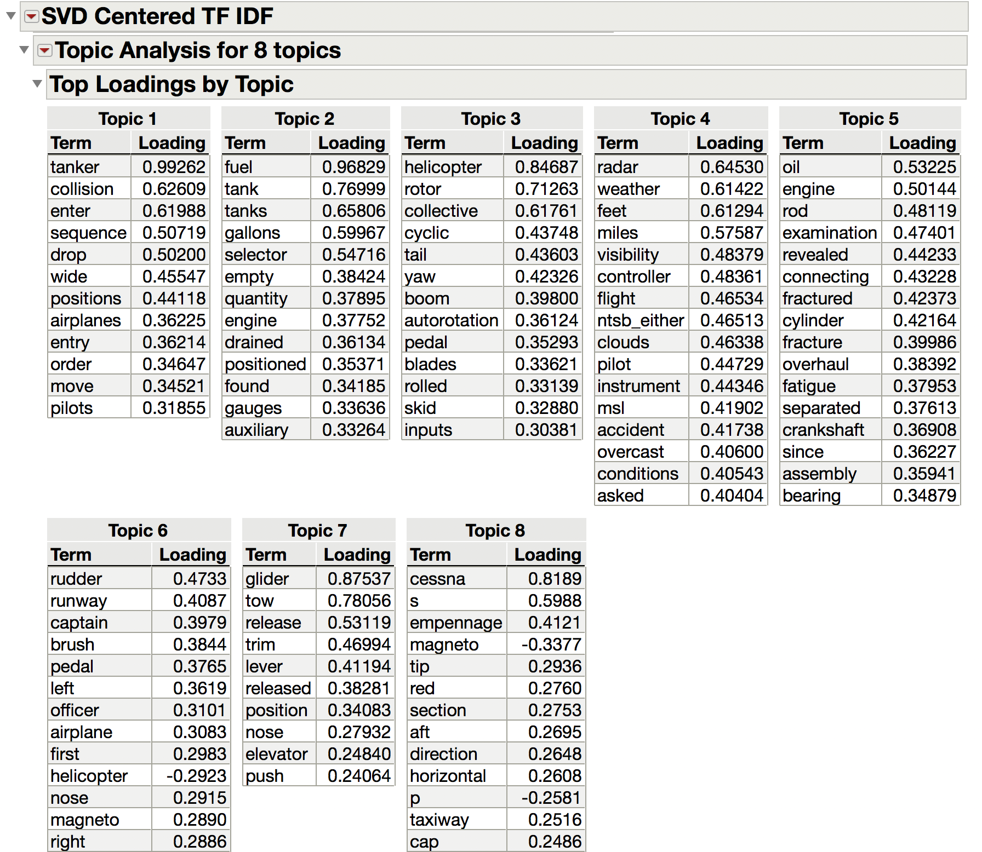
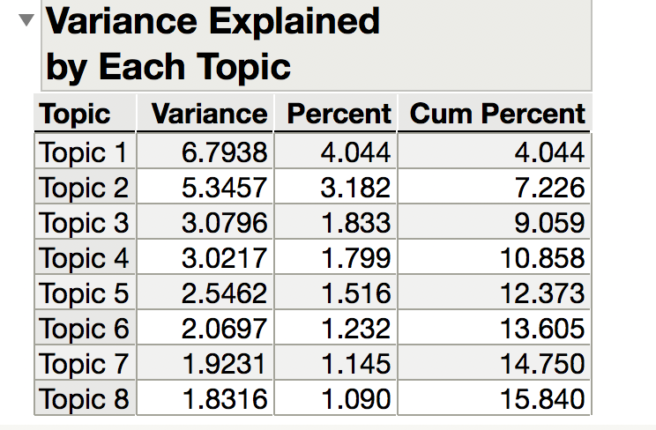
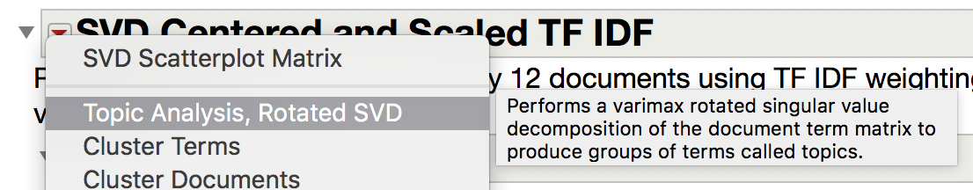
Flying Through the Word Cloud into Modeling with JMP Pro Text Explorer
Laura A. Higgins, Ph.D.
JMP Senior Global Technical Enablement Engineer, SAS
Which terms occur together: Topic Analysis
What conceptual topics and themes occur across documents?
What terms occur together across documents?
Also what terms are not found together?
Step 1: create document term matrix
Topic 3 = helicopter crashes
Topic 4 = weather
How to do this
Explore different number of topics – use Variance output to quantify how much signal.
Each topic shows how terms load
Negative terms are not found with positive terms
Read text to understand. Try using in modeling for further interpretation with other variables.
Topic 6 = steering but not about helicopters

Slide 5
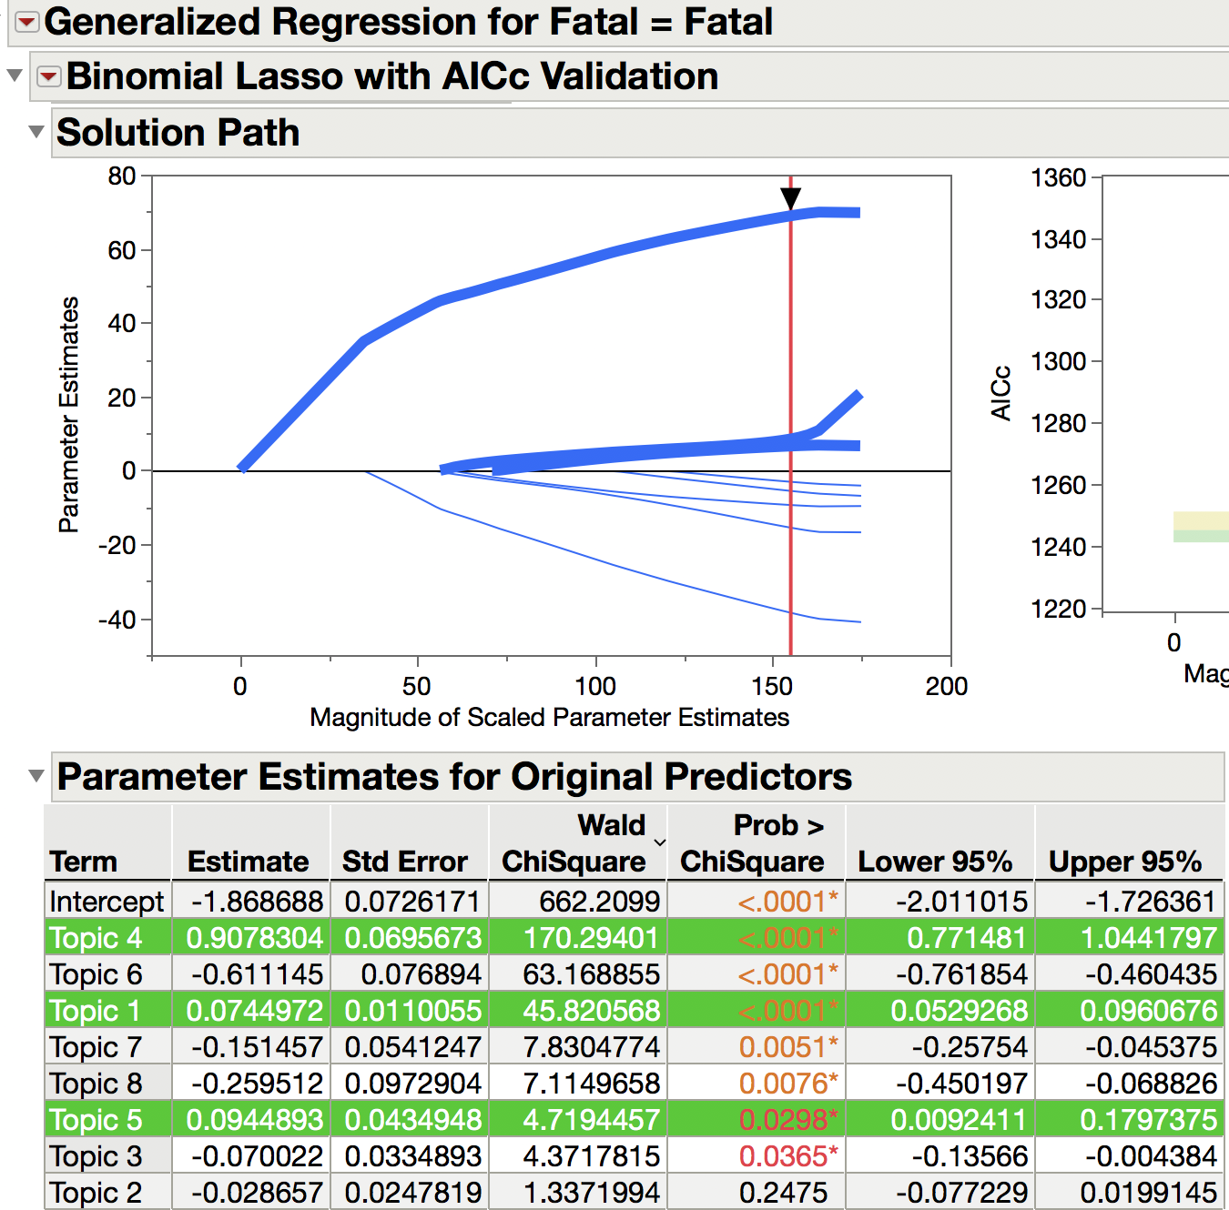
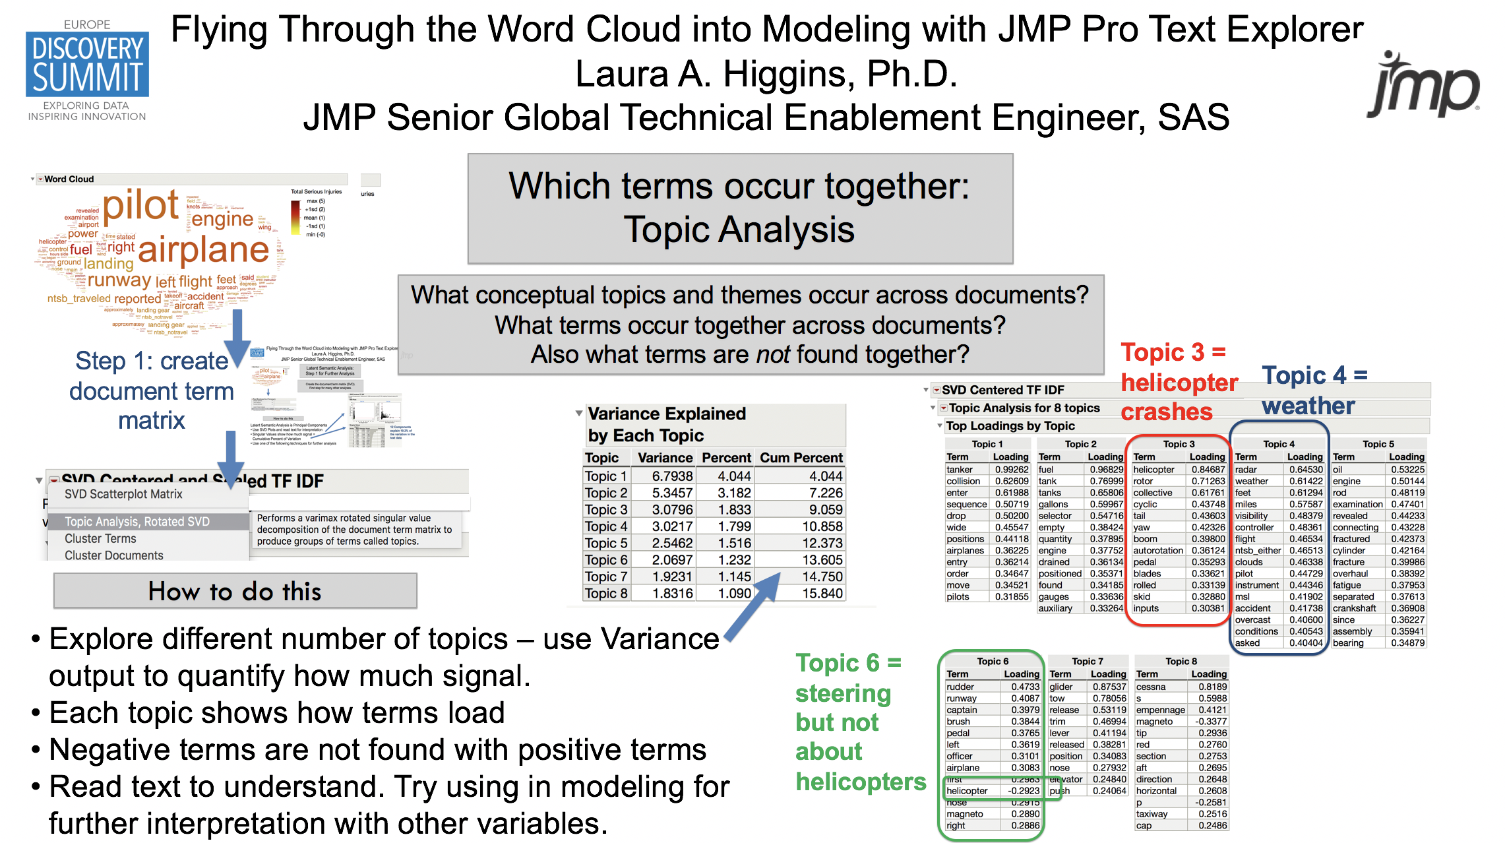
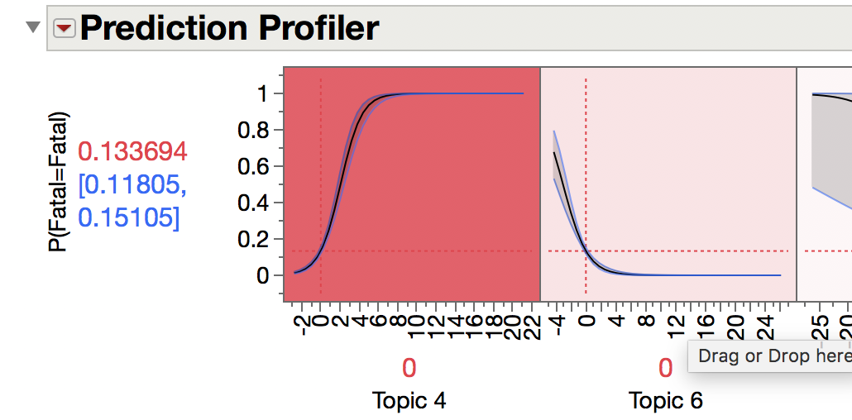
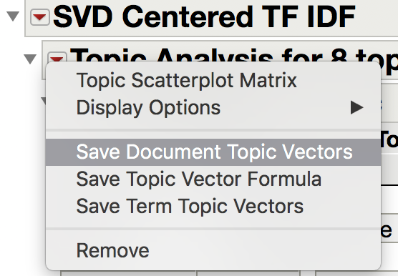
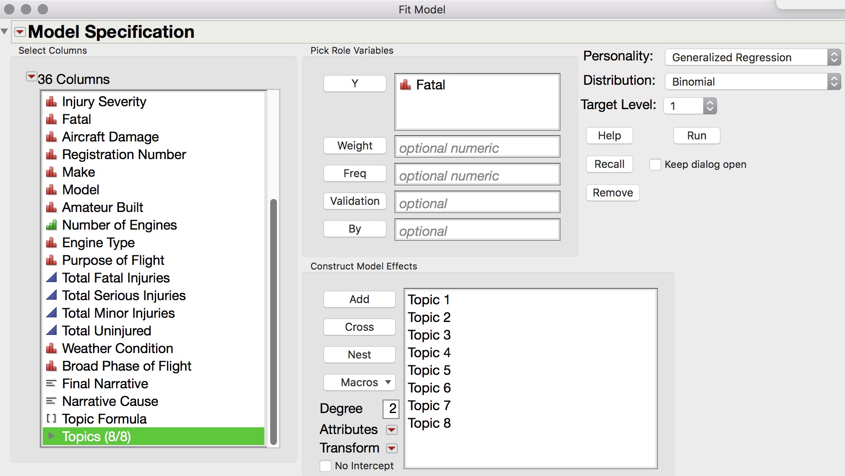
Flying Through the Word Cloud into Modeling with JMP Pro Text Explorer
Laura A. Higgins, Ph.D.
JMP Senior Global Technical Enablement Engineer, SAS
Use Topic Analysis Output in Models
Create stable variables from text analysis to use in modeling. Understand if topics contribute in a positive or negative way to an outcome variable.
Step 1: create document term matrix
How to do this
Use Document Topic Vectors in GenReg with another outcome variable
Topics 4, 1, 5 contribute to Fatal Accidents
All other topics contribute to non-fatal accidents
Topics 4, 6 are the most important for understanding fatal vs non-fatal accidents
Step 2:
Topic Analysis

Slide 6
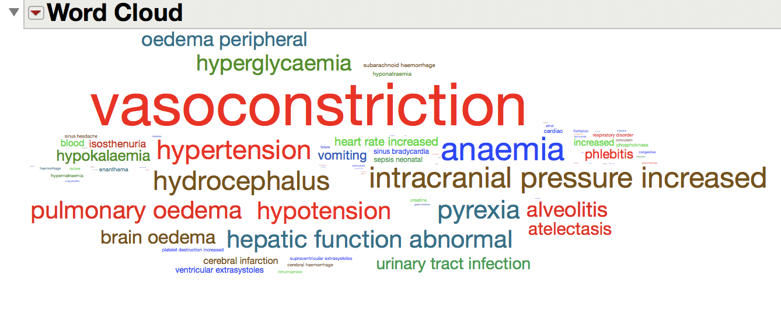
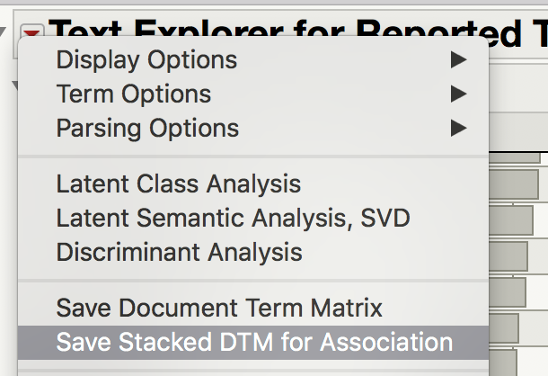
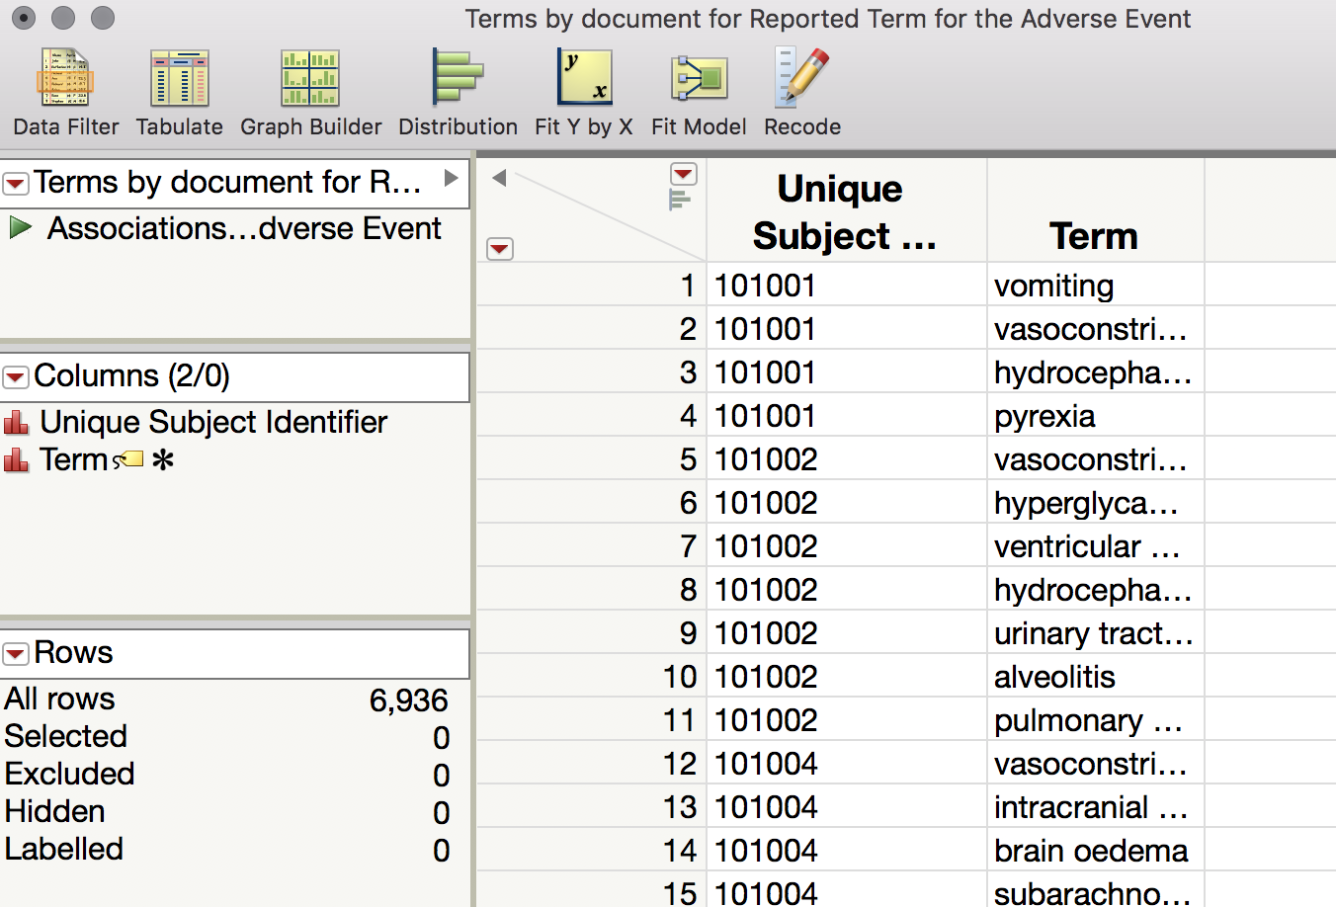
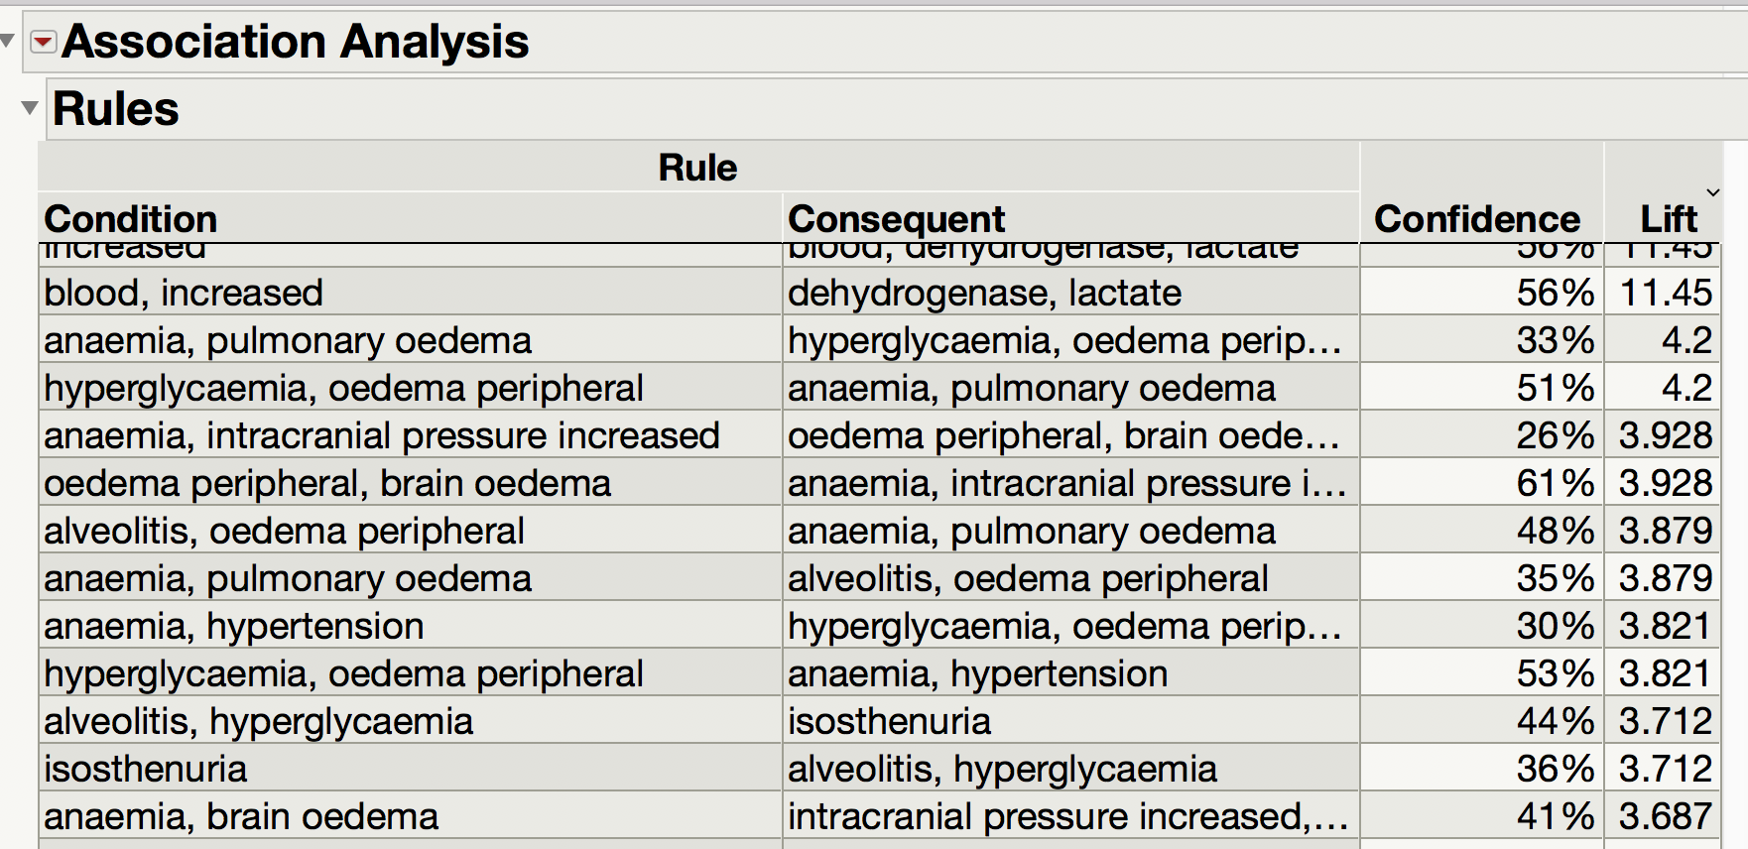
Flying Through the Word Cloud into Modeling with JMP Pro Text Explorer
Laura A. Higgins, Ph.D.
JMP Senior Global Technical Enablement Engineer, SAS
Create Output for Association Analysis
Find what words occur with each other.
Create data ready for analysis in Association analysis (market basket analysis)
How to do this
Save document term matrix DTM in the right format for Association Analysis.
Creates a new table with a script.

Slide 7
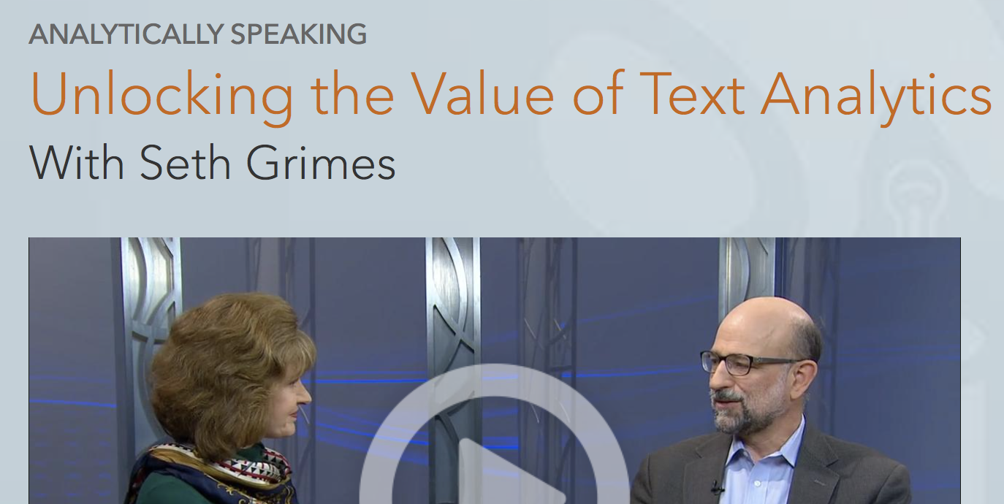
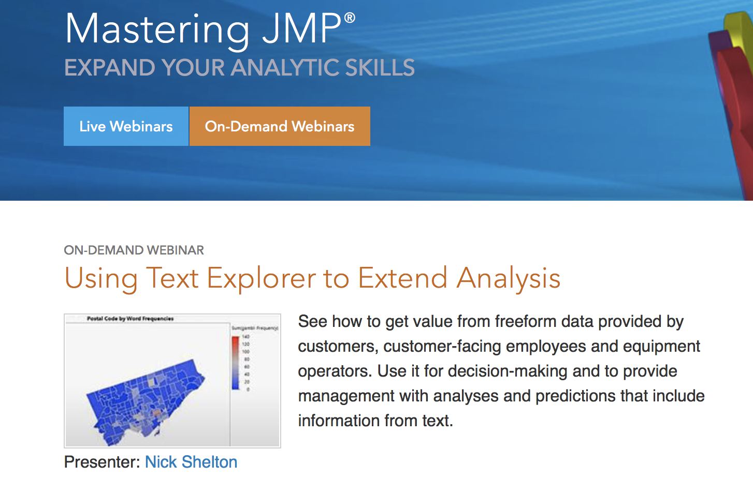
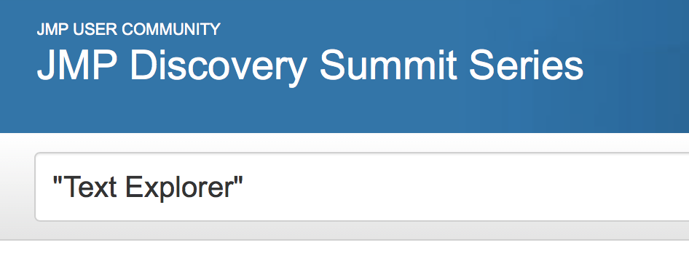
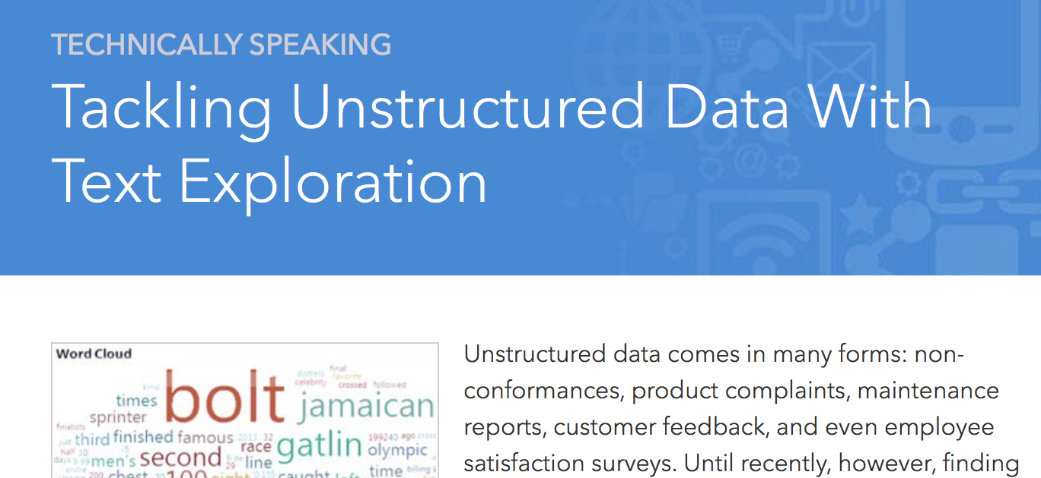
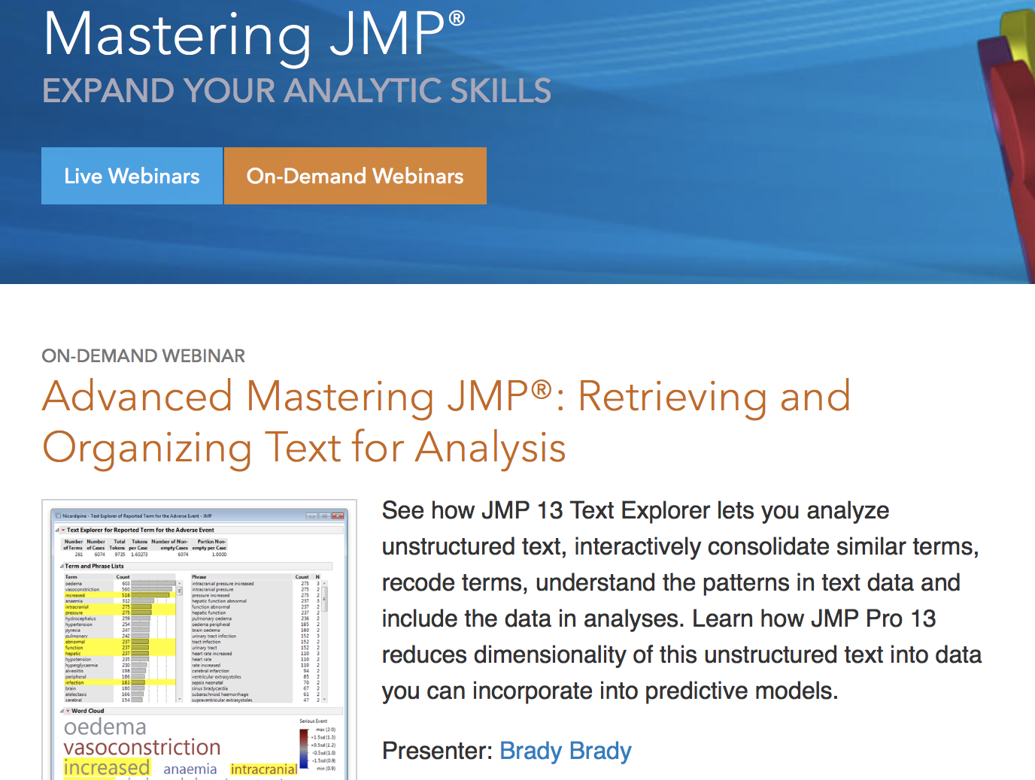
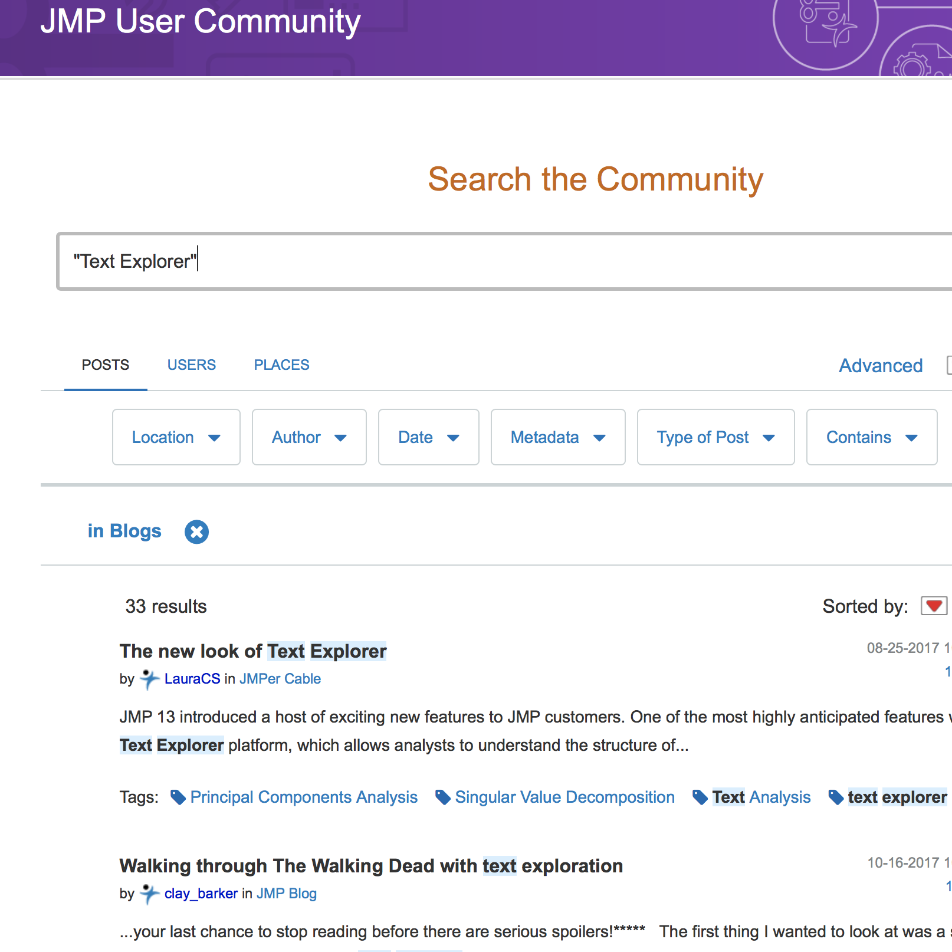
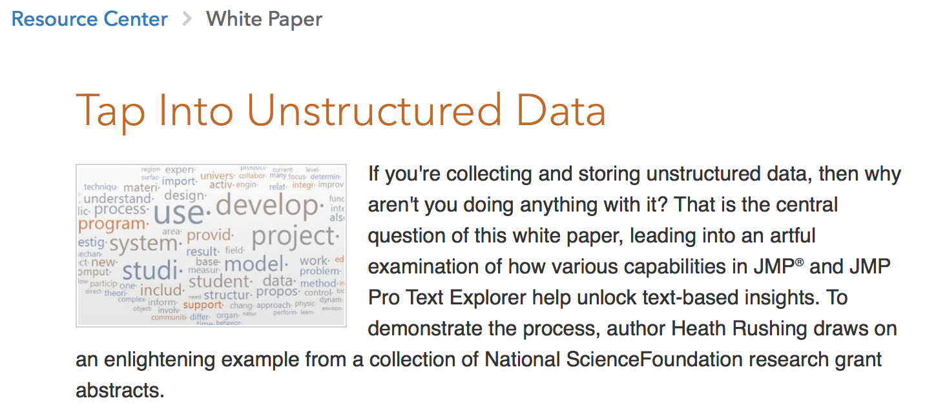
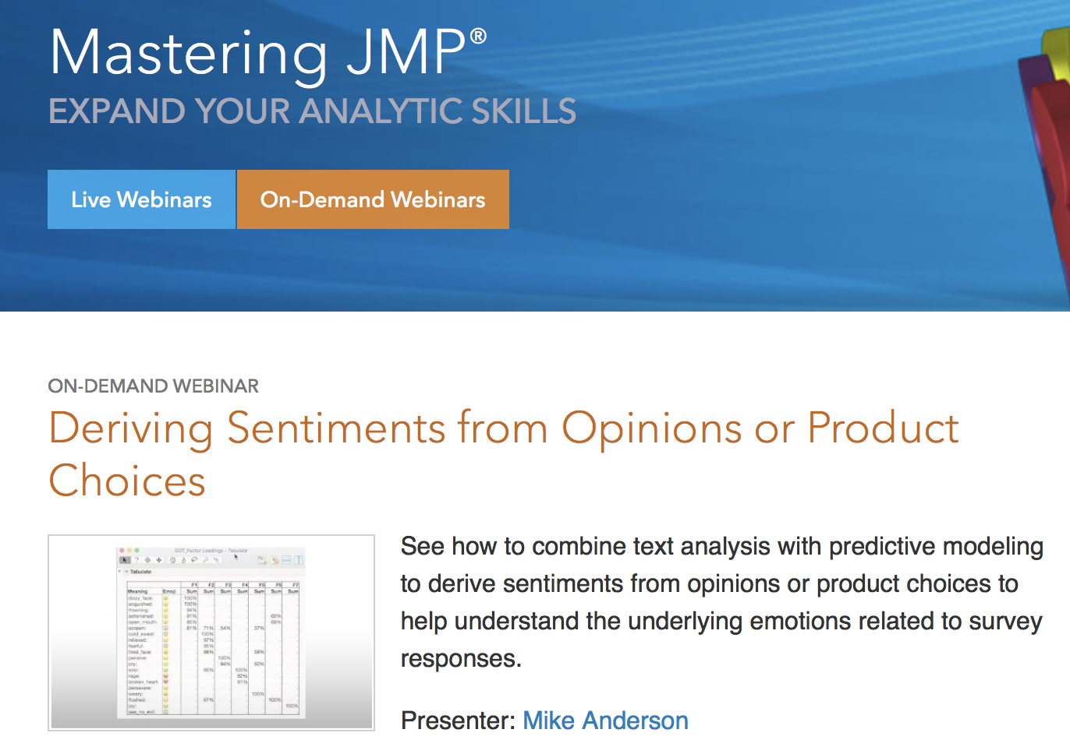
Flying Through the Word Cloud into Modeling with JMP Pro Text Explorer
Laura A. Higgins, Ph.D.
JMP Senior Global Technical Enablement Engineer, SAS
Where To Learn More

