Slide 1
Recent Developments in JMP Quality and SPC
JMP Discovery 2019
Laura Lancaster
Annie Zangi
Jianfeng Ding

Slide 2
INTRODUCTION
Recent Developments in Quality and SPC
Process Capability in Distribution (JMP 15) – Laura Lancaster
CUSUM Control Chart – Annie Zangi
Model Driven Multivariate Control Chart (JMP 15) – Jianfeng Ding

Slide 3
Process Capability in Distribution Platform
Reasons for the Changes
Increase consistency between platforms.
  Process capability report is now consistent among
    Process Capability
    Control Chart Builder
    Distribution
  Fitters in the Distribution platform were updated.
    Distribution and Process Capability now use the same fitters.
    New fitters have improved performance, and the Distribution fit reports are more consistent among various distribution fits.
Modernize and enrich features of process capability in Distribution.

Slide 4
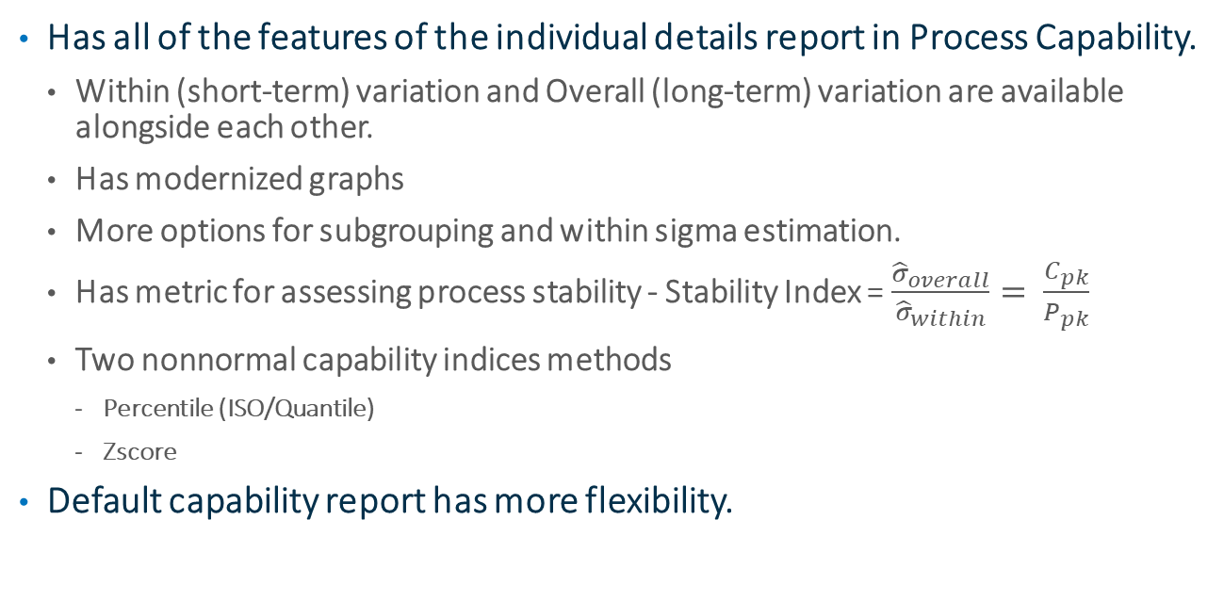
Process Capability in Distribution Platform
New Capability Analysis Features in Distribution
Has all of the features of the individual details report in Process Capability.
  Within (short-term) variation and Overall (long-term) variation are available alongside each other.
  Has modernized graphs
  More options for subgrouping and within sigma estimation.
  Has metric for assessing process stability - Stability Index = $\frac{{\hat{σ}}_{overall}}{{\hat{σ}}_{within}}= \frac{C_{pk}}{P_{pk}}$
  Two nonnormal capability indices methods
    Percentile (ISO/Quantile)
    Zscore
Default capability report has more flexibility.

Slide 5
Process Capability Report
New Features in Process Capability
Interactive Capability - Similar to capability animation in the legacy capability report.
Ability to fix parameters for nonnormal distribution fits.

Slide 6
Process Capability in Distribution Platform
Demo
Cheese manufacturer tests the final product weights for their cheese lines.
They test 4 cheeses in each sample.

Slide 7
Process Capability in Distribution Platform
Demo
Pharmaceutical company tests the capability of their process to keep drug impurities at low levels, less than 0.5%.
They believe these distributions are lognormal.

Slide 8
Process Capability in Distribution Platform
Legacy Capability and Fitters
All old scripting should still work and will call the legacy capability and distribution fitters.
There is a platform preference to use the legacy capability report instead of the new process capability report.
It is possible to access the legacy fitters from the distribution menu.

Slide 9
DETECTING SMALL SHIFTS IN YOUR PROCESS

Slide 10
Introduction
Traditional Shewhart charts are well established in detecting sudden spikes and large shifts (3 sigma or greater) in the process.

Slide 11
Introduction
What if we want to detect a small shift, or small gradual drift in the process mean?

Slide 12
CUSUM Control Chart DEMO
Notice that while sitting in I-40 traffic, temp gauge is continuing to rise. I suspect my car’s cooling system isn’t working right…

Slide 13
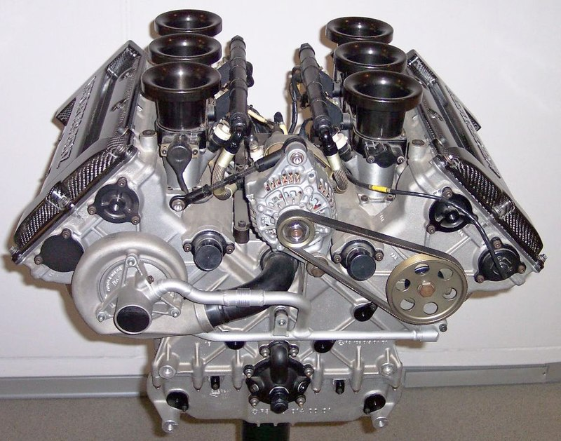
A V6 internal combustion engine from a Mercedes-Benz

Slide 14
Manual says
Normal engine operating conditions:
100C +/- 10
Which means,
Target: 100 C
Sigma: 10

Slide 15
Points
Formulas
The points plotted (Woodall & Adams, 1993), are
C+[i] = max[0, (xi - Target) - K + C+[i-1]]
C-[i] = min[0, (xi - Target) + K + C-[i-1]]
where (xi - Target) is standardized by sigma.

Slide 16
The Average Run Length (or ARL) is the average number of runs we can expect before seeing an out-of-control signal.

Slide 17

How can the Model Driven Multivariate Control Chart Platform Help You?
Jianfeng Ding
Senior Research Statistician Developer
JMP Division, SAS Institute

Slide 18
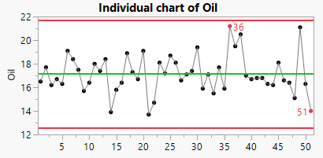
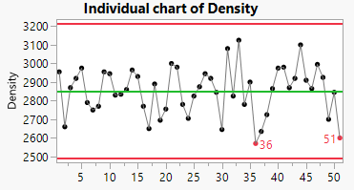
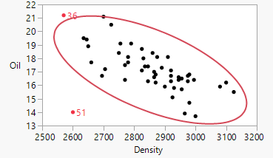
Traditional Statistical Process Control (SPC )
SPC charts
  Shewhart, CUSUM and EWMA
Disadvantage
  Charts a small number of variables
  Examines them one at a time
Most outliers remain undetected
  No covariance information

Slide 19
Multivariate Statistical Process Control (MSPC)
Projection methods
PCA and PLS
Advantages | Handles a large number of variables Reduces dimensionality Handles correlation
Apply models
Build models
Historical process
quality data
New process data
Monitoring processes | Hotelling's T² Squared prediction error (SPE) Scores
Diagnosing processes | Contribution plots

Slide 20

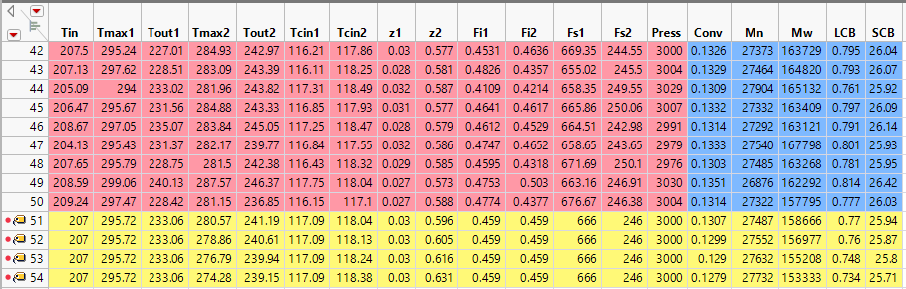
Data Overview
T_{cin1}
F_{s2} F_{i2} T_{in}
T_{cin2}
The simulated data from MacGregor et al (1994)
F_{s1}
F_{i1}
T_{in}
Process
Quality
Pressure
Tmax2
Tmax1
Temperature
Tout1
Tout2
Fault
Location z
z1
z2
Two-zone LDPE reactor with a typical temperature profile

Slide 21
Demos
PLS modeling historical data
T2, SPE, Scores
monitoring processes
Contribution plots
diagnosing processes
1
2
3

Slide 22
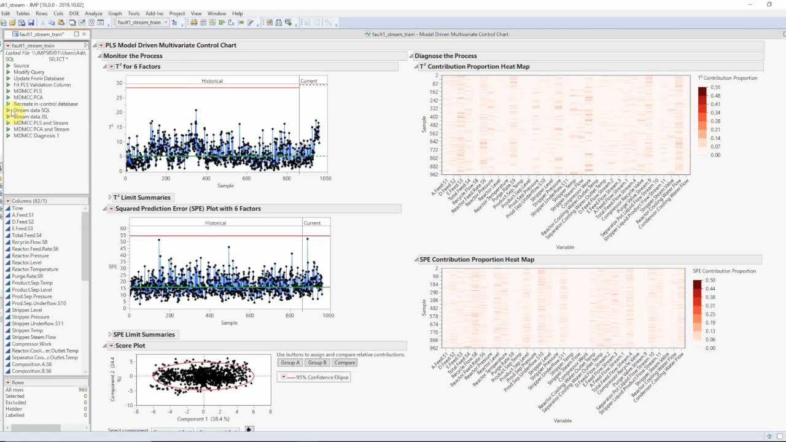



Example-Tennessee Eastman Process
Process data streaming

Slide 23

Questions?
Visit us at Discovery Expo.
Thank you!
Laura.Lancaster@jmp.com
Annie.Zangi@jmp.com
Jiangeng.Ding@jmp.com

