Slide 1


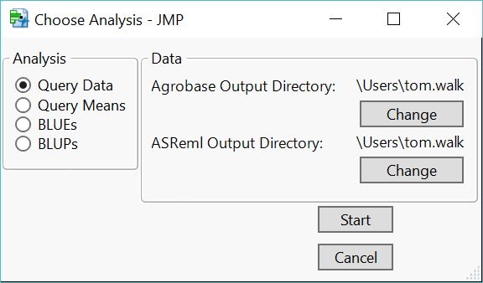
JMP as a Central Component of a Data Management and Analysis Platform
Thomas Walk, Ana Heilman Morales, Richard Horsley
North Dakota State University
Abstract
Requirements
User Interface
Crop breeders repeat tasks for thousands of breeding lines grown at multiple locations over many years
JMP JSL and Add-Ins allow for automation of data management and analysis
At NDSU, we made Add-Ins to query MS SQL Server databases and to analyze data in mixed models built in JMP or ASReml, an app built for breeding research
DB queries are made through New SQL Query, with parameters selected in user interface boxes
Results can be run through mixed model analysis directly in JMP or in ASReml launched from JMP through RunProgram
ASReml output goes to JMP tables through Parse XML
Code is written in object-oriented JSL functions
With methods available in JSL and Add-Ins, along with the ease of creating user interfaces, JMP has become a central piece in plant breeding research at NDSU.
Requires JMP, DB access (Agrobase), SQL Server driver, and ASReml for each user
Users install Add-In that connects to bulk of scripts stored in shared folder
Scripts in shared folder can be modified without requiring reinstallation of Add-In or any other changes on user computers
Non-modal Window
Default directory is user home
Click Start opens DB connected form to select query parameters
Stays open for multiple analyses until Cancel clicked
Add-In Organization
User computers
blue_blup_start
Shared folder
dsn_creds_remote_no_pwd
choose_analysis
Future Development
Objectives
Options to use JMP and ASReml for both BLUEs and BLUPs
Output graphics, e.g. histograms, heat maps
More dynamic UI with changing options based on user selections
query_data
run_BLUEs
query_means
run_BLUPs
Expedite plant breeding through automation of repeated tasks
Connect analysis with DB queries
Updated analysis using mixed models
query_agrobase_data
query_agrobase_means
query_data.sql
query_means.sql
run_asreml_code
run_jmp_blups
parse_asreml_xml

Slide 2
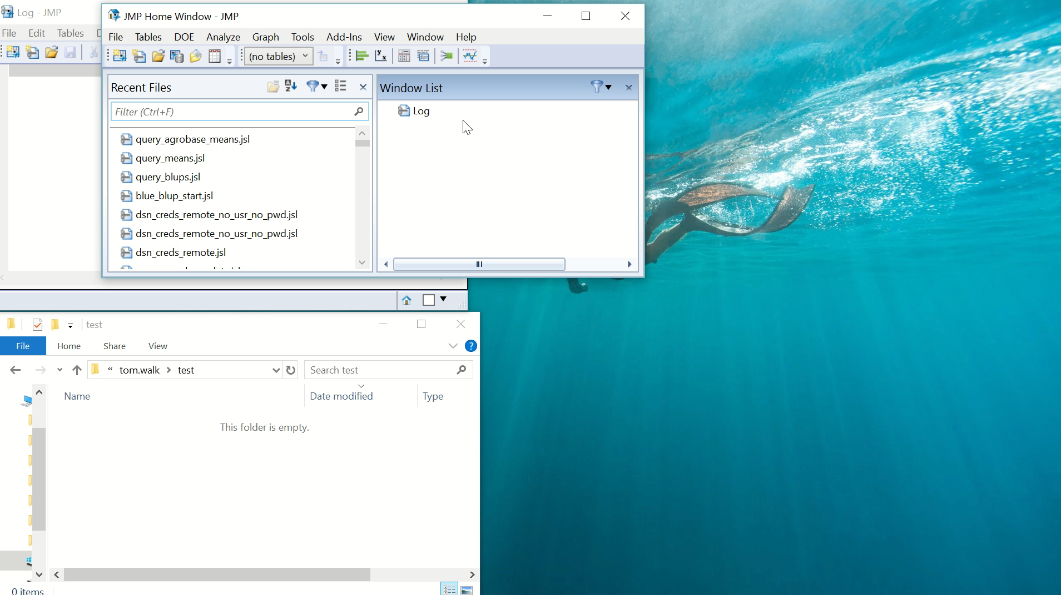
Running Add-In

