Slide 1
Large-Scale Process Monitoring Using JMP
Laura Lancaster and Jianfeng Ding

Slide 2

Motivation
Modern manufacturing is becoming increasingly complex and can produce enormous amounts of data.
Those huge amounts of data need to regularly monitored and analyzed to maintain quality.
It can be difficult to keep up with monitoring so much data with limited time and resources!

Slide 3

JMP
Tools for Large-Scale Monitoring
Process Capability, Process Screening, and Model Driven Multivariate Control Charts
Help analysts quickly and efficiently monitor and test large numbers of processes to assess where to focus attention.
Saves time, reduces workload, and improves quality!

Slide 4
Process Capability
A Platform for Screening Process Capability
Helps scan many processes to quickly assess how well they are performing compared to their specification limits.
Creates graphs for quick visual identification of processes that are within or out of spec or considered capable or incapable.
Creates summary reports of capability analysis for each process.
Can also be used for in-depth analysis of process capability for each process.

Slide 5
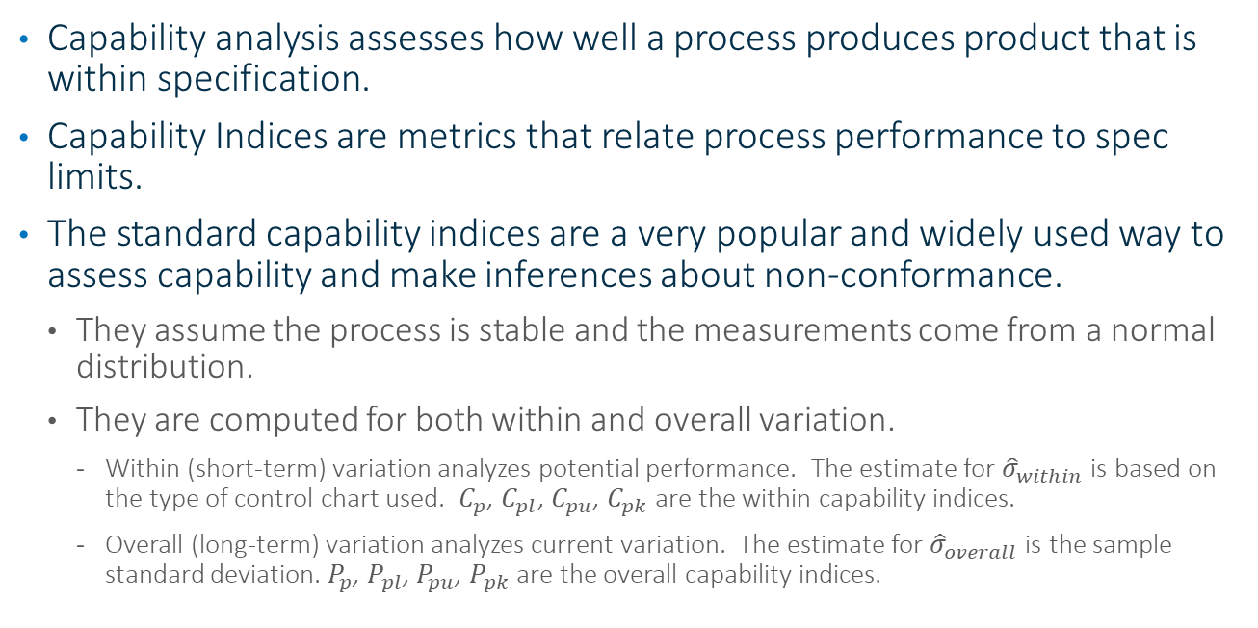
Process Capability
Capability Analysis
Capability analysis assesses how well a process produces product that is within specification.
Capability Indices are metrics that relate process performance to spec limits.
The standard capability indices are a very popular and widely used way to assess capability and make inferences about non-conformance.
  They assume the process is stable and the measurements come from a normal distribution.
  They are computed for both within and overall variation.
    Within (short-term) variation analyzes potential performance. The estimate for ${\hat{σ}}_{within}$ is based on the type of control chart used. $C_{p}$, $C_{pl}$, $C_{pu}$, $C_{pk}$ are the within capability indices.
    Overall (long-term) variation analyzes current variation. The estimate for ${\hat{σ}}_{overall}$ is the sample standard deviation. $P_{p}$, $P_{pl}$, $P_{pu}$, $P_{pk}$ are the overall capability indices.

Slide 6
Process Capability
Within Sigma Estimates
Within sigma estimates in Process Capability are related to the following types of control charts:
  I-MR (Individuals and Moving Range Charts)
  XBar-R/S (Average and Range/Standard Deviation Charts)
  XBar-MR-R/S (Three Way/Between-and-Within Charts)

Slide 7
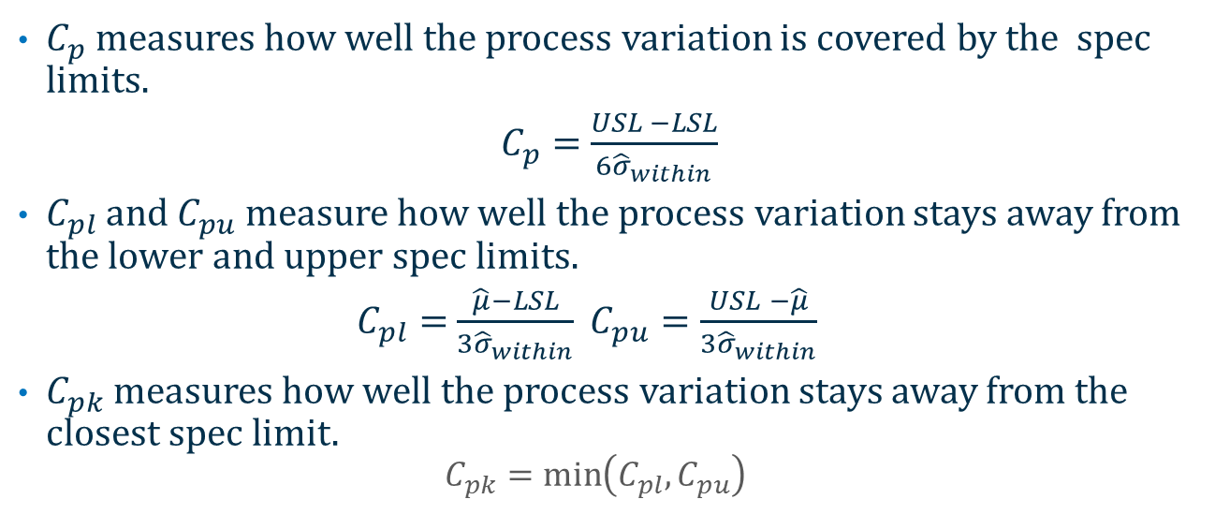
Process Capability
Standard Capability Indices
$C_{p}$measures how well the process variation is covered by the spec limits.
$C_{p}=$ $\frac{USL −LSL}{6{\hat{σ}}_{within}}$
$C_{pl}$ and $C_{pu}$measure how well the process variation stays away from the lower and upper spec limits.
$C_{pl}=$ $\frac{\hat{μ}−LSL}{3{\hat{σ}}_{within}}$ $C_{pu}=\frac{USL −\hat{μ}}{3{\hat{σ}}_{within}}$
$C_{pk}$ measures how well the process variation stays away from the closest spec limit.
  $$C_{pk}=\min\left(C_{pl},C_{pu}\right)$$

Slide 8
Process Capability
Graphs for Screening Capability
Capability Box Plots
  A graph of box plots for each process, centered by the target and scaled by the spec limits range.
  Makes it easy to analyze process variation relative to spec limits.
Goal Plot
  Plots process mean shifts standardized to specs on the x-axis and standard deviations standardized to specs on the y-axis.
  Makes it easy to access which processes are capable or incapable based on whether they are inside the goal.
  Helps determine the types of problems causing a process to be incapable.

Slide 9
Process Capability
Example – Catamaran Semiconductor’s Capability Analysis of Wafer Measurements
In their wafer production there are many steps and types of measurements taken.
Measurements are taken on several locations on each wafer.
We assume a subgroup size of n=1. The specification limits are saved as column properties in the data table.
Guideline | Ppk
Adequate | > 1.33
Marginal | 1.0 – 1.33
Poor | < 1.0

Slide 10
Process Screening
A Screening Platform for Quality
Helps scan large numbers of processes for stability and capability to quickly and easily assess where to focus attention.
Calculates and summarizes control chart, process stability, and process capability metrics.
Facilitates further exploration of selected processes with easy access to Control Chart Builder and the Process Capability platforms as well as performing shift and drift detection.
A good process is both stable and capable!

Slide 11
Process Screening
Monitoring Variation
Two types of process variability
  Common Cause Variation – routine variation that is part of the system
  Special Cause Variation – non-routine, unexpected variation that needs to be identified and investigated
Control charts are used to determine what types of variation are present in the process.
Various tests can be used to identify special cause variation.
A process is considered stable if it operates with an absence of special causes over time.

Slide 12
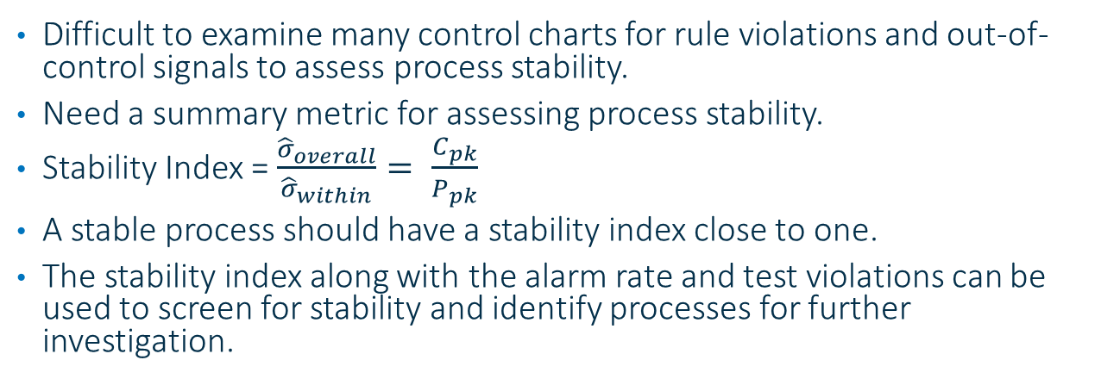
Process Screening
Monitoring Variation for Many Processes
Difficult to examine many control charts for rule violations and out-of-control signals to assess process stability.
Need a summary metric for assessing process stability.
Stability Index = $\frac{{\hat{σ}}_{overall}}{{\hat{σ}}_{within}}= \frac{C_{pk}}{P_{pk}}$
A stable process should have a stability index close to one.
The stability index along with the alarm rate and test violations can be used to screen for stability and identify processes for further investigation.

Slide 13
Process Screening
Control Chart Options
Control charts:
  I-MR (Individuals and Moving Range Charts)
  XBar-R/S (Average and Range/Standard Deviation Charts)
  XBar-MR-R/S (Three Way/Between-and-Within Control Charts)
Control chart alarms:
  Western Electric/Nelson tests (can be customized in preferences)
  Range Limit Exceeded

Slide 14
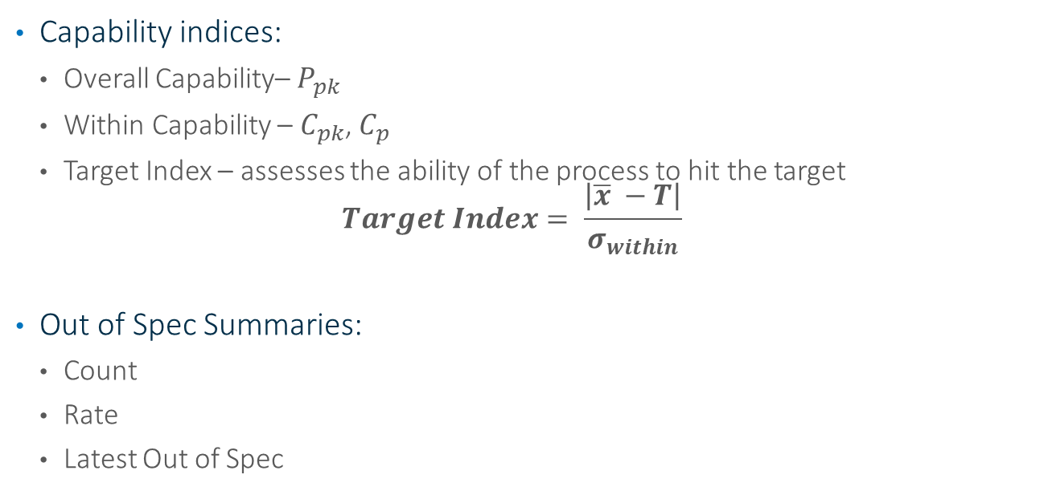
Process Screening
Capability Options
Capability indices:
  Overall Capability– $P_{pk}$
  Within Capability – $C_{pk}$, $C_{p}$
  Target Index – assesses the ability of the process to hit the target
  $$Target Index= \frac{\left|\overline{x} −T\right|}{σ_{within}}$$
Out of Spec Summaries:
  Count
  Rate
  Latest Out of Spec

Slide 15
Process Screening
Graph Options
Quick Graphs for Selected Items – Small graphs of selected processes to view and compare many processes at one time.
Process Performance Graph – Four quadrant graph that assesses processes in term of stability and capability.
Goal Plot – Graph for quickly assessing how processes are conforming to their spec limits.

Slide 16
Process Screening
Process Performance Graph
*Ramirez and Ramirez

Slide 17
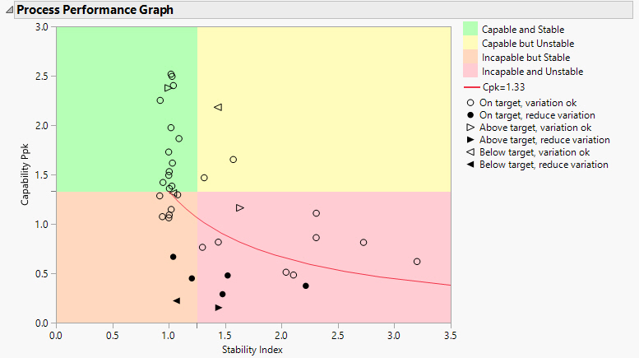

Process Screening
Process Performance Graph
Stability Index = $\frac{{\hat{σ}}_{overall}}{{\hat{σ}}_{within}}= \frac{C_{pk}}{P_{pk}}$

Slide 18
Process Screening
Options for Further Exploration
Control Charts for Selected Items – Launches Control Chart Builder report of selected processes.
Process Capability for Selected Items – Launches Process Capability report of selected processes.

Slide 19
Process Screening
Example – Monitoring Anchor Display’s OLED Production
Anchor Display produces several OLED devices that require many steps in production.
We will analyze the stability and capability for several production steps for 6 of their devices over several weeks.
We will assume a subgroup size of n=1. The spec limits are saved in a separate table.

Slide 20
Process Screening
Anchor Display’s Quality Guidelines
Guideline | Stability Index | C_{p} , C_{pk} , P_{pk} | Target Index
Adequate | <1.25 | >1.33 | <0.5
Marginal | 1.25-1.5 | 1.0-1.33 | 0.5-1.0
Poor | >1.5 | <1.0 | <1.0

Slide 21
Process Screening
Example – Revisit Catamaran Semiconductor’s Wafer Measurements
Use Process Screening platform to screen for stability and capability.
Use screening results to drill down to problem areas.

Slide 22
Process Screening
Process Shift and Drift Detection
Shift and Drift Detection helps to further examine unstable processes to identify sudden shifts or drifts in the mean.
Shift detection calculations find the size and location of large mean shifts.
  Runs an EWMA fit in forward direction and then in reverse direction.
  Identifies the largest positive and negative differences between successive EWMA values that exceed one within-sigma.
  Largest Upshift – Reports the absolute values of the largest upward shift, divided by within sigma, and the location of the first subgroup involved in this shift as the upshift position.
  Largest Downshift – Reports the absolute values of the largest downward shift, divided by within sigma, and the location of the first subgroup involved in this shift as the downshift position.

Slide 23
Process Screening
Process Shift Detection Graphs
Shift Graph - Shows locations of mean shifts that exceed the number of within-sigma units times the Shift Threshold (3 by default).
Show Shifts in Quick Graphs – Shows locations of means shifts in any displayed quick graphs.

Slide 24
Process Screening
Process Drift Detection
Drift detection calculations try to find slow drifts in the mean.
  Runs classic double-exponential smoothing model of Holt in both forward and backward directions.
  The slope estimates are used to characterize the drift. (These values can be found in the process details data tables.)
  Drift summaries - Reports Mean Up Drift, Mean Down Drift, and Mean Abs Drift based on slope estimates
Drift Graph – A graph of the drift (slope estimates) that enables detection of smaller and more gradual changes in the process.
Drift Graph Selected - Creates a drift graph for each process selected in the summary table.

Slide 25
Process Screening
Outlier Detection for Shift and Drift Detection
Outliers need to be handled automatically before shift and drift detection.
Automatic outlier detection is based on the within-sigma estimate and the user-defined Outlier Threshold. (5 by default.)

Slide 26
Process Screening
Example – Revisit Anchor Display’s OLED Production Process
We will analyze their unstable processes for means shifts and drifts.

Slide 27
Process Screening
Example – Monitoring Dockside Pharmaceutical’s Table Weights
They monitor the tablet weights for all of their drugs in tablet dosage form.
We will examine their recent tablet weight data, where they weigh 5 tablets per sample. (They prefer XBar-S charts.)
The spec limits are saved as column properties.
They use a 2 phase approach with their control charts. Need to import control chart limits.

Slide 28
Process Screening
Example – Monitoring Leeward Pharma’s Production Processes
They want to analyze their production data for seven of their products that are broken down into sub-steps.
Since production is based on demand, processes have varying amounts of data.
We will assume a subgroup size of n=1. The spec limits are saved as column properties.

Slide 29
References
Holt, C. C. (1957). Forecasting trends and seasonal by exponentially weighted averages. International Journal of Forecasting, 20(1), 5-10.
Knoth, S. (2012). CUSUM, EWMA, and Shiryaev-Roberts under drift. Frontiers in Statistical Quality Control, 10, 53-67.
Ramirez, B., & Ramirez, J. (2018). Douglas Montgomery’s Introduction to Statistical Quality Control: A JMP Companion. Cary, NC: SAS Institute Inc.
Ramirez, B., & Runger, G. (2006). Quantitative techniques to evaluate process stability. Quality Engineering, 8(1), 53-68.
Sall, John. (2018). Scaling-up process characterization. Quality Engineering, 30(1), 62-78.

Slide 30
Laura.Lancaster@jmp.com

