Slide 1
From Development to Testing: A Journey of Creating and Validating a JMP Add-In
Presenter: William Fisher
Organization: Clemson University

Slide 2
Speaker Introduction
Currently pursuing a PhD in Mathematical Sciences at Clemson University

Slide 3
Speaker Introduction
Currently pursuing a PhD in Mathematical Sciences at Clemson University
  Research Interests: Experimental Design and Preference Learning

Slide 4
Speaker Introduction
Currently pursuing a PhD in Mathematical Sciences at Clemson University
  Research Interests: Experimental Design and Preference Learning
Interning with the JMP R&D DOE and Reliability team since May 2024.

Slide 5
Speaker Introduction
Currently pursuing a PhD in Mathematical Sciences at Clemson University
  Research Interests: Experimental Design and Preference Learning
Interning with the JMP R&D DOE and Reliability team since May 2024.
  Worked on projects related to:
    Discrete Choice Experimentation
    Software Testing

Slide 6
Overview
Motivation for Creating the Add-In: Learning User Interface Preferences of Easy DOE (Usability Study)
Creating a JMP Add-In for Designing Contextual Discrete Choice Experiments using JSL.
Testing the Add-In through the JSL Unit Testing Framework.

Slide 7
Motivation for Creating the Add-In: Learning User Interface Preferences of Easy DOE (Usability Study)

Slide 8
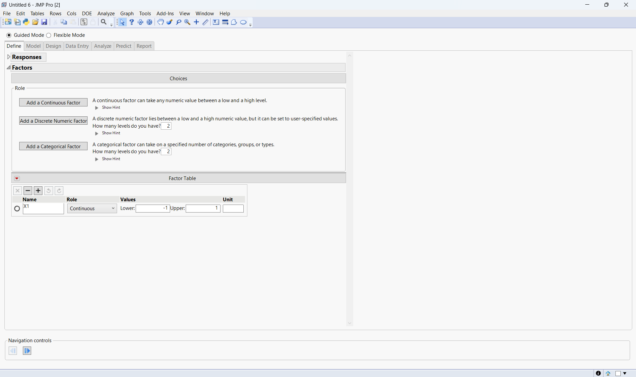
Easy DOE in JMP
Easy DOE Workflow
Define: specify factors and responses.
Model: select effects to estimate and number of runs.
Design: view the experimental design.
Data Entry: record observed responses for each run.
Analyze: fit the model and select active terms.
Predict: profile the response using the fitted model and select the optimal factor settings
Report: view the summary report
Figure 1: Starting Screen for Guided Mode in Easy DOE

Slide 9
Easy DOE in JMP
Easy DOE Workflow
Define: specify factors and responses.
Model: select effects to estimate and number of runs.
Design: view the experimental design.
Data Entry: record observed responses for each run.
Analyze: fit the model and select active terms.
Predict: profile the response using the fitted model and select the optimal factor settings
Report: view the summary report
Figure 1: Starting Screen for Guided Mode in Easy DOE

Slide 10
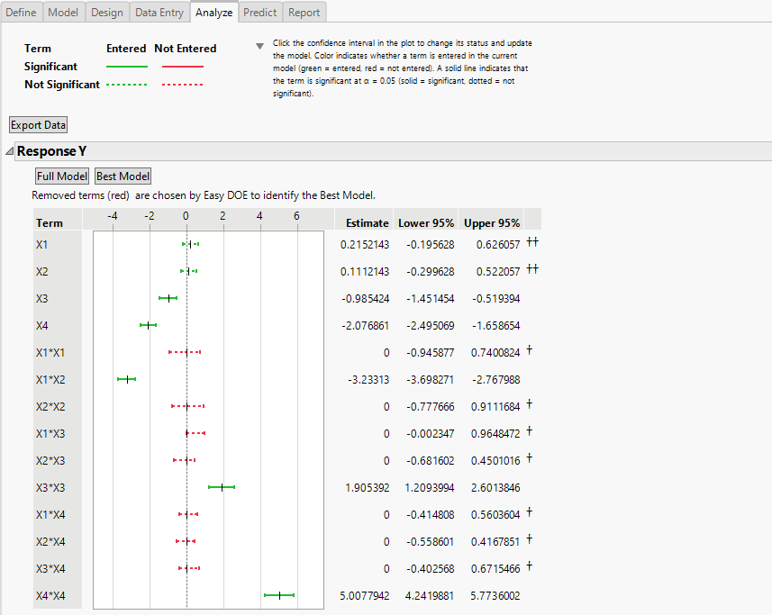
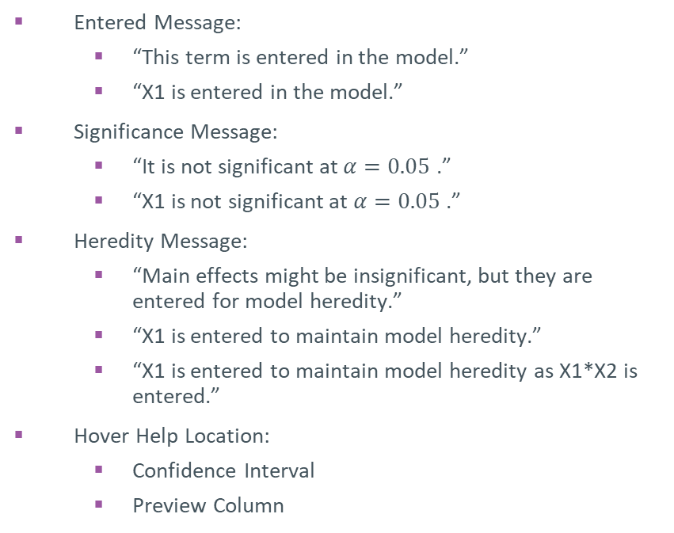
Hover Help Settings in the Analyze Tab
Hover Help Settings
Entered Message:
  “This term is entered in the model.”
  “X1 is entered in the model.”
Significance Message:
  “It is not significant at $α=0.05$ .”
  “X1 is not significant at $α=0.05$ .”
Heredity Message:
  “Main effects might be insignificant, but they are entered for model heredity.”
  “X1 is entered to maintain model heredity.”
  “X1 is entered to maintain model heredity as X1*X2 is entered.”
Hover Help Location:
  Confidence Interval
  Preview Column
Entered Message
Significance Message
Heredity Message
Figure 2: Hover Help Settings of the Analyze Tab

Slide 11
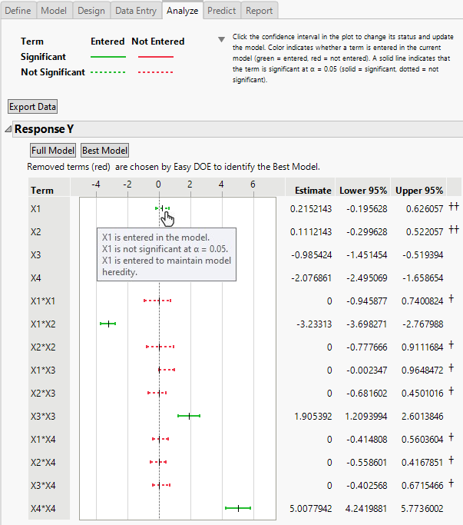
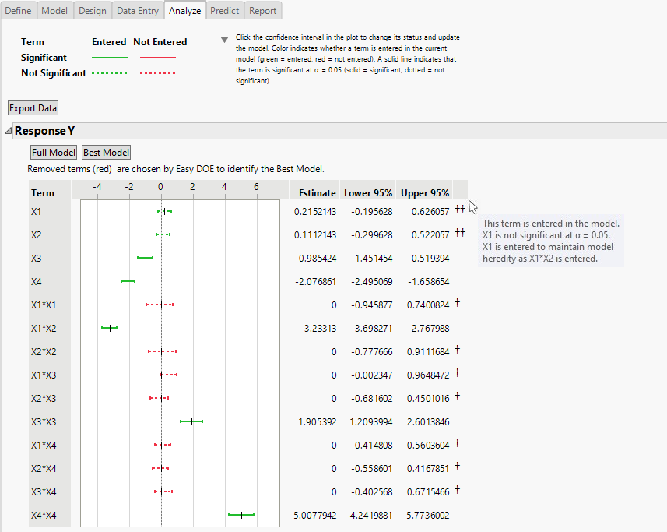
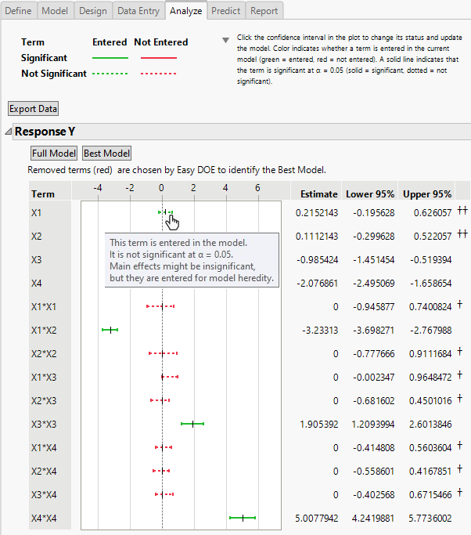



Goal: Learn Hover Help Preferences Across Demographic Groups
Hover Help 1
Hover Help 2
Hover Help 24
Experience Level in DOE
New to DOE
Experienced in DOE
Purpose of Using Easy DOE
Personal Use
Demographic Group 1
Demographic Group 2
Demographic Group 3
Teaching Others

Slide 12






Contextual Discrete Choice Experimentation
Data Collection
Questionnaire
Question 1: Which option do you prefer?
Question K: Which option do you prefer?

Slide 13
Contextual Discrete Choice Experimentation
Preference Modeling and Analysis
Hover Help Settings
User Contextual Information
Utility

Slide 14












Design of Contextual Discrete Choice Experiments
Screening Study
Using Information from Screening Study to Design Contextual DCE
Hover Help Settings
User Contextual Information
Utility
Question 1: Which do you prefer?
A
B
Bayesian D-Optimal Designs

Slide 15
Creating a JMP Add-In for Designing Contextual Discrete Choice Experiments using JSL

Slide 16
JSL and JMP Add-Ins
JSL: The JMP Scripting Language allows users to extend the functionality of JMP, for example by allowing users to write scripts to

Slide 17
JSL and JMP Add-Ins
JSL: The JMP Scripting Language allows users to extend the functionality of JMP, for example by allowing users to write scripts to
  Automatically run a routine multi-step analysis.

Slide 18
JSL and JMP Add-Ins
JSL: The JMP Scripting Language allows users to extend the functionality of JMP, for example by allowing users to write scripts to
  Automatically run a routine multi-step analysis.
  Fit a specified model to data which is generated on a daily basis.

Slide 19
JSL and JMP Add-Ins
JSL: The JMP Scripting Language allows users to extend the functionality of JMP, for example by allowing users to write scripts to
  Automatically run a routine multi-step analysis.
  Fit a specified model to data which is generated on a daily basis.
JMP Add-In: A JSL script which extends the functionality of JMP that other JMP users can download and use.

Slide 20
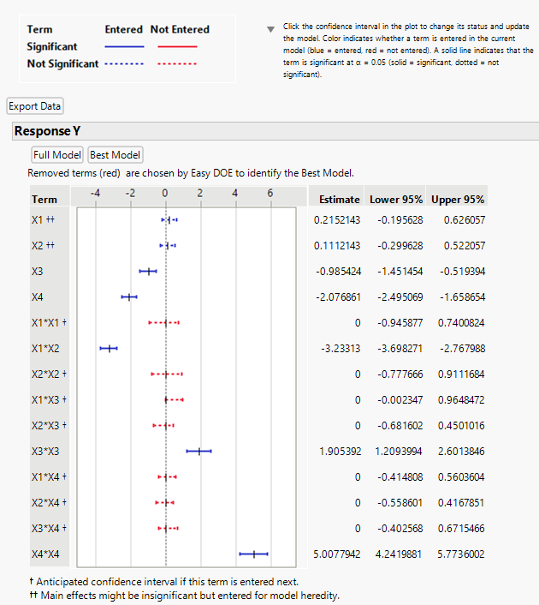
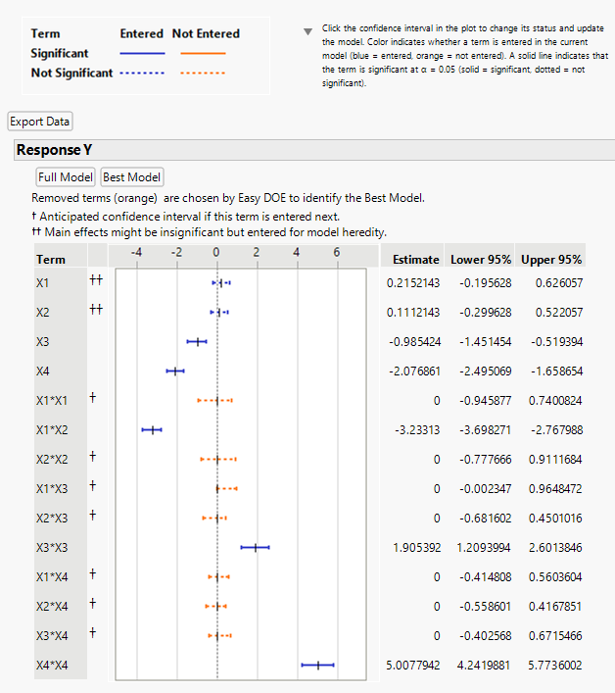
Why Create a JMP Add-In to Solve our Problem?
We were conducting multiple usability studies
  Conducted the same usability study at different points in time.
  Conducted different usability studies where UI factors of interest or contextual effects could change.
Figure 3: Usability Study for Color Scheme and Location of Notification Messages/Icons.

Slide 21
Why Create a JMP Add-In to Solve our Problem?
We were conducting multiple usability studies
  Conducted the same usability study at different points in time.
  Conducted different usability studies where UI factors of interest or contextual effects could change.
The process of designing discrete choice experiments for different contexts could be tedious
  Required calculating a prior mean and covariance matrix for each context based on the screening study.
  Could be automated through JSL scripting.
Figure 3: Usability Study for Color Scheme and Location of Notification Messages/Icons.

Slide 22
Why Create a JMP Add-In to Solve our Problem?
We were conducting multiple usability studies
  Conducted the same usability study at different points in time.
  Conducted different usability studies where UI factors of interest or contextual effects could change.
The process of designing discrete choice experiments for different contexts could be tedious
  Required calculating a prior mean and covariance matrix for each context based on the screening study.
  Could be automated through JSL scripting.
Allows us to create contextual discrete choice experiments for a wide range of choice tasks / problems.
Figure 3: Usability Study for Color Scheme and Location of Notification Messages/Icons.

Slide 23


Workflow of Contextual DCE Add-In: Screening Study and Analysis
Data from Screening Study
Experimenter selects a data table containing:
  Choice Indicator Column
  Subject ID Column
  Choice Set ID Column (Question ID)
  Profile Attributes (Hover Help Settings)
  Subject Covariates (Contextual Information)
Screening Model Specification
Experimenter specifies
  Profile Effects (Model Effects of Hover Help Settings on Utility)
  Subject Effects (Model Effects of Contextual Information on Utility)
Screening Model Estimation
Specified utility model is estimated using JMP’s Choice Analysis Platform
  Profile effects and the interaction between profile and subject effects are estimated, along with the correlation matrix of model effects.
Profile Effects
Subject Effects
Utility

Slide 24
Workflow of Contextual DCE Add-In: Experimental Design
Select a Group for Further Study
Experimenter selects levels for each contextual factor to specify a group for subsequent study
Make Design for Selected Group
Using preference information obtained from the screening study, a Bayesian D-optimal Design is constructed for the experimenter’s selected group using JMP’s Choice Design platform.
Level Specification for Contextual Factor 1:
Contextual Factor 1 – Level 1
….
Level Specification for Contextual Factor J:
Contextual Factor J – Level 1
Make Design

Slide 25
Demonstration

Slide 26
Testing the Add-In through the JSL Unit Testing Framework

Slide 27
The JSL Unit Testing Framework
Unit Testing:
  Involves testing individual components of a software application to identify errors.

Slide 28
The JSL Unit Testing Framework
Unit Testing:
  Involves testing individual components of a software application to identify errors.
  Automated unit testing allows one to frequently run unit tests on a software application, helping to identify and correct newly introduced errors through the development process.

Slide 29
The JSL Unit Testing Framework
Unit Testing:
  Involves testing individual components of a software application to identify errors.
  Automated unit testing allows one to frequently run unit tests on a software application, helping to identify and correct newly introduced errors through the development process.
JSL Unit Testing Framework:
  An automated unit testing framework tailored for JSL applications.

Slide 30
The JSL Unit Testing Framework
Unit Testing:
  Involves testing individual components of a software application to identify errors.
  Automated unit testing allows one to frequently run unit tests on a software application, helping to identify and correct newly introduced errors through the development process.
JSL Unit Testing Framework:
  An automated unit testing framework tailored for JSL applications.
  Components are tested through use of the function
  ut assert ( expression, expected value )

Slide 31
The JSL Unit Testing Framework
Unit Testing:
  Involves testing individual components of a software application to identify errors.
  Automated unit testing allows one to frequently run unit tests on a software application, helping to identify and correct newly introduced errors through the development process.
JSL Unit Testing Framework:
  An automated unit testing framework tailored for JSL applications.
  Components are tested through use of the function
  ut assert ( expression, expected value )
  A report will be returned letting the tester know which test cases failed, so that they may be further investigated.

Slide 32
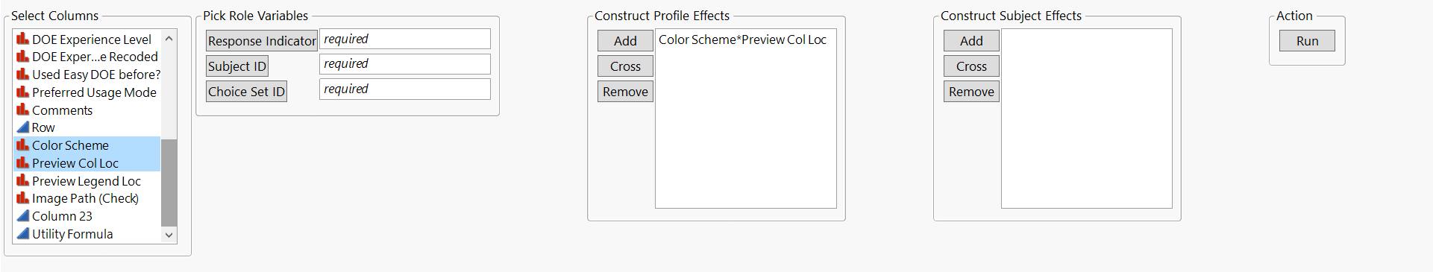
Examples of Unit Tests for the Contextual DCE Add-In
Figure 4: Testing the correctness of the output for the cross button for the screening model specification.

Slide 33
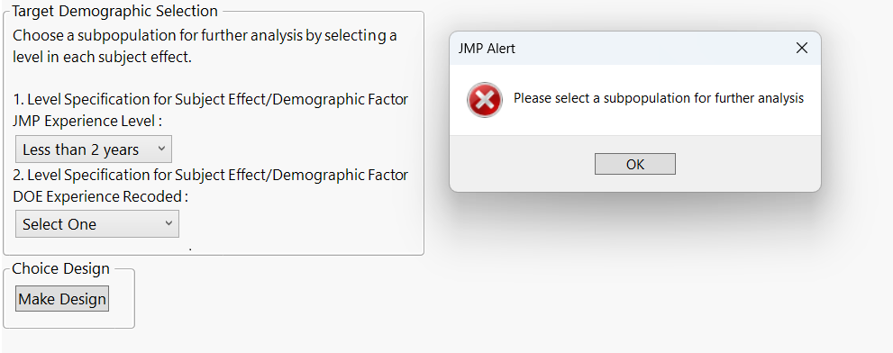

Examples of Unit Tests for the Contextual DCE Add-In
Figure 5: Testing that an error message is displayed if there is no level selected for a given contextual factor when selecting a group for further study.

Slide 34
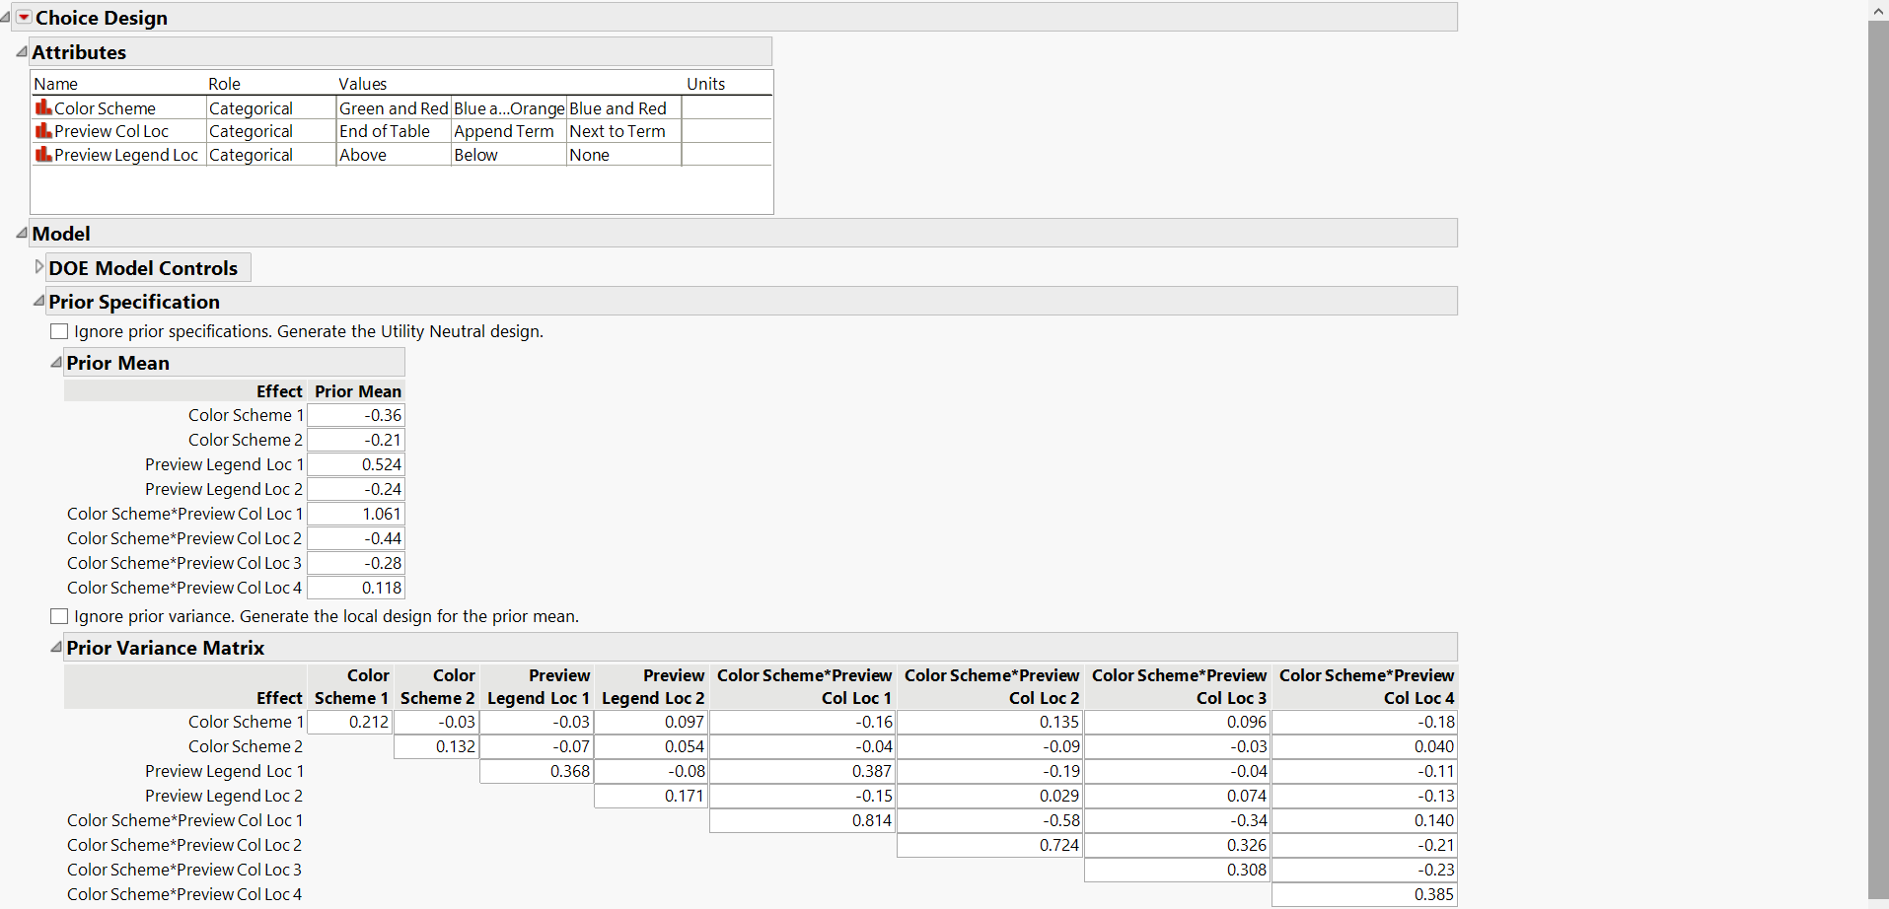
Examples of Unit Tests for the Contextual DCE Add-In
Figure 6: Testing that prior information obtained from the screening study is loaded in correctly to the choice design platform.

Slide 35
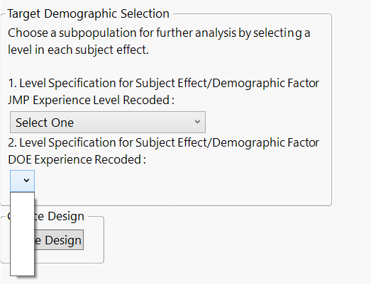
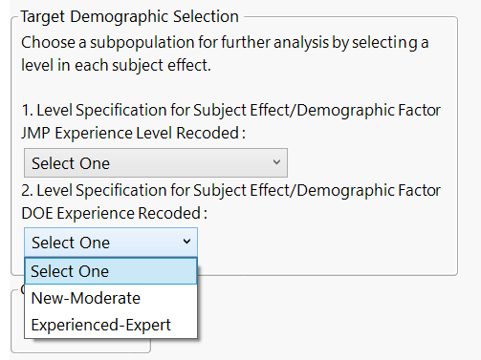
Automated Unit Testing and Code Refactoring
Automated Unit Testing allows one to refactor one’s code, and check if any errors were introduced.
  Example: We found an error in the menu for selecting a demographic group when one of the contextual factors had Value Labels.
  After fixing the Value Label issue, we could rerun our unit test script to help ensure no unintended errors were introduced.
Figure 7: Before and after identifying the Value Label error.

Slide 36
Conclusion
Introduced the problem of designing contextual discrete choice experiments to help learn user interface preferences in Easy DOE across different subsets of users.

Slide 37
Conclusion
Introduced the problem of designing contextual discrete choice experiments to help learn user interface preferences in Easy DOE across different subsets of users.
Demonstrated how JSL scripting allowed us to create a convenient-to-use JMP Add-In for constructing contextual discrete choice experiments.

Slide 38
Conclusion
Introduced the problem of designing contextual discrete choice experiments to help learn user interface preferences in Easy DOE across different subsets of users.
Demonstrated how JSL scripting allowed us to create a convenient-to-use JMP Add-In for constructing contextual discrete choice experiments.
Discussed the importance of unit testing as a way to help detect errors during and after the development process.

Slide 39
Questions
?
?
?

