Slide 1
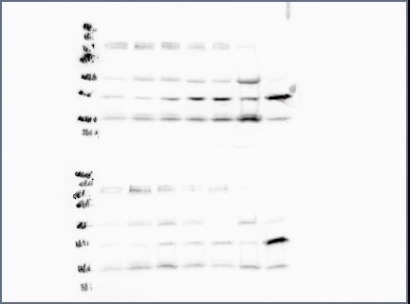
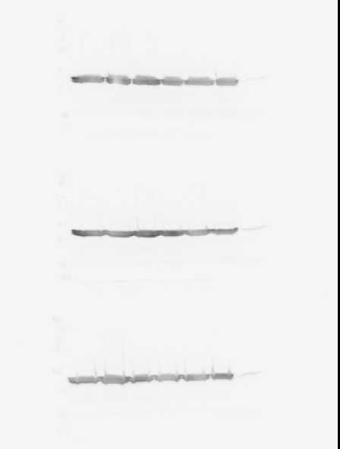
Replace with logo
Graphs 1
Introduction Methods & Objectives
This slide/poster size is 40.97” x 23.04” (16:9 aspect ratio)
Minimum font: 28pt (this may seem large, but at this poster size it’s not)
Recommended font Types: Calibri, Arial, Times New Roman
Multiple pages can be used. Multiple page allows adequate spacing for adding more content, images, graphs and videos
This is only a template. All content may be modified
Layout should always be in landscape orientation & recommended 1-5 slides max unless you hyperlink.
Check all your hyperlinks to make sure it goes to your desired slides
Slide Show Toolbar: Select “Setup Slide Show” then select “loop continuously until stopped”
Embedded videos can only be displayed in the following formats: .mov, .mp4, .mpeg. Note: Upload your video file along with your PowerPoint file.
Save all mathematical formulas and equations to images (.jpg, .png) when embedding or upload your excel file along with your PowerPoint file.
Save PowerPoint as .pptx to ensure all your embedded images and videos are included.
Western Blot
PLSCR1
36kd
Actin
46kd
Time (Hours)
Results Click graphs to enlarge
This PowerPoint 2011 template produces a 40.97” X 23.04” presentation poster. You can use it to create your research poster and save valuable time placing titles, subtitles, text, and graphics.
Images
Images
Conclusions References & Acknowledgements
We provide a series of YouTube tutorials that will guide you through the poster design process and answer your poster production questions. To view our template tutorials, go online to https://www.youtube.com/playlist?list=PLBz4JvE0AKmweXsMNGeyRXgWgN_lj_b5L
Need assistance? Call 617-588-3508 option 2
Thanks to whomever should be acknowledged in this research.
Reference A
Reference B
Reference C
Notes:
Single sided poster!

Slide 2
Graphs 1
Western Blot Data
Western Blot
PLSCR1
36kd
Actin
46kd
Time (Hours)

Slide 3
Graphs 1

