Slide 1



Using JMP® To Analyze Factors That Predict Depression
Grant Reeves & Moumita Sen
MBA Students (Marketing Analytics), Oklahoma State University
According to the Department of Health and Human Resources, over two million adolescents aged 12-17 suffered from major depression episodes in the past year
Based on official symptoms found on WHO websites, we analyzed top nine symptoms that can predict depression in adolescents
ABSTRACT
METHODS
RESULTS
CONCLUSIONS

Slide 2


DATA SELECTION AND PREPARATION
Year | Year of Survey
Demographic Variables | Sex, Grade, Race, Age, BMI
Sexual Orientation | Straight, Gay/Lesbian, Bisexual, Not Sure
BMI Indicator | 0 if BMI is less than 30 else 1
Symptoms | 0 for No and 1 for Yes
Percentage | Percentage of Yes (symptom variables) out of total questions answered
Depression Flag | 0 if the percentage variable is less than 50%, 1 if it is greater than 50%
D
A
T
A
S
E
T
117,815 observations
17 input variables and 5 variables created
1 target variable
ABSTRACT
METHODS
RESULTS
CONCLUSIONS

Slide 3
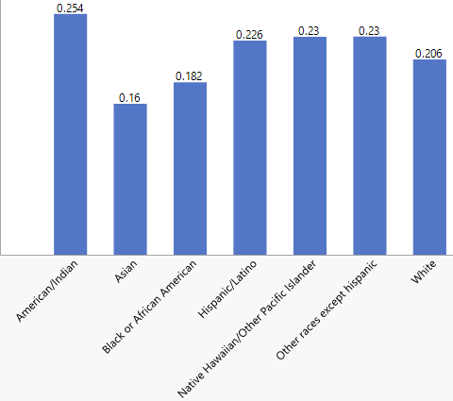
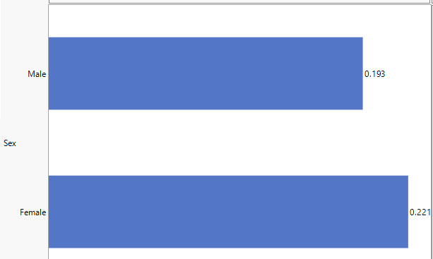

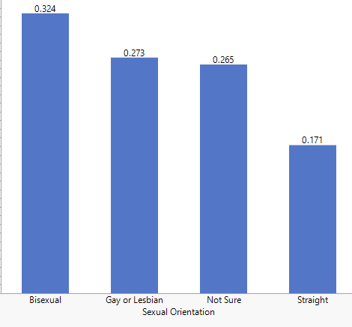


ANALYSIS OF DEMOGRAPHIC VARIABLES WITH PERCENTAGE (MEAN)
On average the below groups showed more signs of being depressed:
Minority Races
BMI >30
ABSTRACT
METHODS
RESULTS
CONCLUSIONS

Slide 4



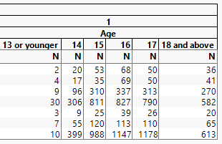
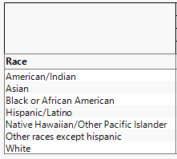
DATA ANALYSIS
Bisexual Females have shown significantly higher indications of depressions as compared to males
Across all ages, among the minority races, Hispanic/Latinos have a higher number of depression flag of 1
ABSTRACT
METHODS
RESULTS
CONCLUSIONS

Slide 5
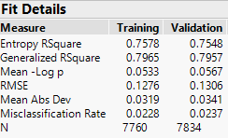
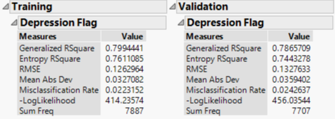
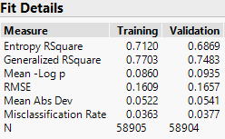
MOST IMPORTANT VARIABLES
Logistic Regression
Neural Network
Decision Tree
Actual suicide attempt, More than 5 drinks of alcohol, Forced to have sexual intercourse, Drug usage
Actual suicide attempt, More than 5 drinks of alcohol, Feel sad or hopeless
Considered all the variables
ABSTRACT
METHODS
RESULTS
CONCLUSIONS

Slide 6
MODEL PERFORMANCE
MODEL COMPARISON
Model | Misclassification Rate |  | Sensitivity
 | Training | Validation | Training | Validation
Logistic Regression | 2.22% | 2.37% | 83.25% | 83.56%
Neural Network | 2.23% | 2.42% | 83.21% | 82.57%
Decision Tree | 3.62% | 3.76% | 81.21% | 79.8%
Logistic Regression is the best model with the lowest misclassification rate and highest sensitivity
ABSTRACT
METHODS
RESULTS
CONCLUSIONS

Slide 7

KEY TAKEAWAYS
High alcohol consumption can be a predictor of not only bad behavior but also depression
School counsellors need to be more aware that minorities in race and sexual orientation are more susceptible to depression
Victims of sexual and drug abuse are highly prone to depression and therefore should be provided an environment to communicate freely
1
2
3
ABSTRACT
METHODS
RESULTS
CONCLUSIONS

Slide 8


M
E
M
B
E
R
S
T
E
A
M
GRANT REEVES
grant.reeves@okstate.edu
806-228-1350
https://www.linkedin.com/in/grantreeves3/
MOUMITA SEN
moumita.sen@okstate.edu
405-762-2468
https://www.linkedin.com/in/moumita-sen/

