Slide 1
New in JMP 14: Balanced Incomplete Block Designs (BIBD)
Ryan Lekivetz

Slide 2
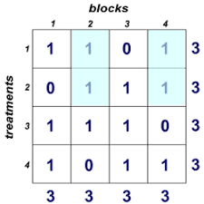
What is a BIBD?
A BIBD is a two-factor design.
One categorical (with t treatments)
The other is a blocking factor (b of size p)
Goals:
Each treatment level appears the same number of times (r)
Each pair of treatment levels appears the same number of times (c)

Slide 3
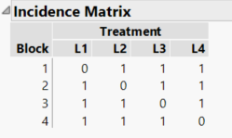
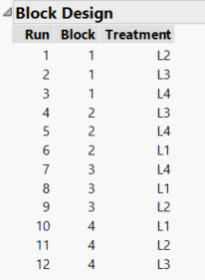
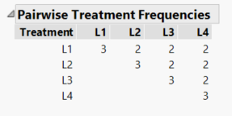

Slide 4
Necessary conditions…
  Definitions:
  t = # of treatments
  r = # of times each treatment occurs (r for replicates)
  b = # of blocks
  p = # number of runs in each block
  c = # of pairwise occurrences
Implications
  n = tr = bp
  c = r(p-1)/(t-1)
  Problem: Meeting the necessary conditions does not guarantee the existence of a BIBD.

Slide 5

Problems
  Given t and b there may not be a BIBD
  Fulfilling the necessary conditions does not guarantee the existence of a BIBD
  So, generating a BIBD is not easy.

Slide 6

Fact: a BIBD is a D–optimal design
  The Custom Designer makes D–optimal designs.
  But, the coordinate exchange algorithm that the Custom Designer uses has trouble finding a BIBD. This is especially true for a BIBD with many runs.
  MaxDiff designer is trying to find a BIBD, but also has no guarantees.

Slide 7

Kudos to developer

Slide 8
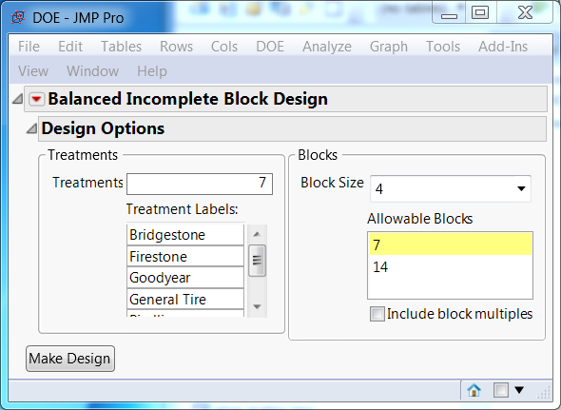
New in JMP 14: BIBD Designer
JMP Demonstration Time!

