Slide 1
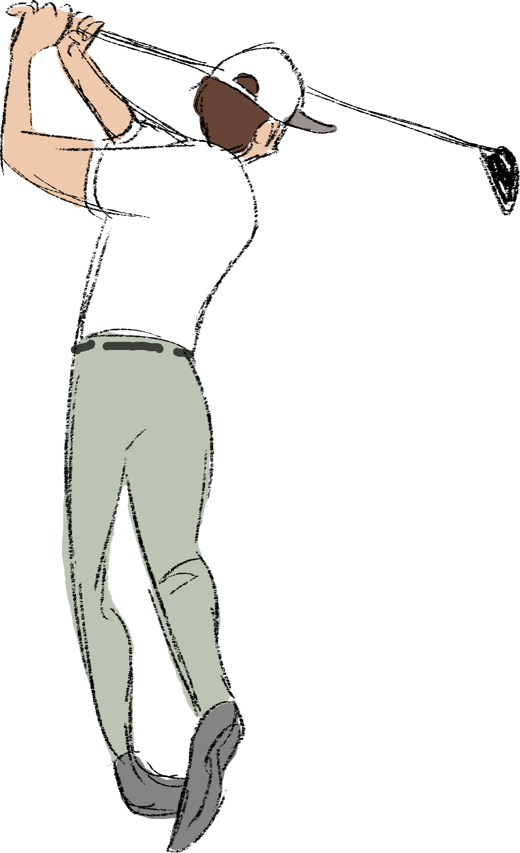
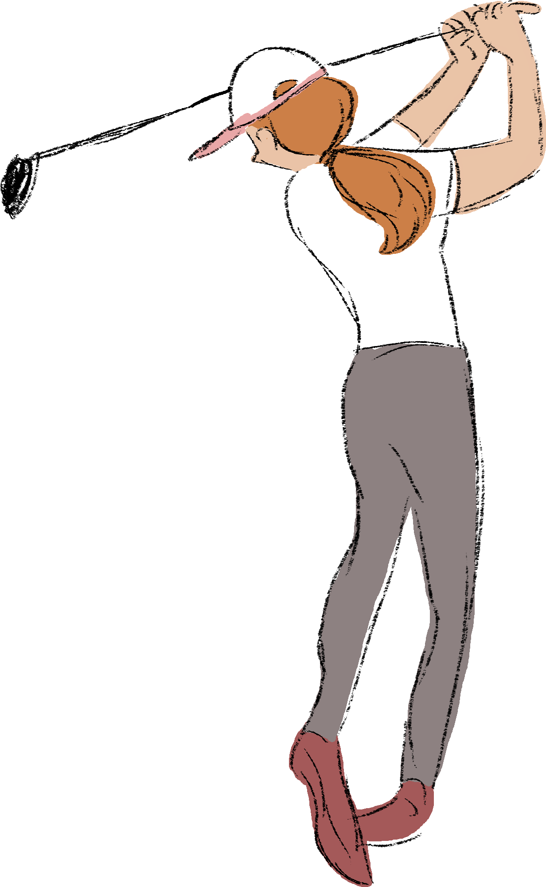
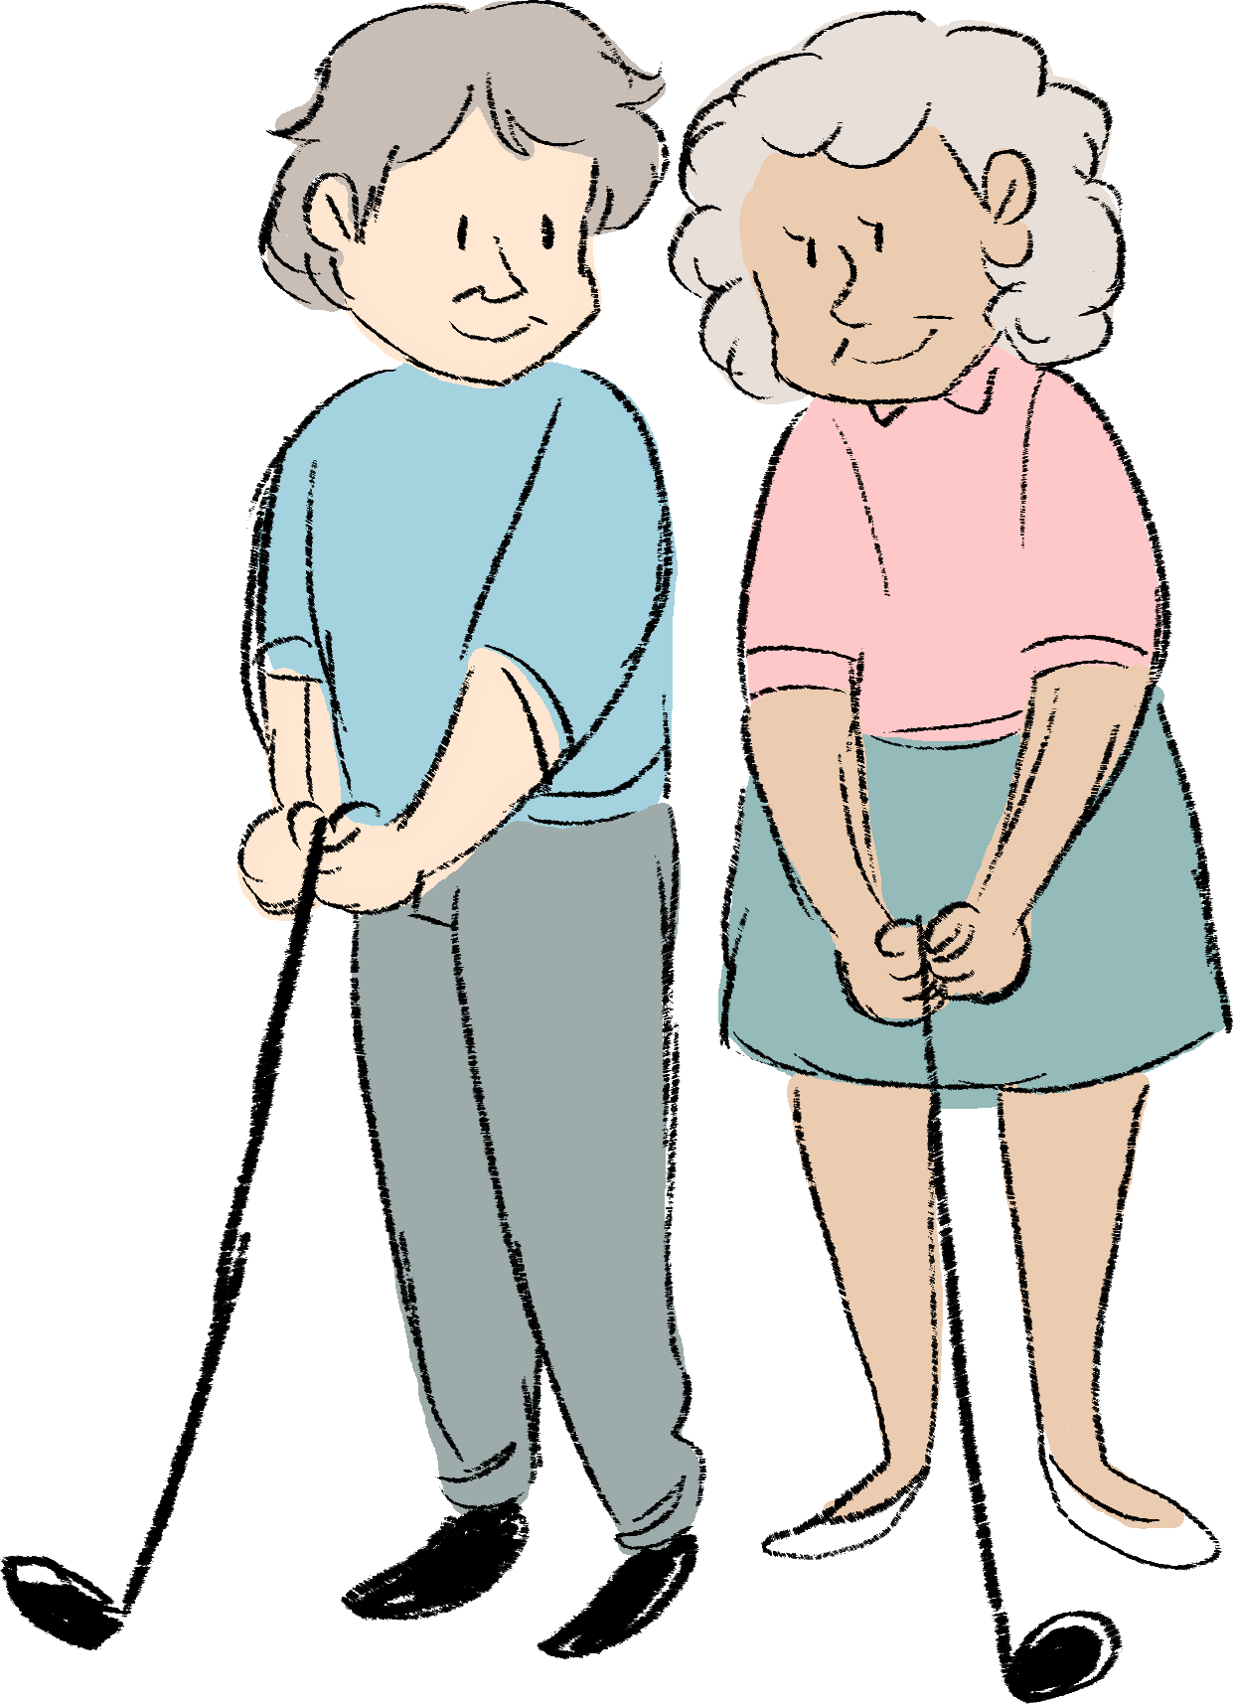

Do Golf Handicaps Always Level the Playing Field?
David C. Trindade, Ph.D.
STAT-TECH
JMP Discovery Summit
October 2018

Slide 2
What is golf handicapping?
Golf handicapping is meant to “level the playing field” and allow players of different abilities to compete nearly equally in tournaments. It’s about fairness and an equal chance to win.
Each golfer has a handicap based on a fairly elaborate formula that uses the ten best, adjusted scores in the most recent twenty rounds. Details on how to determine a golfer’s handicap are provided in the appendix.
In competition, the handicap is subtracted from a golfer’s gross score to determine the net score. The net scores among players within a flight division are then ranked and the lowest net scores are the event winners.

Slide 3


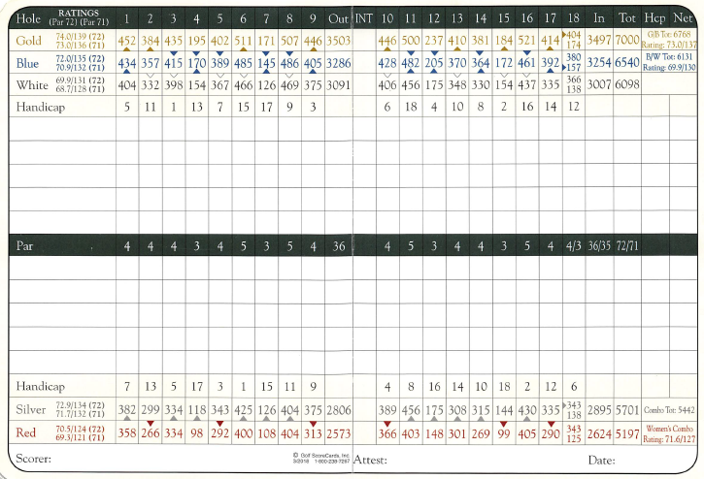

A Brief Introduction to the USGA Handicapping System
A typical golf course will have several different sets of tee-boxes on each hole from which the golfers play their round. The tee-boxes indicate different overall lengths in yards or meters of the course played.
The tee-boxes are often color labeled*: Gold or Black for the longest yardages (called the “tips”), Blue or Green for the popular intermediate yardages, White or Silver for more forward tees, and Yellow or Red for the shortest yardages.
For each set of tees, there will be two important rating numbers such as 74.2/131. The first number is the course “par” rating based on the overall yardage for the 18 holes. The second is the “slope”, a measure of the course difficulty from the chosen tees.
These two numbers are meant to adjust for scores of golfers playing from different courses and tee-boxes.
Example scorecard and ratings.
* In Maui, HI, Kaanapali course has tees labeled Uliuli, Keo Makamae, and Pu Koko’o.

Slide 4
What Is a Fair Handicapping System?
From a statistical viewpoint, how can we determine that the handicapping system is fair and performing as expected?
Expectation:
Gross scores should increase nearly linearly with handicaps, but net scores should be reasonably consistent and comparable across handicaps.
The analysis approach we employ is to compare graphs of the gross and net scores versus handicaps.

Slide 5
Statistical Analysis of Gross and Net Scores
For golfers competing, there should be a positive, nearly linear, increasing relationship between the golfers’ gross scores and the current handicap. The slope of the regression line should be statistically significant, and RSquare should be reasonably high.
If the handicap system is fair, there should be little or no correlation between the golfers’ net scores and the current handicaps. The slope of the regression line and RSquare should both be near zero.

Slide 6
Investigating the Relationship Between Gross and Net Scores with JMP
For this talk, we apply JMP’s analytical and visualizing capabilities to investigate the relationship between gross and net scores versus handicaps for four different tournaments run at a private country club.
We employ some of JMP’s powerful analytical capabilities such as: Fit Y by X, Distributions, Graph Builder, Outlier Screening, and BY variable formula functions.

Slide 7
Discovery with JMP
In the process, we uncover several interesting scoring differences for various tournaments among men, seniors, and women.
An “Aha!” moment occurs when we discover that the handicapping system for a certain tournament type can result in outcomes not consistent with a level playing field for all competitors.

Slide 8
Discovery with JMP
In addition, we also address some interesting issues:
1. Was there any sandbagging occurring in the tournament?
2. What is the most difficult tournament for women golfers?
3. How many golfers in a tournament “shoot their handicaps”?

Slide 9
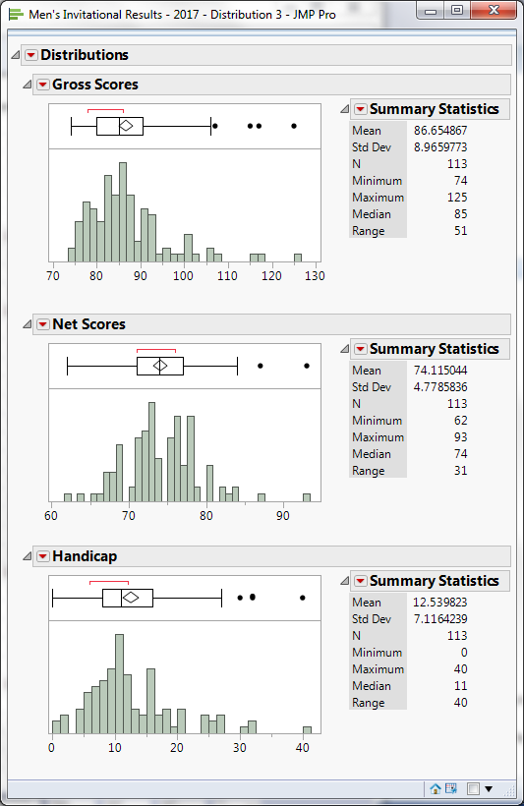
SCVCC 2017 Men’s Invitational Results
A total of 113 men played the blues tees (par 71).
The Gross Scores ranged from 74 to 125, with median 85.
The Net Scores ranged from 62 to 93, with median 74.
The Handicaps ranged from 0 to 40, with median 11.
Note how JMP’s Summary Statistics have been customized to show the minimum, maximum, median, and range.

Slide 10
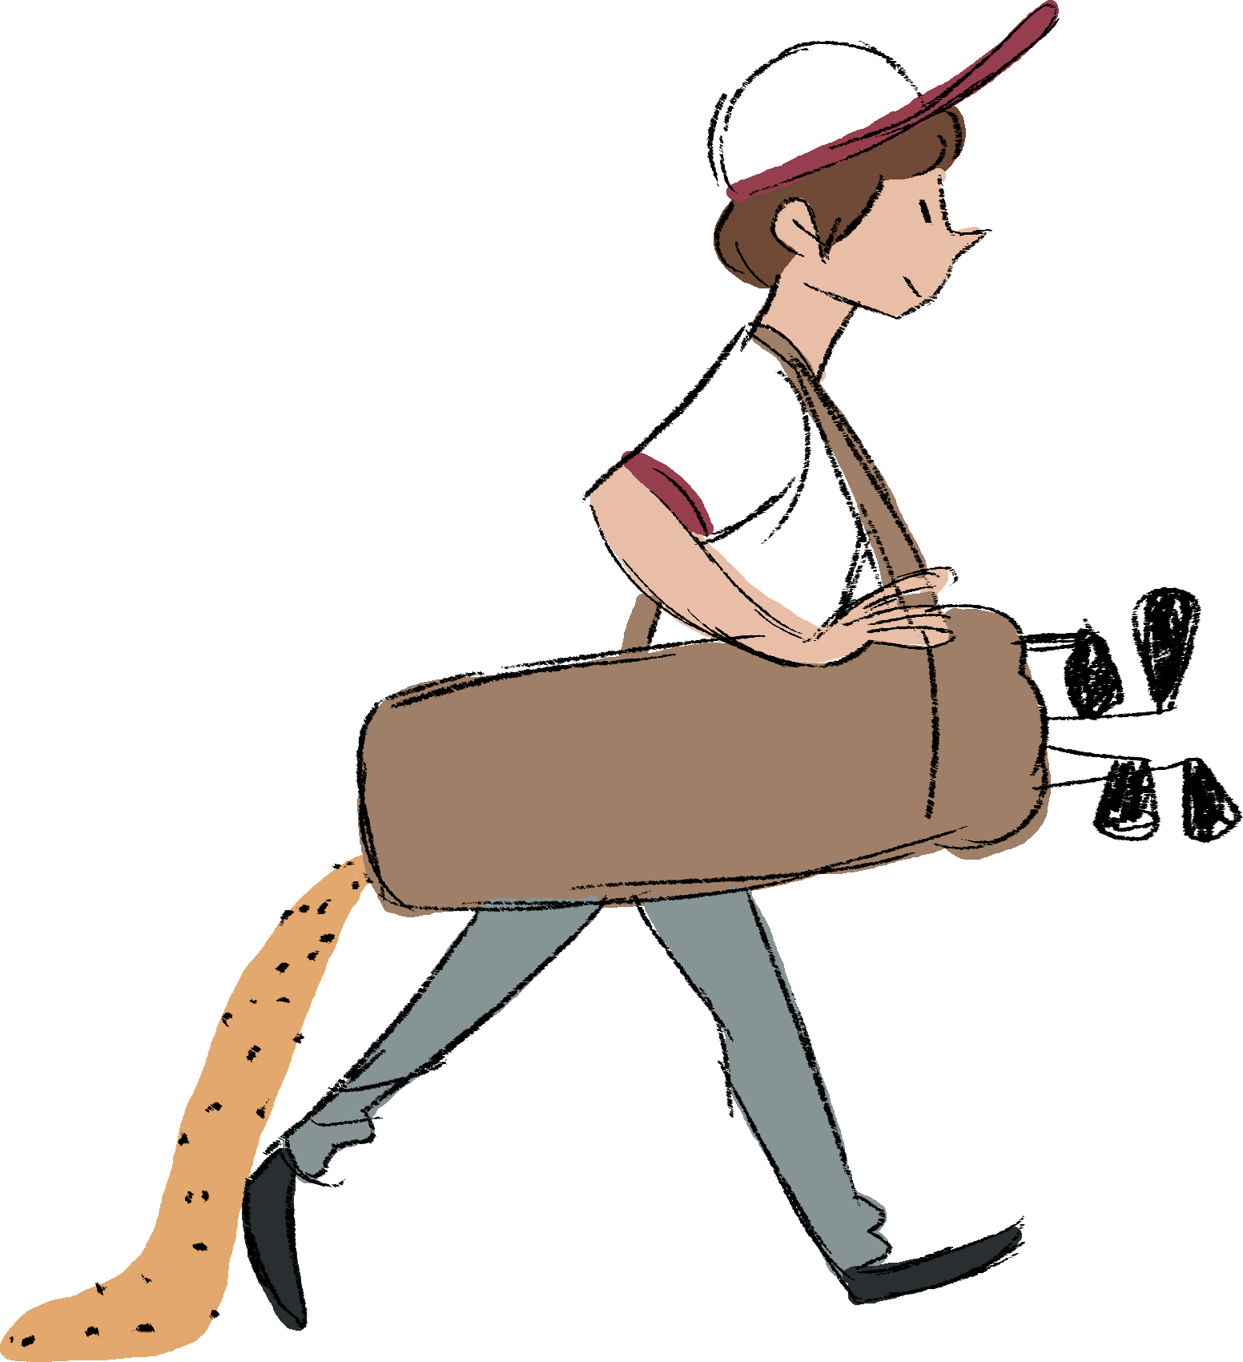
Sandbagging: Outlier Detection
It can be informative to detect exceptionally low outliers in the net scores, especially scores that are posted by what are referred to as “sandbaggers”, individuals who shoot unusually low scores not consistent with their handicaps in competition.

Slide 11
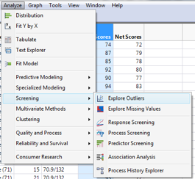
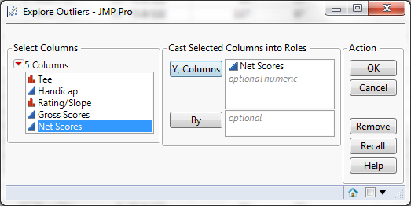
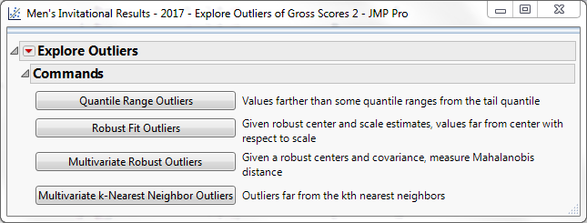
Checking for Outliers in Net Scores with JMP
Analyze, Screening, Explore Outliers
Cast Roles
Select Either Quantile Range or Robust Fit Outliers

Slide 12
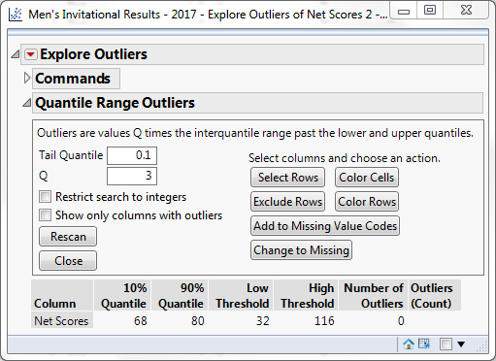
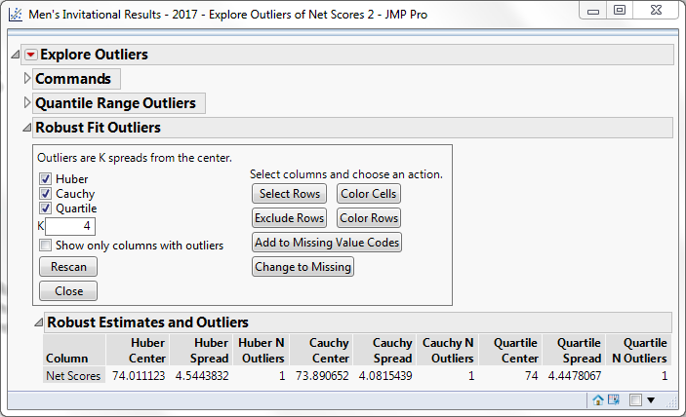
Checking for Outliers in Net Scores with JMP
Quantile Range showed no outliers. Robust Range identified a possible outlier.
To view outliers, click Net Scores Column and Select Rows to highlight row with suspect outlier.
Quantile Range Outliers
Robust Fit Outliers

Slide 13
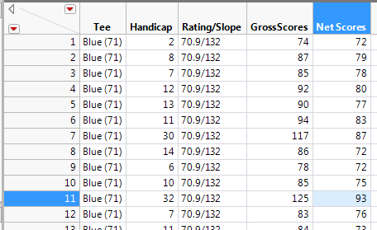
Outlier Row in Net Scores
JMP highlighted rows 11 with Handicap 32, Gross Score 125, and Net Score 93. This was a high outlier and no evidence of sandbagging!
We can choose to Hide and Exclude this outlier by right clicking on the row, but we will include it in the analysis that follows.

Slide 14
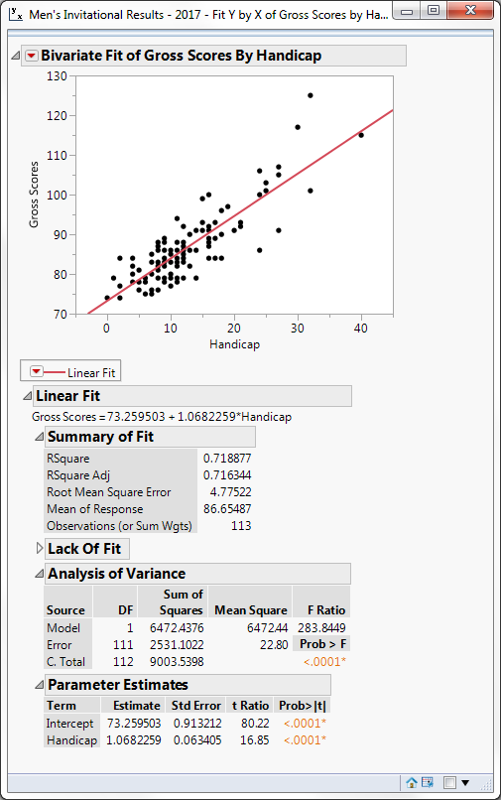
Gross Scores Versus Handicaps (Fit Y by X)
As expected, there is a statistically significant, linear relationship between the gross scores and the handicaps.
Slope of the regression line is ~1.
RSquare is roughly 72%, that is, the handicap factor reduces the variance in the distribution of gross scores by 72%.

Slide 15
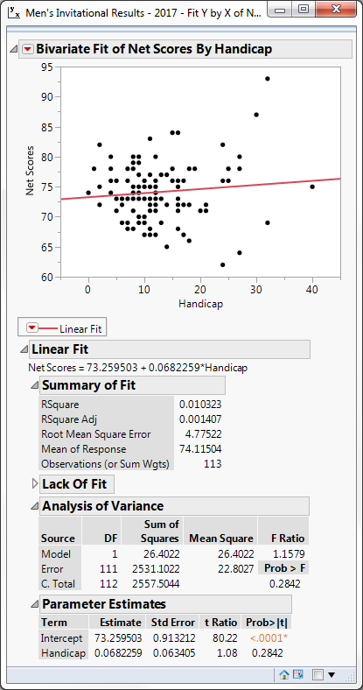
Net Scores Versus Handicaps
There is no statistically significant relationship between the net scores and the handicaps.
Slope of the regression line is ~0.07
RSquare is only ~1%.
We interpret these results as indicating that the handicap factor produced fairly consistent and comparable scores among the players, that is, there was a relatively level playing field for the competing golfers.

Slide 16
Mean Scores by Handicap (Formula byVariable)
Because of the variation in individual gross and net scores for each handicap value, it can be informative to consider estimating the mean scores for each handicap and then applying Fit Y by X.
A very useful capability in the formula menu easily allows the mean estimation via the byVariable in the Col Mean function to calculate means based on the entries in a specific column.
For example, suppose we wish to calculate the gross mean scores by handicap. We set up a separate column labeled “Gross Mean Scores by Handicap” in the data table.

Slide 17




Mean Scores by Handicap (Formula byVariable)
In the formula entry whiteboard space, select Statistical, Col Mean, and click on the “Gross Scores” column to get the entry shown below:
Next, with the “Gross Scores” outline box highlighted, click the insert symbol “^” to display the “byVariable” box, and click the “Handicap” column for that entry.
JMP will now fill in the column with the mean gross scores for each handicap.
Because of the different number of golfers at each handicap value, we can also set up a separate column for weights or frequency for the number of players at each handicap value using formula below.
Note that multiple byVariables can be inserted in the formula.

Slide 18
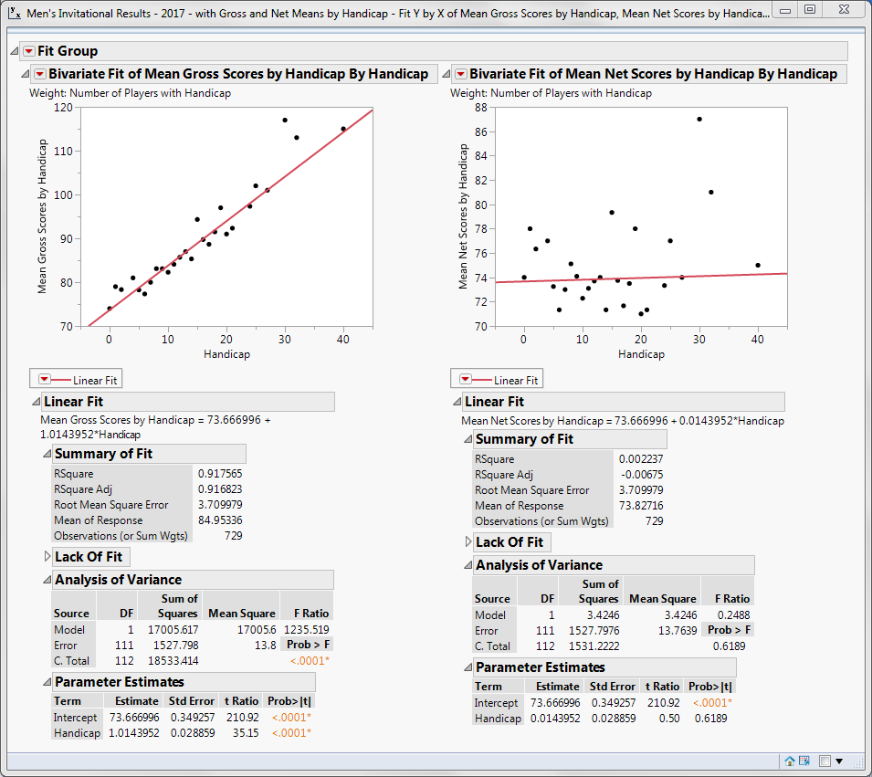
Gross and Net Mean Scores by Handicap
By using the weighted mean scores by handicap, we have much less variation in the plots.
The regression line slope for Mean Gross Scores versus handicap is ~1.0.
The RSquare ~92%.
The regression line slope for Mean Net Scores versus handicap is ~0.01.
The RSquare is only ~0.2%.
The expectation of a level playing field is supported.

Slide 19
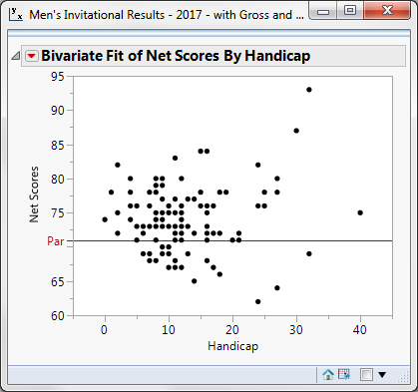
“Shooting a Handicap”
How often does a golfer shoot his/her handicap in a tournament, that is, have net scores of par or better?
This plot shows that even with a fairly level playing field, it is still challenging for golfers to “shoot their handicap”.
Only 31 or 31/113 = 27% had net scores of par (71) or better.

Slide 20


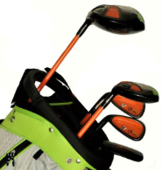
Analyses of Three Other Tournaments*
A similar analyses was done on three other tournaments.
  2018 Men’s Stroke Play Championship (two rounds) with 74 golfers
  2018 Red-White-Blue Tournament on July 4th with 116 golfers (47 men, 44 seniors, and 25 women)
  2018 5-Club Tournament with 103 golfers (52 men, 32 seniors, and 21 women)
The analysis results for the first two tournaments were also supportive of a level playing field*. The second tournament did have some interesting outcomes that we will mention. However, the third tournament produced an “Aha!” moment that we will reveal later in this talk.
*The detailed results for these tournaments are presented in the Appendix.

Slide 21
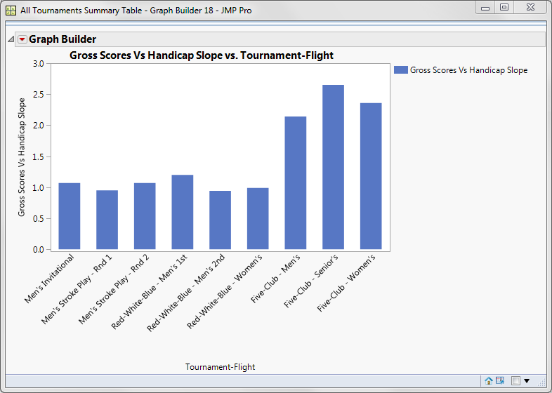
Slopes of Gross Scores Vs. Handicaps for the Tournaments
Slopes of Regression Lines
With the exception of the Five-Club tournament, the results from the other three competitions were similar.
There was a strong, linear, increasing, statistically significant relationship between the gross scores and the handicaps.
For six different rounds across four tournaments the slopes of the regression lines were roughly 1.
For the Five-Club competition, the slopes were more than double the other tournaments, reflecting the added difficulty of playing with only five clubs.

Slide 22
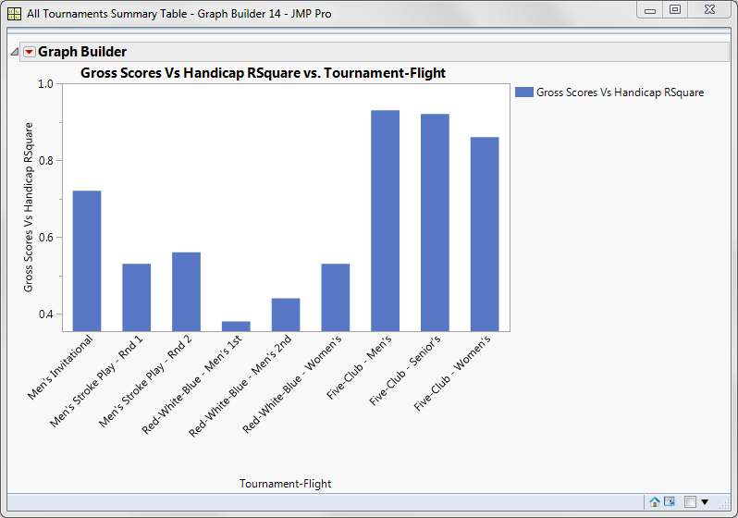
RSquares of Gross Scores Vs. Handicaps for the Tournaments
RSquares
The regression line RSquares for the nine different tournament rounds ranged from a low of 0.38 to a high of 0.92.
For the Five-Club competition, the RSquares were the highest of all tournaments, reflecting the importance of the handicap for this tough format.

Slide 23
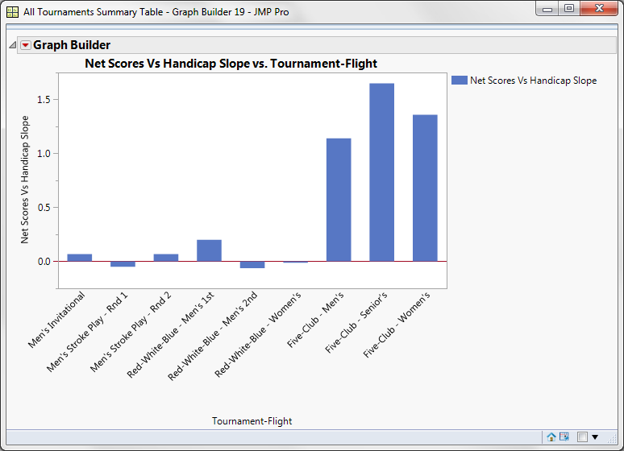
Slopes of Net Scores Versus Handicaps for the Tournaments
Slopes of Regression Lines
With the exception of the Five-Club tournament, the results from other competitions were similar.
There was no statistically significant relationship between the net scores and the handicaps. Slopes were near zero.
The playing field was level for these six tournaments rounds.
For the Five-Club competition, there were statistically significant slopes indicating that the net scores were actually increasing with handicaps.
For the Five-Club competition, the playing field was not level.

Slide 24
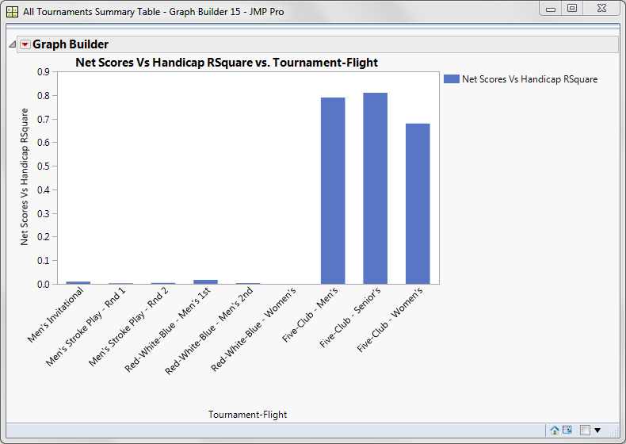
RSquares of Net Scores Vs. Handicaps for the Tournaments
RSquares
Further confirmation that the Five-Club tournament was different occurred by viewing the RSquare estimates.
For the other tournaments, the RSquare estimates were near zero, supporting a level playing filed.
For the Five-Club competition, the high and significant RSquares indicated that net scores rose with handicaps.

Slide 25
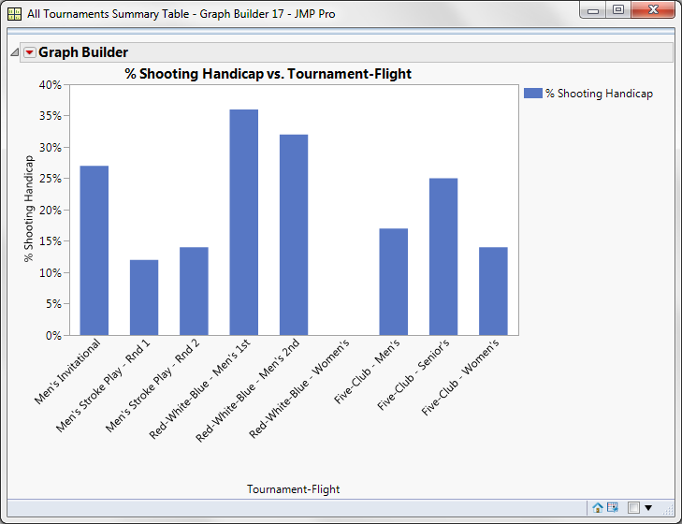
Percent “Shooting Their Handicap” for Net Score
The range of the percent shooting their handicap went from zero to 36%.
For the Red-White-Blue tournament, the men’s first flight had 36% shooting their handicap, the highest of all tournaments. This result is not too surprising since 6 of the 18 tees were played from the red tees, and men normally play from the longer blue or white tees.
In contrast, for the women’s flight, no one had a net score of par or better. Again, no surprise here since 12 of the 18 tees were the white and blue tees that women seldom played. Women typically play from the red tees.
Although a tough format for women, all women are competing within a single division, which makes the competition fair.

Slide 26
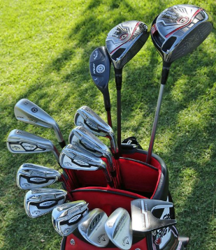
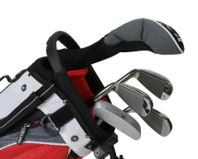
Detailed Analysis of 5-Club Tournament
For this tournament, golfers are allowed to use any 5 clubs of their choice for the round instead of the normal maximum limit of 14.

Slide 27
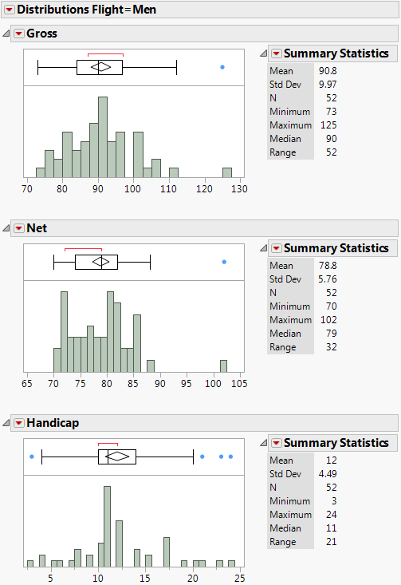
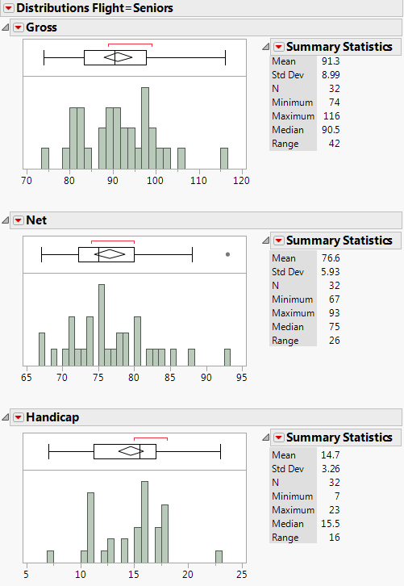
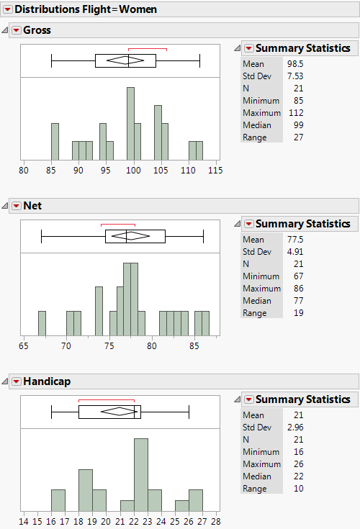
SCVCC 2018 5-Club Tournament
A total of 105 golfers played in three separate flights: 52 men, 32 seniors, and 21 women).
Each flight played from different tees: blue for men, white for seniors, and red for women in a single round.
The men’s handicaps ranged from 3 to 24, with median 11. The seniors’ handicaps ranged from 7 to 23, with median 15.5, and the women’s handicaps ranged from 16 to 26 with median 22.

Slide 28
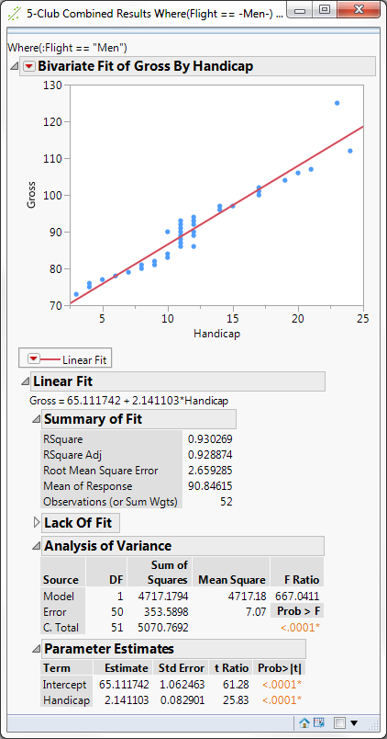
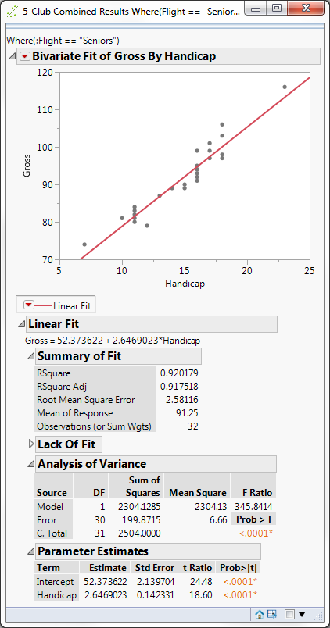
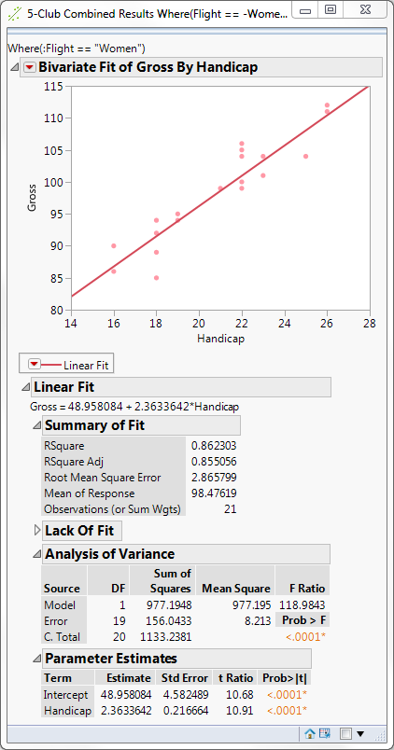
5-Club Tournament: Gross Scores
As expected, all three flight groups show a similar, statistically significant, strong linear relationship between the gross score and the handicap.
Slopes are >2 for all groups, that is, double other tournaments.
RSquares are roughly 93%, 92%, and 86%, respectively, for the three groups.

Slide 29
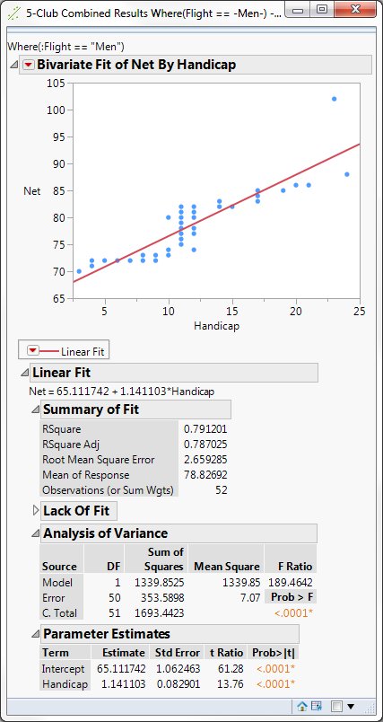
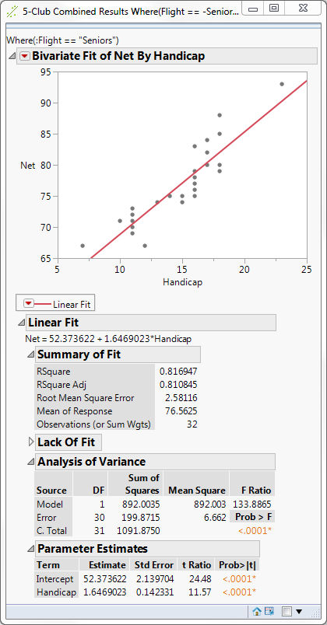
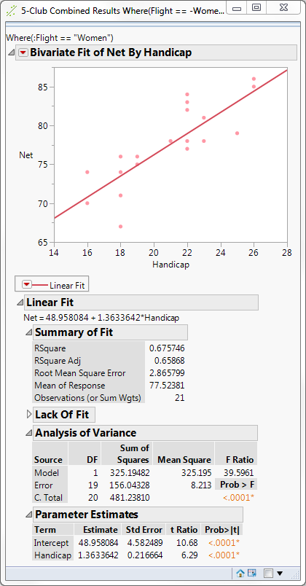
5-Club Tournament: Net Scores, the Aha! Moment
A surprise occurs when we see statistically significant linear relationships between the net scores and the handicaps for all three flights.
Slopes are all >1.
RSquares are 79%, 82%, and 68%, respectively.
Unexpectedly, the handicaps are not producing a level playing field among the golfers.

Slide 30
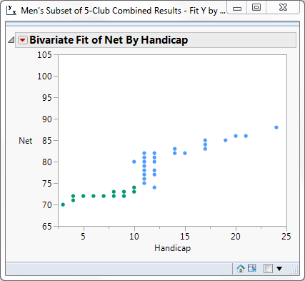
Further Insight for Men’s Net Scores
There appears to be three distinct patterns in the net scores for men.
One nearly flat pattern holds for handicaps of 10 or below, indicating a level playing field for that group.
The second pattern shows a clustering around 11 or 12, a transition period.
The third pattern shows a rising slope with handicaps for 13 and above, signifying a non level playing field.
We conclude that low handicap golfers do well even with a limited number of clubs compared to higher handicap golfers who struggle more with fewer clubs.

Slide 31
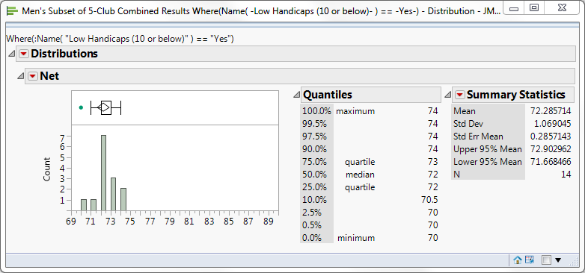
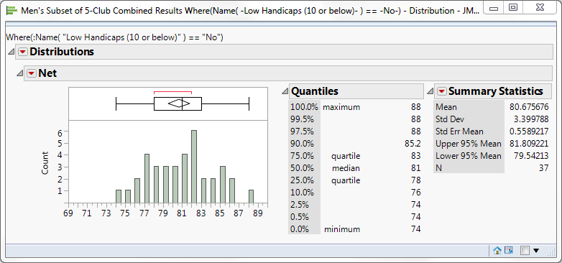
Comparison of Patterns for Men’s Net Scores
The mean net score for low handicaps of 10 or below is 72.3, which is close to par.
The mean net score for higher handicaps of 11 or above is 81.7, which is nearly 10 strokes above par.

Slide 32
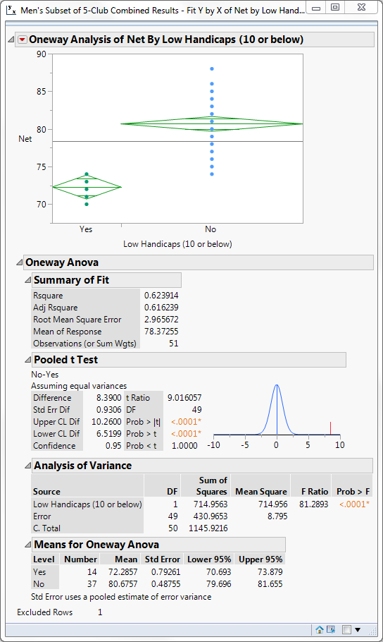
Test of Means for Men’s Net Scores
There is a statistically significant difference in the mean net scores between the low and high handicaps.
Clearly, the 5-club tournament is a more difficult format for golfers, especially for those with high handicaps.
In this case, the handicaps do not level the playing field, and low handicap golfers have a distinct advantage playing in this format.

Slide 33
Summary
For most situations, the handicap system has the effect of leveling the playing field for golfers: men, seniors, and women.
However, this is not the case when golfers play in the 5-club tournament, where low handicap golfers have a distinct skill advantage.
JMP provides excellent visual and analytical capabilities for investigating the fairness of the handicapping system.

Slide 34
Appendix
A. Introduction to USGA handicapping system
B. Analysis of three other tournament scores

Slide 35

What is a “Handicap Differential” for a Round?
A handicap differential is computed from four elements:
  The number 113 (the Slope Rating of a course of standard difficulty)
  Adjusted gross (ESC) score (adjustment for a “blow-up” score on a hole)
  USGA Course Rating (total yardage)
  Slope Rating (difficulty)
The Handicap Differential formula is (to nearest tenth):
For example, say the blue tees at a course have a slope rating of 135 and a course rating of 72.0. If a golfer shoots an adjusted gross score of 85, the differential would be 113 x (85-72)/135 = 10.9.

Slide 36
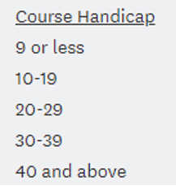
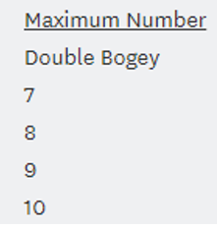
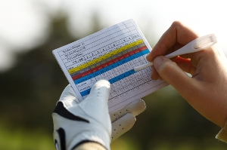
Equitable Score Control (ESC)
To exclude unusually high scores and be more representative of a player’s potential ability, the equitable score control (ESC) table sets a limit to the number of strokes a player can take on a hole depending on that player’s course handicap.
For example, a player with a handicap of 15 is allowed a maximum of 7 strokes to be posted for handicap purposes on any hole, irrespective of the actual score on that hole.
ESC adjustment table

Slide 37

Calculating the Handicap Index*
Average the 10 best Handicap Differentials out of the last 20 rounds
Multiply the average by 0.96
Truncate, not round, to nearest tenth
*Handicap indexes are typically updated twice a month.

Slide 38
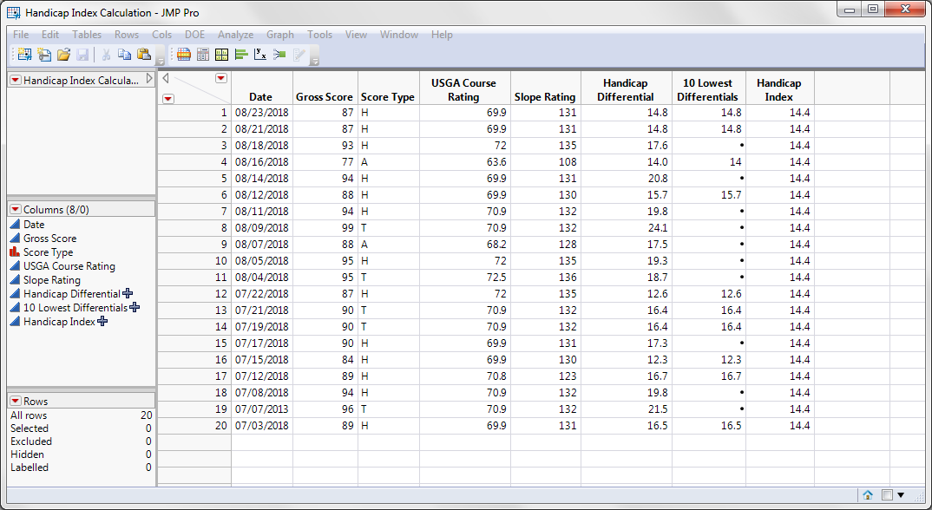
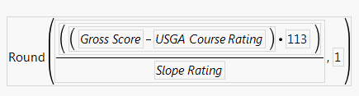


Handicap Index (Example Calculation in JMP)
Handicap Differential Formula
Handicap Index Formula
Formula for 10 Lowest Differentials
Score type:
H = Home
A = Away
T = Tournament

Slide 39
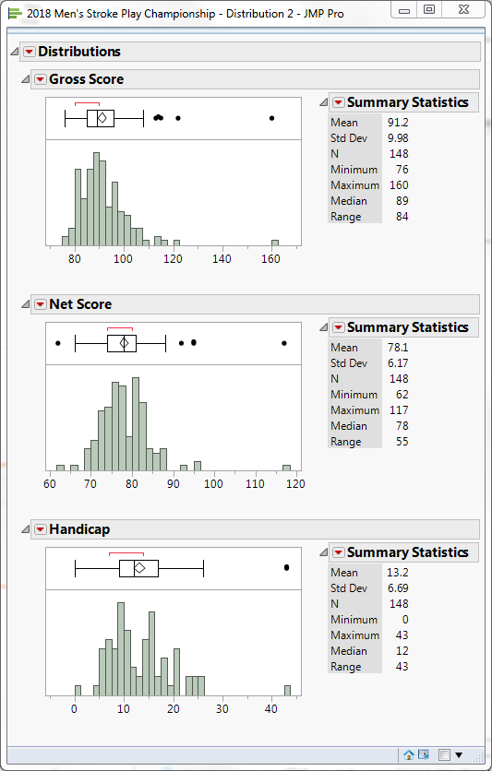
SCVCC 2018 Men’s Stroke Play Championship
A total of 74 men played the blues tees (par 72).
The Gross Scores ranged from 74 to 160, with median 89.
The Net Scores ranged from 62 to 117, with median 78.
The handicaps ranged from 0 to 43, with median 12.
Exploring Outliers identified one score (gross 160, net 117, handicap 43) that we excluded.

Slide 40
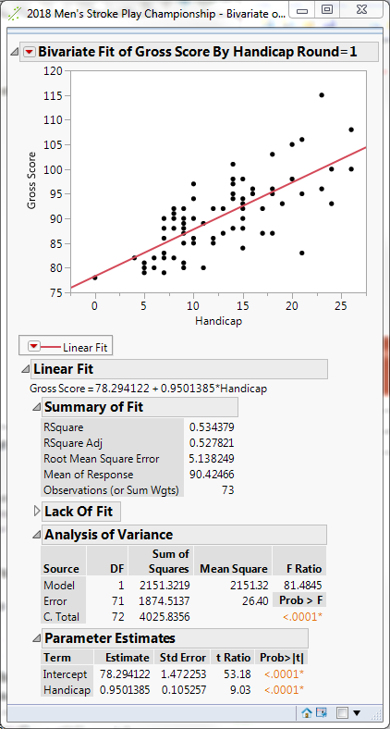
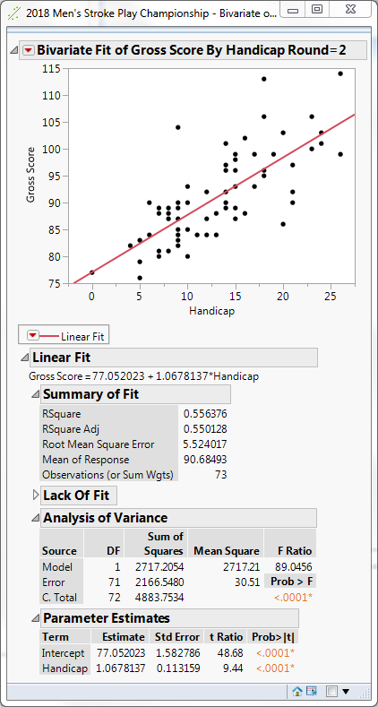
Two Rounds of Gross Scores Versus Handicaps
Both rounds show a statistically significant, strong linear relationship between the gross score and the handicap.
Slopes are ~1.
RSquares are consistent for the two rounds at roughly 53% and 56%, respectively.

Slide 41
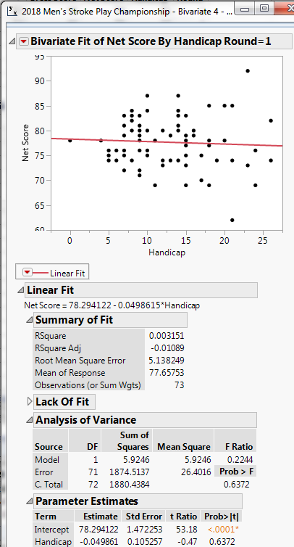
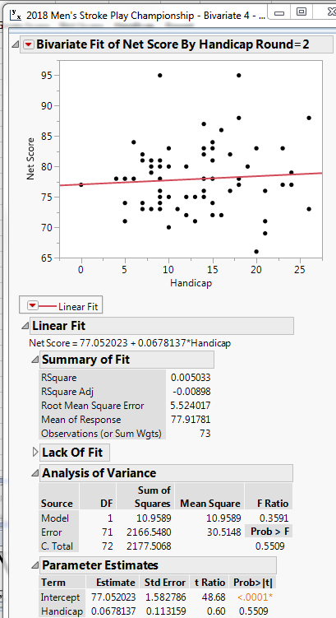
Two Rounds of Net Scores Versus Handicaps
Again we see the lack of a statistically significant relationship between the net scores and the handicaps for the two rounds.
Slopes are ~-0.05 and ~0.07.
RSquares are ~0.3% and ~0.5%.
As expected, the handicaps resulted in a level playing field among the golfers for both rounds.

Slide 42
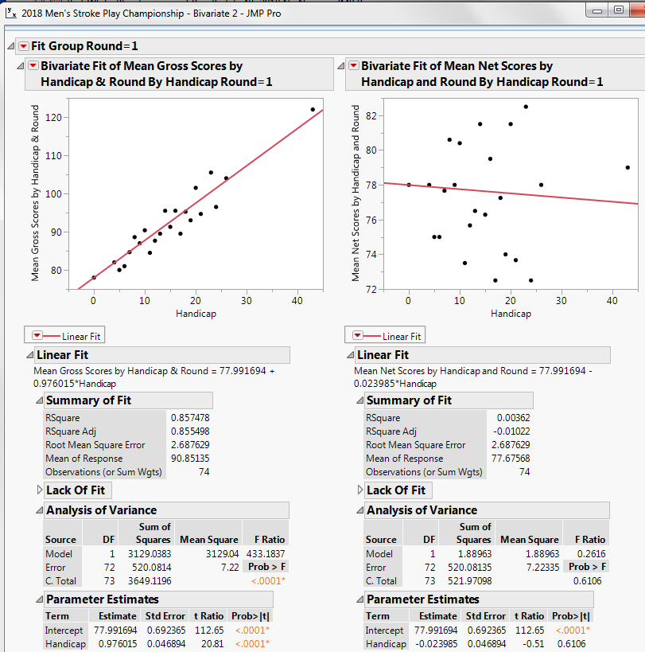
First Round Mean Gross and Mean Net Scores Versus Handicaps
There is a statistically significant, strong linear relationship between the mean gross scores and the handicaps.
Slope is ~1.
RSquare is ~86%.
In contrast, there is no significant relationship between the mean net scores and the handicap.
Slope is ~0.02.
RSquare is ~0.4%.

Slide 43
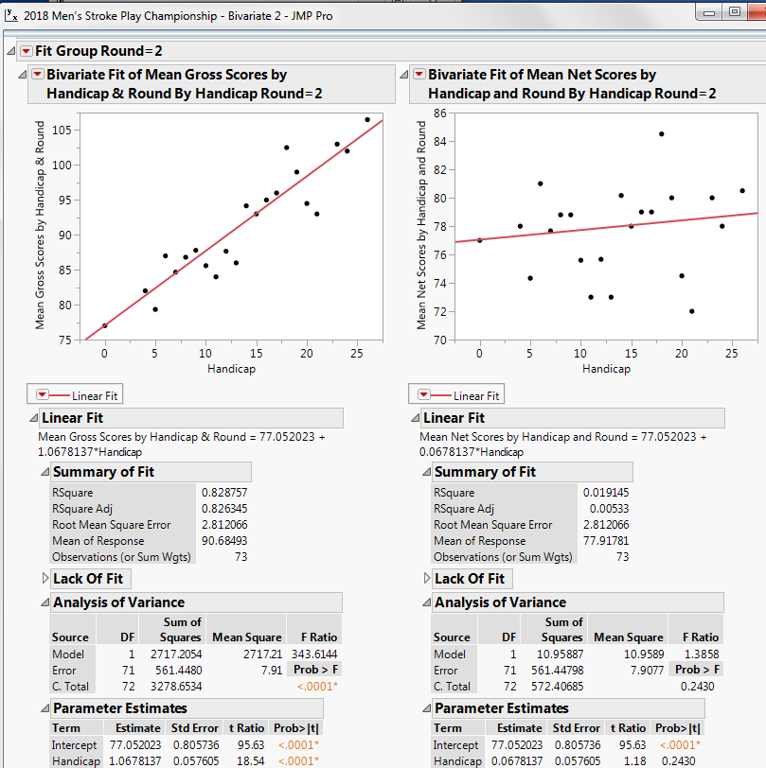
Second Round Mean Gross and Mean Net Scores Versus Handicaps
Similar to the first round, there is a statistically significant, strong linear relationship between the mean gross scores and the handicaps.
Slope is ~1.
RSquare is ~83%.
In contrast, there is no significant relationship between the mean net scores and the handicap.
Slope is ~0.07.
RSquare is ~2%.
Both rounds confirm a fairly level playing field.

Slide 44
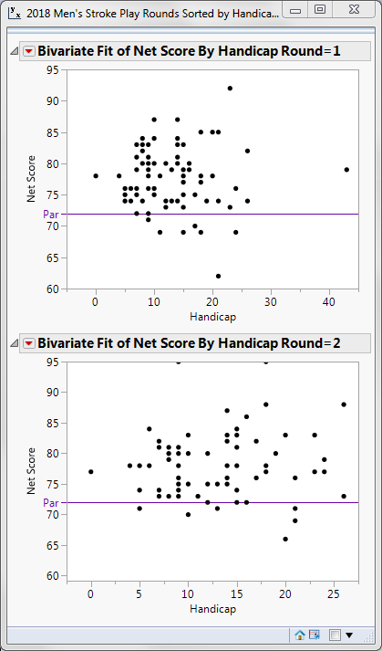
“Shooting a Handicap”
In the first round, 9 or 9/74 = 12% had net scores of par (72) or better.
In the second round, 10 or 10/74 = 13.5% had net scores of par (72) or better.
Combined, 19 golfers or 12.8% shot their handicap in either round.

Slide 45



SCVCC 2018 Red-White-Blue Tournament
A total of 116 golfers (91 men and 25 women) played from three different sets of tees (6 red, 6 white, and 6 blue) of their choice in a single round.
The men’s division was divided into two flights by handicaps: below and above 13. Handicaps ranged from -1 to 42.
The women were in a separate flight with handicaps ranging from 6 to 34.
Exploring Outliers did not detect any outliers in net scores in any group.

Slide 46



Red-White-Blue Tournament: Gross Scores
All three flight groups show a similar, statistically significant, strong linear relationship between the gross score and the handicap.
Slopes are ~1.
RSquares are roughly 38%, 44%, and 53%, respectively, for the three groups.

Slide 47



Red-White-Blue Tournament: Net Scores
There is a lack of statistically significant relationships between the net scores and the handicaps for all three groups.
RSquares are only about 1.7%, 0.4%. and 0.02%, respectively.
The data confirms that the handicaps resulted in a level playing field among the golfers within any group.

Slide 48


Test of the Equality of Net Scores Across Flights
There is a statistically significant difference between the mean scores for each flight.
Here we use All Pairs, Tukey’s HSD Means Comparison test.
An alternative representation is done using Graph Builder.

Slide 49

Men’s First Flight Mean Gross and Mean Net Scores Versus Handicaps
There is a statistically significant, strong linear relationship between the mean gross scores and the handicaps.
Slope is ~1.
RSquare is ~78%.
There is a significant but weak relationship between the mean net scores and the handicap.
Slope is ~0.2.
RSquare is only ~9%.

Slide 50

Men’s Second Flight Mean Gross and Mean Net Scores Versus Handicaps
Similar to the first flight, there is a statistically significant, strong linear relationship between the mean gross scores and the handicaps.
Slope is ~1.
RSquare is ~68%.
In contrast, there is no significant relationship between the mean net scores and the handicap.
Slope is ~-0.06.
RSquare is ~1%.

Slide 51

Women’s Flight Mean Gross and Mean Net Scores Versus Handicaps
Similar to the Men’s flights, there is a statistically significant, strong linear relationship between the mean gross scores and the handicaps.
Slope is ~1.
RSquare is ~62%.
In contrast, there is no significant relationship between the mean net scores and the handicap.
Slope is ~-0.01.
RSquare is ~0.02%.
The handicaps appear to have leveled the playing field across all three flights.

Slide 52

“Shooting a Handicap”
For the men’s first flight, 17 or 17/47 = 36% had net scores of par or better. This is no surprise since 6 of the 18 tees were played from the red tees.
For the men’s second flight, 14 or 14/44 = 32% had net scores of par or better.
For the women’s flight, no one had a net score of par or better. Again, this is not surprising since 12 of the 18 tees were played from the white and blue tees. Women nearly always play from the shorter red tees.

Slide 53

Men’s Flight Mean Gross and Mean Net Scores Versus Handicaps
There is a statistically significant, strong linear relationship between the mean gross scores and the handicaps.
Slope is ~2.
RSquare is ~94%.
In contrast to previous tournaments, there is a statistically significant and strong relationship between the mean net scores and the handicap.
Slope is ~1.
RSquare is ~81%.

Slide 54

Seniors’ Flight Mean Gross and Mean Net Scores Versus Handicaps
Similar to the Men’s flight, there is a statistically significant, strong linear relationship between the mean gross scores and the handicaps.
Slope is ~2.6.
RSquare is ~97%.
In contrast to previous tournaments, there is a strong significant relationship between the mean net scores and the handicap.
Slope is ~1.6.
RSquare is ~92%.

Slide 55

Women’s Flight Mean Gross and Mean Net Scores Versus Handicaps
Similar to the Men’s and Seniors’ flights, there is a statistically significant, strong linear relationship between the mean gross scores and the handicaps.
Slope is ~2.4.
RSquare is ~96%.
In contrast to previous tournaments, there is a strong and significant relationship between the mean net scores and the handicap.
Slope is ~1.4.
RSquare is ~90%.
For the 5-club event, the handicaps have not leveled the playing field across all three flights.

Slide 56

“Shooting a Handicap”
For the men’s flight, 9 or 9/52 = 17% had net scores of par (72) or better.
For the seniors’ flight, 8 or 8/32 = 25% had net scores of par or better.
For the women’s flight, only 3 or 3/21 = 14% had net scores of par or better.

